Slide 1
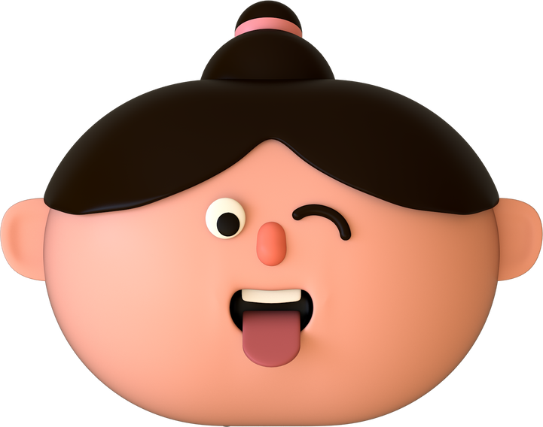
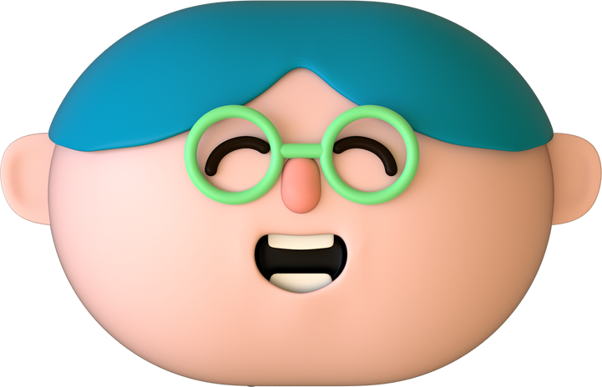
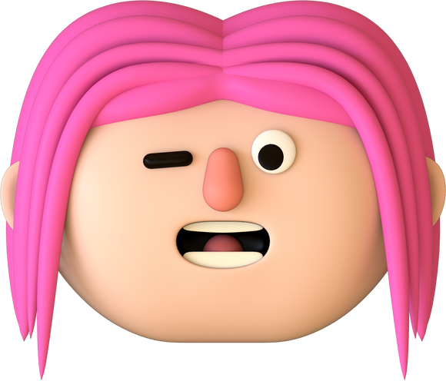
determine your face shape & hairstyle
in 30 second
Are you still confused about how to choose a hairstyle?

Slide 2
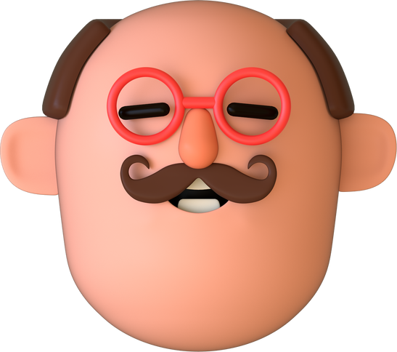
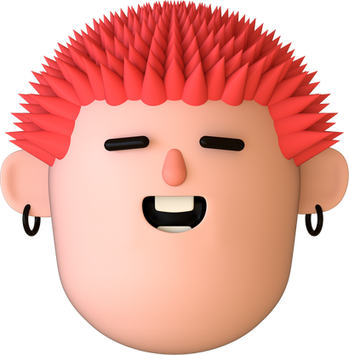
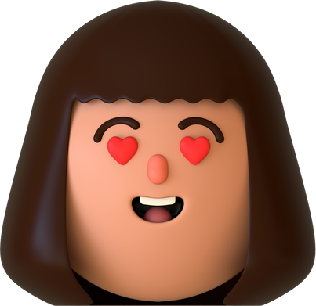
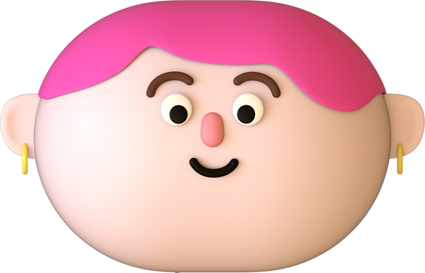
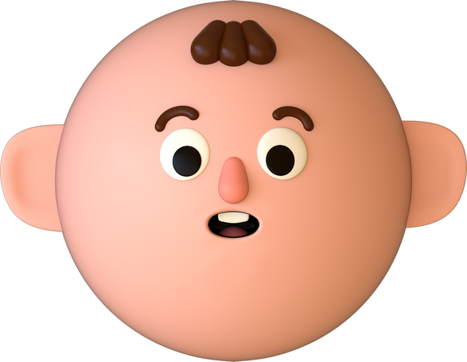
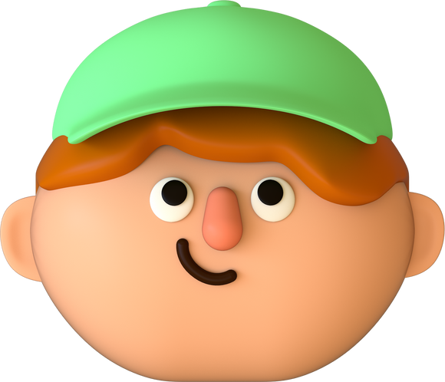
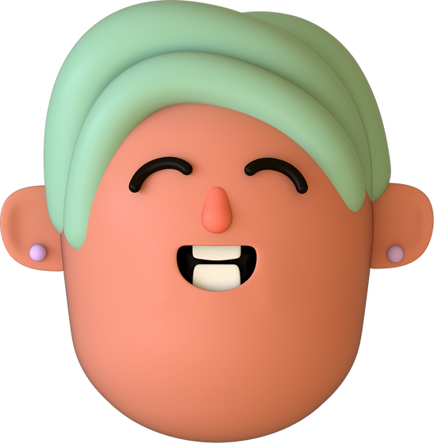
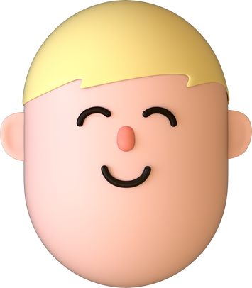
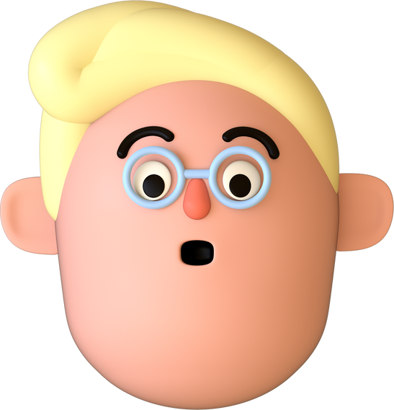
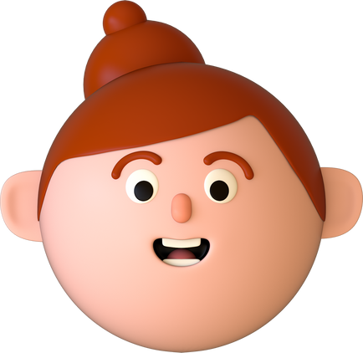
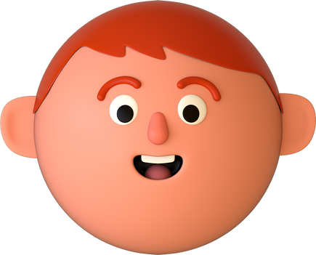
Are you ready?
It is just a FUNNY QUIZ!! If you didn't find your result in those various face shapes, please test it again! Or your face shape might fall somewhere in between.
start the quiz

Slide 3
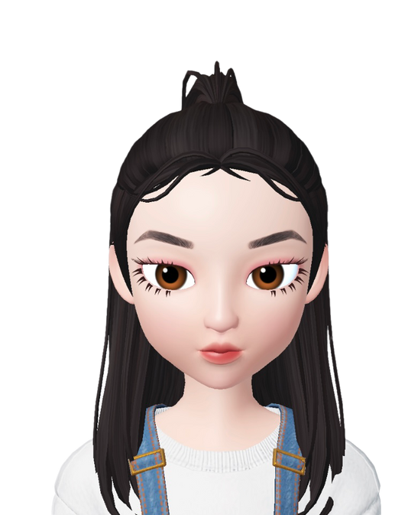
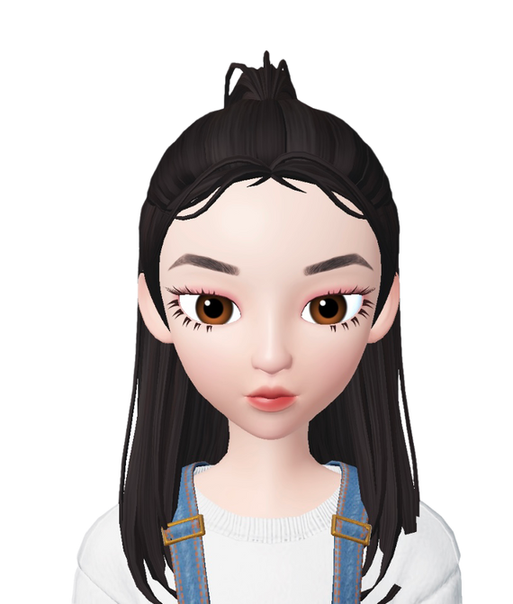
#1 pick the widest part of your face.
Select the answer you want!
A
B

Slide 4
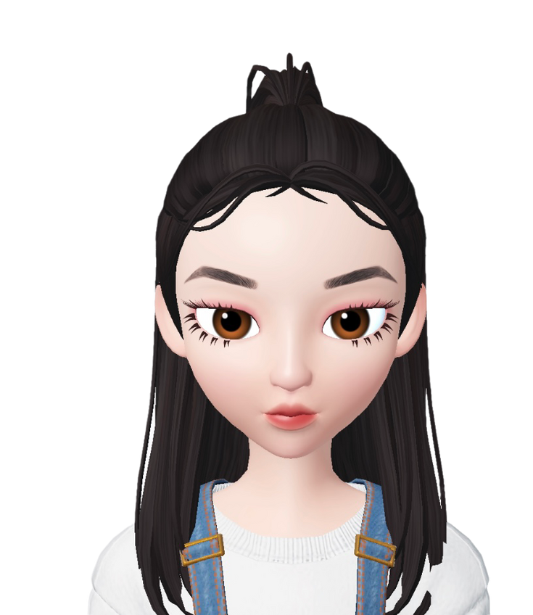
line 1
#2
Compare your face width which is line 1, and your length line 2.
a. Line 1 > Line 2
B. Line 2 ≥ Line 1
line 2
Select the answer you want!

Slide 5
line 1
#2
Compare your face width which is line 1, and your length line 2.
a. Line 1 > Line 2
B. Line 2 ≥ Line 1
line 2
Select the answer you want!

Slide 6
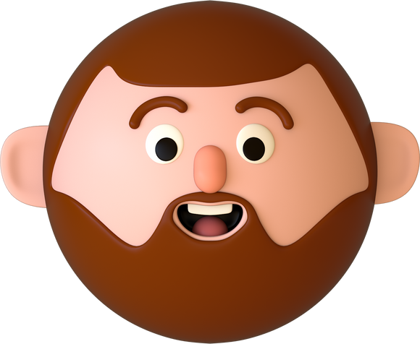
Select the answer you want!
#3
contrast your forehead width which is line 3, and your jaw width which is line 4.
A. Line 3 > Line 4
B. Line 4 > Line 3
line 3
line 4

Slide 7
Select the answer you want!
#3
contrast your forehead width which is line 3, and your jaw width which is line 4.
A. Line 3 > Line 4
B. Line 4 > Line 3
line 3
line 4

Slide 8
Select the answer you want!
#3
contrast your forehead width which is line 3, and your jaw width which is line 4.
A. Line 3 > Line 4
B. Line 4 > Line 3
line 3
line 4

Slide 9
Select the answer you want!
#3
contrast your forehead width which is line 3, and your jaw width which is line 4.
A. Line 3 > Line 4
B. Line 4 > Line 3
line 3
line 4

Slide 10
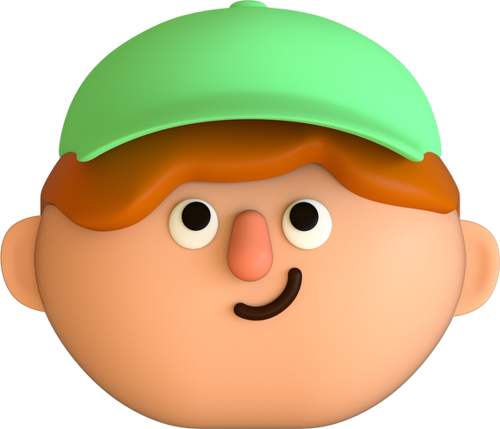
#4
determine the shape of your chin.
a. pointed chin
B. round chin
Select the answer you want!

Slide 11
#4
determine the shape of your chin.
a. pointed chin
B. round chin
Select the answer you want!

Slide 12
#4
determine the shape of your chin.
a. pointed chin
B. round chin
Select the answer you want!

Slide 13
#4
determine the shape of your chin.
a. pointed chin
B. round chin
Select the answer you want!

Slide 14
#4
determine the shape of your chin.
a. pointed chin
B. round chin
Select the answer you want!

Slide 15
#4
determine the shape of your chin.
a. pointed chin
B. round chin
Select the answer you want!

Slide 16
#4
determine the shape of your chin.
a. pointed chin
B. round chin
Select the answer you want!

Slide 17
#4
determine the shape of your chin.
a. pointed chin
B. round chin
Select the answer you want!

Slide 18
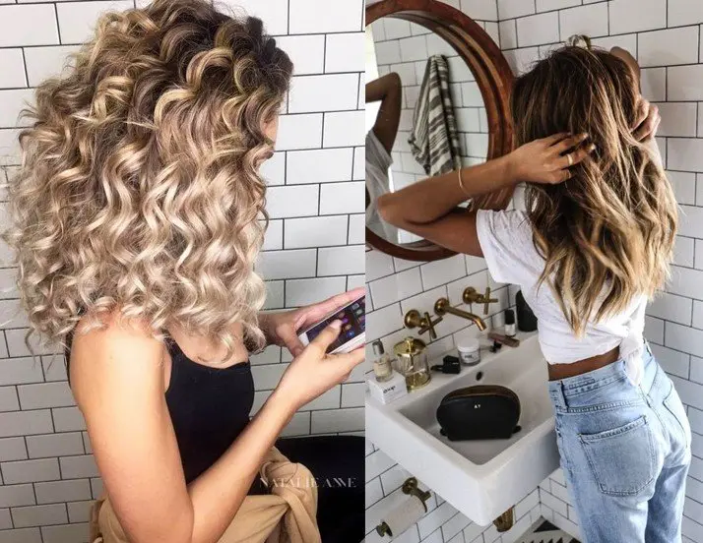
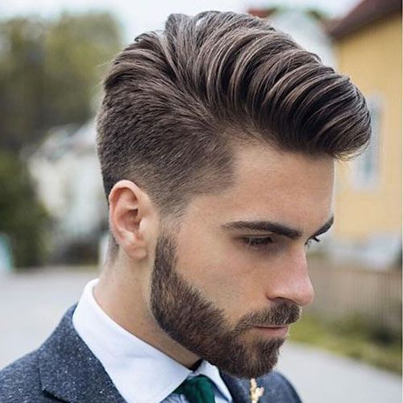
Everyone's looks and personality are different, so the appropriate hairstyles are also different. The hairstyle options below are for reference only. You should choose the hairstyle you like and is most appropriate!
square face
Thanks for your participation!
Hairstyles for men: Short Layer, Side Layer
Hairstyles for women: Wavy Hair, Curly Hair
take the quiz again

Slide 19
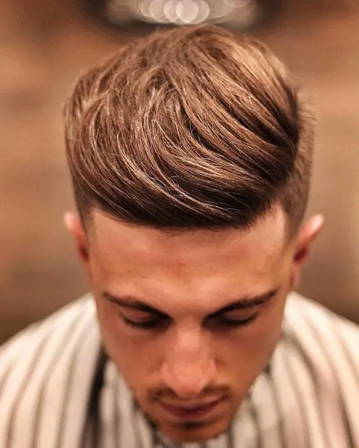
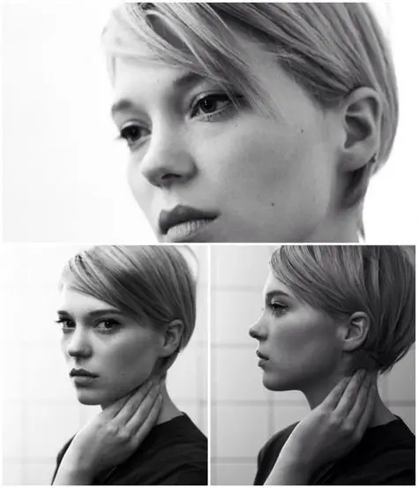
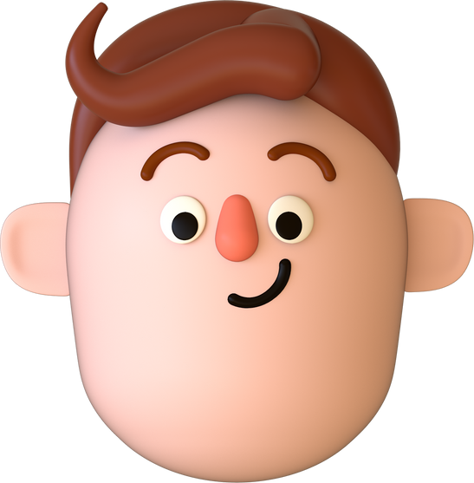
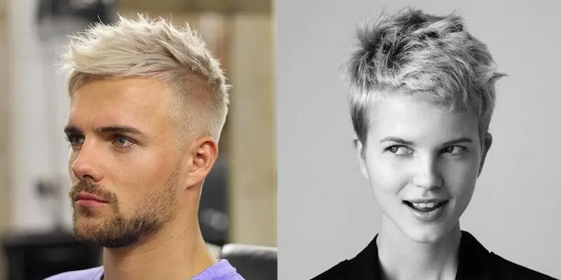
round face
Hairstyles for men:
quaff, spiky, crew cut
Hairstyles for women:
short neat bob, pixie, bun
Everyone's looks and personality are different, so the appropriate hairstyles are also different. The hairstyle options above are for reference only. You should choose the hairstyle you like and is most appropriate!
take the quiz again
Thanks for your participation!

Slide 20
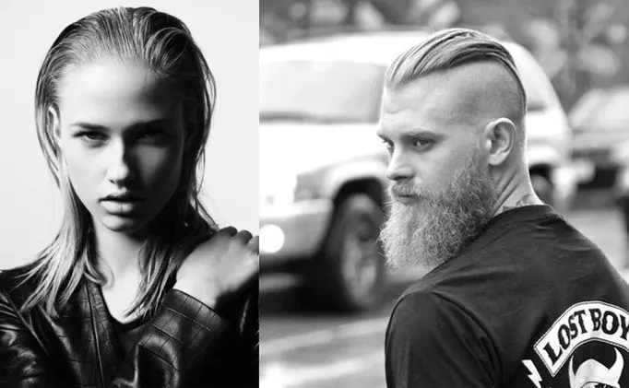
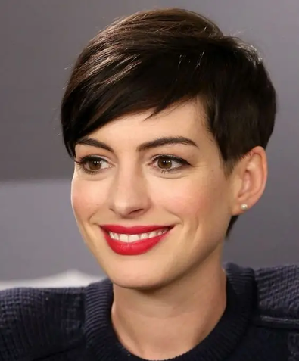
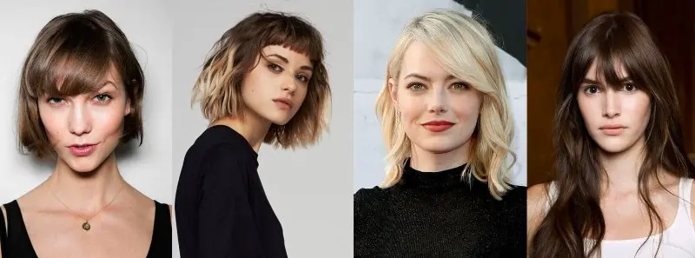
oblong face
Hairstyles for men:
slicked back, side part
Hairstyles for women:
bangs, bob hair, wavy hair
Everyone's looks and personality are different, so the appropriate hairstyles are also different. The hairstyle options below are for reference only. You should choose the hairstyle you like and is most appropriate!
take the quiz again
Thanks for your participation!

Slide 21
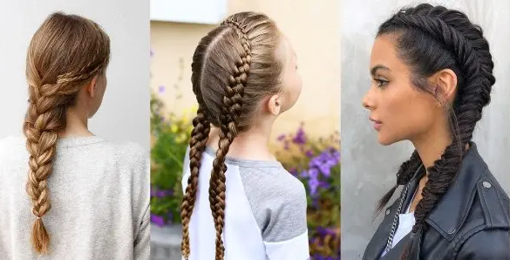
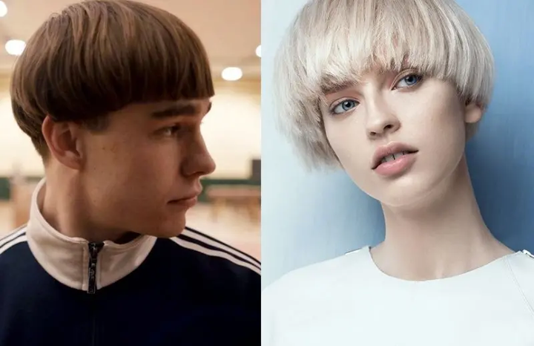
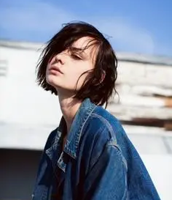
diamond face / heart-shaped face
Hairstyles for men:
heart-bangs hair, layer bowl cut
Hairstyles for women:
bob, layers, braids, shaved
Everyone's looks and personality are different, so the appropriate hairstyles are also different. The hairstyle options below are for reference only. You should choose the hairstyle you like and is most appropriate!
take the quiz again
Thanks for your participation!

