Slide 1

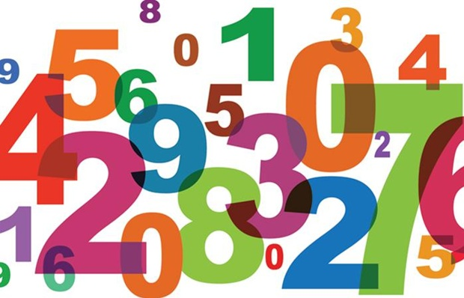
The Numbers in 4 languages
Seham Alnafeesah - Fall2021
COMM486

Slide 2




Please choose the language you want to explore its numbers.
French
Spanish
Arabic
Chinese
Done

Slide 3


0
1
2
3
4
Zéro
Un
Deux
Trois
Quatre
5
6
7
8
9
Cinq
Six
Sept
Huit
Neuf
Home

Slide 4
0
1
2
3
4
cero
Uno
dos
tres
cuatro
5
6
7
8
9
cinco
seis
siete
ocho
nueve
Home

Slide 5
0
1
2
3
4
sifr
wahid
ithnan
thlatha
Arba’a
5
6
7
8
9
khmsa
sitta
saba 'a
thmneya
tis'a
Home

Slide 6
0
1
2
3
4
líng
yī
liǎng
sān
sì
5
6
7
8
9
wǔ
lìu
qī
bā
jiǔ
Home

Slide 7

I hope you learned how to say the numbers in these 4 languages, and hope you enjoyed my presentation.
Seham Alnafeesah
sehamm@udel.edu
Home

