Slide 1
Learn about your plate
Get Started Here

Slide 2
How it works
Select the image you want to explore.
Once directed to the slide use the red button in the bottom corner to return to the plate.
The goal of using this tool is to learn about creating a balanced diet and the importance behind what should be incorporated into your diet.
On your plate, you will find a protein, a vegetable, a carbohydrate, and a healthy fat.
There is also a glass of water that you can use to learn about its importance in a meal.

Slide 3
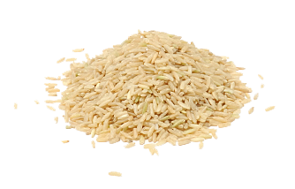
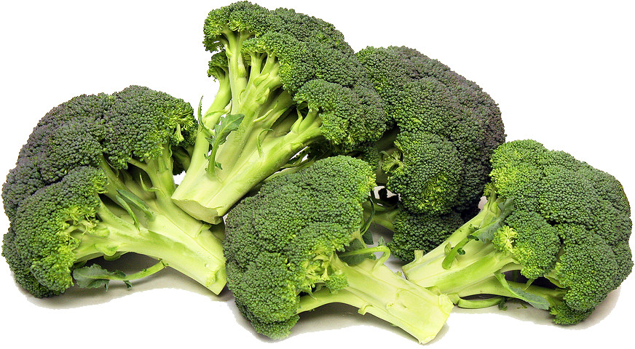

Slide 4
Protein
The National Academy of Medicine recommends that adults get a minimum of 0.8 grams of protein for every kilogram of body weight per day.
¼ of the plate you create should be a protein source.
Some protein sources can benefit your health more than others depending on different factors such as the amount they are processed, fat content, amount of amino acids, etc.
Examples of sources include :
Lean chicken
Ground lean turkey
Salmon
Tuna
Eggs

Slide 5
Carbohydrates
Carbohydrates provide energy production, energy storage, building macromolecules, sparing protein, and assisting in lipid metabolism.
Carbohydrates can provide the body support bodily functions and physical activity by providing glucose to the body which is than converted into energy.
They should make up 1/4 of a balanced plate.
Some examples include
Quinoa
Brown rice
Pasta
Lentils

Slide 6
Fruits and vegetables
It is important to include a wide variety of fruits and vegetables in your diet. No single fruit or vegetable can provide a complete amount of nutrients in a healthy diet.
Vegetables and fruits can rduce the risk of heart disease, strokes, eye problems, digestive problems, and come types of cancer.
Fruits and vegetables should account for half of your plate when creating a balanced meal.
Some fruits and vegetables you can include in a meal are
Broccoli
Spinach
carrots
Bluberries
Bananas

Slide 7
Healthy fats
Looking at your daily intake, 20% to 30% of daily calories should come from healthy fats.
Healthy fats are beneficial to overall health and are needed to help the body absorb vitamins and produce energy.
Healthy fats can reduce cravings, reduce the risk of diabetes, and reduce inflammation.
Some foods that contain healthy fats include
Nuts
Avocados
Olive oil
Chia seeds
Flax seeds

Slide 8
Water
Water is a critical part of a diet for good health. Water is necessary for survival; in addition, it has many benefits when incorporated into everyday life.
The human body is made up of about 60% water. The body uses this water to regulate body temperature and maintain body functions.
Keeping the body properly hydrated allows for the blood, brain, bones, and joints to stay protected and maintain moisture.
Water allows the body to excrete waste through persperation, urination, and defecation.
Water allows the body to stay healthy by reducing cravings for high sugar, high fat, and high sodium foods.
Including water in your meals helps digestion and breaks down food.

