Slide 1
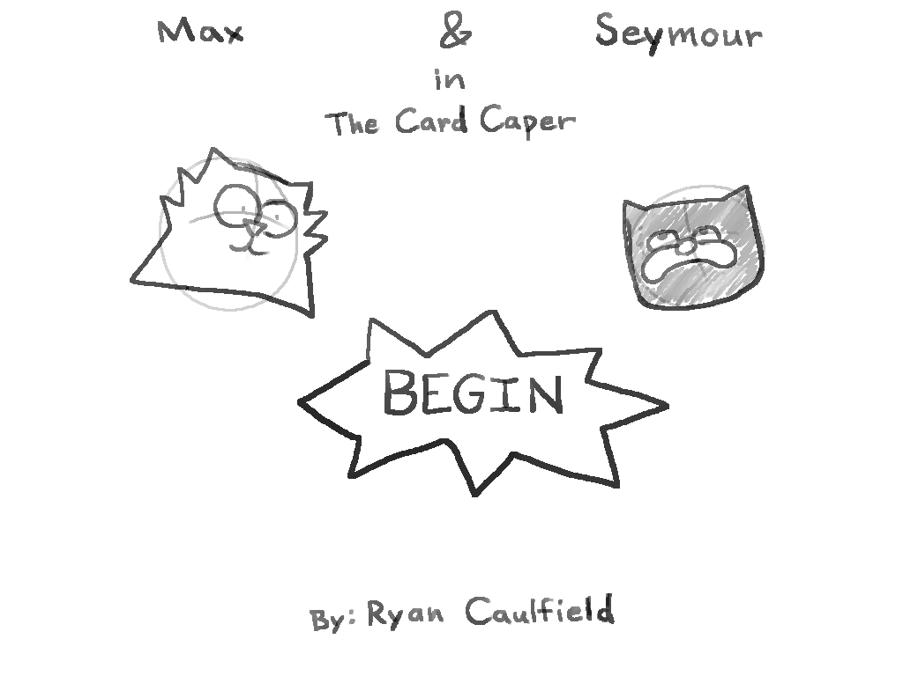
Titlecard

Slide 2
Panel_1

Slide 3
Panel_2

Slide 4
Panel_3

Slide 5
Panel_4

Slide 6
Panel_5

Slide 7
Panel_6

Slide 8
Panel_7

Slide 9
Panel_8_decision1

Slide 10
Admire_1

Slide 11
Ignore_1

Slide 12
Ignore_2

Slide 13
Ignore_3

Slide 14
Ignore_4_decision2

Slide 15
spaceOut_1

Slide 16
Remember_1

Slide 17
Remember_2

Slide 18
Remember_3

Slide 19
Remember_4

Slide 20
Remember_5_end1

Slide 21
Steal_1

Slide 22
Steal_2

Slide 23
Steal_3

Slide 24
Steal_4

Slide 25
Steal_5_decision3

Slide 26
Purchase_1

Slide 27
Purchase_2

Slide 28
Purchase_3

Slide 29
Purchase_4

Slide 30
Purchase_5

Slide 31
Purchase_6_end2

Slide 32
Return_1

Slide 33
Return_2

Slide 34
Return_3

Slide 35
Return_4

Slide 36
Return_5

Slide 37
Return_6

Slide 38
Return_7_end3

