Slide 1
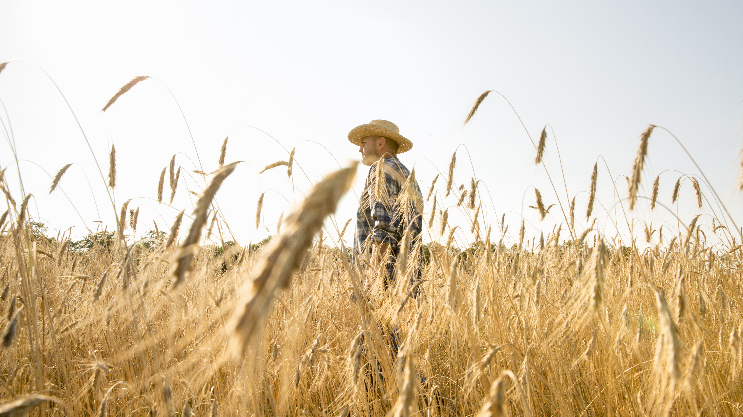
Oh The Places You Will Hike
By: Rudolph Ricciuti

Slide 2
How long do you have?
Backpack
Hike

Slide 3
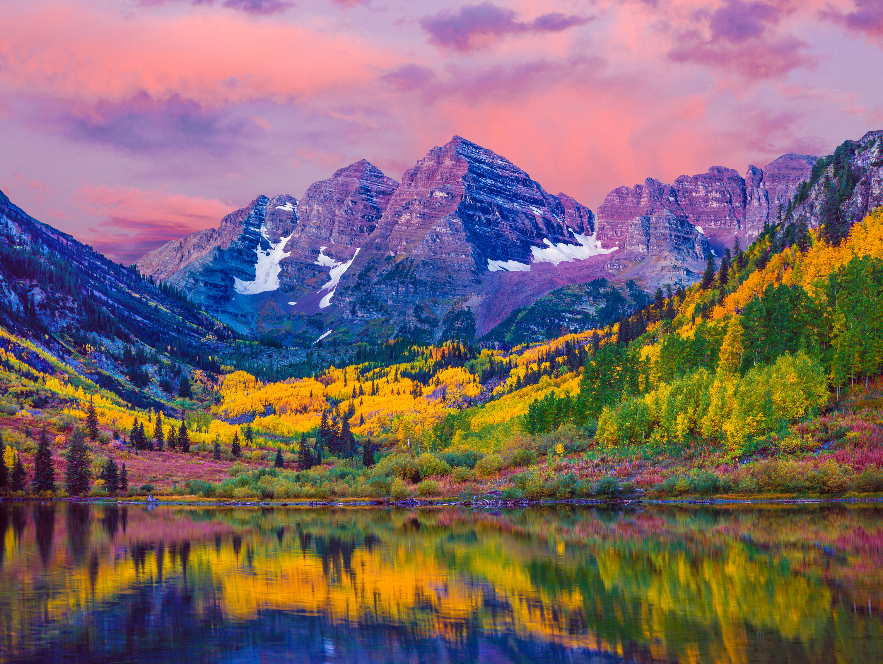
What type of terrain?
Flat
Hilly

Slide 4
What type of terrain?
Flat
Hilly

Slide 5
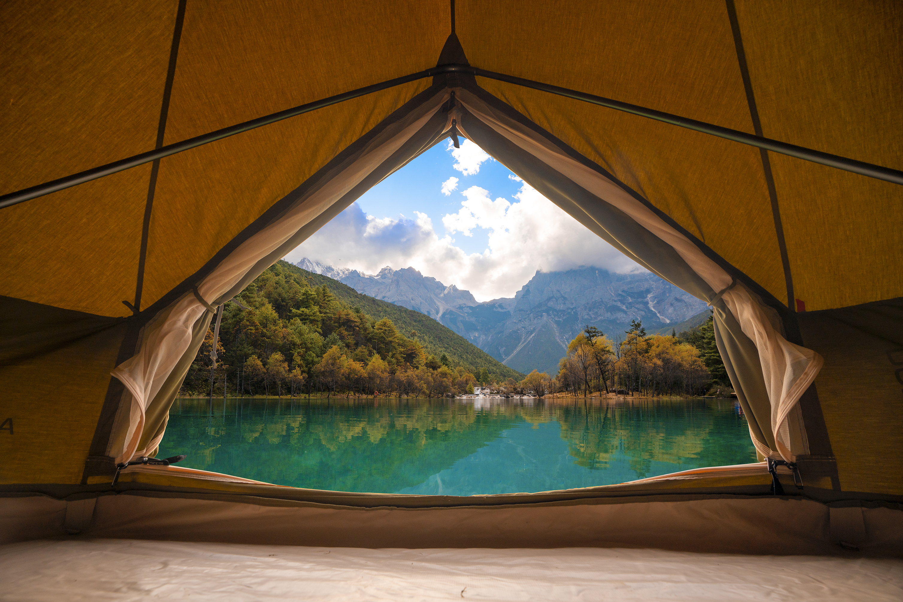
What distance are you looking for?
Long
Short

Slide 6
What distance are you looking for?
Long
Short

Slide 7
What distance are you looking for?
Long
Short

Slide 8
What distance are you looking for?
Long
Short

Slide 9
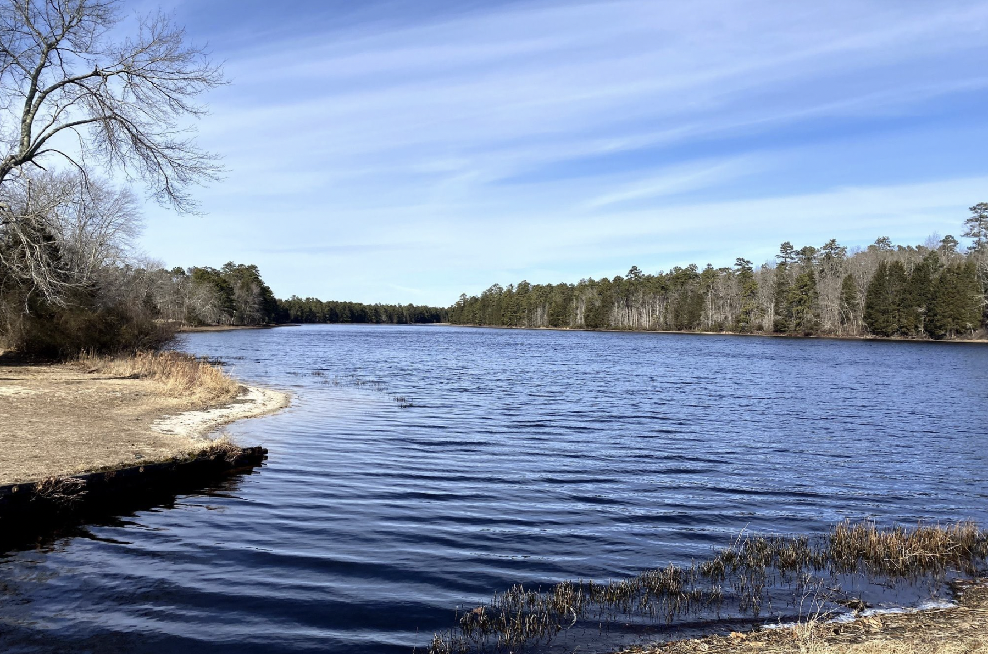
You got Mullica River Trail!
Distance 18.2 Miles
Elevation gain 160ft
Time 6 hours 20 minutes
Click Here to Restart!!
Enjoy your Trip!

Slide 10
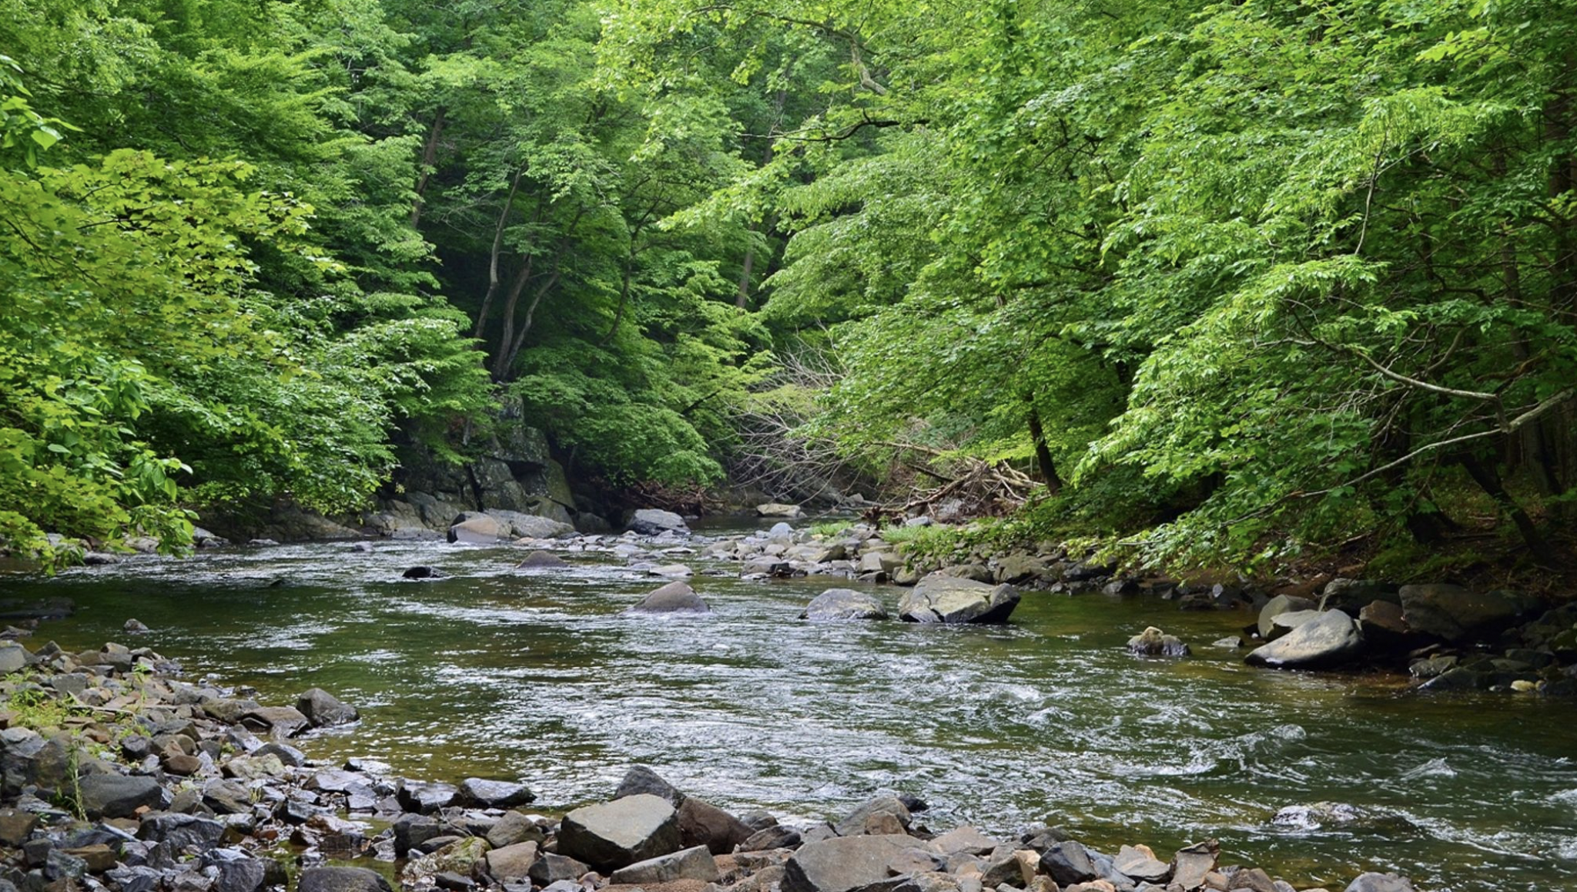
You got Jerusalem mills to Harford Road!
Distance 6 miles
Elevation gain 469 ft
Time 2 hours 20 minutes
Click Here to Restart!!
Enjoy your Trip!

Slide 11
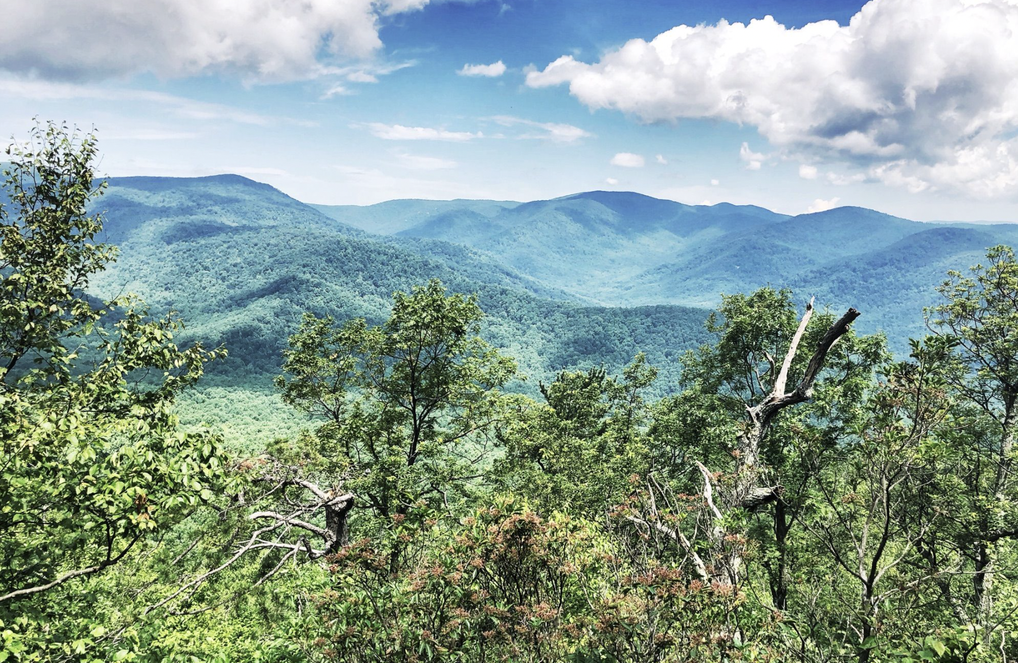
You got Old Rag Mountain Loop!
Distance 9.5 miles
Elevation gain 2,683 ft
Time 5 hours
Click Here to Restart!!
Enjoy your Trip!

Slide 12
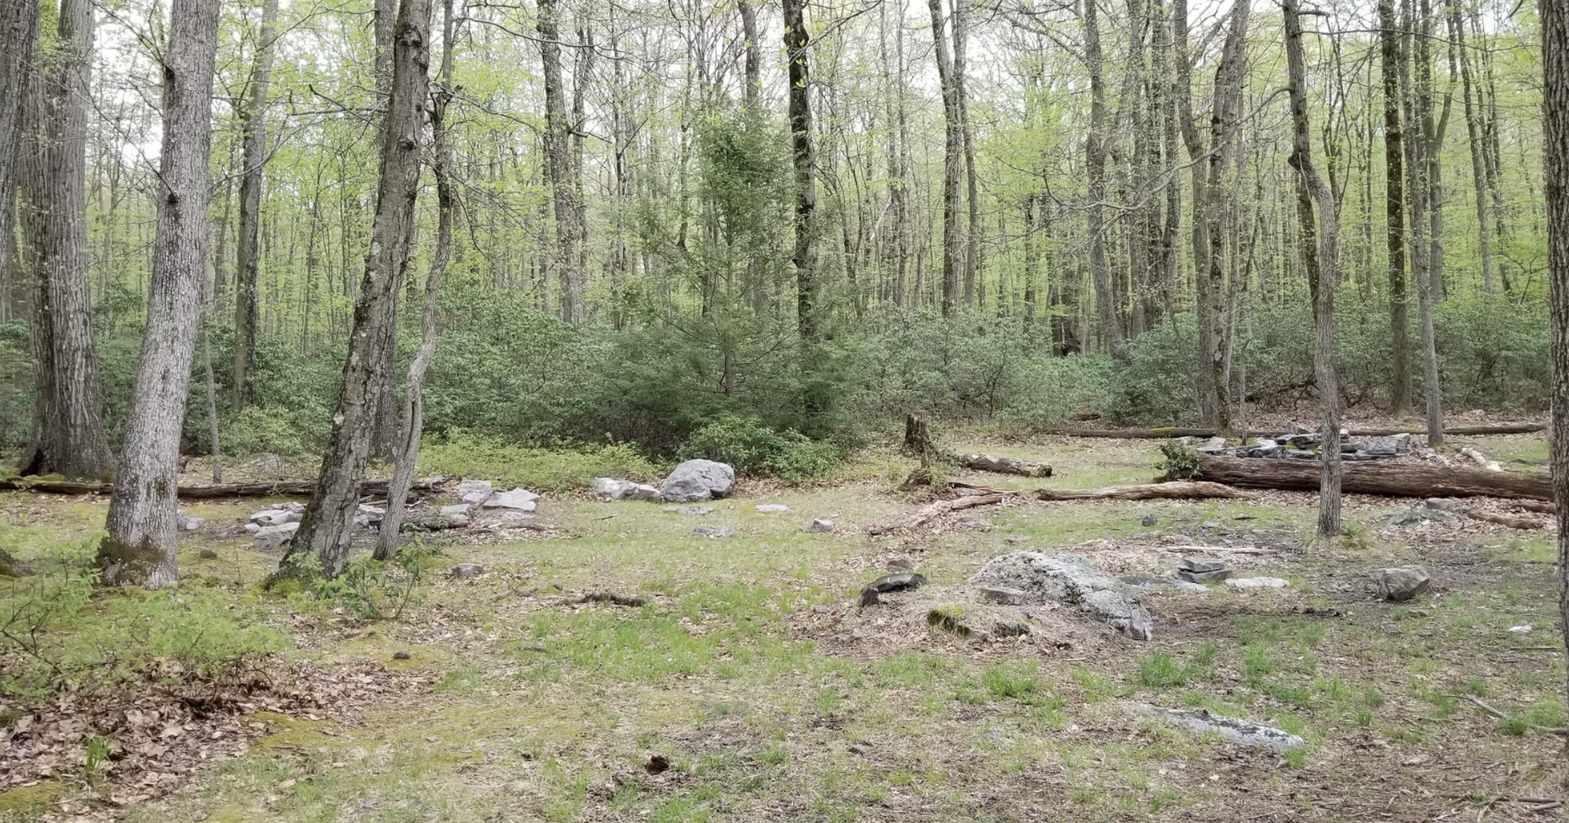
You got Dehart Dam Loop!
Distance 7.4 miles
Elevation gain 1,414 ft
Time 3 hours 27 minutes
Click Here to Restart!!
Enjoy your Trip!

Slide 13
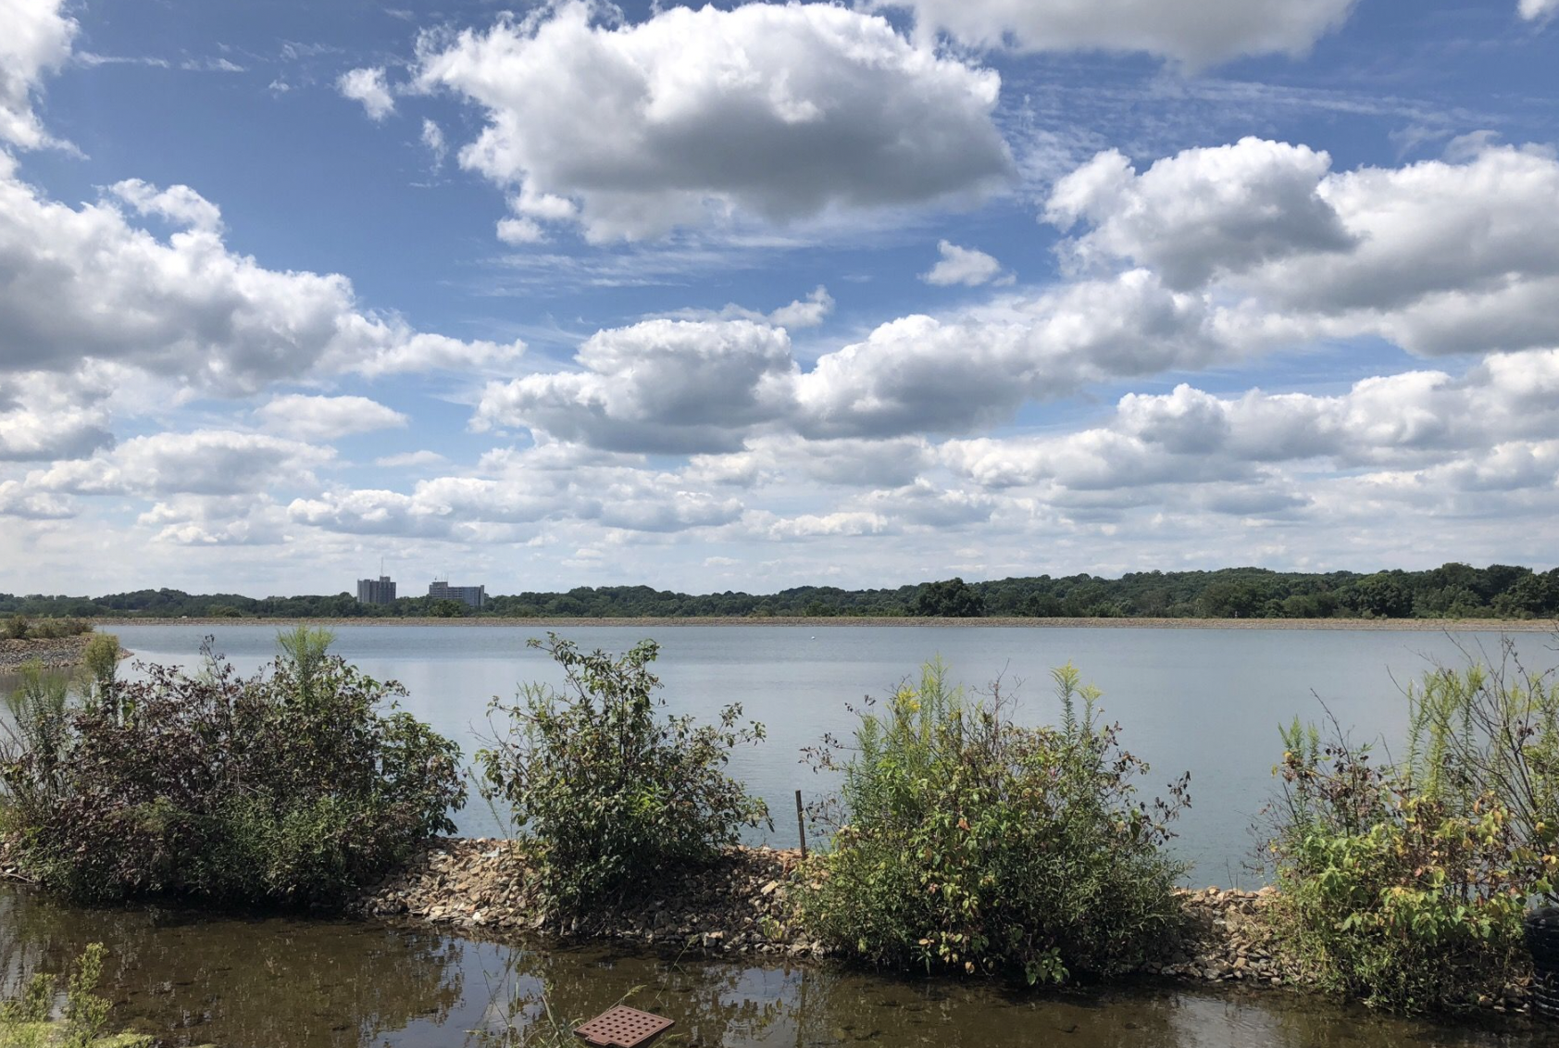
You got Whitney Farm Trail!
Distance 8.8
Elevation gain 587 ft
Time 3 hours 24 minutes
Click Here to Restart!!
Enjoy your Trip!

Slide 14
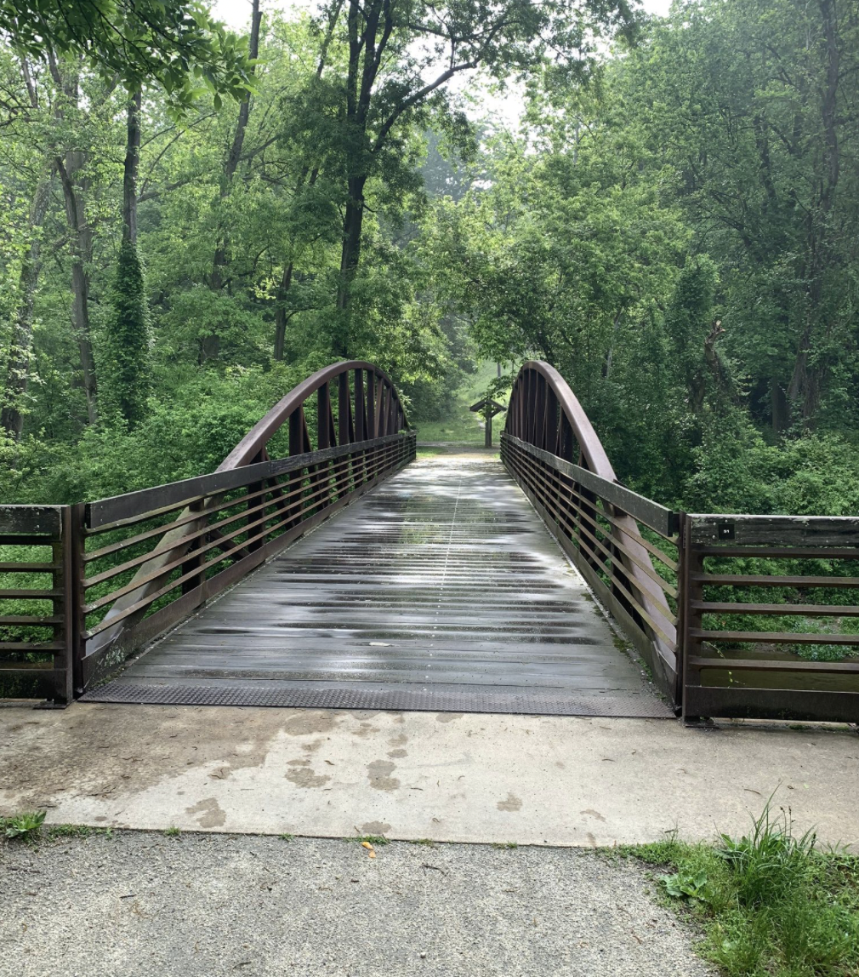
You got Newark and Pomeroy Rail Trail!
Distance 5.3 miles
Elevation gain 183 ft
Time 1 hour 56 minutes
Click Here to Restart!!
Enjoy your Trip!

Slide 15
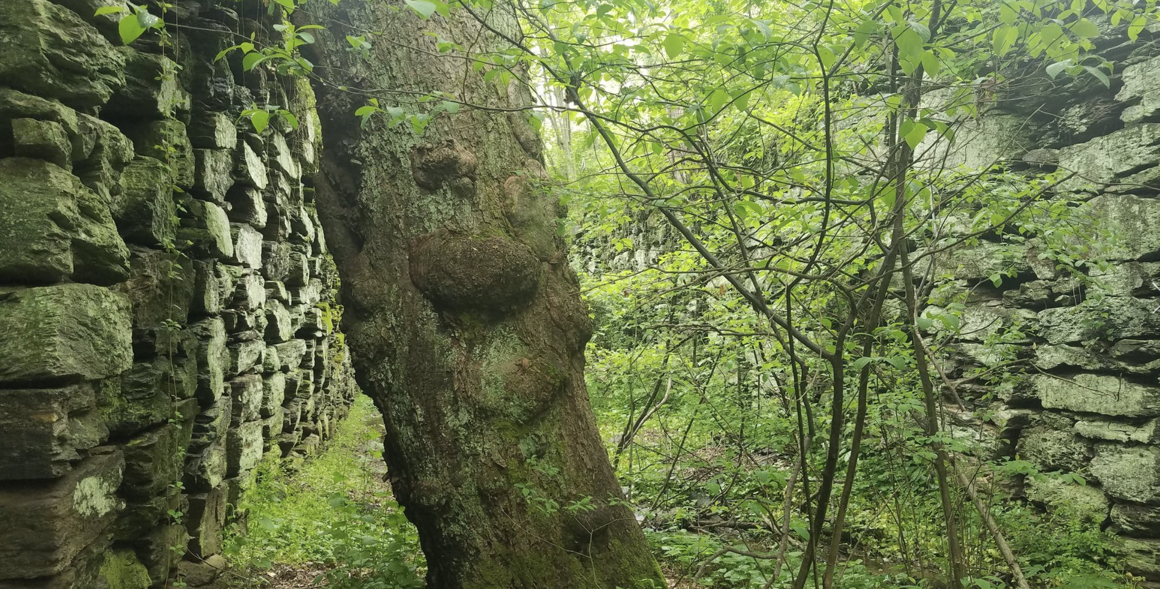
You got Mason-Dixon Trail!
Distance 9.4 miles
Elevation gain 1,673ft
Time 4 hours 18 minutes
Click Here to Restart!!
Enjoy your Trip!

Slide 16
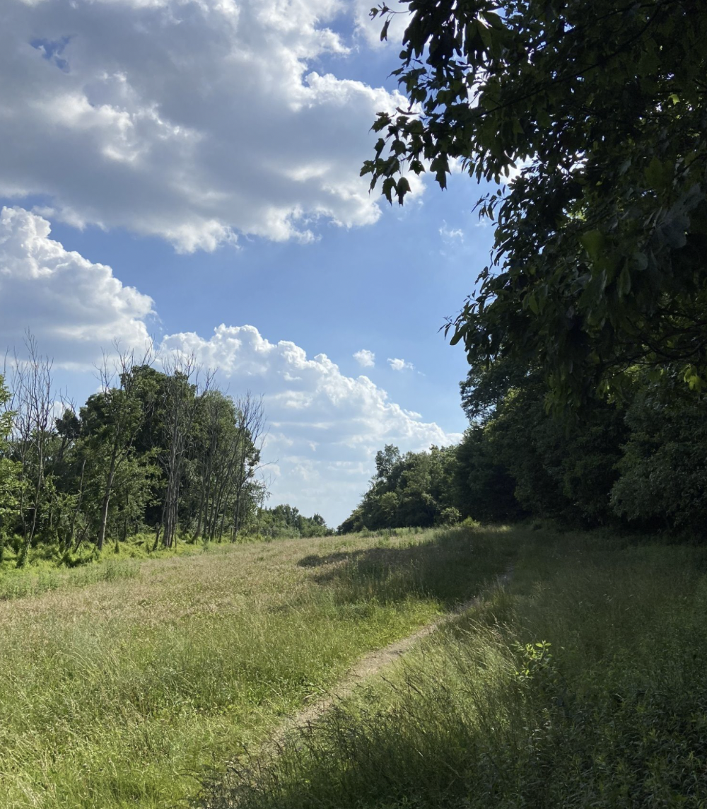
You got Auburn lookout via the Appalachian Trail!
Distance 5.7 miles
Elevation gain 1,089 ft
Time 3 hours 31 minutes
Click Here to Restart!!
Enjoy your Trip!

