Slide 1
Which law school should you attend?
By: Katie Holmes

Slide 2
Do you want to attend law school in a city setting ?
Yes
No

Slide 3
Which city would you prefer to live in?
New York City
Albany
Buffalo
Syracuse

Slide 4
Would you like to attend a Law school that is ranked in the top 100 law schools?
Yes
No, that doesn’t matter to me
New York City is the home of numerous prestigious law schools.

Slide 5
Is it important that the law school you attend has guaranteed housing for first year students?
Yes
No

Slide 6
Do you have the GPA/LSAT score to get into a top 10 law school? (gpa of a 3.5 or above and an lsat score of 168 and above)
Yes!
Nope

Slide 7
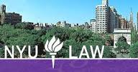
The best law school for you is…
Either Columbia University School of Law or New York University School of Law!
Columbia University School of Law
Columbia University School of Law is located in Manhattan and was one of the first law schools established in the US.
It is ranked number 4 in the top 100 law schools.
It offers guaranteed housing for students through out all of law school.
Here is the link to the law schools website: https://www.law.columbia.edu/
New York University School of Law
NYU School of Law was founded in 1835 and is located in Greenwich Village in Manhattan.
It is ranked number 6 in the top 100 law schools.
Housing is pretty much guaranteed for incoming 1L students who meet payment and application deadlines.
Here is the link to the law schools website: http://www.law.nyu.edu/

Slide 8
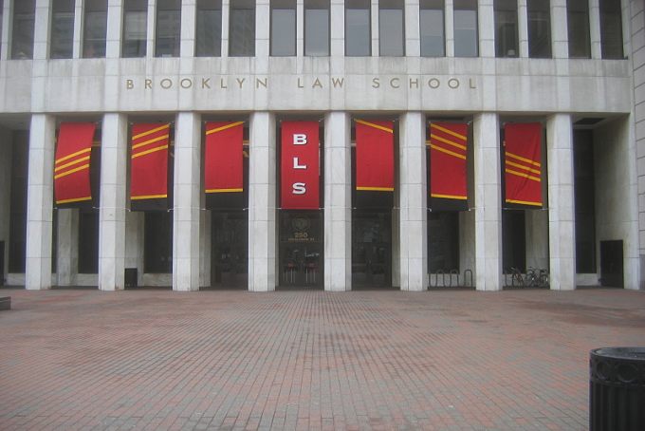
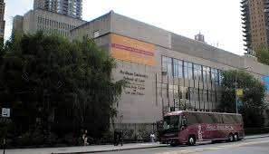
The best law school for you is…
Either Brooklyn Law School or Fordham University School of Law!
Brooklyn Law School
Brooklyn Law School is located in the Brooklyn Heights Historic District.
It is ranked number 58 in the top 100 law schools.
Brooklyn Law guarantees housing for 1L students who submit their housing forms by the due date.
Here is a link to the law schools website: http://www.brooklaw.edu/
Fordham University School of Law
Fordham Law is located in Manhattan right next to Lincoln Center.
It is ranked number 38 in the top 100 law schools.
Guaranteed housing is offered for law students.
Here is a link to the law schools website: http://law.fordham.edu/

Slide 9
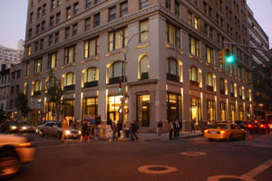
The best law school for you is…
Benjamin N. Cardozo School of Law!
Benjamin N. Cardozo School of Law is located in Greenwich Village in Manhattan. It is just blocks from Union Square and easily accessible to all parts of Manhattan.
Cardozo School of Law is ranked number 58 in the top 100 law schools.
Cardozo School of Law offers housing to a number of incoming law students in an apartment building called the Alabama, but this building is not large enough to guarantee all incoming students housing.
Cardozo is well known for its special program called the Innocence Project where students represent prisoners whose innocence may be proved through DNA testing. They also offer some other interesting opportunities such as the Prosecutor Practicum, human rights and genocide clinic, mediation clinic, and many more.
Here is a link to the law schools website: http://www.cardozo.yu.edu/

Slide 10
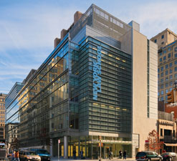
The best law school for you is…
New York Law School!
New York Law School is an independent, student-centered
law school located in the TriBeCa district in lower
Manhattan.
New York Law School is located within a four block radius from the Federal Courts, New York State Civil Courts, New York State Criminal Courts, Family Court and the Court of International Trade. This is very convenient for people who are interested in doing externships or internships in the courts.
It was founded in 1891 and is one of the oldest independent law schools in the country.
Compared to the other law schools in New York this school is slightly easier to get accepted to. If you have a GPA over a 2.86 and an LSAT score of over a 150 you have a good chance of getting accepted.
Here is a link to the law schools website: http://www.nyls.edu/

Slide 11
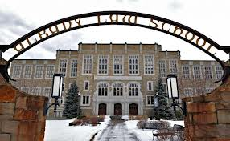
The best Law School for you is…
Albany Law School!
Albany Law School is located in the heart of Albany.
It is the oldest independent law school in North America.
Concentrations in alternative dispute resolution, business law, civil and constitutional rights, civil litigation, criminal law, environmental law, estate law, family and elder law, government administration and regulation, health law, intellectual property, international law, labor and employment law and tax law are offered.
Here is the link to the law school’s website: http://www.albanylaw.edu/Pages/home.aspx

Slide 12
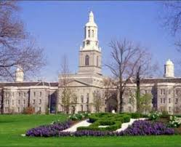
The best Law School for you is…
SUNY Buffalo Law School!
SUNY Buffalo Law School is a public law school located in Buffalo, NY on the SUNY Buffalo’s north campus.
This law school has been around for 125 years.
SUNY Buffalo law school offers numerous opportunities abroad, as well as externships and internships.
Concentrations in civil litigation, criminal law, intellectual property law and technology, international law, environment law program, family law program, finance transaction program, housing finance and development law program and labor and employment law program are available.
Here is the link to the law school’s website: http://www.law.buffalo.edu/

Slide 13
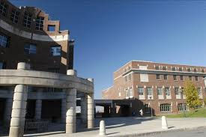
The best law school for you is…
Syracuse University College of Law!
Syracuse University College of Law is located in Syracuse.
It was founded in 1895 and was accredited by the American Bar Association in 1923.
Syracuse University College of Law has a number of different clinical programs, externship programs and advocacy skill programs.
Many different joint degree programs are also offered. Such as a JD/MS in computer science, a JD/MS in forensic science, a JD/MBA, and many more.
Here is the link to the law schools website: http://www.law.syr.edu/

Slide 14
Would you like to live closer to or in Long Island or closer to or in upstate New York?
Closer to/in Long Island
Closer to/in upstate New York

Slide 15
Would you like to attend a law school that is ranked in the top 100 law schools?
Yes
That doesn’t really matter to me

Slide 16
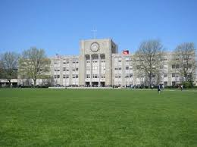
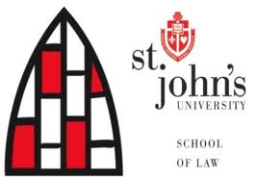
The best Law School for you is…
St. John’s Law School!
St. John’s Law School is located in Queens, New York. It opened in 1925.
It is located on the St. John’s campus, which is different from many other schools which have separate campuses for the law school and other graduate degrees.
Admissions to St. John’s law school is highly competitive, They receive over 2,500 application and the entering class is only around 250.
St. John’s Law School is ranked number 98 in the top 100 law schools in the United States.
Here is the link to the law schools website: http://www.stjohns.edu/law

Slide 17
Do you want to go to a school that is on a campus (has a green, multiple buildings, etc) or would you prefer to go to a school that is just one or two buildings in a town or city?
I prefer a school that has a campus.
I prefer a school that is just one or two buildings in a city or town.

Slide 18
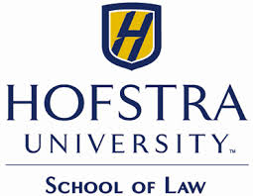
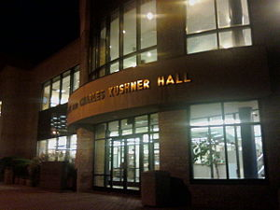
The best law school for you is…
Hofstra Law School!
Hofstra Law School is located in Hempstead Long Island on the beautiful campus of Hofstra University.
Hofstra Law School offers eight concentrations. The concentrations offered are in alternative dispute resolution , business law honors, criminal law and procedure, energy and environmental law, family law, health law, intellectual property law and international law.
Hofstra Law School offers over 200 externships, has 5 journals that students are able to join, has a moot court, pro bono work opportunities, and specific skills courses, such as advanced trial advocacy, business drafting, modern divorce advocacy and legal interviewing, counseling and negotiation.
Here is the link to the law schools website: http://law.hofstra.edu/

Slide 19
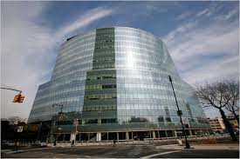
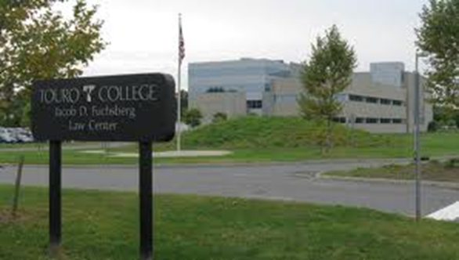
The best law school for you is…
Either CUNY School of Law or Touro Law Center!
CUNY School of Law
CUNY School of Law is located in Long Island City.
It is easily accessible to all five boroughs.
The cost of CUNY School of Law is substantially less than half the cost of most private law schools.
If money is a big concern this is your best bet.
Here is the link to the law schools website: http://www.law.cuny.edu/index.html
Touro Law Center
Touro Law Center is located in Central Islip.
It is located about an hour car or train ride from New York City.
Since it is so close to the courts it is known for working closely with both the federal and state courthouses.
Here is the link to the law schools website: http://www.tourolaw.edu/

Slide 20
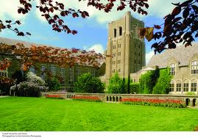
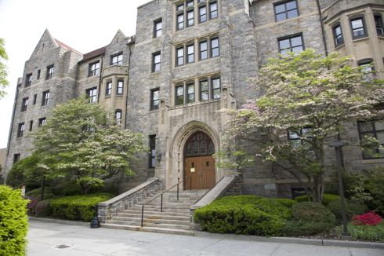
The best law school for you is…
Either Cornell Law School or Pace Law School!
Cornell Law School
Cornell Law School is located in Ithaca,
New York. It was established in 1887.
Cornell is ranked #13 in the top 100 law schools in the United States.
It is an extremely prestigious school. The average LSAT score for the most recent entering class was a 167 and the median
GPA was a 3.66.
Here is the link to the law schools website: http://www.cornell.edu/
Pace Law School
Pace Law School is located in White Plains, New York. It was established in 1976.
Two special programs Pace law offers are the January accelerated program and the Pipeline Program.
The median LSAT score for the incoming class is 153 and the median GPA is 3.33.
Here is the link to the law schools website: http://www.law.pace.edu/

