Slide 1
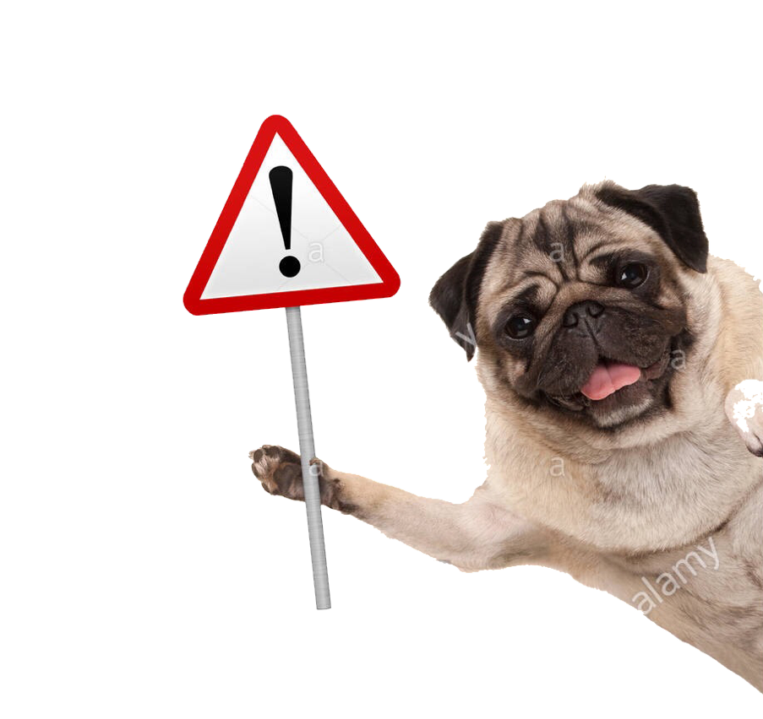
What is the perfect dog for you?
START
HERE

Slide 2
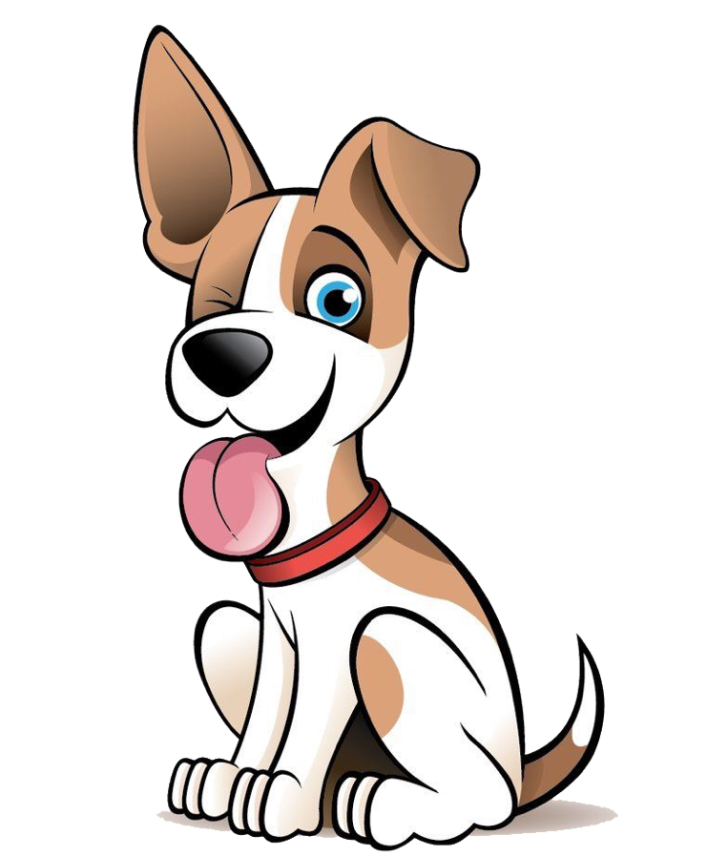
First! Would you rather have a dog that is…
Friendly
or
Protective

Slide 3
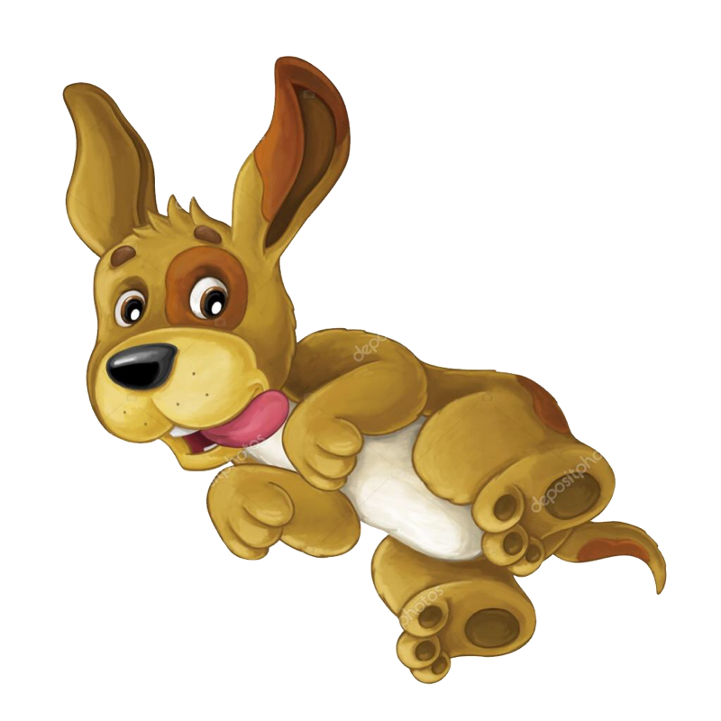
Next choice! Do you want your dog to be…
Reserved
or
Energetic

Slide 4
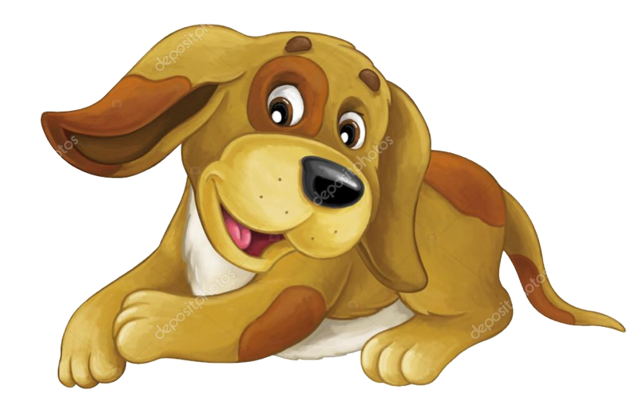
Next choice! Do you want your dog to be…
Reserved
or
Energetic

Slide 5
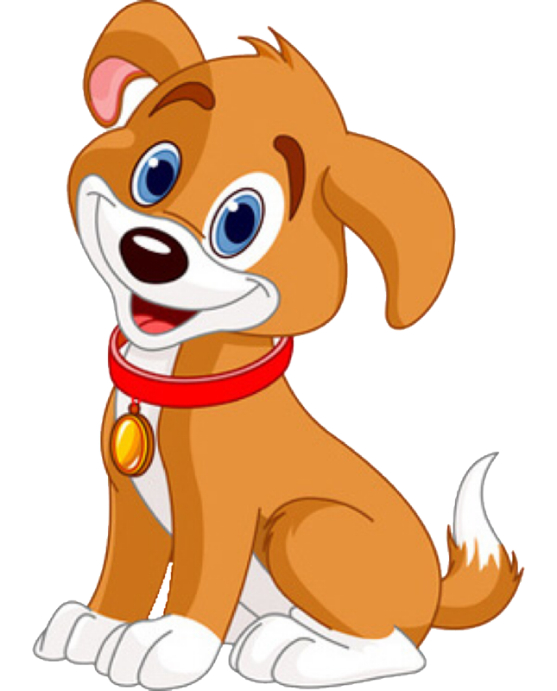
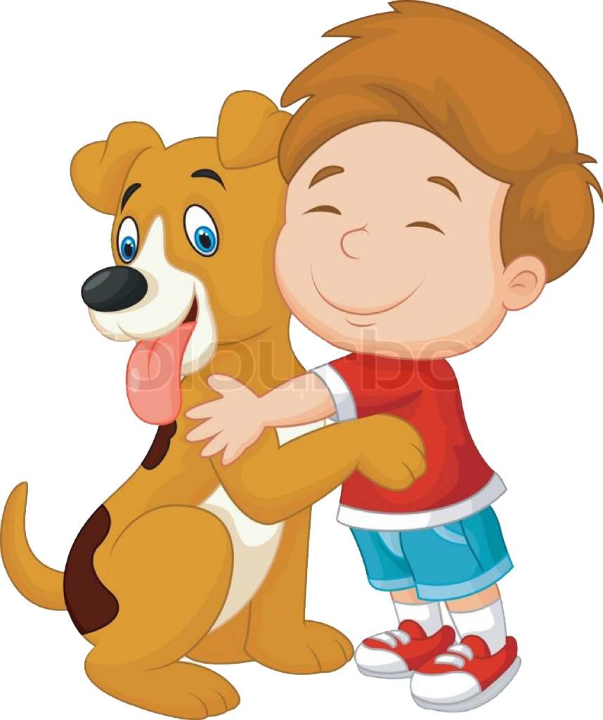
How about a dog that is…
Independent
or
A companion

Slide 6
How about a dog that is…
Independent
or
A companion

Slide 7
How about a dog that is…
Independent
or
A companion

Slide 8
How about a dog that is…
Independent
or
A companion

Slide 9
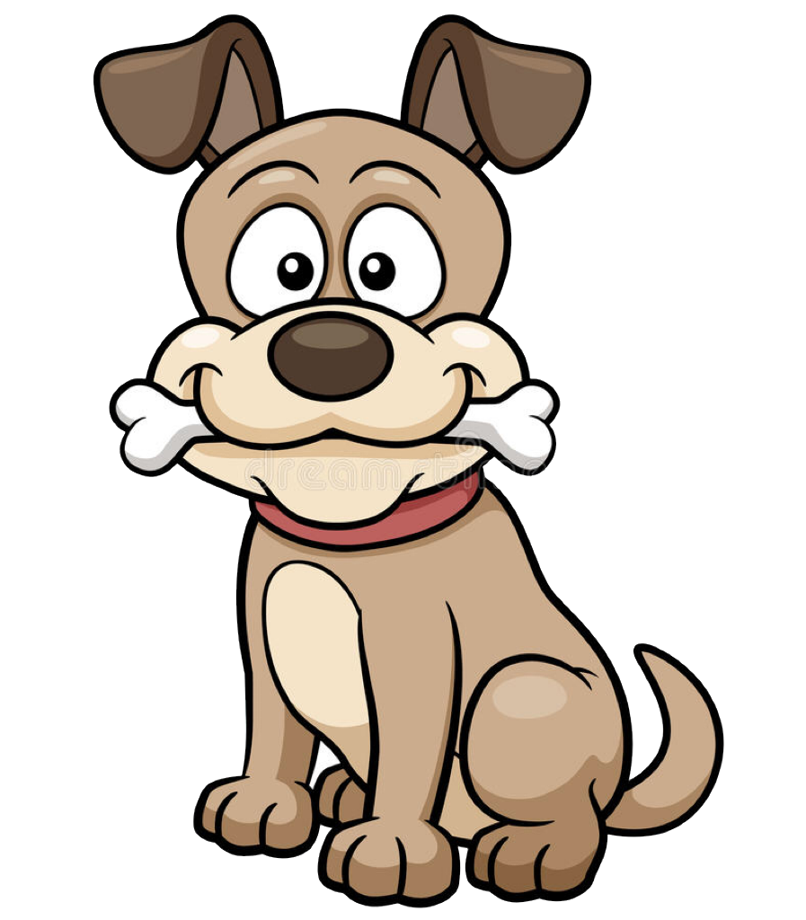
Final question! What size dog would you want?
BIG!
or
small

Slide 10
Final question! What size dog would you want?
BIG!
or
small

Slide 11
Final question! What size dog would you want?
BIG!
or
small

Slide 12
Final question! What size dog would you want?
BIG!
or
small

Slide 13
Final question! What size dog would you want?
BIG!
or
small

Slide 14
Final question! What size dog would you want?
BIG!
or
small

Slide 15
Final question! What size dog would you want?
BIG!
or
small

Slide 16
Final question! What size dog would you want?
BIG!
or
small

Slide 17
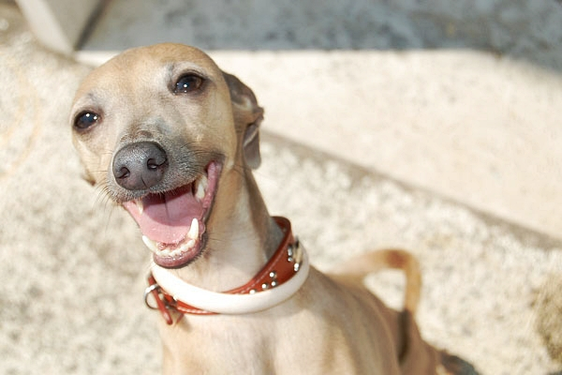
You got a… Greyhound!!!
Take this quiz again!

Slide 18
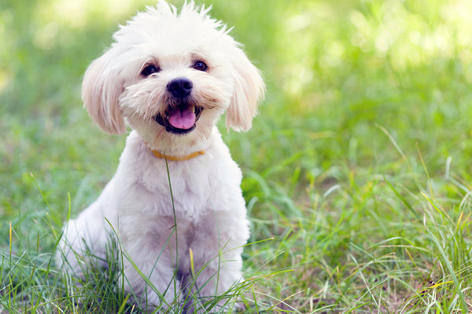
maltese
You got a… Maltese!!!
Take this quiz again!

Slide 19
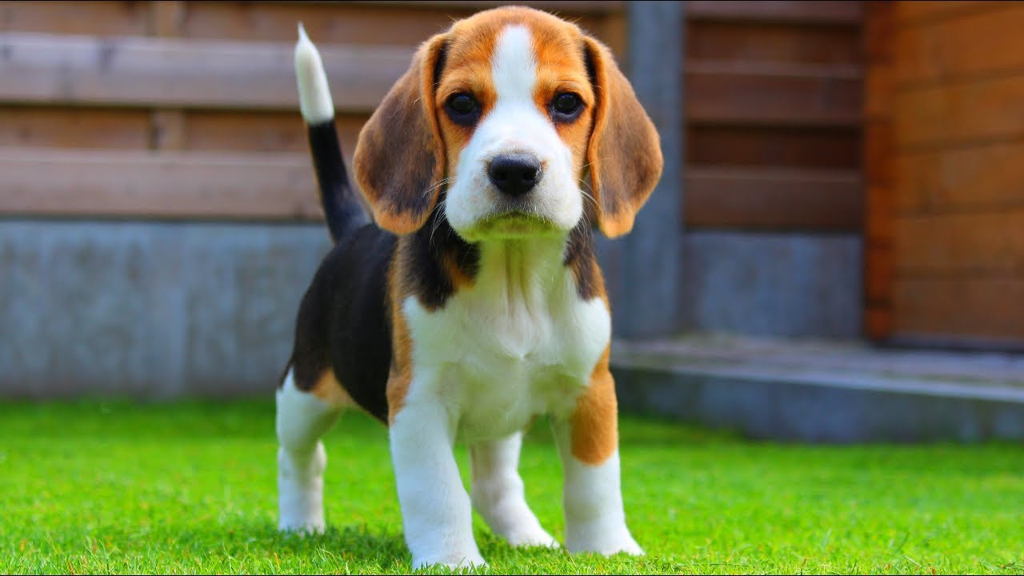
You got a… Beagle!!!
Take this quiz again!

Slide 20
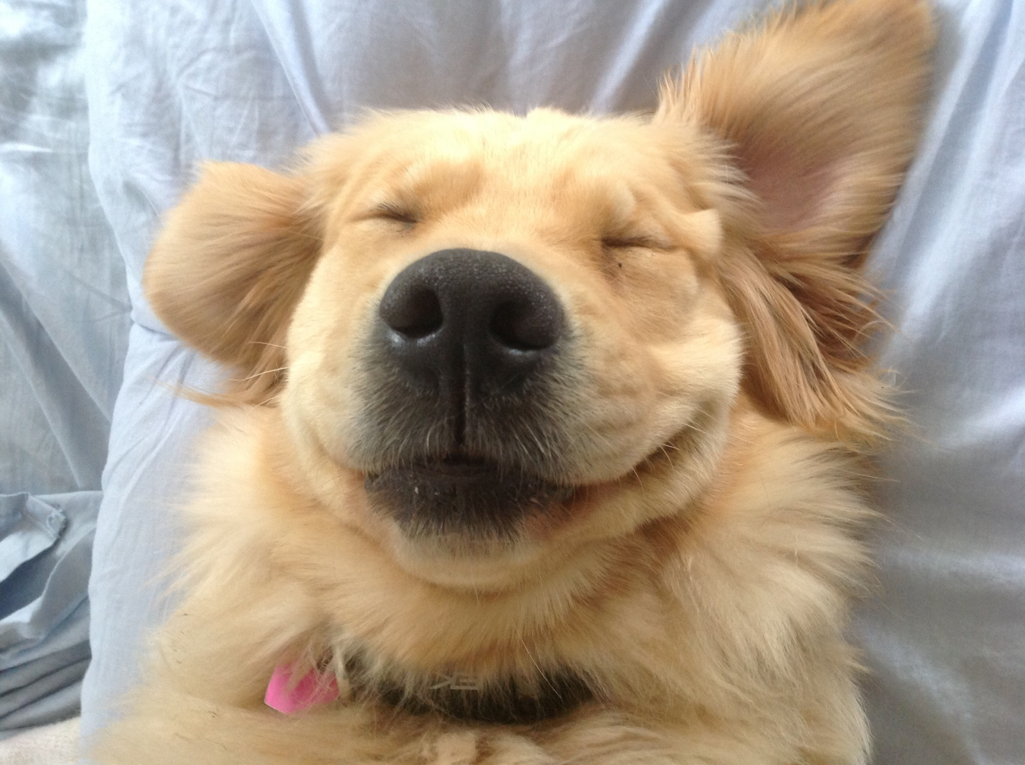
You got a… Golden Retriever!!!
Take this quiz again!

Slide 21
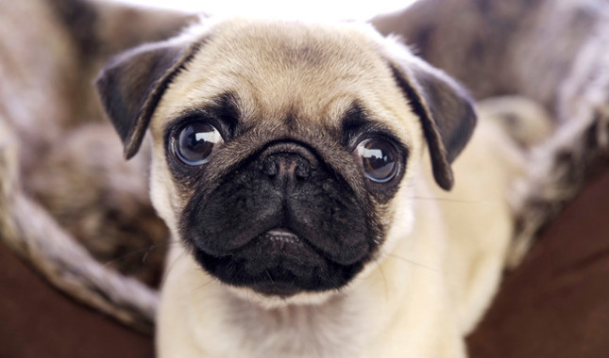
You got a… Pug!!!
Take this quiz again!

Slide 22
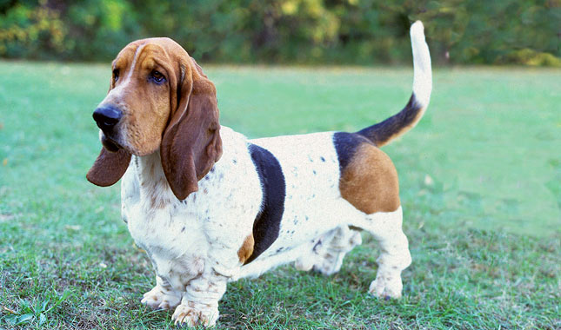
You got a… Bassett Hound!!!
Take this quiz again!

Slide 23
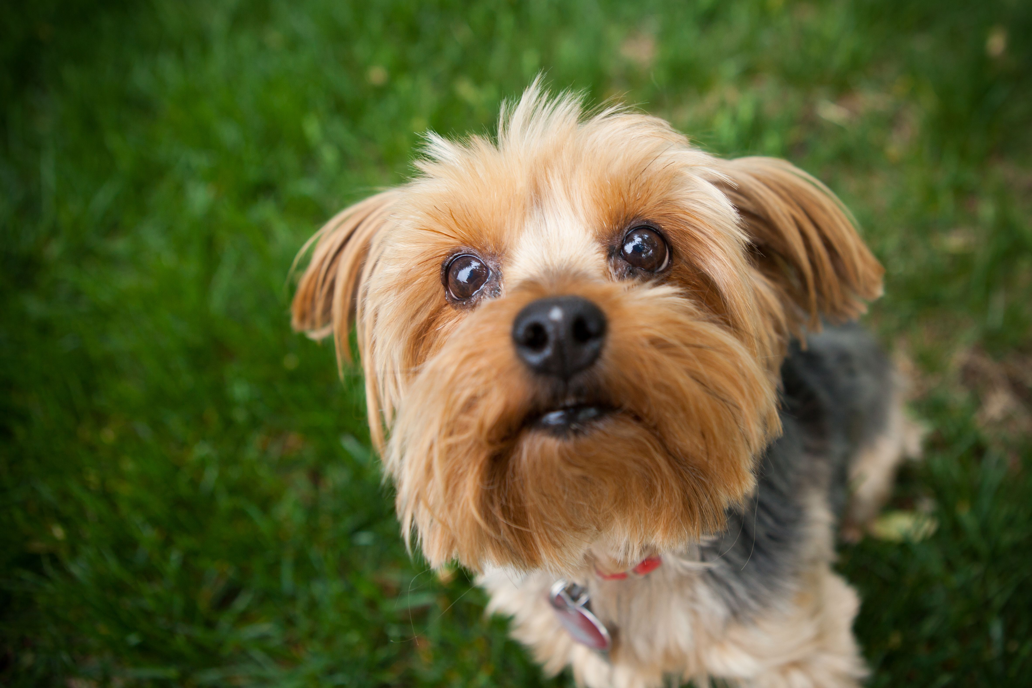
Yorkshire terrier
You got a… Yorkshire terrier!!!
Take this quiz again!

Slide 24
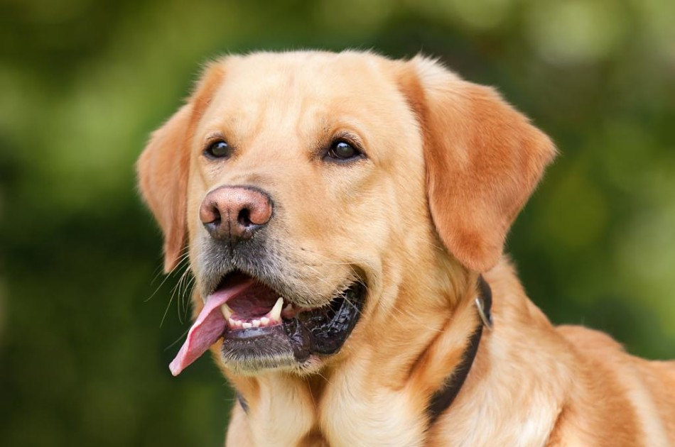
lab
You got a… Labrador Retriever!!!
Take this quiz again!

Slide 25
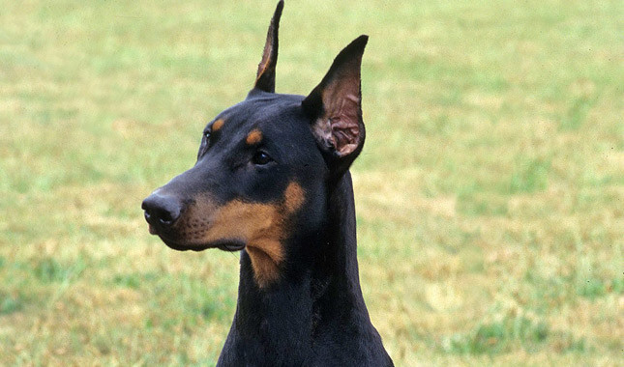
Doberman pinscher
You got a… Doberman Pinscher!!!
Take this quiz again!

Slide 26
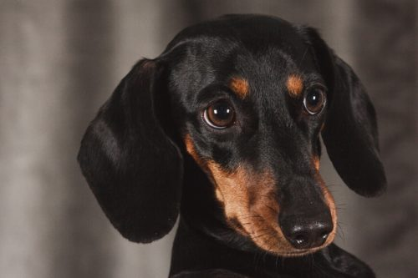
dachshund
You got a… Dachshund!!!
Take this quiz again!

Slide 27
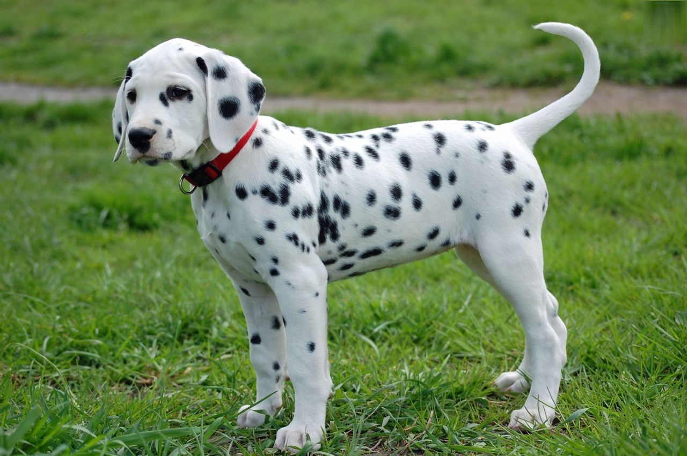
dalmatian
You got a… Dalmatian!!!
Take this quiz again!

Slide 28
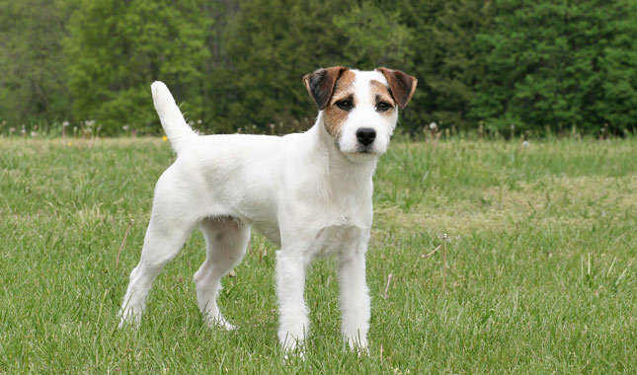
Jack Russell terrier
You got a… Jack Russell Terrier!!!
Take this quiz again!

Slide 29
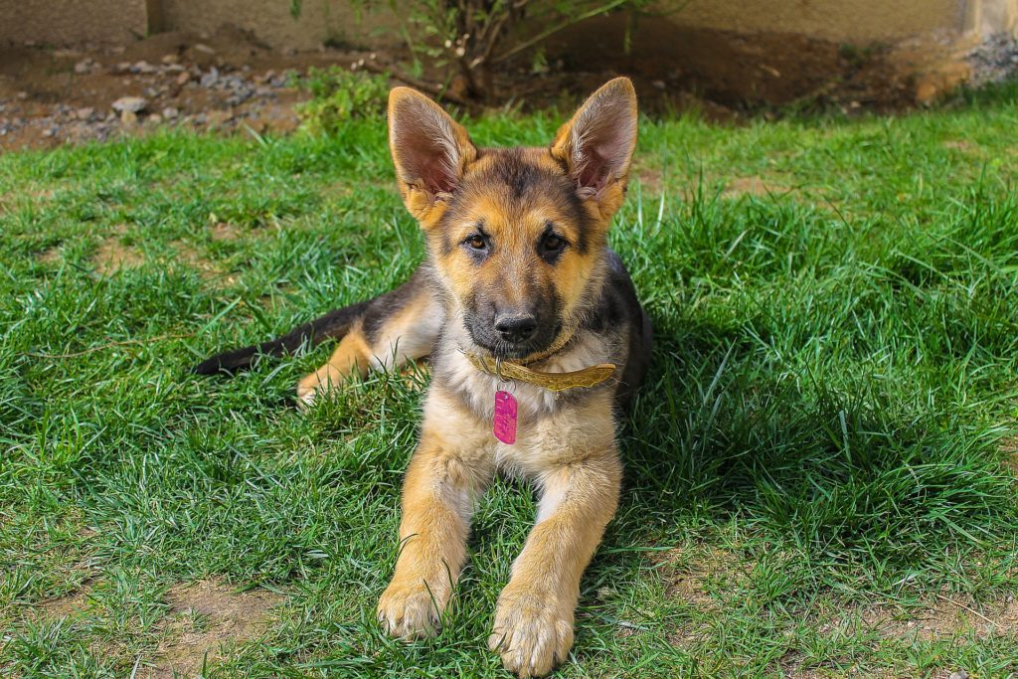
German shepherd
You got a… German Shepherd!!!
Take this quiz again!

Slide 30
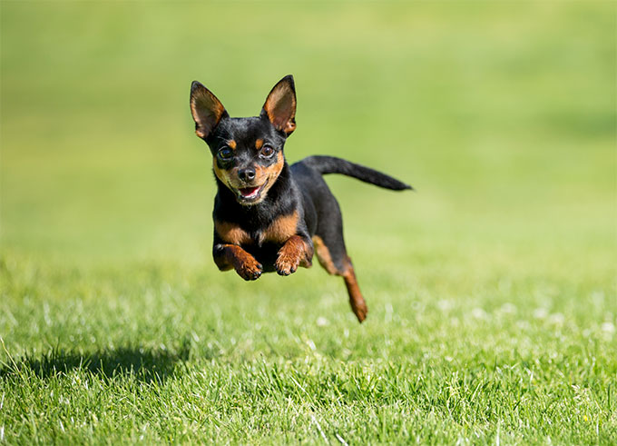
Chihuahua
You got a… Chihuahua!!!
Take this quiz again!

Slide 31
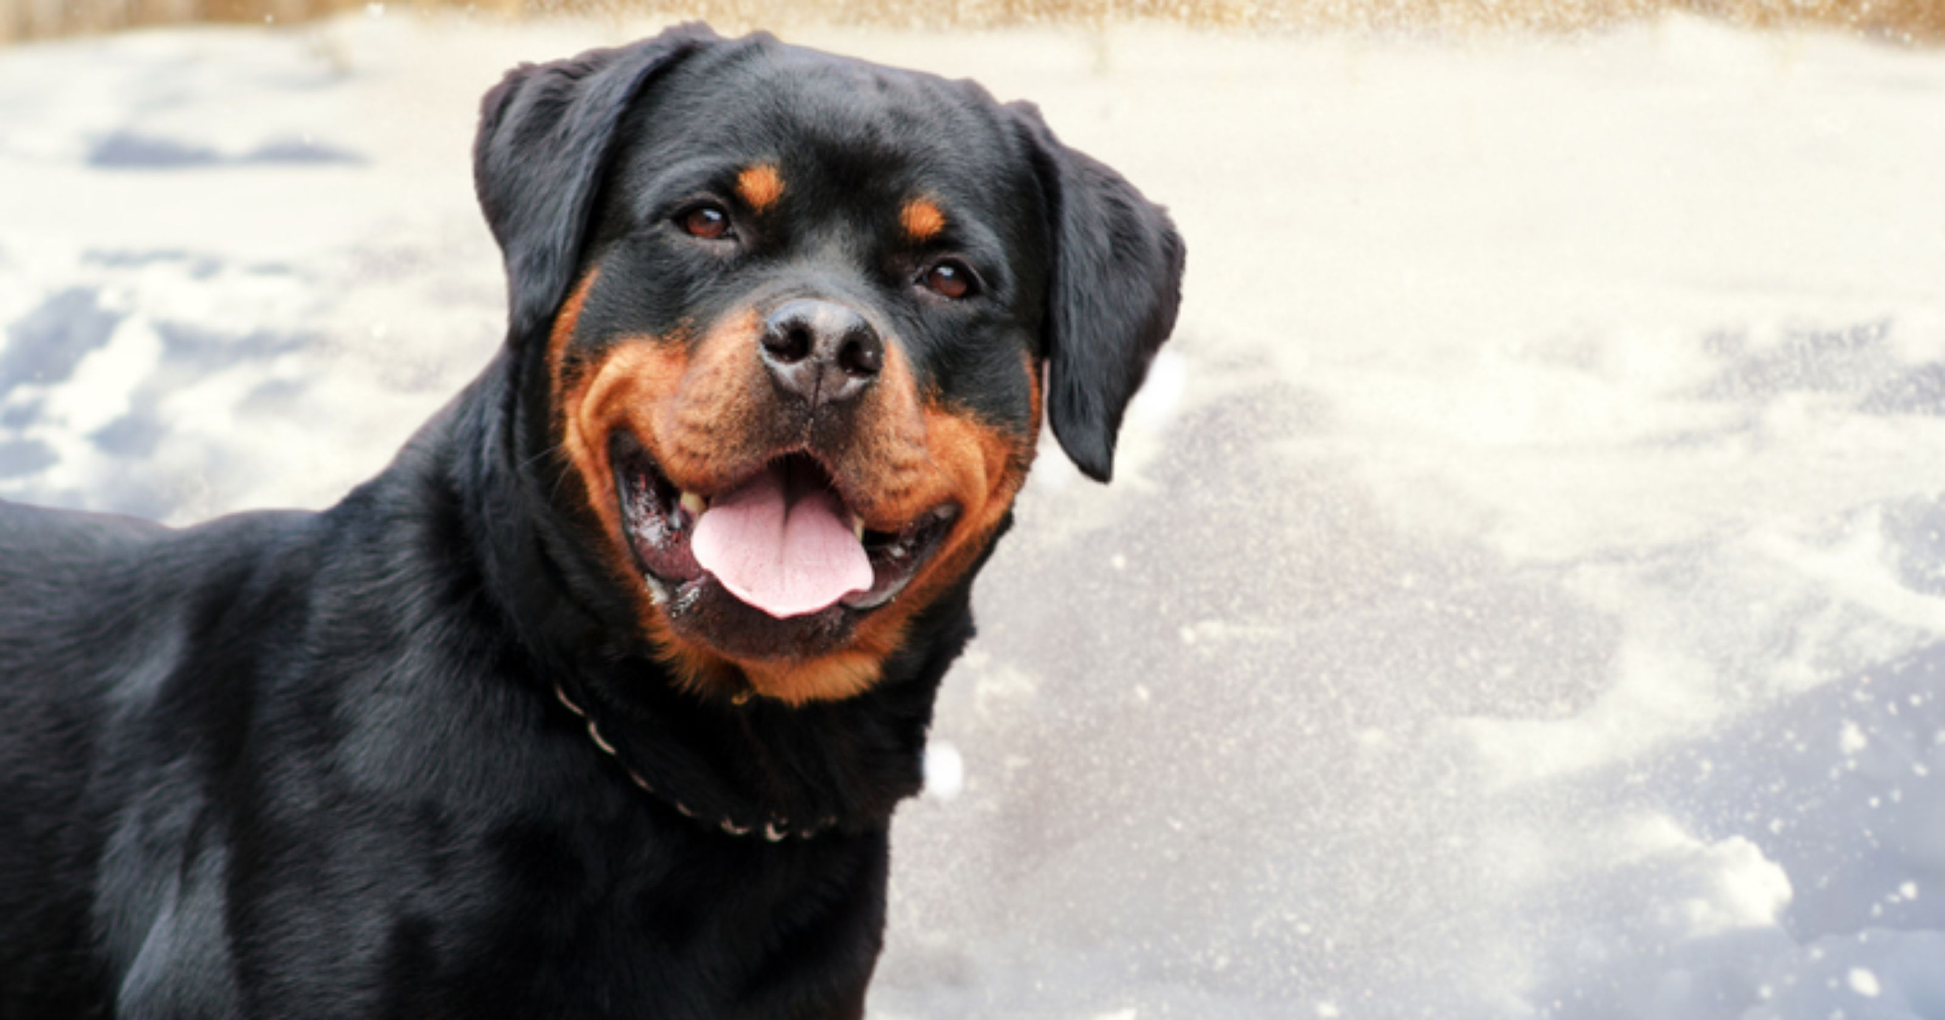
Rottweiler
You got a… Rottweiler!!!
Take this quiz again!

Slide 32
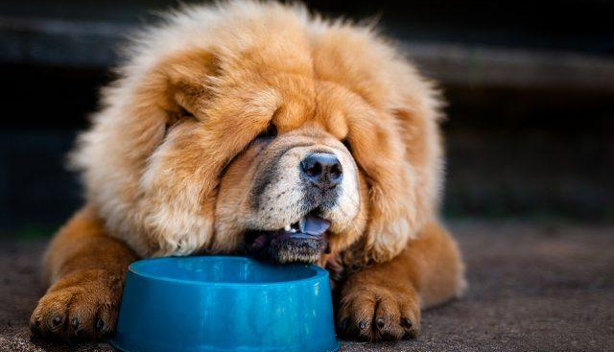
Chow chow
You got a… Chow Chow!!!
Take this quiz again!

