Slide 1
Find Your Perfect Vacation Location
START HERE

Slide 2
Do you want to…
Stay in the USA
Travel outside the country
OR

Slide 3
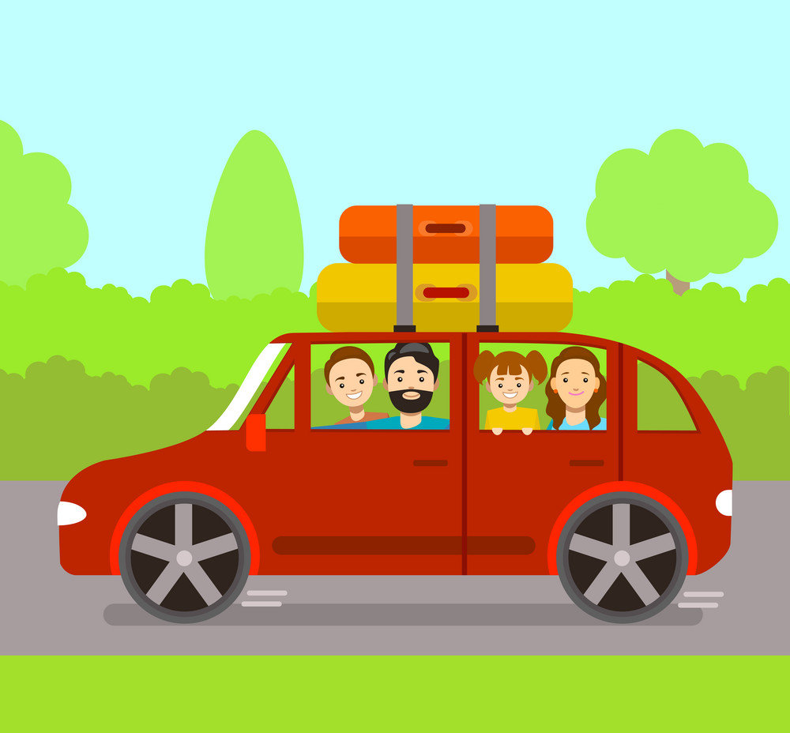
Are you looking for a family friendly location?
Yes
No
OR

Slide 4
Are you looking for a family friendly location?
Yes
No
OR

Slide 5
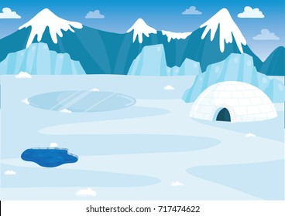
Do you prefer a vacation location that is…
Tropical
Arctic
OR

Slide 6
Do you prefer a vacation location that is…
Tropical
Arctic
OR

Slide 7
Do you prefer a vacation location that is…
Tropical
Arctic
OR

Slide 8
Do you prefer a vacation location that is…
Tropical
Arctic
OR

Slide 9
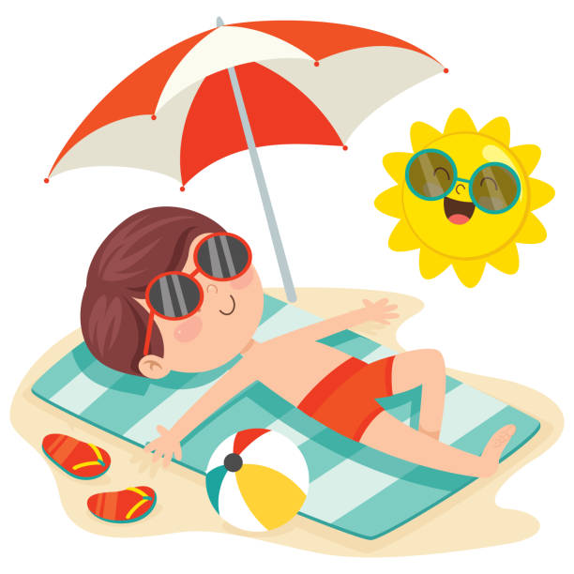
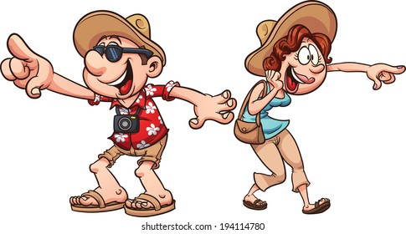
On your vacation do you want to…
Lay down and relax
Explore and see attractions
OR

Slide 10
On your vacation do you want to…
Lay down and relax
Explore and see attractions
OR

Slide 11
On your vacation do you want to…
Lay down and relax
Explore and see attractions
OR

Slide 12
On your vacation do you want to…
Lay down and relax
Explore and see attractions
OR

Slide 13
On your vacation do you want to…
Lay down and relax
Explore and see attractions
OR

Slide 14
On your vacation do you want to…
Lay down and relax
Explore and see attractions
OR

Slide 15
On your vacation do you want to…
Lay down and relax
Explore and see attractions
OR

Slide 16
On your vacation do you want to…
Lay down and relax
Explore and see attractions
OR

Slide 17
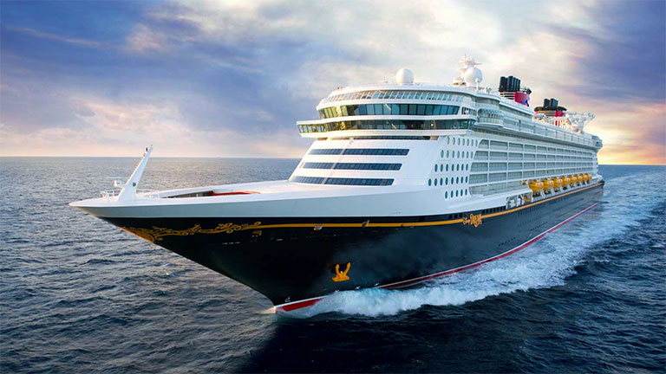
You got… DISNEY CRUISE
Click Here to Re-Take
Notes:
USA, family, tropical, laydown and relax

Slide 18
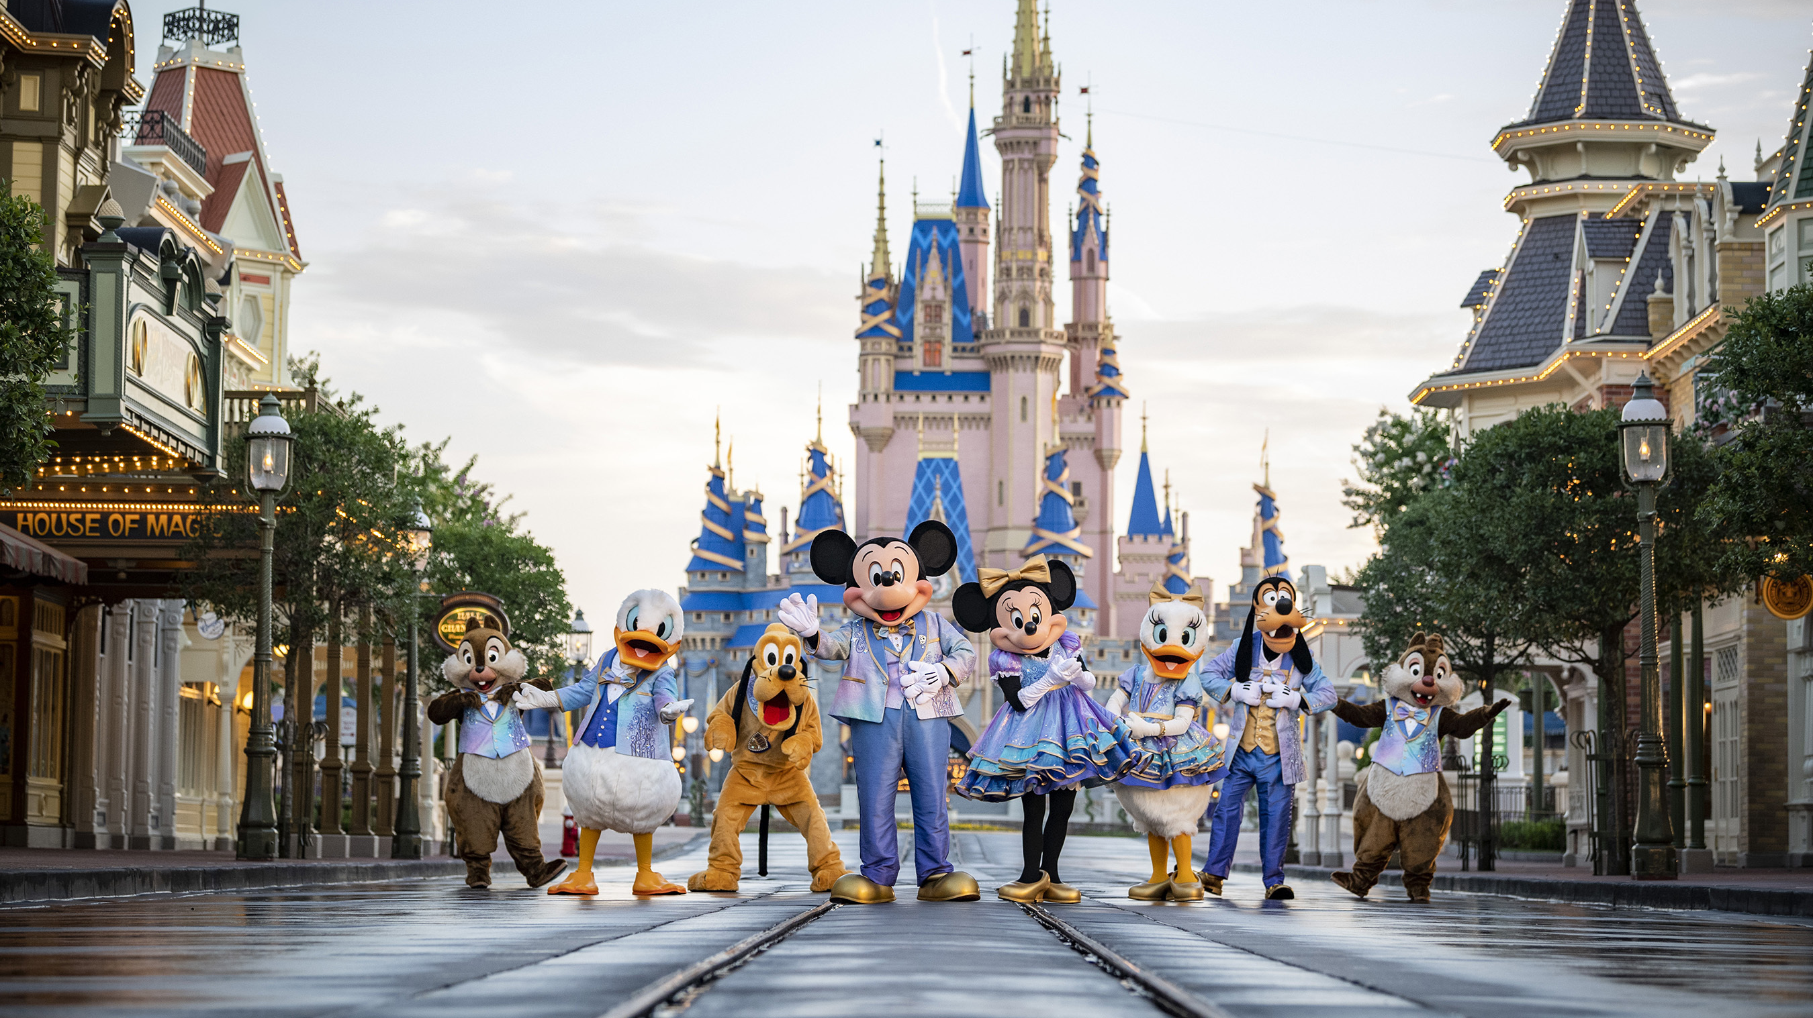
You got… WALT DISNEY WORLD
Click Here to Re-Take
Notes:
Usa, family, tropical, explore

Slide 19
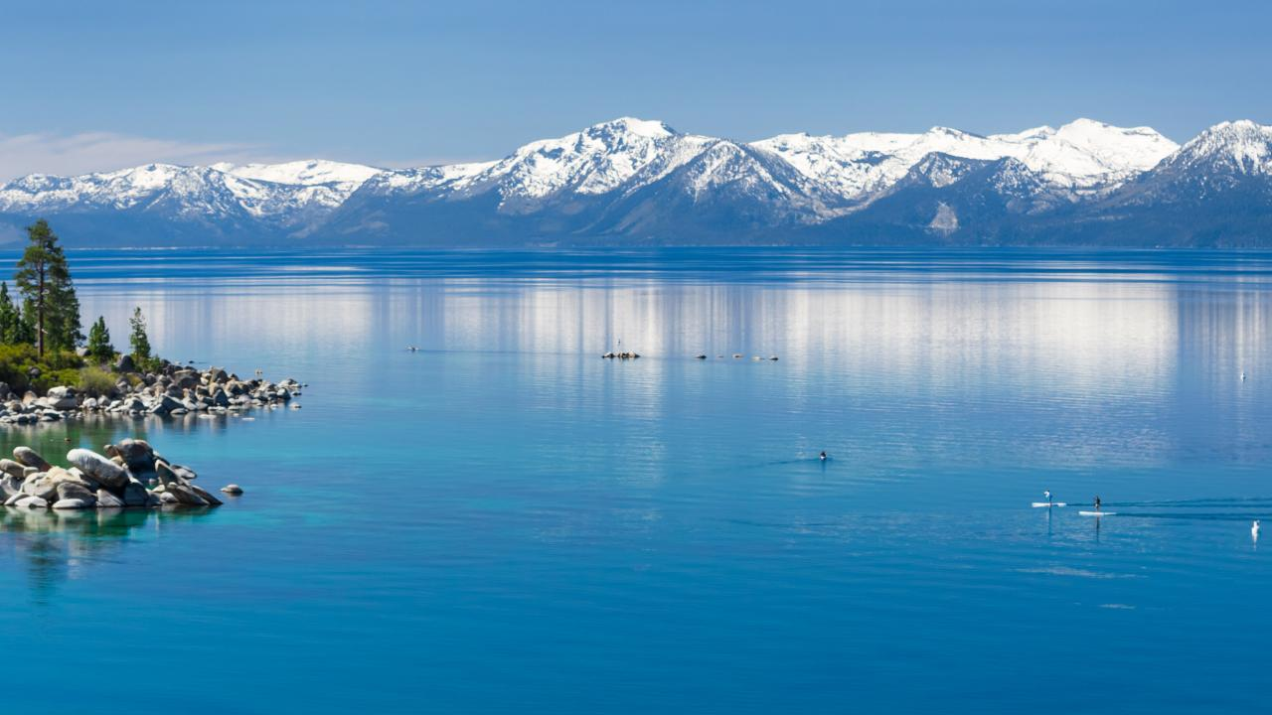
You got… LAKE TAHOE
Click Here to Re-Take
Notes:
USA, family, arctic, relax

Slide 20
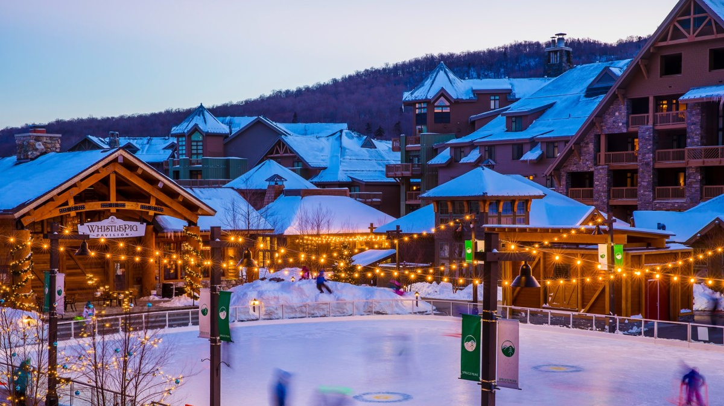
You got… VERMONT SKI RESORT
Click Here to Re-Take
Notes:
USA, family, arctic, explore

Slide 21
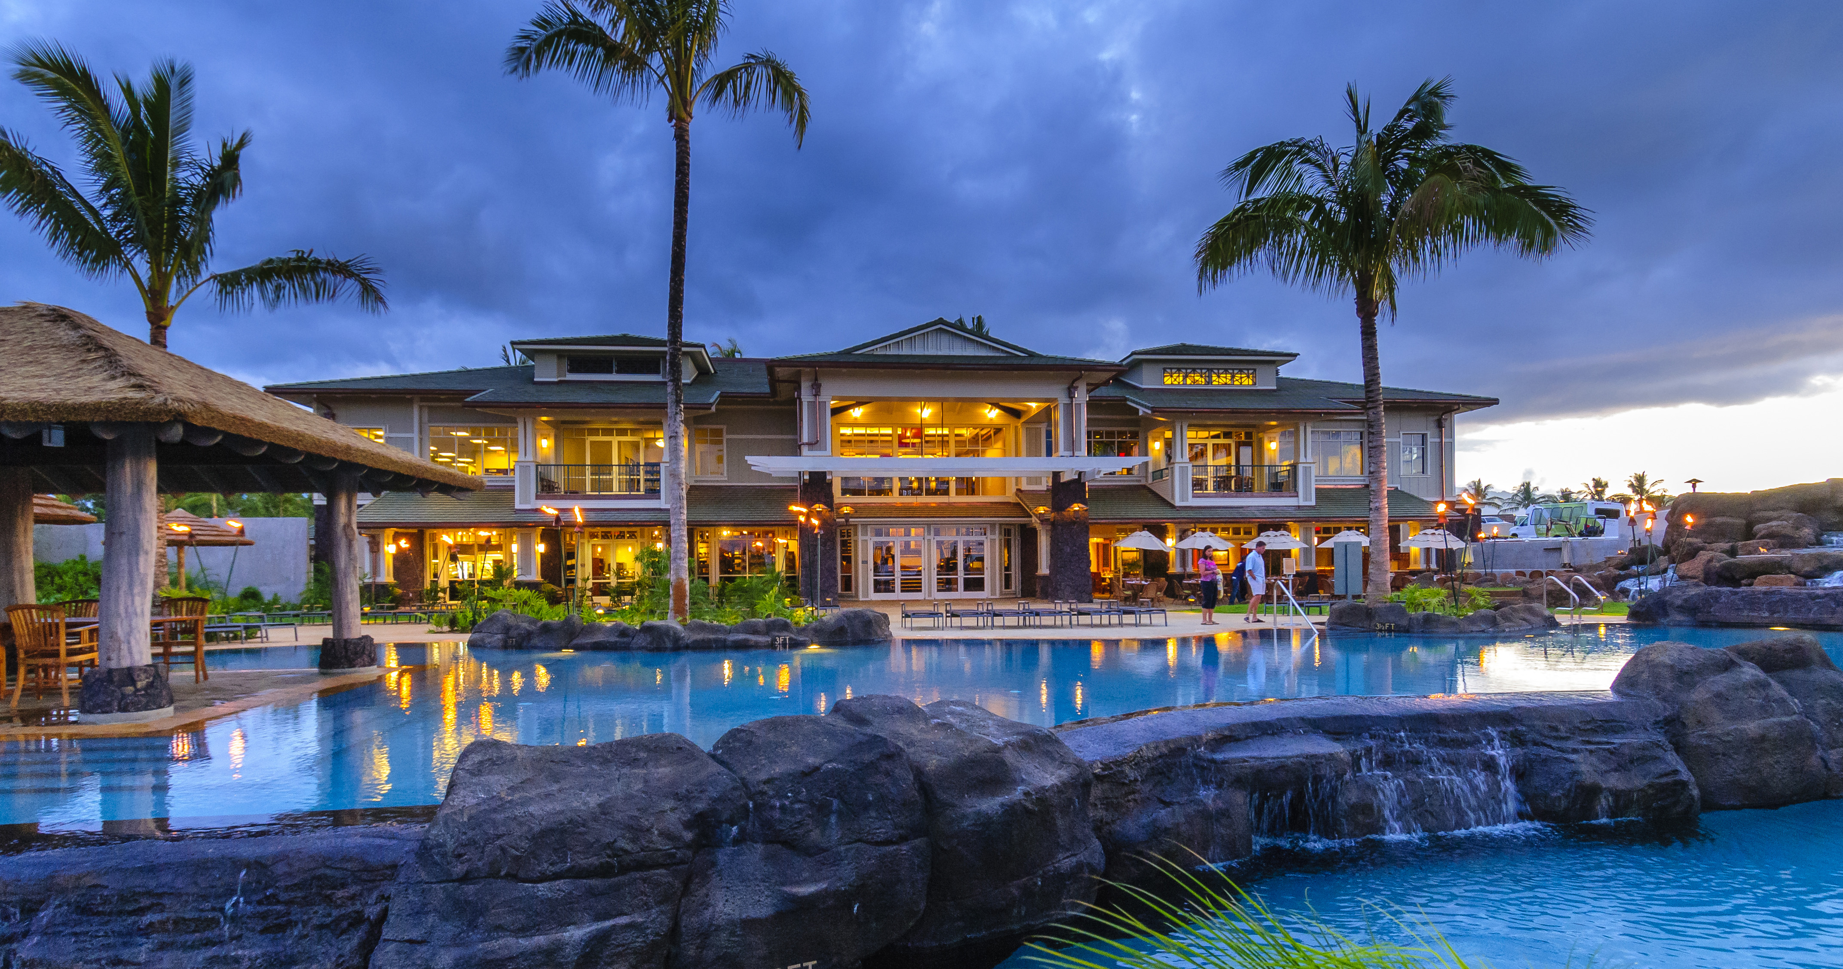
You got… HAWAII
Click Here to Re-Take
Notes:
USA, no family, tropical, lay down and relax

Slide 22
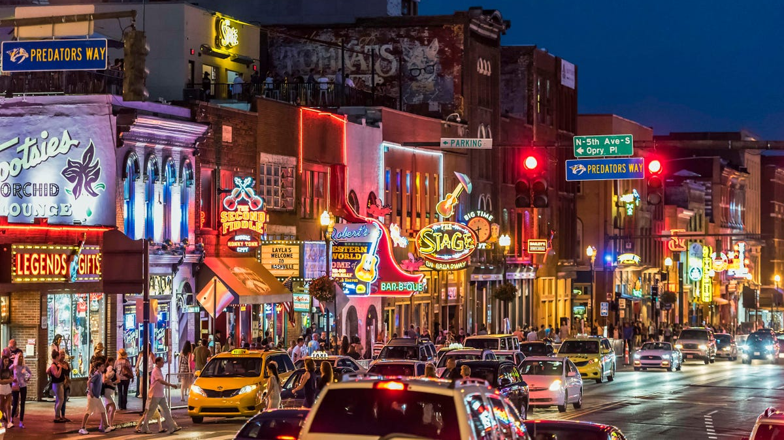
You got… NASHVILLE, TN
Click Here to Re-Take
Notes:
USA, no family, tropical, explore

Slide 23
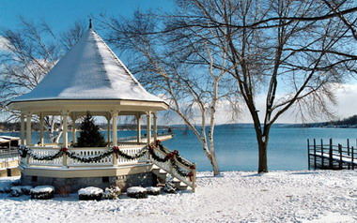
You got… THE FINGER LAKES IN NY
Click Here to Re-Take
Notes:
USA, no family, arctic, lay down and relax

Slide 24
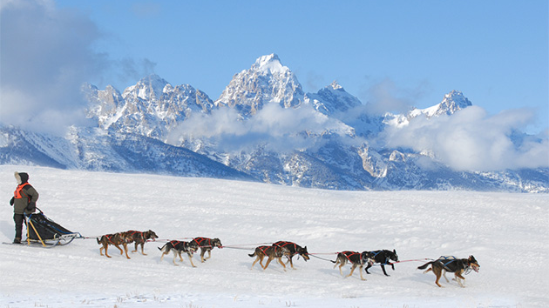
You got… ALASKA
Click Here to Re-Take
Notes:
USA, no family, arctic, explore

Slide 25
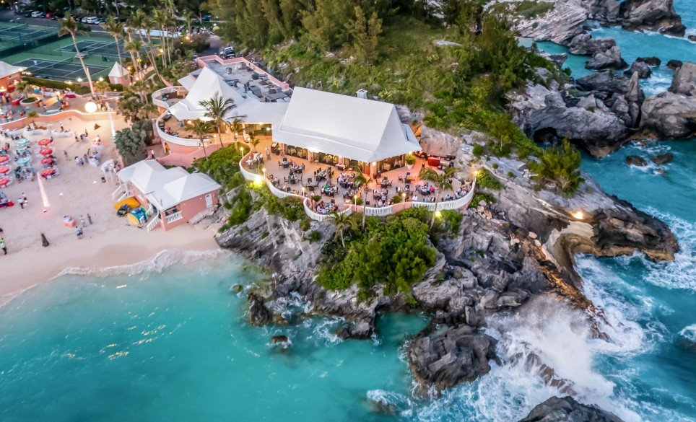
You got… BERMUDA
Click Here to Re-Take
Notes:
Out of the country, family, tropical, relax

Slide 26
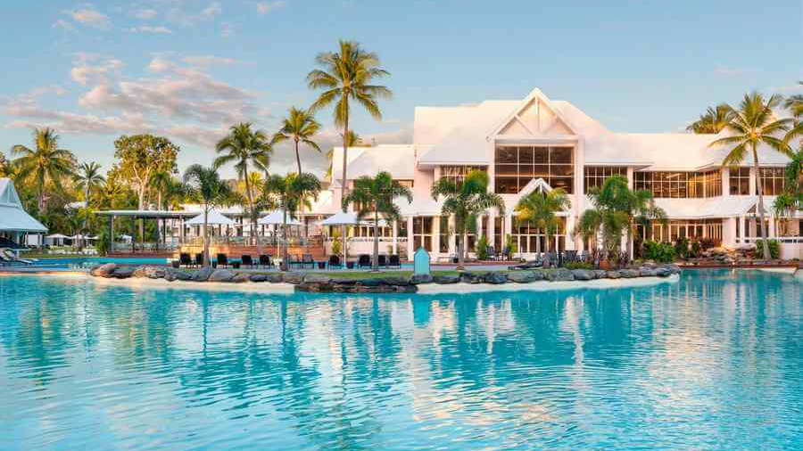
You got… AUSTRALIA
Click Here to Re-Take
Notes:
Out of the country, family, tropical, explore

Slide 27
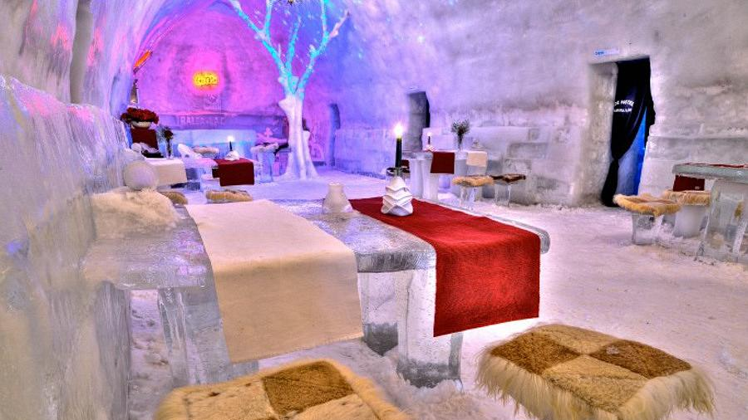
You got… ROMANIA’S ICE HOTEL
Click Here to Re-Take
Notes:
Out of the country, family, arctic, relax

Slide 28
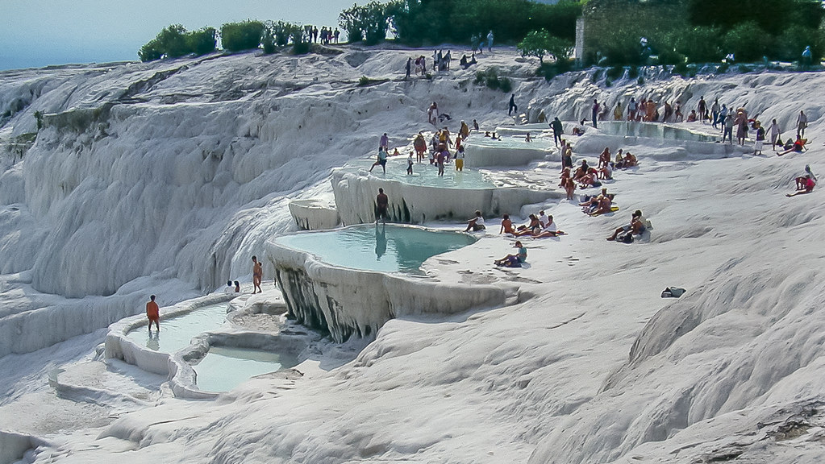
You got… TURKEY
Click Here to Re-Take
Notes:
Out of the country, family, arctic, explore

Slide 29
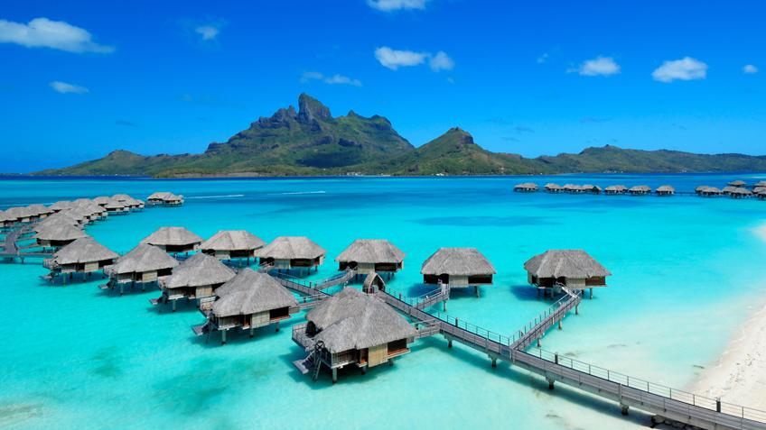
You got… BORA BORA OVERWATER VILLAS
Click Here to Re-Take
Notes:
Out of country, no family, tropical, relax

Slide 30
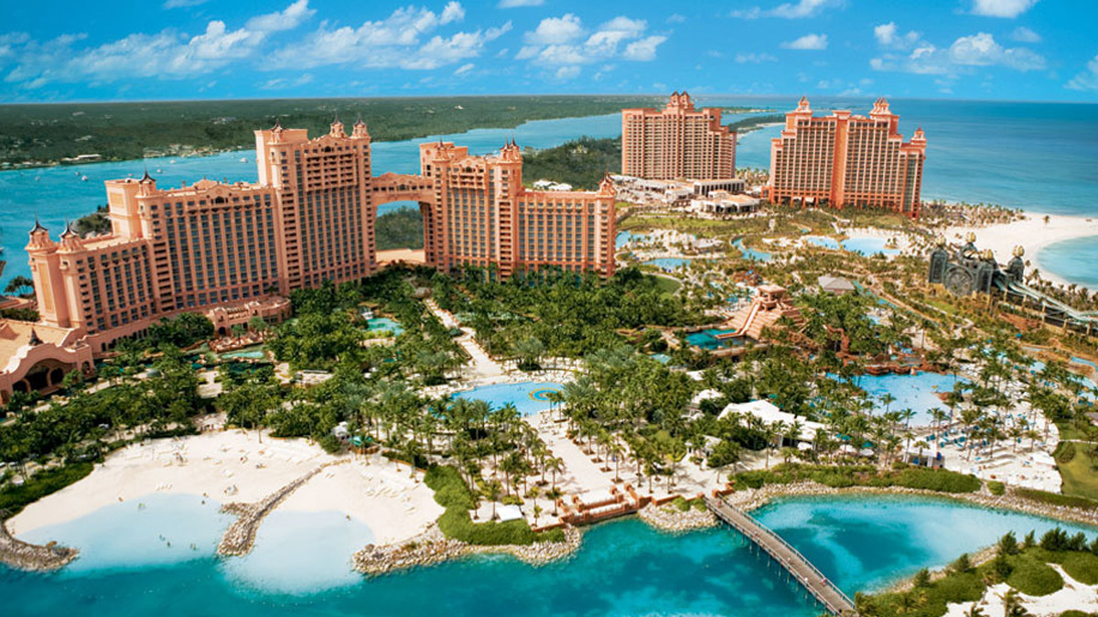
You got… ATLANTIS PARADISE ISLAND IN THE BAHAMAS
Click Here to Re-Take
Notes:
Out of country, no family, tropical, explore

Slide 31
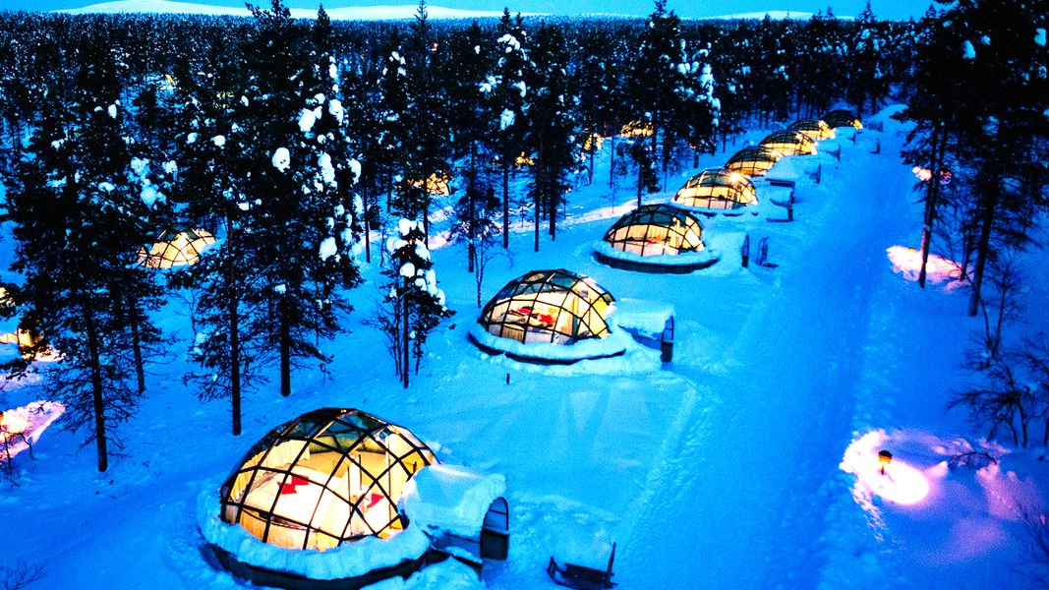
You got… NORTHERN LIGHTS IGLOO RESORT IN CANADA
Click Here to Re-Take
Notes:
Out of Country, no family, arctic, relax

Slide 32
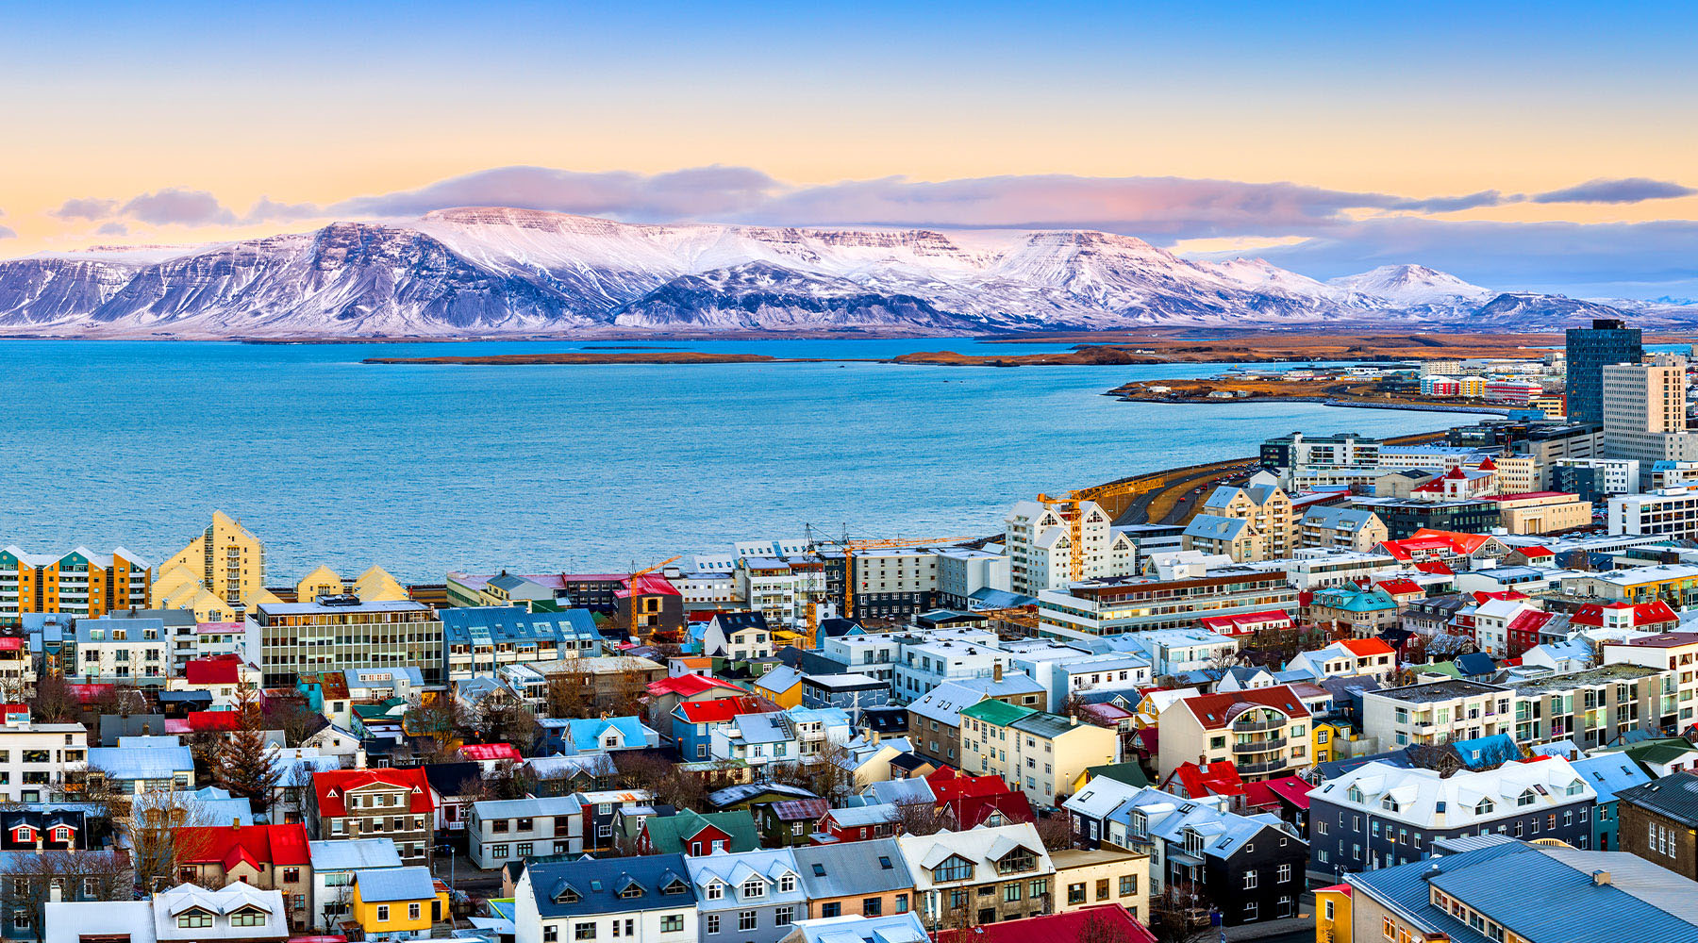
You got… ICELAND
Click Here to Re-Take
Notes:
Out of Country, no family, arctic, explore

