Slide 1
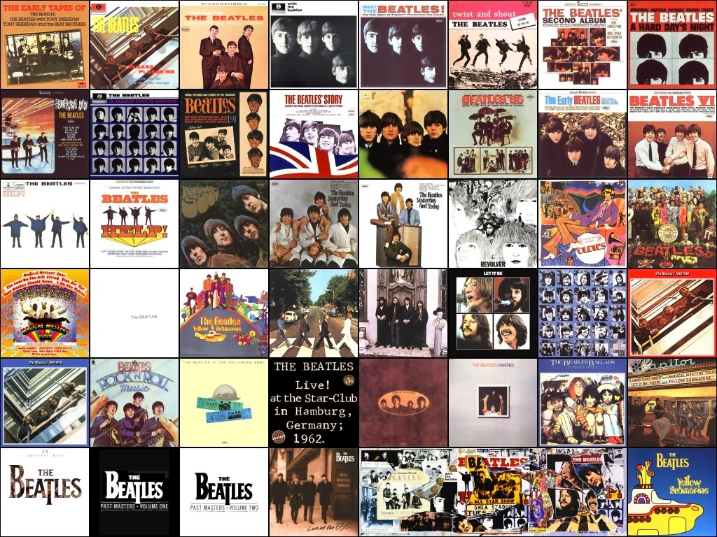
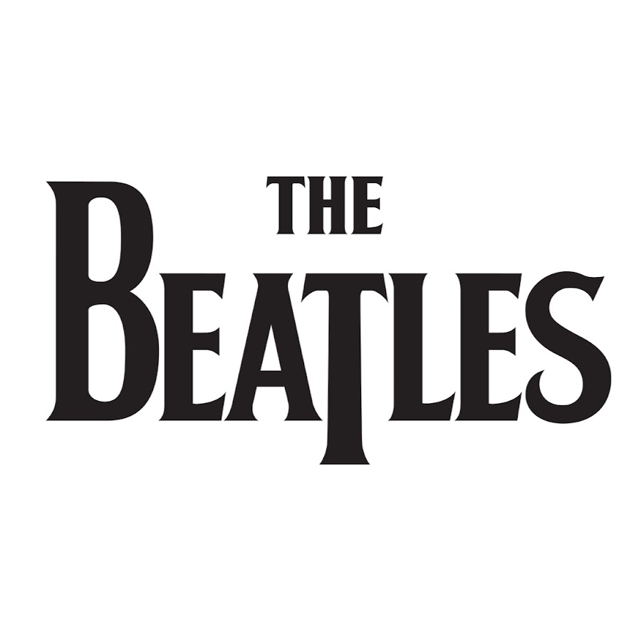

Slide 2
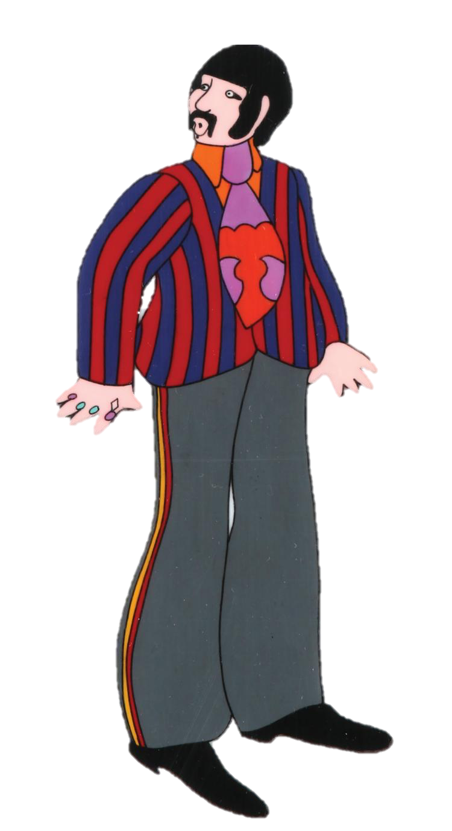
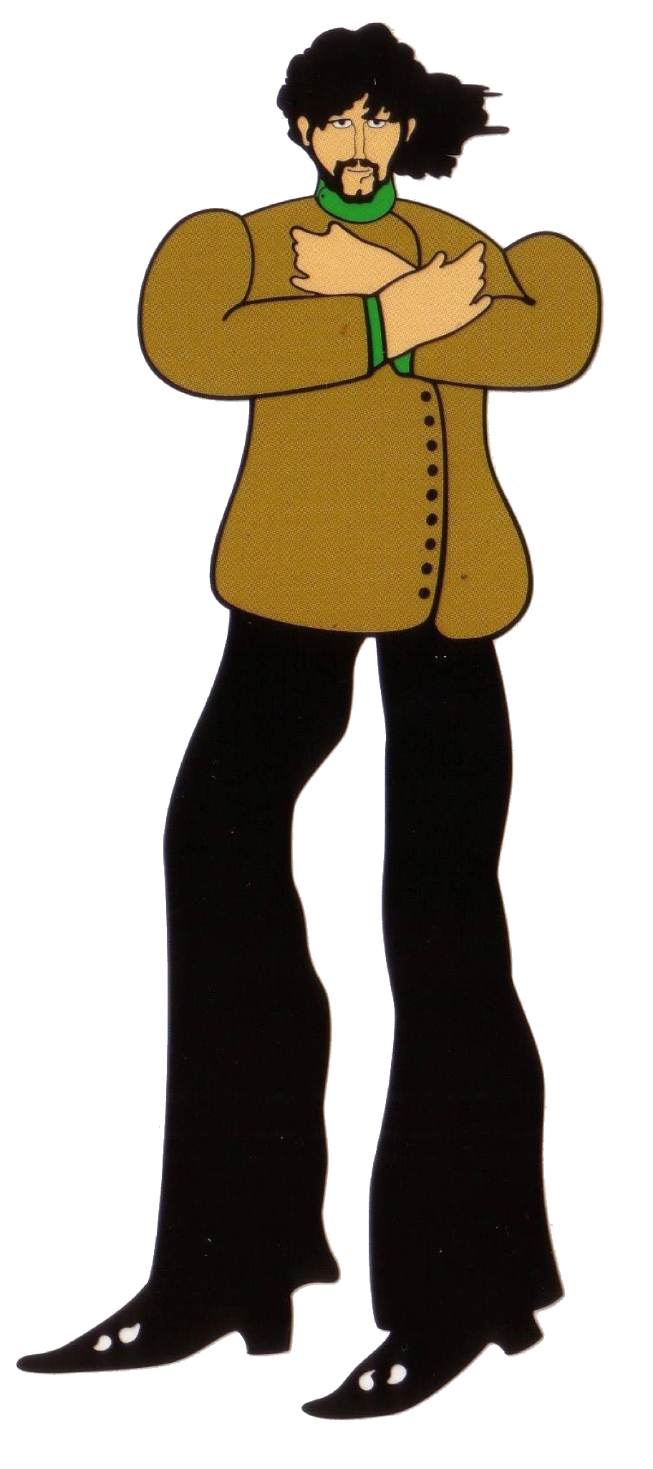
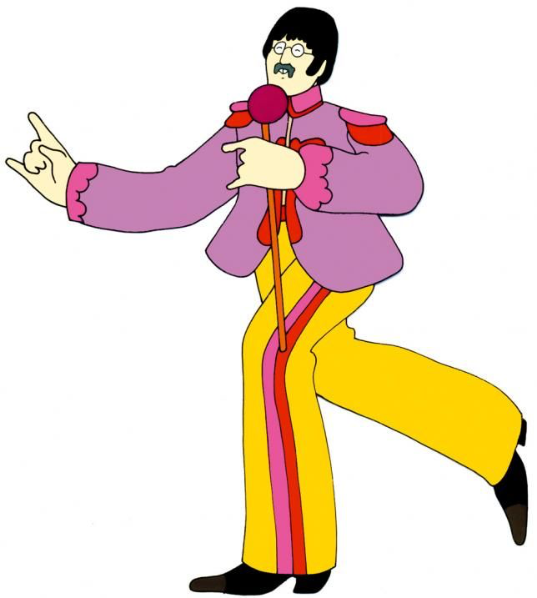
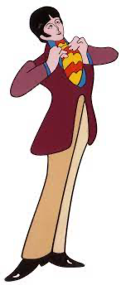
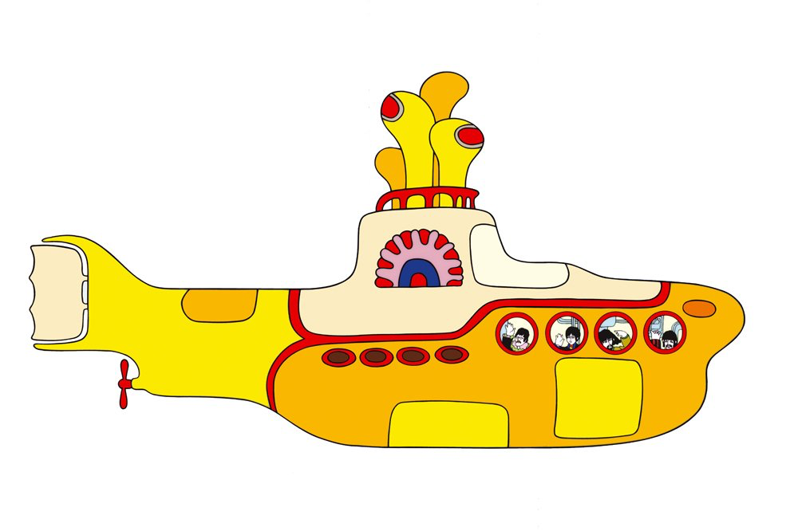
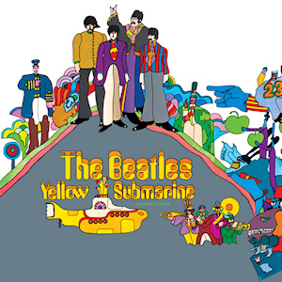
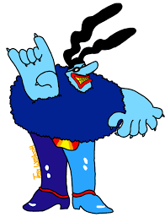
Early Life
Beginning
Memorable Moments
Breakup

Slide 3
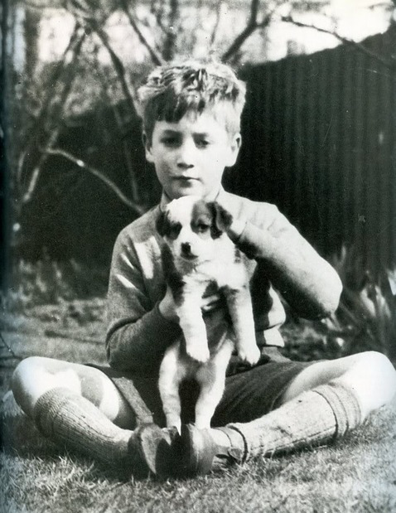
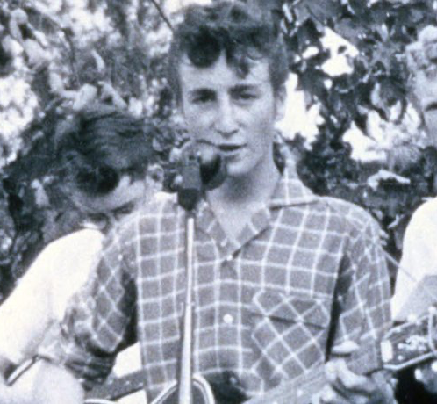
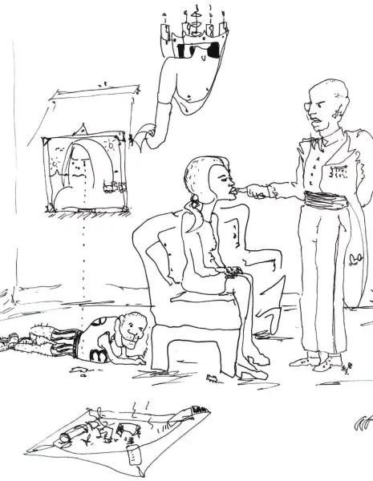
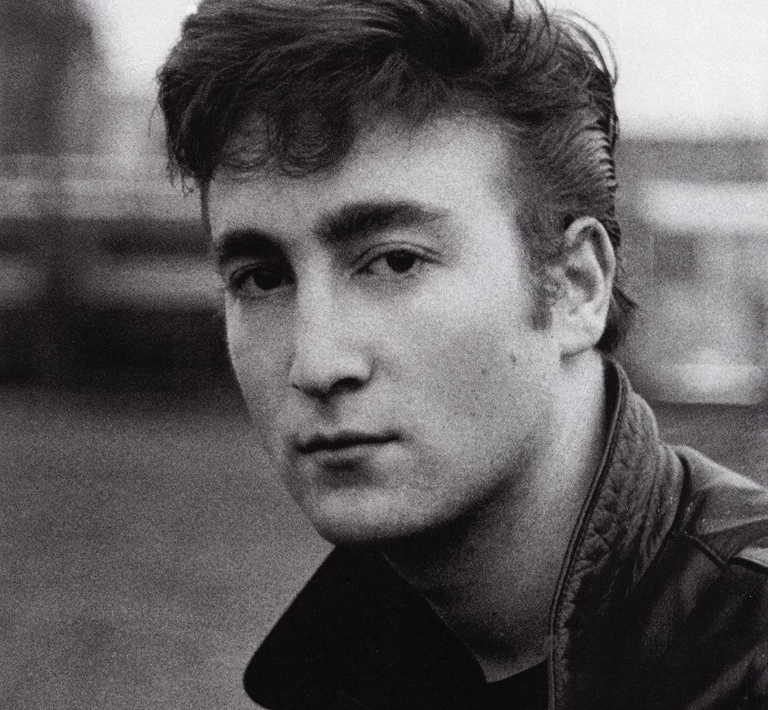
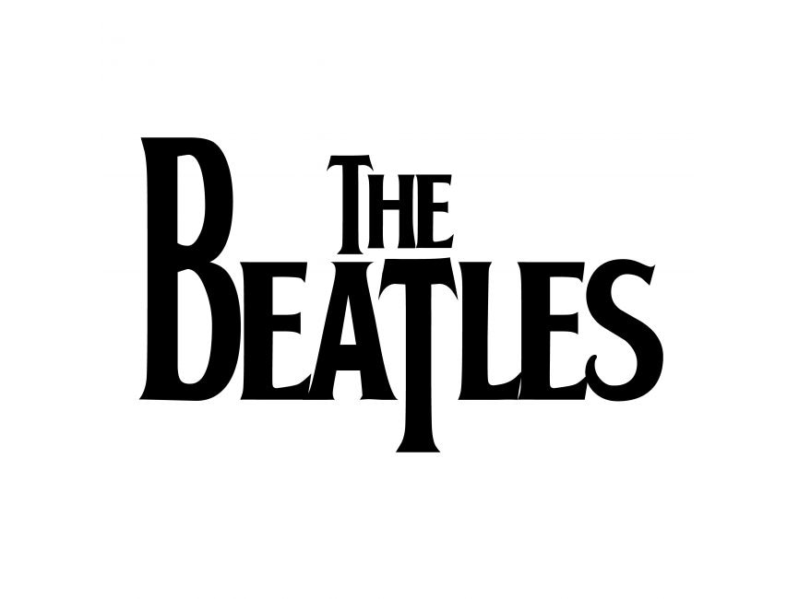
John Lennon
Born: October 9, 1940, in Liverpool, England
He was raised by his Aunt Mimi after his parents separated and his father left completely
He remained close to his mother who taught him how to play the banjo and the piano as well as bought him his first guitar
In July of 1958, his mother was hit by a car and was killed
As a child he got into trouble and did not do well in school
He enjoyed art and would draw grotesque figures and cripples

Slide 4
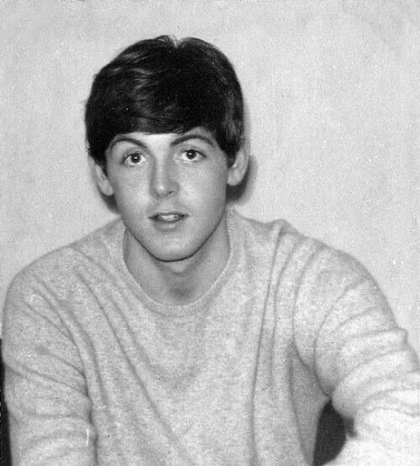
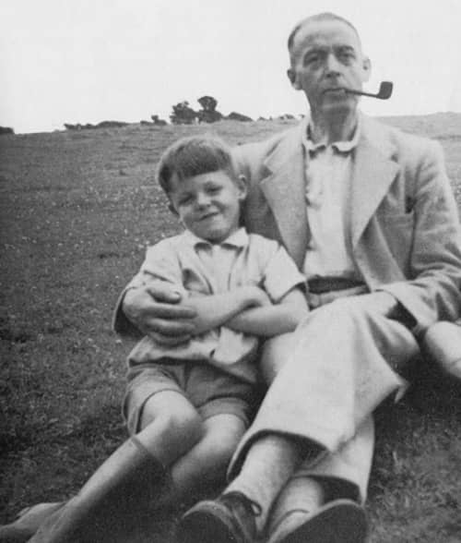
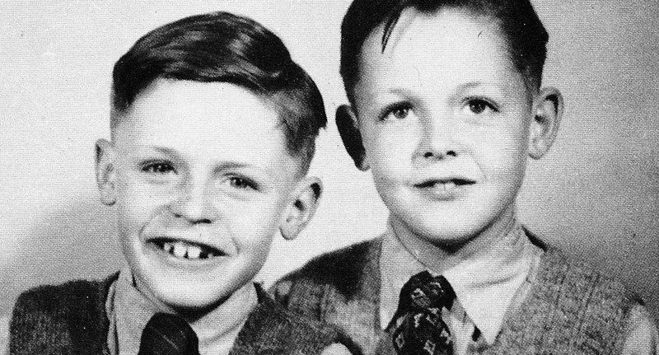
Paul McCartney
Born: June 18, 1942, in Liverpool, England
He grew up with his mother, father, and younger brother in a traditional working-class family
His mother died of breast cancer in October of 1956, which influenced some his later songs
His father was the leader of Jim Mac’s Jazz Band and their families often gathered around the piano while he played

Slide 5
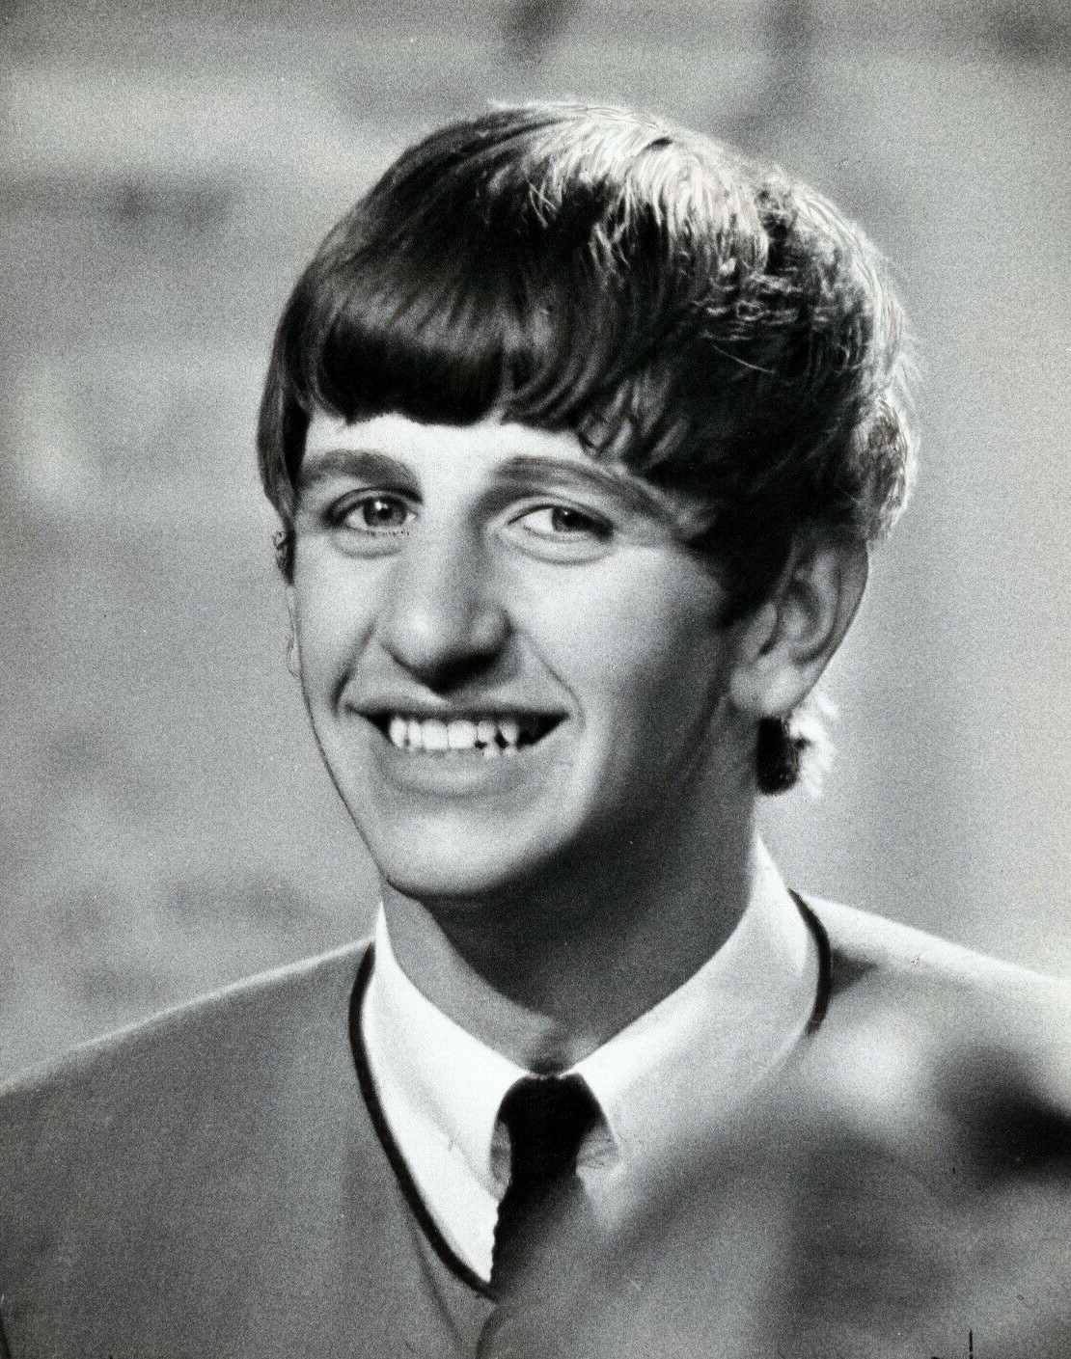
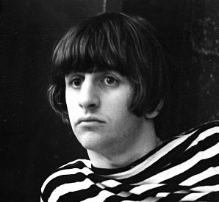
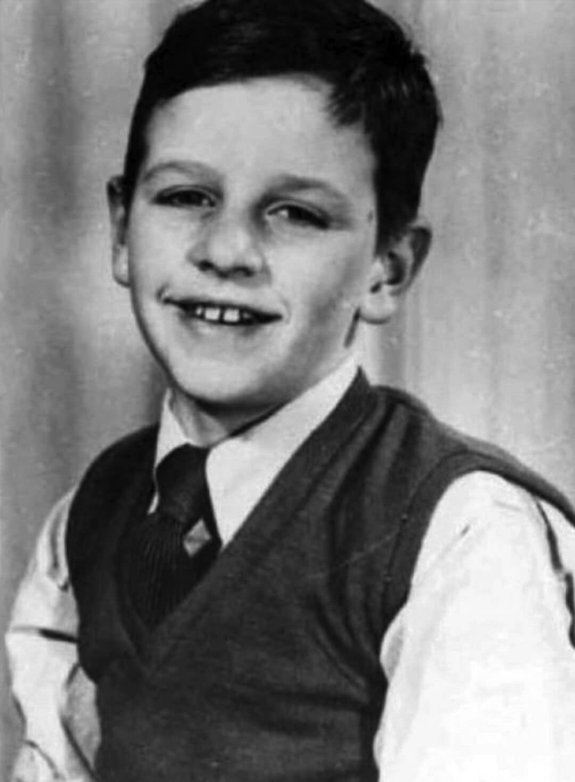
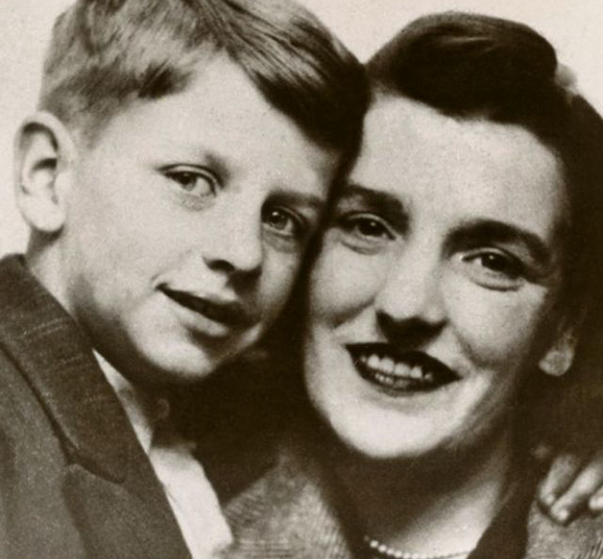
Ringo Starr
Born: July 7, 1940, in Liverpool, England
His actual name is Richard Starkey
His parents worked in a bakery and got divorced when he was a child
Starkey spent a lot of time in the hospital as a child when his appendix burst and then got a lung infection
A healthcare worker introduced him to the drums when he was in the hospital
When he got older, he became the drummer for a couple of different bands

Slide 6
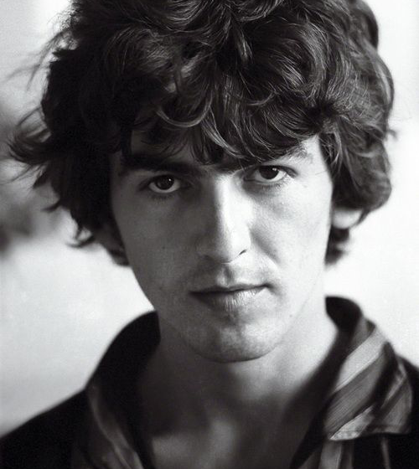
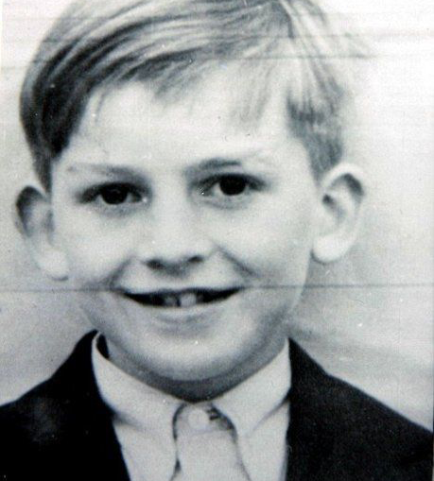
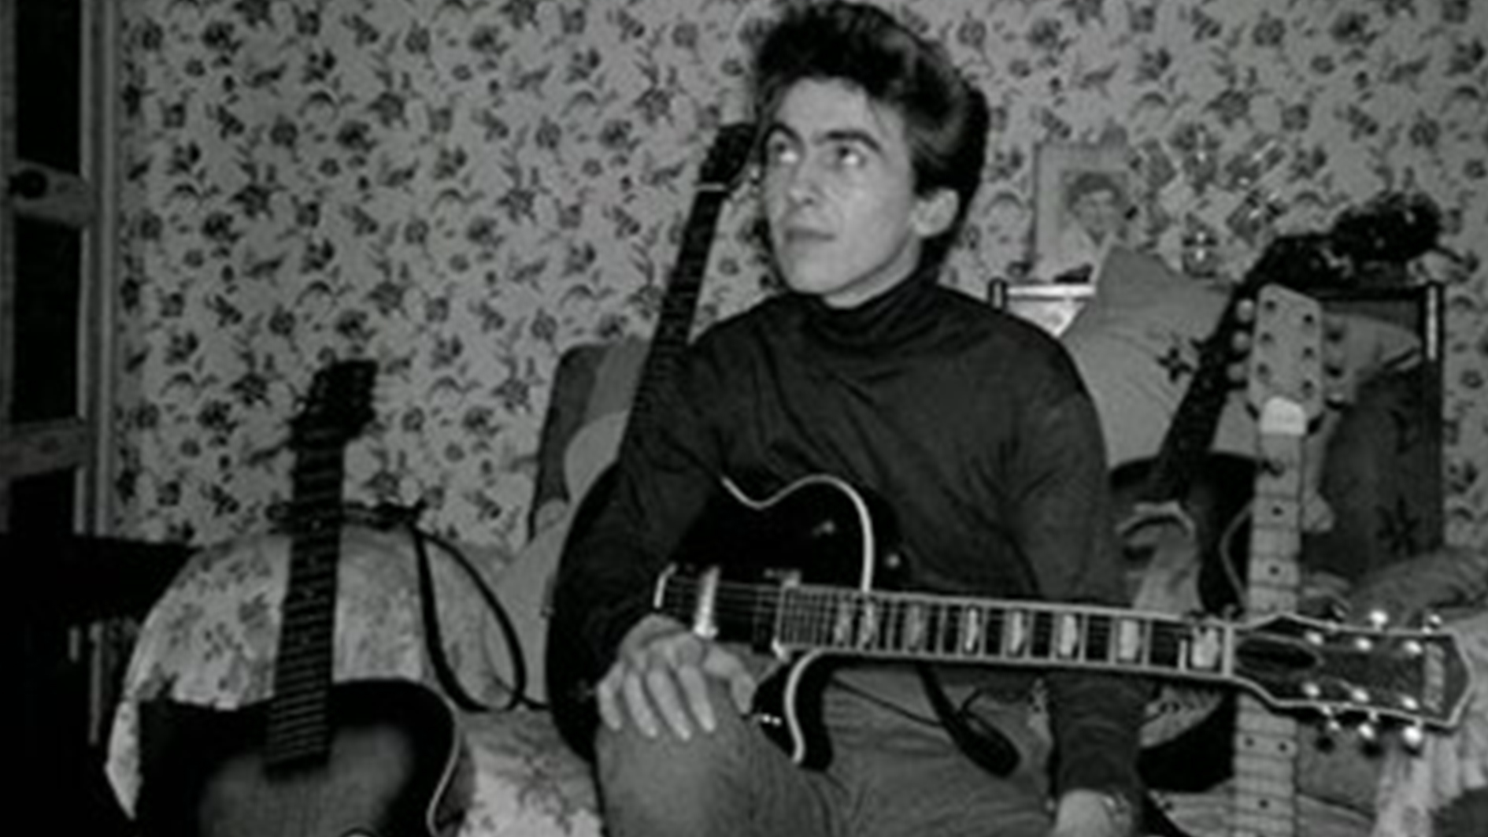
George Harrison
Born: February 25, 1943, Liverpool England
Harrison was the youngest of four children in a working-class family
His father was a steward in the navy while his mother was a grocery store clerk
Harrison began playing guitar in secondary school
He later met Paul McCartney who asked him to join the Quarrymen, a band started by Lennon

Slide 7
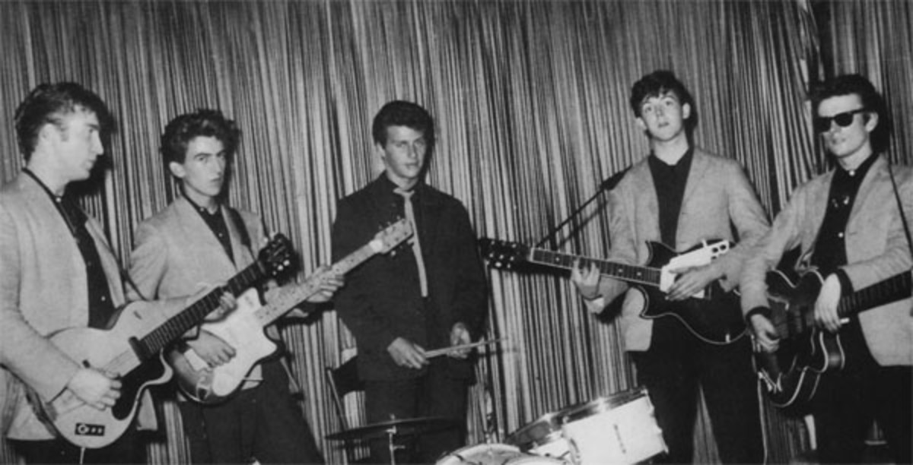
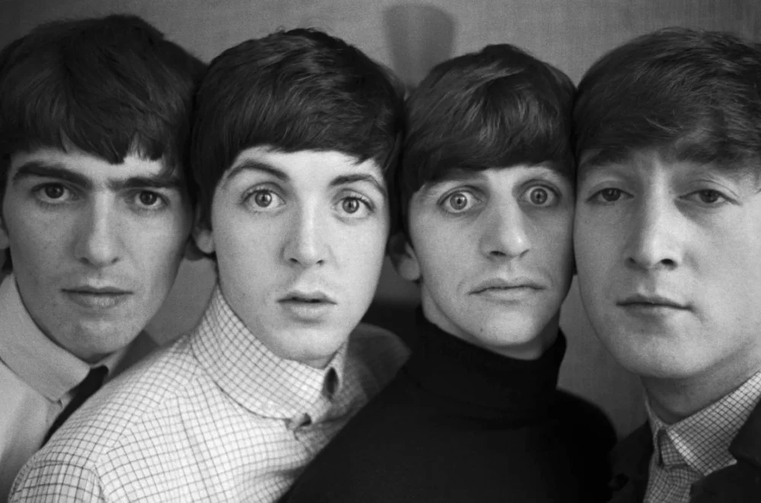
Beginning of The Beatles
THE QUARRYMEN
A band started by Lennon with some his classmates in high school
It was named after their high school, Quarry Bank High School
It was a skiffle band (a type of folk music) that played at parties and school dances
In October of 1957, Paul McCartney joined the band
In search of a lead guitarist, George Harrison, their friend from school joined
Ringo Starr later replaced the first drummer Pete Best
Starr sometimes subbed in for Best when he wouldn’t show up for gigs
Lennon, McCartney and Harrison changed the name from The Quarrymen to The Beatles in 1960
They wanted to have a bug related name; they were inspired by a band called ”The Crickets”

Slide 8
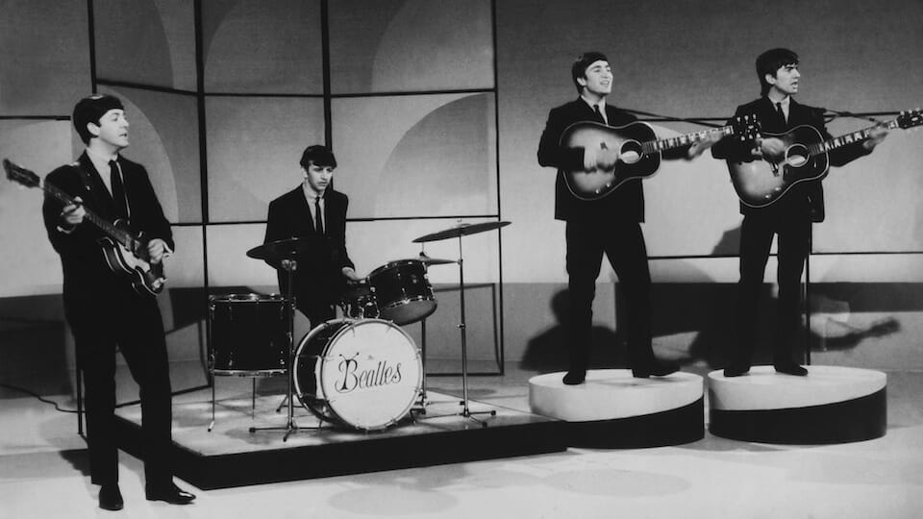
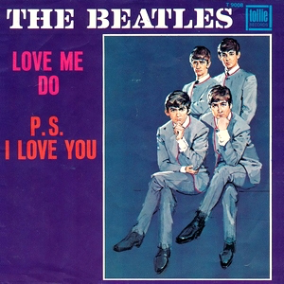
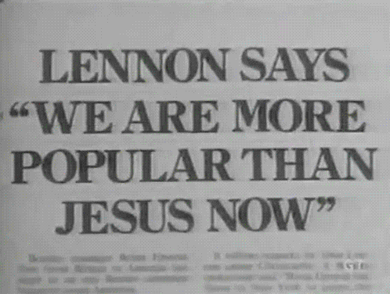
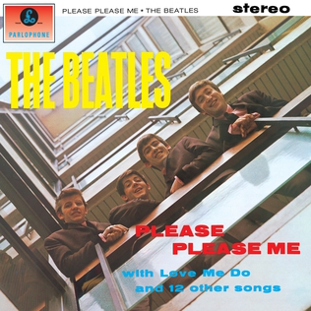
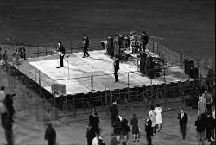
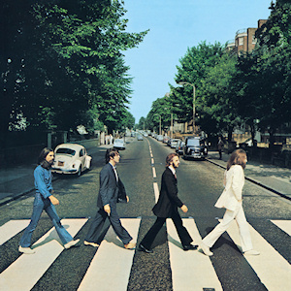
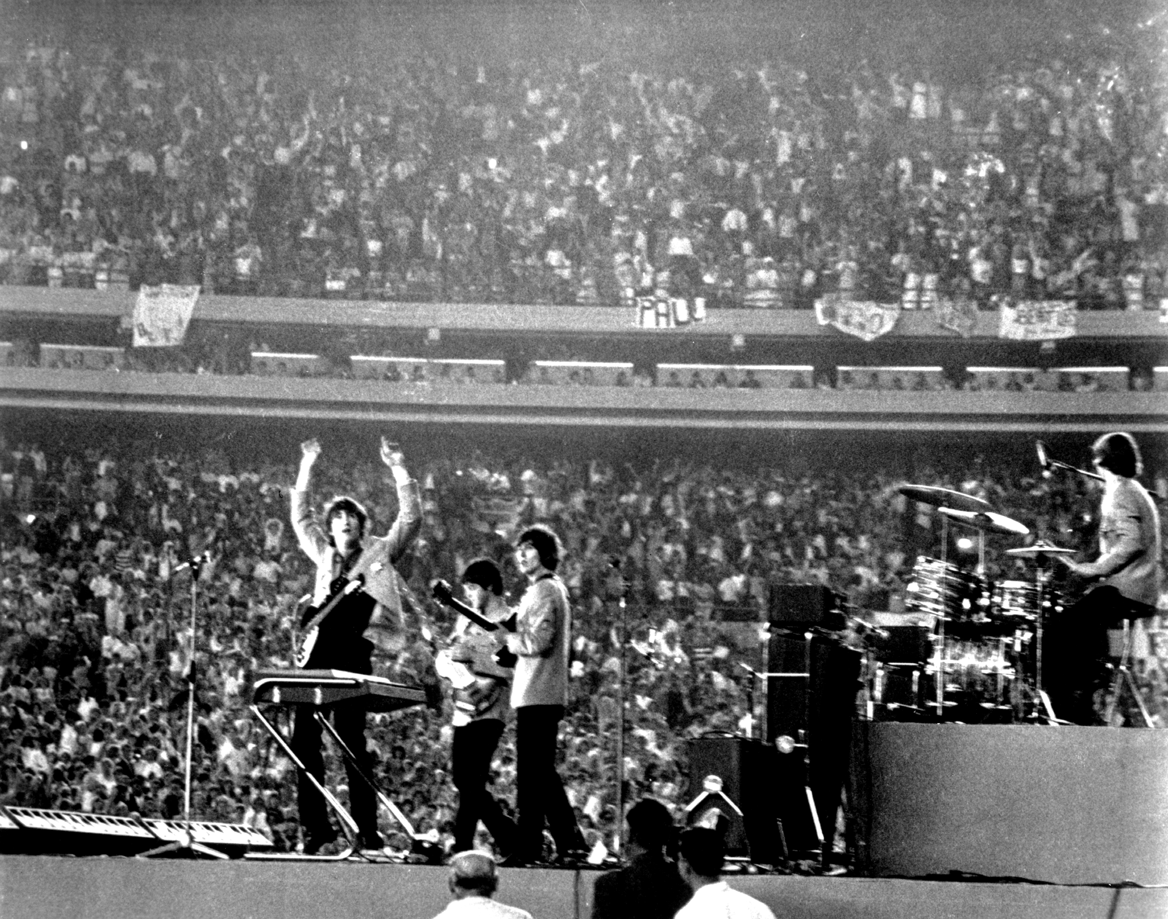
Memorable Moments
5 Oct. 1962
Released the first single “Love Me Do” and made UK charts
22 Mar. 1963
Released their first album “Please Please Me”
9 Feb. 1964
Appeared on “The Sullivan Show” and for three straight episodes and became known as the Fab Four
15 Aug. 1965
The Beatles play for more 55,000 fans at Shea Stadium in Queens, NY
Aug. 1966
A magazine released a quote by Lennon saying he was “more popular than Jesus,” which caused a lot of chaos in the Christian community
29 Aug. 1966
The Beatles play their final concert in San Francisco which had a small showing due to Lennon’s Jesus comment
26 Sep. 1969
The popular album Abbey Road was released, and Lennon was planning on quitting the band

Slide 9
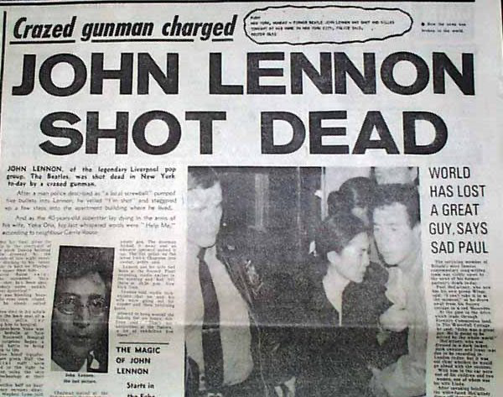
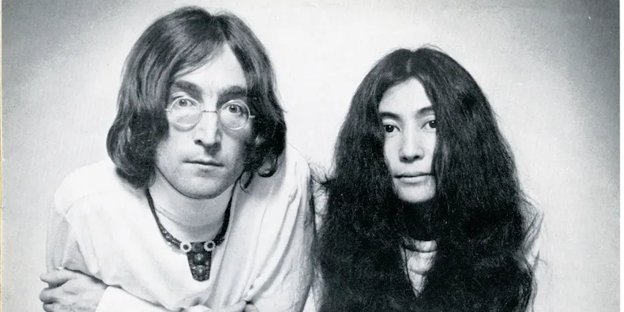
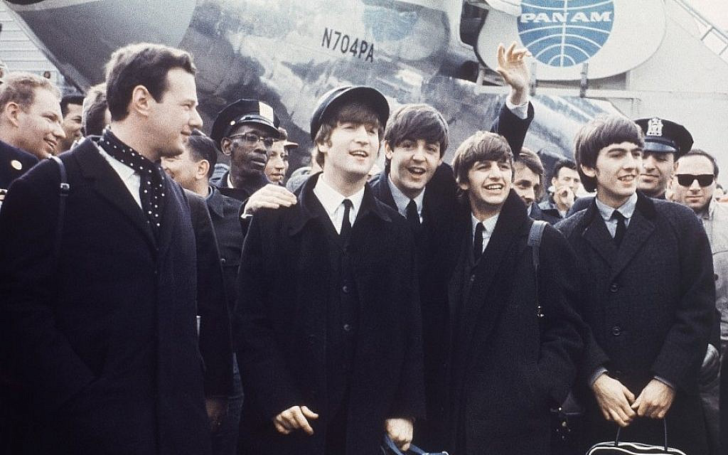
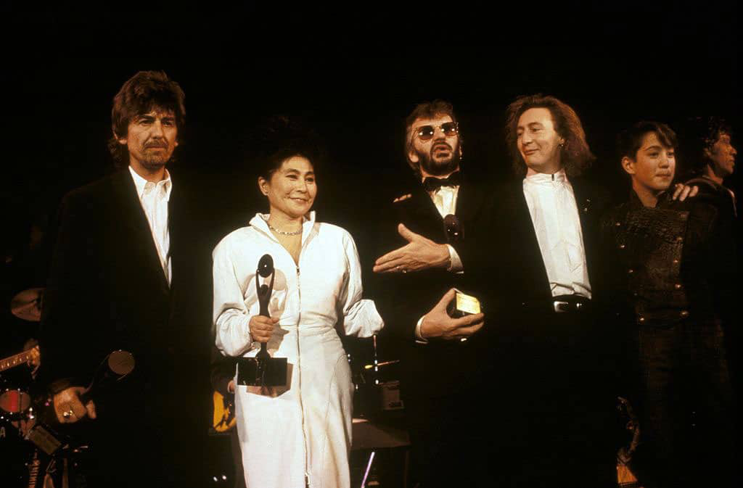
Breakup
August 1967: Their manager, Brian Epstein, died of a drug overdose
Epstein played a crucial role in the band financially and they argued about who should replace him
1968: Yoko Ono, Lennon’s girlfriend, was constantly at his side greatly influencing his music
This caused many issues between the band members, and many believe she was a large reason the band broke up
September 20, 1969: Lennon announced he was leaving the band
This was the same day The Beatles signed a deal with Apple Records which helped them financially
May 8, 1970: The Beatles released their famous single “Let it Be,” which they started recording before Lennon quit
The relationships between the band members were very unstable and the band fell apart
December 8, 1980: John Lennon was shot and killed outside of his apartment in New York City
January 20, 1998: The Beatles got inducted in the Rock and Role Hall of Fame

Slide 10
Works Cited
Encyclopædia Britannica, inc. (n.d.). Paul McCartney. Encyclopædia Britannica. Retrieved May 11, 2022, from https://www.britannica.com/biography/Paul-McCartney
John Lennon: The troubled beatle. Biographics. (2022, January 27). Retrieved May 11, 2022, from https://biographics.org/john-lennon-troubled-beatle/
A&E Networks Television. (2021, May 25). Paul McCartney. Biography.com. Retrieved May 11, 2022, from https://www.biography.com/musician/paul-mccartney
Encyclopædia Britannica, inc. (n.d.). Ringo Starr. Encyclopædia Britannica. Retrieved May 11, 2022, from https://www.britannica.com/biography/Ringo-Starr
Encyclopædia Britannica, inc. (n.d.). George Harrison. Encyclopædia Britannica. Retrieved May 11, 2022, from https://www.britannica.com/biography/George-Harrison-British-musician
Daveliftongmail-Com. (2016, February 6). The day George Harrison joined John Lennon and Paul McCartney. Ultimate Classic Rock. Retrieved May 11, 2022, from https://ultimateclassicrock.com/55-years-ago-harrison-joins-quarry-men/
How did the beatles get their name? McCartney Times. (2019, August 5). Retrieved May 11, 2022, from https://mccartney.com/?p=14322
25 most Memorable moments in beatles history. Yardbarker. (2020, March 31). Retrieved May 11, 2022, from https://www.yardbarker.com/entertainment/articles/25_most_memorable_moments_in_beatles_history/s1__24772124#slide_13
Wood, S. (2021, November 24). Why did the Beatles break up? History.com. Retrieved May 11, 2022, from https://www.history.com/news/why-did-the-beatles-break-up

