Slide 1
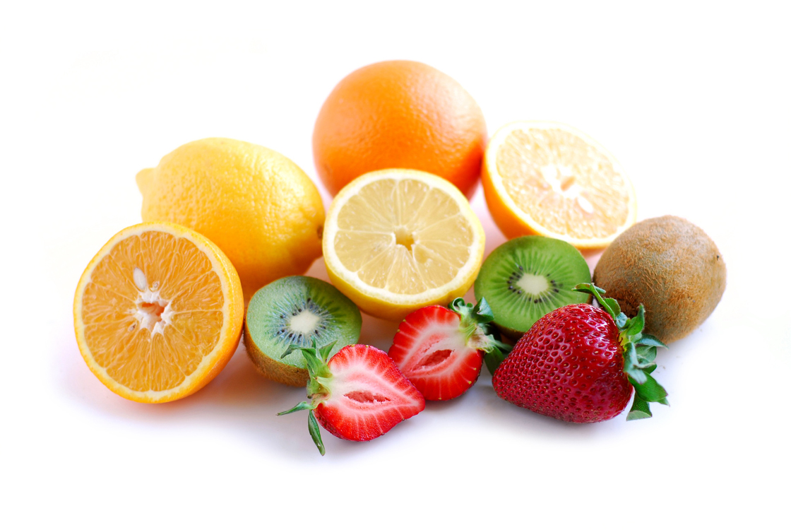
Health Benefits
Of Fruit
By Hannah Anderson
Click here to explore the wonderful world of fruit.

Slide 2
To find out the health benefits of fruit on a certain organ or system, click on a circle below or the words connected to it.
Immune Health
Brain
Health
Cancer prevention
Cardiovascular Health
Weight Control
Digestive Health

Slide 3

Fruit and Brain Health
Studies have shown that consuming blueberries at least three times per week can improve memory.
Potassium is necessary for information transmission in the brain; bananas are a good source of this mineral.
Avocados contain a large amount of unsaturated fat, including omega-3 fatty acids, which have been associated with decreased anxiety and depression.
There are multiple types of fat. Saturated and trans fats are associated with heart disease, but unsaturated fats are a staple of a healthy diet.
Want to know more?

Slide 4

Fruit and Immune Health
Fruits can boost your immune system’s ability to fight infections. For example, cranberries help to prevent urinary tract infections, while vitamin A, found in papaya and grapefruit, is necessary to fight the flu and the common cold.
Excessive free radical production can trigger inflammatory processes in immune cells that contribute to issues like arthritis. Vitamin C, found in citrus fruits, can reverse this process.
Free radicals are molecules that are unintended by-products of cellular respiration. They can cause damage to cells if they are not neutralized by antioxidants.
Want to know more?

Slide 5

Fruit and Cancer Prevention
Berries provide a hefty helping of antioxidants. Eat raspberries, blueberries, or strawberries regularly to reduce your risk of breast and colon cancers.
When DNA becomes mutated by free radicals, cells can start to divide uncontrollably, causing cancer. Consuming vitamin C can prevent this damage from occurring. Excellent sources of this antioxidant include oranges, kiwifruit, and cantaloupe.
Cancer is not a single disease, but a collection of related diseases. Food that helps prevent one type of cancer may have no effect on another type.
Want to know more?

Slide 6

Fruit and Cardiovascular Health
Red wine has been shown to protect against heart disease. Red grapes provide the same benefits, lowering “bad” LDL cholesterol and reducing blood pressure.
Oxidative stress in the blood vessels leads to plaque formation, which can eventually cause heart attacks and strokes. Fruits like cranberries provide antioxidants that specifically block oxidative stress in the arteries.
LDL cholesterol is considered “bad” cholesterol because it deposits cholesterol on the walls of arteries, causing these blood vessels to harden and making it harder for blood to travel there.
Want to know more?

Slide 7

Fruit and Weight Control
Most fruits are a good source of fiber, which helps you feel full, but are low in calories. Some of nature’s 100-calorie snacks include an orange, a cup of blueberries, or an apple.
Raspberries contain a phytonutrient called rheosmin that increases cellular metabolism rates. Consuming raspberries helps you burn fat at a greater rate, contributing to weight control.
Phytonutrients are chemicals found in plant products. They differ from essential nutrients in that they are not required for life, but phytonutrients are believed to provide many health benefits.
Want to know more?

Slide 8
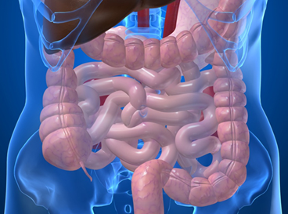
Fruit and Digestive Health
Many fruits contain insoluble fiber, which promotes regularity and prevents constipation. Examples include pineapple, prunes (dried plums), and strawberries.
Your colon contains billions of bacteria that help to digest food and synthesize vitamins. Apples and bananas have been shown to increase the growth of these good bacteria, preventing the growth of bad bacteria that can cause digestive distress.
Humans do not have the enzymes necessary to digest fiber. Many other organisms, including some of the bacteria in the human colon, do have these enzymes.
Want to know more?

Slide 9

Click on the bolded terms in each slide to learn more about the topic!

