Slide 1
WELCOME!
Start designing your own pasta dish here
Start Designing

Slide 2
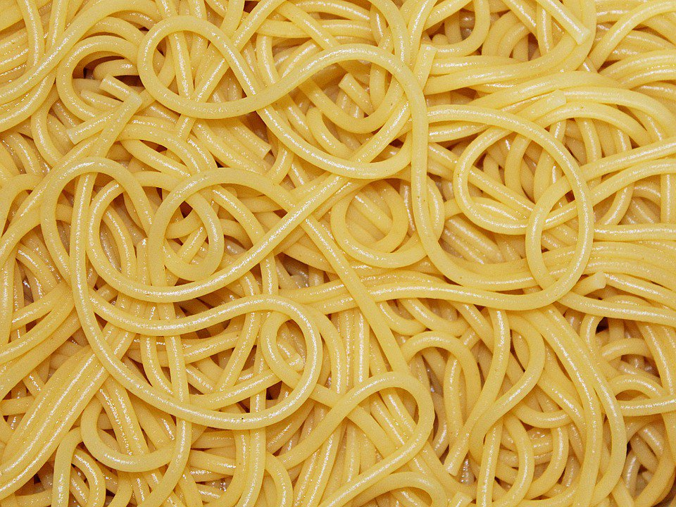
Pick a Pasta for your dish
Rigatoni
Spaghetti

Slide 3
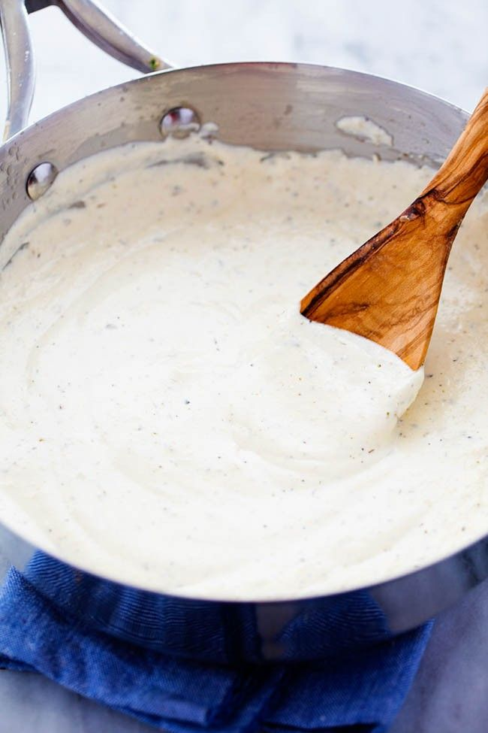
Pick a Sauce for your Rigatoni dish
Alfredo Sauce
Tomato Sauce

Slide 4
Pick a Sauce for your Spaghetti dish
Alfredo Sauce
Tomato Sauce

Slide 5
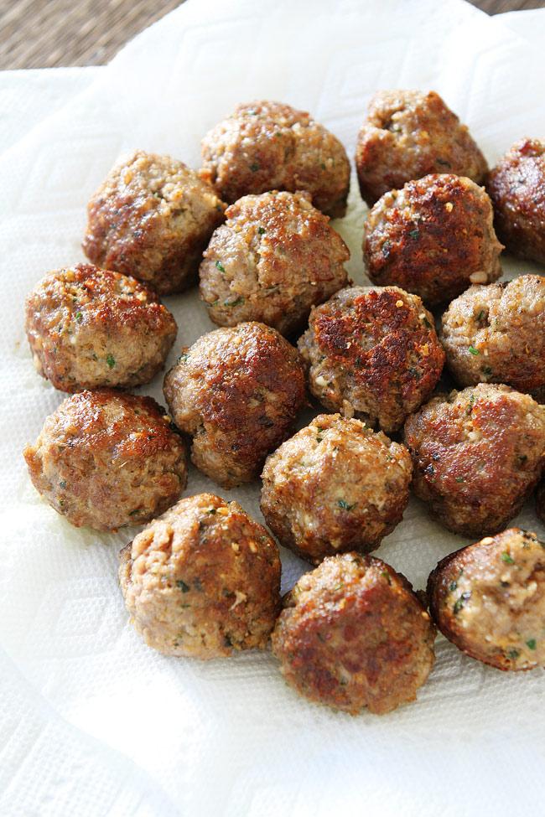
Pick a topping for your Rigatoni dish
Meatballs
Sausage

Slide 6
Pick a topping for your Spaghetti dish
Meatballs
Sausage

Slide 7
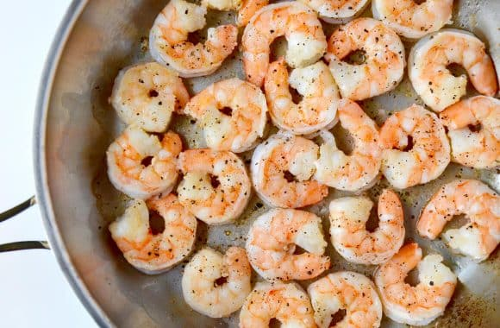
Pick a topping for your Rigatoni dish
Chicken
Shrimp

Slide 8
Pick a topping for your Spaghetti dish
Chicken
Shrimp

Slide 9
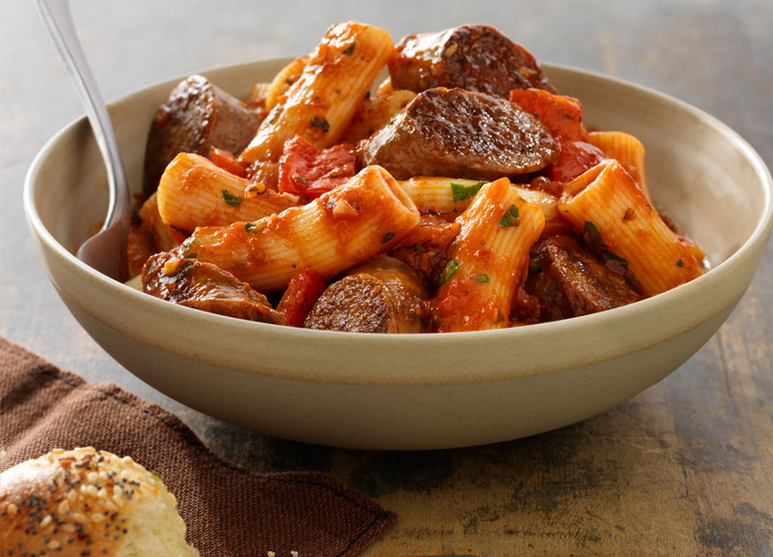
CONGRATULATIONS!!
Enjoy your Rigatoni and Sausage in Tomato Sauce!
Restart

Slide 10
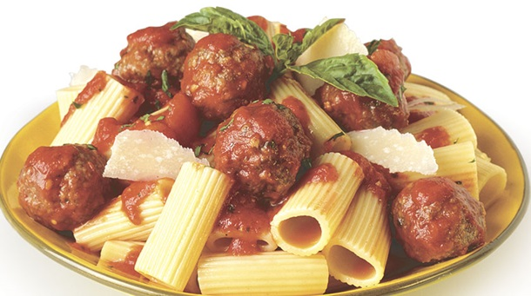
CONGRATULATIONS!!
Enjoy your Rigatoni and Meatballs in Tomato Sauce!
Restart

Slide 11
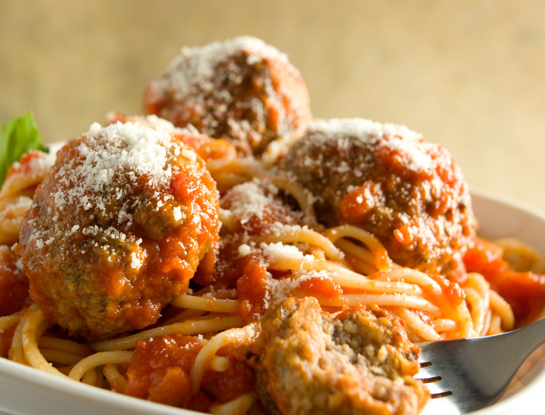
CONGRATULATIONS!!
Enjoy your Spaghetti and Meatballs in Tomato Sauce!
Restart

Slide 12
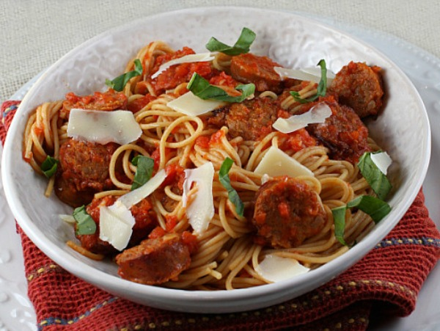
CONGRATULATIONS!!
Enjoy your Spaghetti and Sausage in Tomato Sauce!
Restart

Slide 13
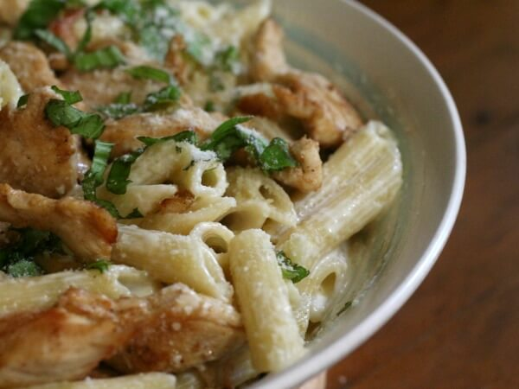
CONGRATULATIONS!!
Enjoy your Rigatoni and Chicken in Alfredo Sauce!
Restart

Slide 14
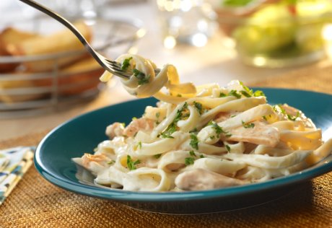
CONGRATULATIONS!!
Enjoy your Spaghetti and Chicken in Alfredo Sauce!
Restart

Slide 15
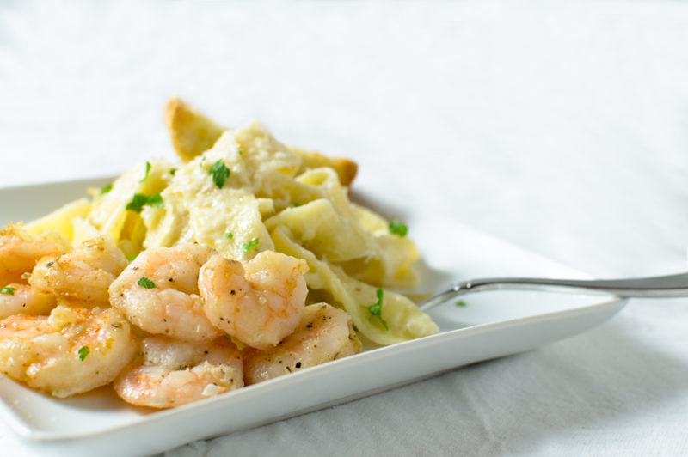
CONGRATULATIONS!!
Enjoy your Rigatoni and Shrimp in Alfredo Sauce!
Restart

Slide 16
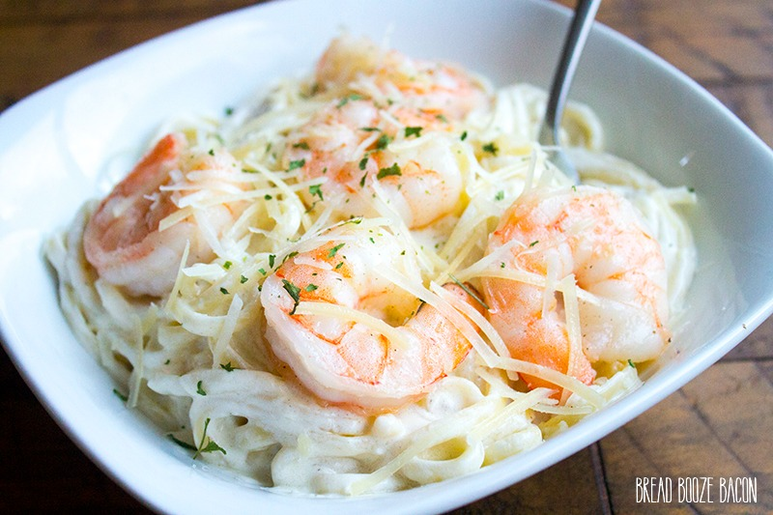
CONGRATULATIONS!!
Enjoy your Spaghetti and Shrimp in Alfredo Sauce!
Restart

