Slide 1
How Blood Flows
Through the Heart
By: Alyson Keane

Slide 2
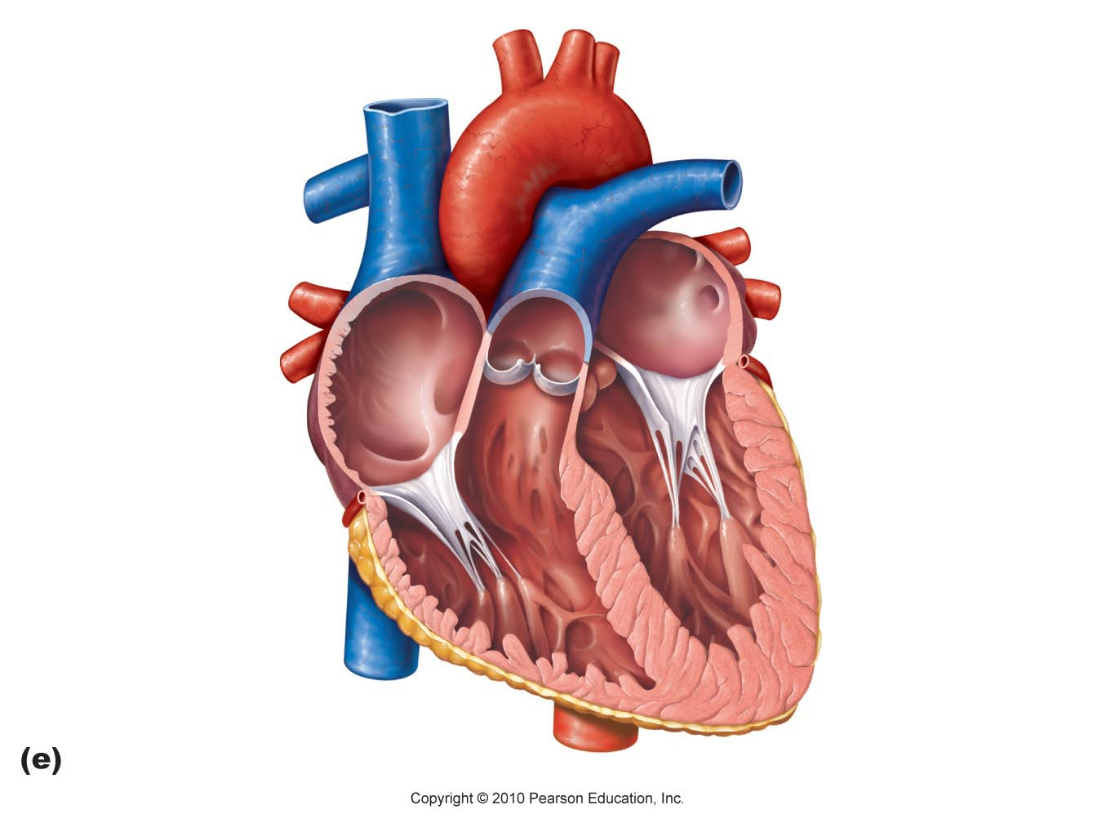
Blood flow starts through the pulmonary vein from the lungs and flows into where? Select the correct term.
Left Atrium
Left Ventricle

Slide 3
That is not correct! Try Again!
Go Back

Slide 4
Great! Once its in the left atrium, it goes where next?
Left Ventricle
Right Ventricle

Slide 5
That is not correct! Try Again!
Go Back

Slide 6
Aorta
Super! Once the blood is in the left ventricle, where does it go?
Right Ventricle

Slide 7
That is not correct! Try Again!
Go Back

Slide 8
Vena Cava
Right! It leaves the heart through the Aorta. But how does it come back?
Pulmonary Artery

Slide 9
That is not correct! Try Again!
Go Back

Slide 10
Great job! Once it leaves the aorta, it travels out to the body and comes back in via the Vena Cava. So, where does it go after that?
Right Atrium
Right Ventricle

Slide 11
That is not correct! Try Again!
Go Back

Slide 12
Superb!. Once it comes through the vena cava, it enters the right atrium! We’re almost done! But where does it go next?
Left Ventricle
Right Ventricle

Slide 13
That is not correct! Try Again!
Go Back

Slide 14
Vena Cava
Fantastic! Once it leaves the right atrium, it goes to the right ventricle. Now, where is the last step that blood goes through?
Pulmonary Artery

Slide 15
That is not correct! Try Again!
Go Back

Slide 16
You are correct! Once it leaves the right ventricle, it’s pumped through the pulmonary artery out to the lungs!

Slide 17
AWESOME JOB!

