Slide 1


FINANCING
YOUR UD
EDUCATION

Slide 2


Timeline for Admitted Students
March 9
Mid-March
Mid-April
May 1
Decision Day, admitted student open house
Merit currently
being released
Full aid released
Deposit Deadline for UD
*You are here

Slide 3
 | Delaware Resident | Out-of-State Student
Tuition | $14,040 | $37,680
Fees | $2,040 | $2,040
Housing | $8,568 | $8,568
Food | $6,270 | $6,270
TOTAL BILLABLE COSTS* | $30,918 | $54,558
Books, Supplies, Course Materials, & Equipment | $1,000 | $1,000
Transportation | $800 | $800
Misc./Personal | $860 | $860
Federal Loan Fees *may vary | $140 | $140
TOTAL NON-BILLABLE COSTS | $2,800 | $2,800
TOTAL BUDGET* | $33,718 | $57,358
UD’s Current Cost of Attendance
Published costs – generally does not represent what is actually paid out of pocket
Billable Costs (direct) – billed by the school
Non-Billable Costs (indirect) – not billed by the school
Not included is UD’s health insurance cost. Students must provide proof of alternate insurance to have health insurance charge waived.
*Differential fee charged for students in Lerner College of Business & Economics, College of Engineering, and School of Nursing. Actual rates announced in early July.

Slide 4

UD Merit Scholarships
Notifications of merit aid are currently being released
Automatically evaluated upon submitting admission application
Does not require repayment
Selection based on high school academic performance and residency
Competitive scholarships – names and amounts vary
Amounts based on UD’s scholarship budget and strength of applicant pool
Renewability (up to 8 semesters total)
                Minimum 3.0 GPA
                Earn at least 12 earned credit hours each consecutive fall/spring semester
          Visit udel.edu/finance to learn more about merit aid

Slide 5
Need-Based Aid
FAFSA is the only form required
  Families must have financial need remaining (after merit aid is applied)
  Pell Grant funding not affected by merit aid
  Cost of Attendance – SAI = Financial Need
Does not require repayment
May come from the University, federal, or state sources
UD grants vary based on residency and program
Selection based on combination of financial need (as determined by FAFSA) and strength of application
Renewability (up to 8 semesters total)
Minimum 2.0 GPA
Full-time enrollment (12 earned credit hours each consecutive fall/spring semester)
FAFSA with equivalent need each year

Slide 6
Work-Study
Earned funds through employment
Federal work-study is based on need and eligibility determined via FAFSA
Maximum award is $2,000
Other employment opportunities available on and around campus (application through UD’s Student Job Page)

Slide 7
Federal Loans
Requires repayment
Eligibility determined via FAFSA
$5,500 max for first-year students
Subsidized portion is need-based and interest is paid by government while student is in school.
Unsubsidized portion is not need-based and interest is paid or added to balance at repayment.
Renewability
Minimum 2.0 GPA
Successful completion of 67% of all courses attempted
Annual FAFSA with equivalent amount of need
(subsidized portion)
Student must complete Entrance Counseling and Master Promissory Note

Slide 8
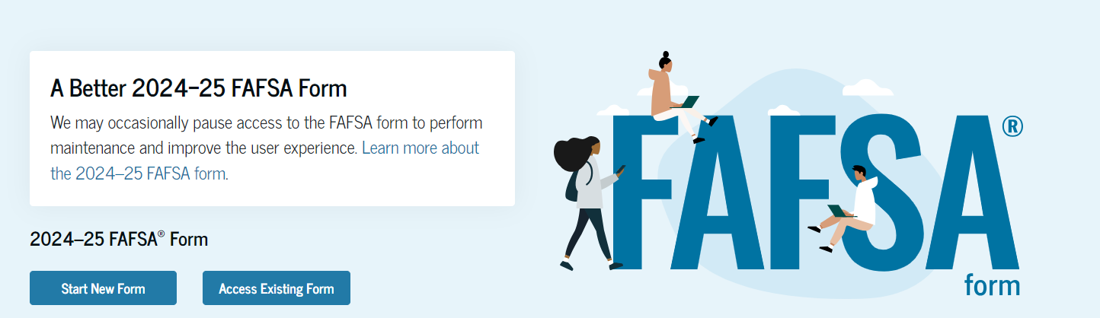
2024-2025 FAFSA
Applications are open as of 12/31/23
FAFSA Simplification has delayed eligibility information to schools
  Full aid eligibility notification mid to late April
Based on 2022 taxes– may appeal if changes for 2023 are significantly different
Additional aid not guaranteed but can review federal aid eligibility

Slide 9

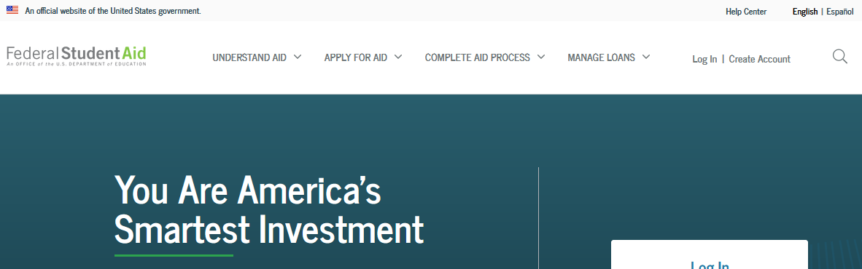
  Online at studentaid.gov (requires creating FSA ID)
Select University of Delaware (code: 001431) on school list
FAFSA under
“Apply for Aid”

Slide 10
Other Financing Options:
Additional loan borrowing (requires repayment)
Federal PLUS Loan is borrowed in parent’s name.
Private education loans are borrowed in student’s name with creditworthy cosigner.
Other outside support
Veterans benefits
Tuition remission
Employer benefits
529 college savings plans

Slide 11
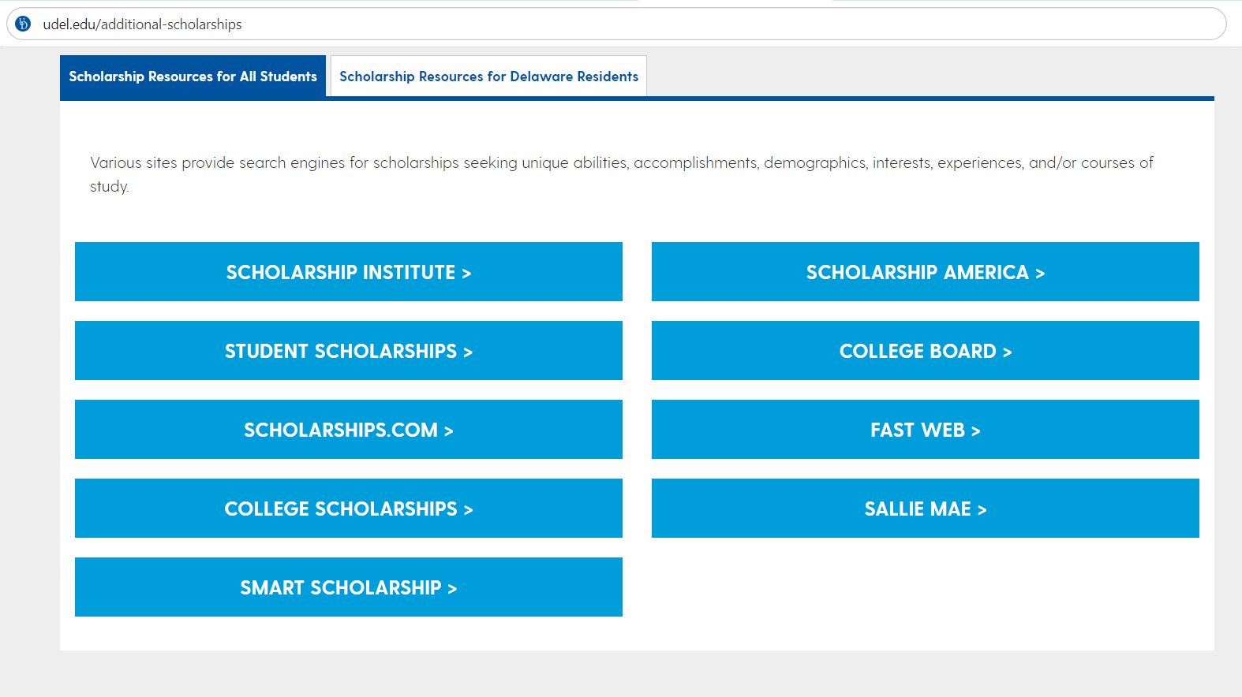
Other Financing Options:
Outside scholarships
Students must find and apply for opportunities.
Check various clubs, organizations, free search engines, state higher education agencies.
  Find additional online databases and state agencies offering outside funding
  Visit udel.edu/additional-scholarships

Slide 12
Looking Forward: Billing and Payments
Costs split between fall and spring semesters.
Fall billing notifications emailed in July and payment due August 1
Spring billing occurs in December and payment due early January
Installment payment plan divides payments over 8 months
$50 fee per semester.
Fall payments due August-November
Spring payments due January- April
Winter and Summer Sessions are optional and billed separately

Slide 13
A Note on Appeals
Merit Scholarships
UD attempts to lead with best offer
Amounts offered are not appealable
Only review is for incorrect information on SRAR
Need-Based Appeals
Requires FAFSA submission
Must have qualifying event for review
                - Loss of wage earner
                - Unemployment or underemployment
        Review to determine if SAI can be reduced
        - May lead to additional grant

Slide 14
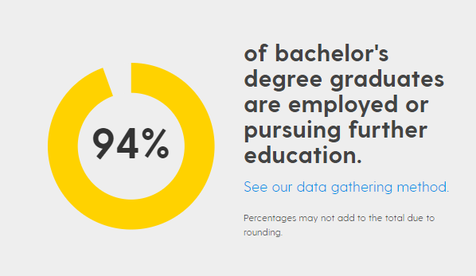
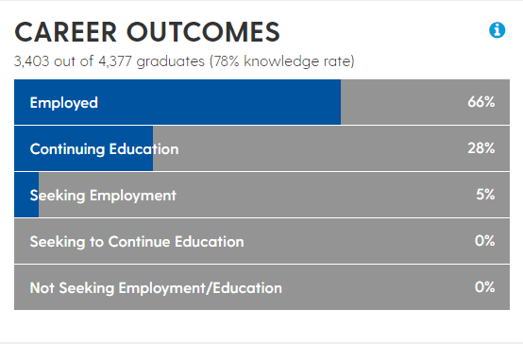
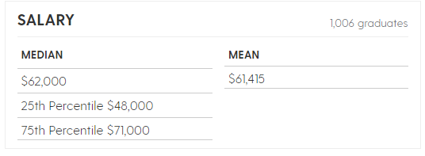

Our Graduates
www.udel.edu/outcomes

Slide 15
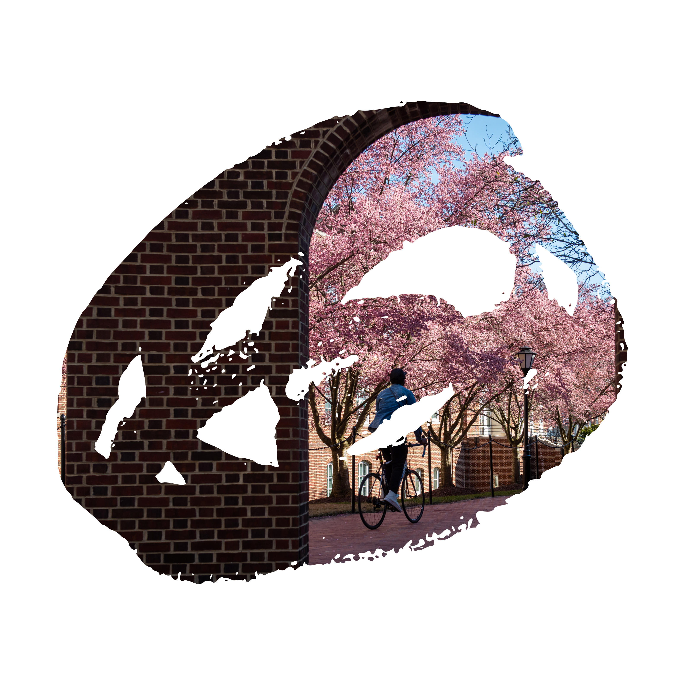
FOR
ADDITIONAL
INFORMATION
My Blue Hen Home
udel.edu/mybluehenhome
Financing Your Degree
udel.edu/finance
Student Financial Services
udel.edu/sfs
Contact Us
udel.edu/4you
(302) 831-2126

