Slide 1
Completing the Consultant Form
Updated 5/30/25

Slide 2
Table of Contents
Section | Slide #
Definitions | 2
Overview | 3
New Consultant Form | 4
Cart & Checkout | 23
Workflow | 32

Slide 3
Definitions
Consultant – any non-University personnel who is engaged by the University for expertise required to fulfill University commitments and objectives for Research, Public Service or Instructional Activities.
Questionnaire – throughout this document and the Consultant Form you will see a questionnaire referenced. This is the Independent Contractor vs Employee Disclosure (ICED) questionnaire which is an HR document used to determine if a consultant should be onboarded as a supplier or employee.

Slide 4
Overview
Previously, two processes were required: first the Consultant Disclosure webform for authorize the engagement, then a requisition workflow to engage and pay the consultant.
With the new Consultant Form, the entire process has been combined into one approval workflow in UDX.
Departmental approvals will be required based on responses in the form
Note: Supplier must be active and fully approved in UD Exchange before the form can be completed.

Slide 5
New Consultant Form

Slide 6
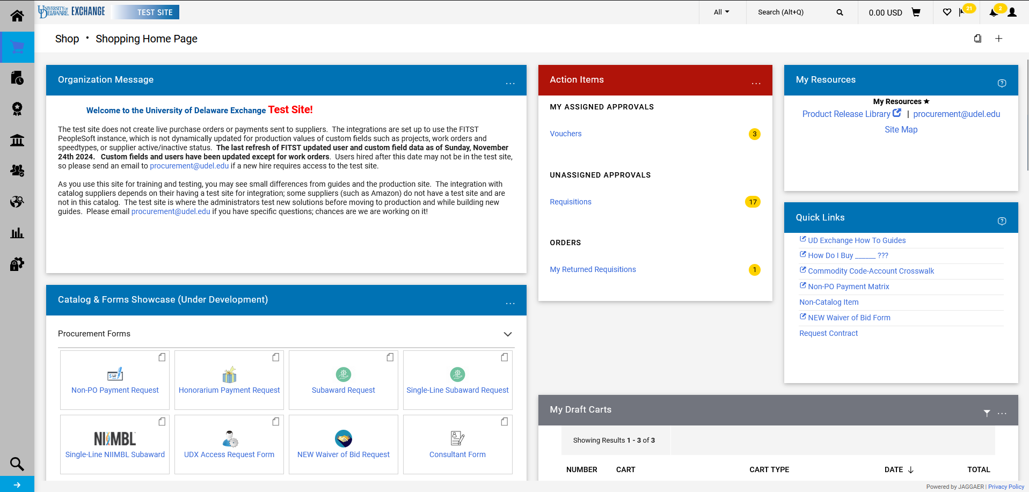
The Consultant Form can be found under the Procurement Forms section of the Catalog & Forms Showcase on the Shopping Home Page. Click on the form to open.

Slide 7
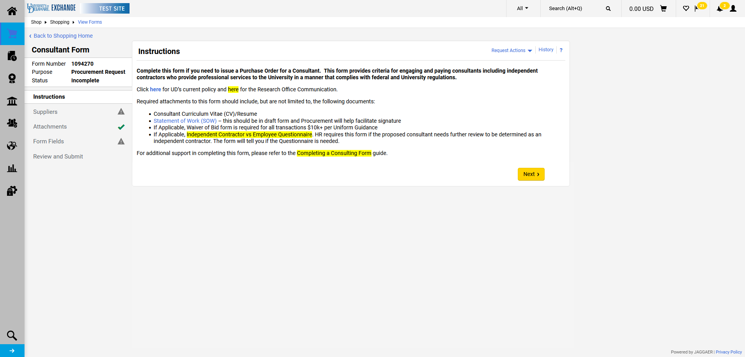
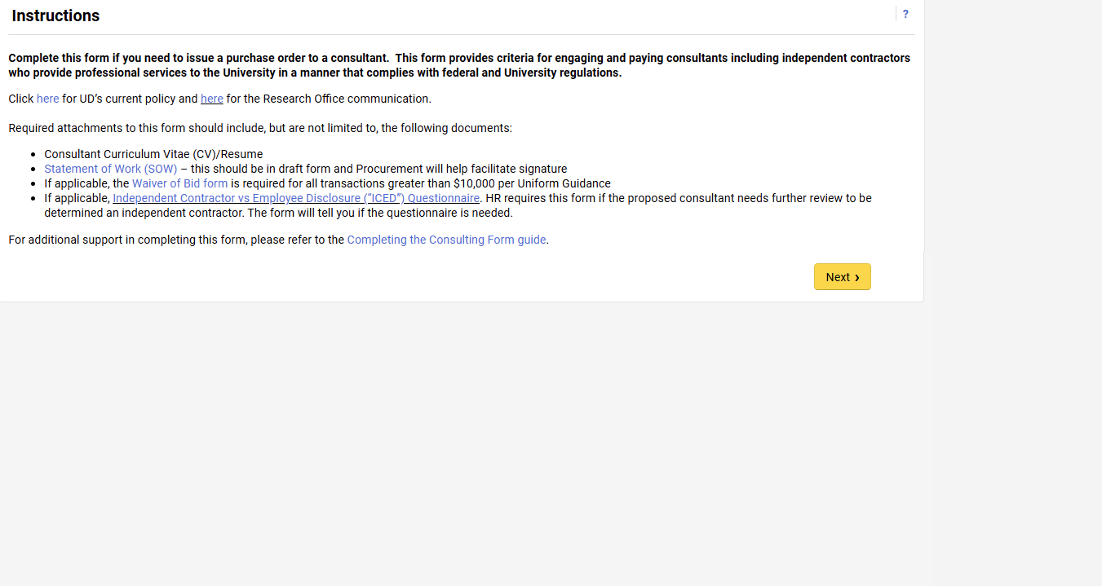
The first page is the Instructions page. Please read and click Next when ready to move forward.

Slide 8
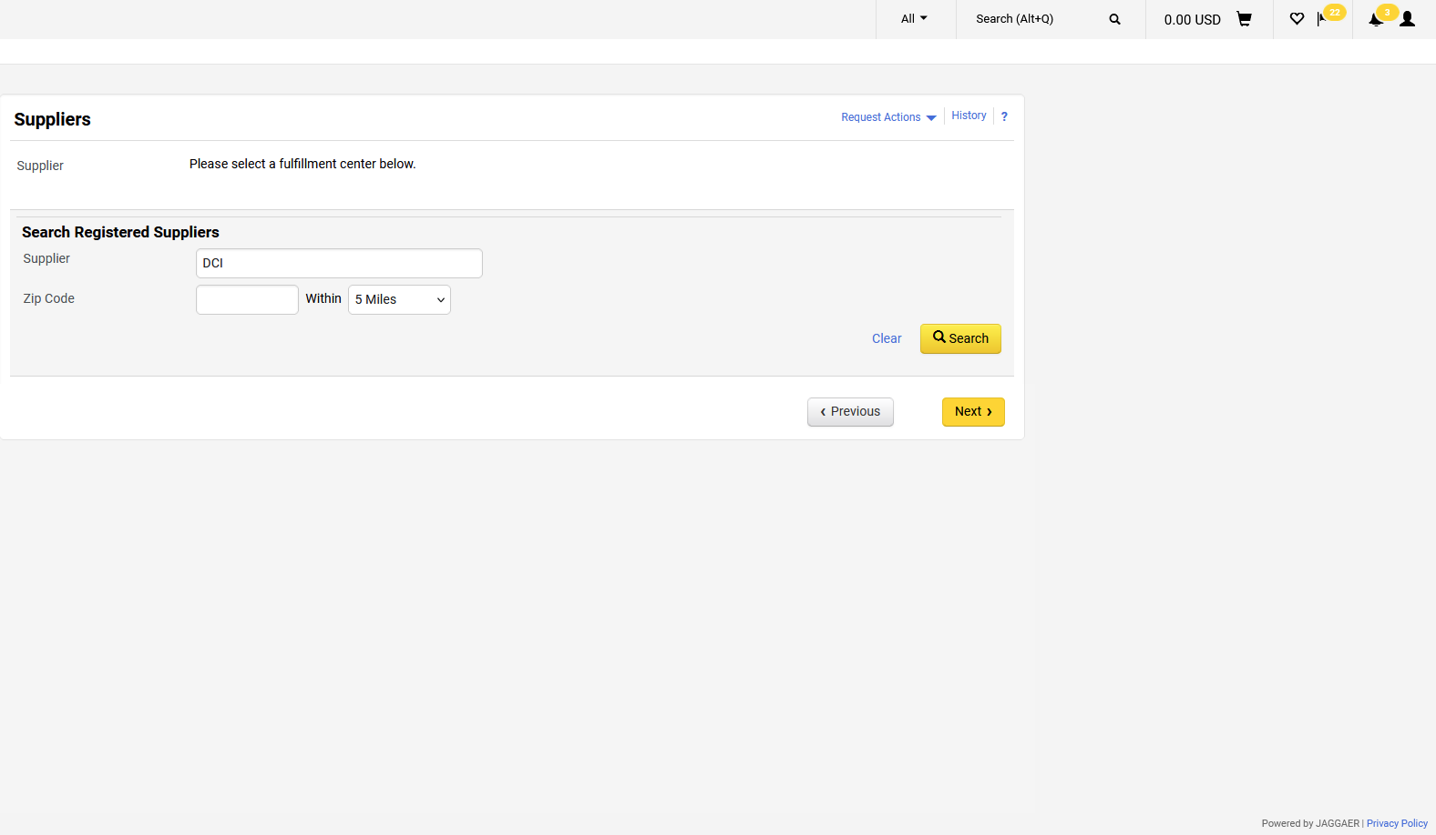
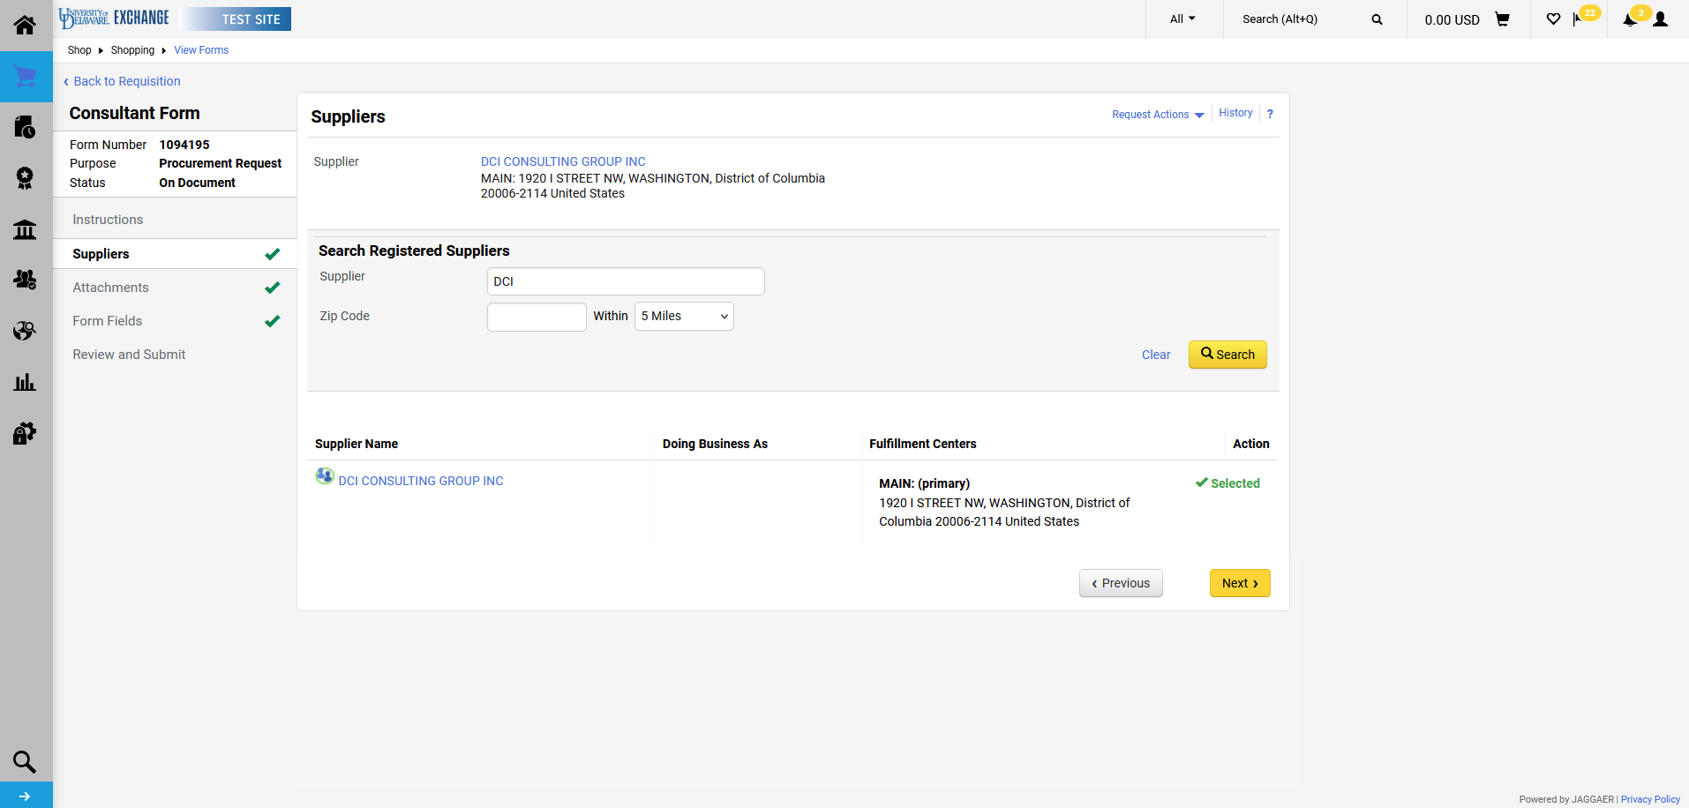
Enter Supplier information.
Click Search.

Slide 9
Select the correct fulfillment center for the supplier.
Click Next.

Slide 10
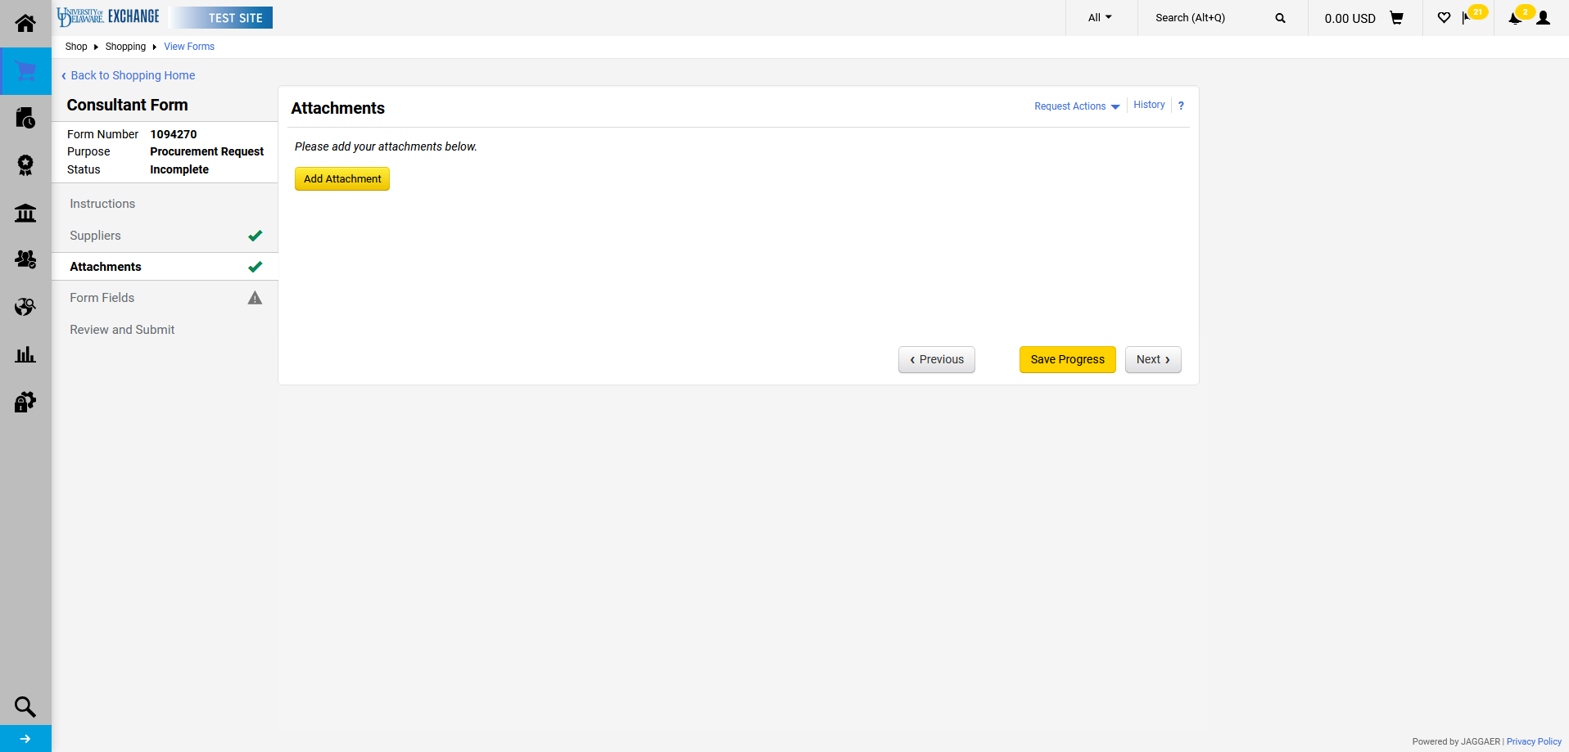
Click Add Attachment to attach pertinent documents.

Slide 11
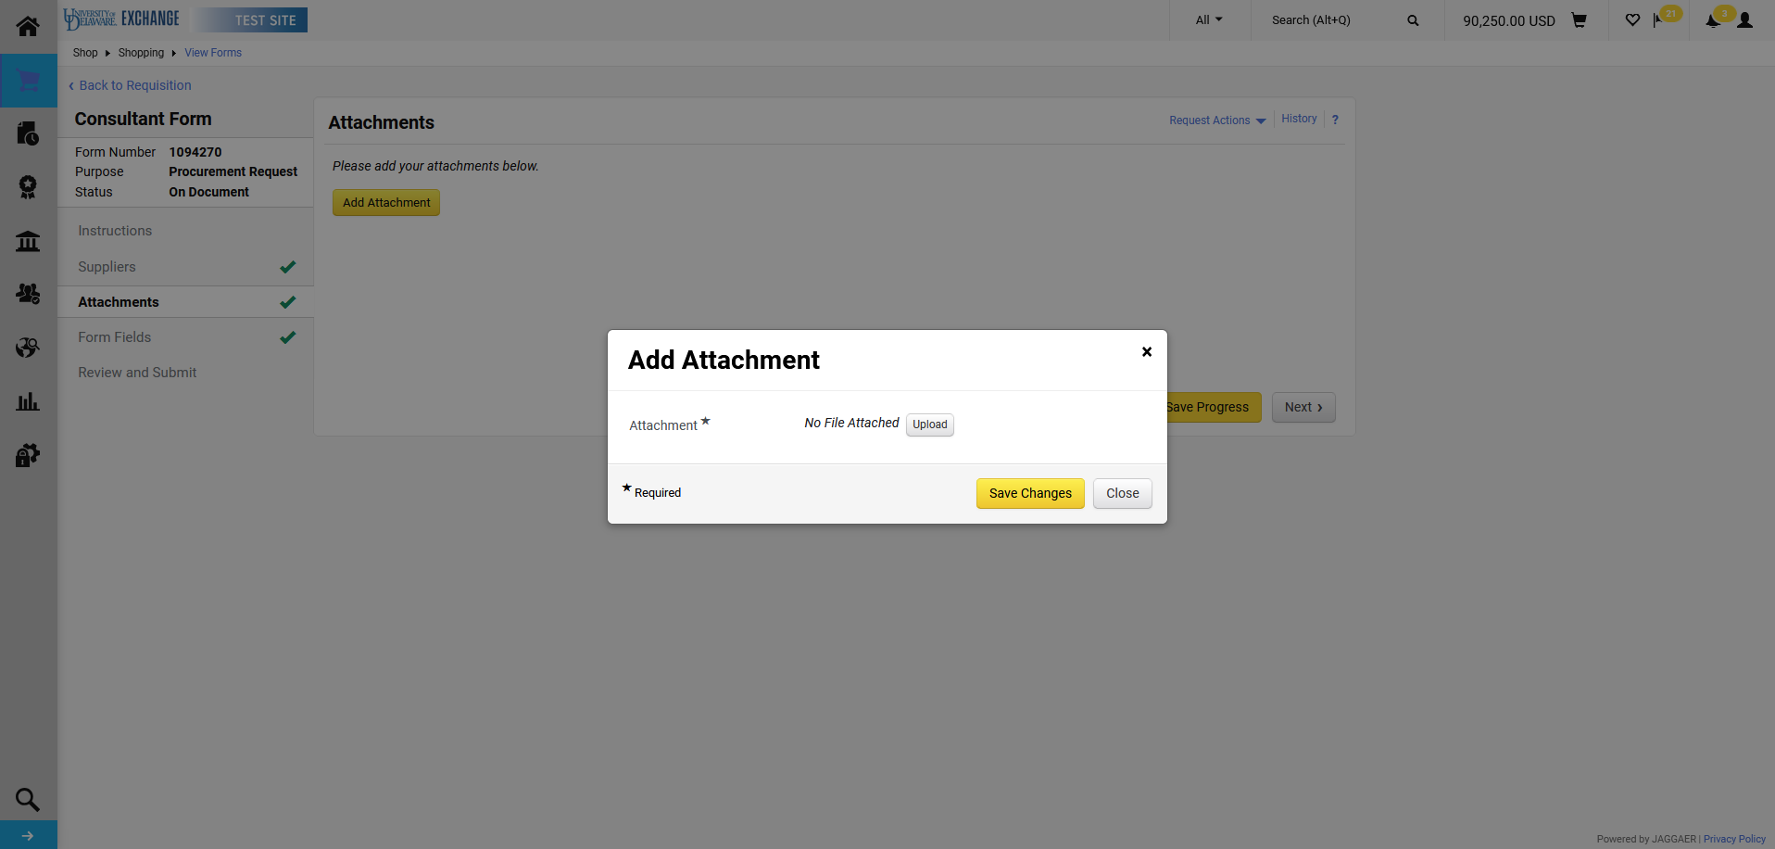
Click Upload to attach each item.

Slide 12
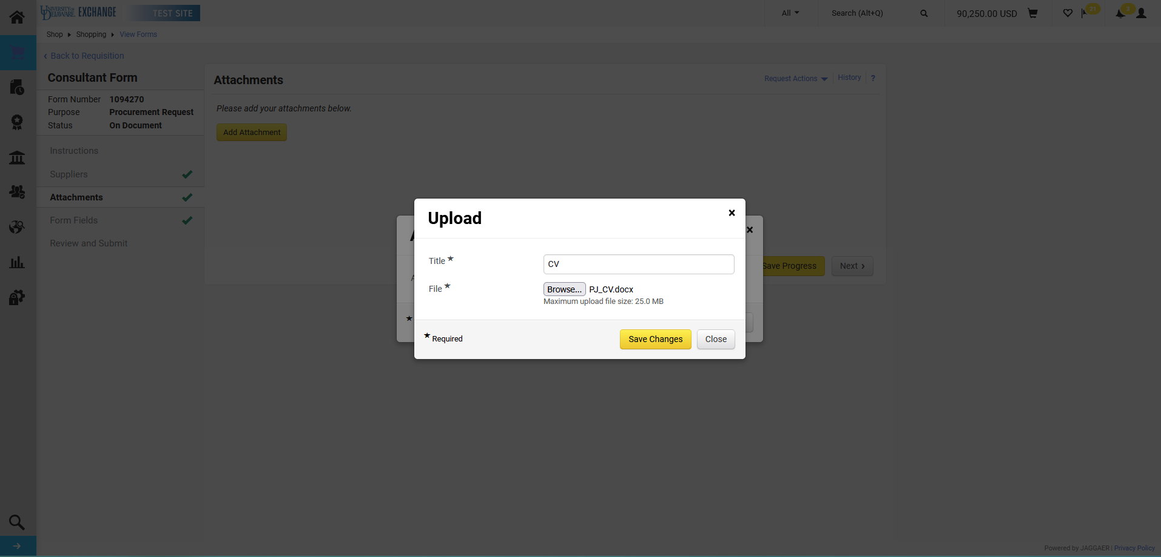
Attach the file and provide a Title. Click Save Changes.

Slide 13
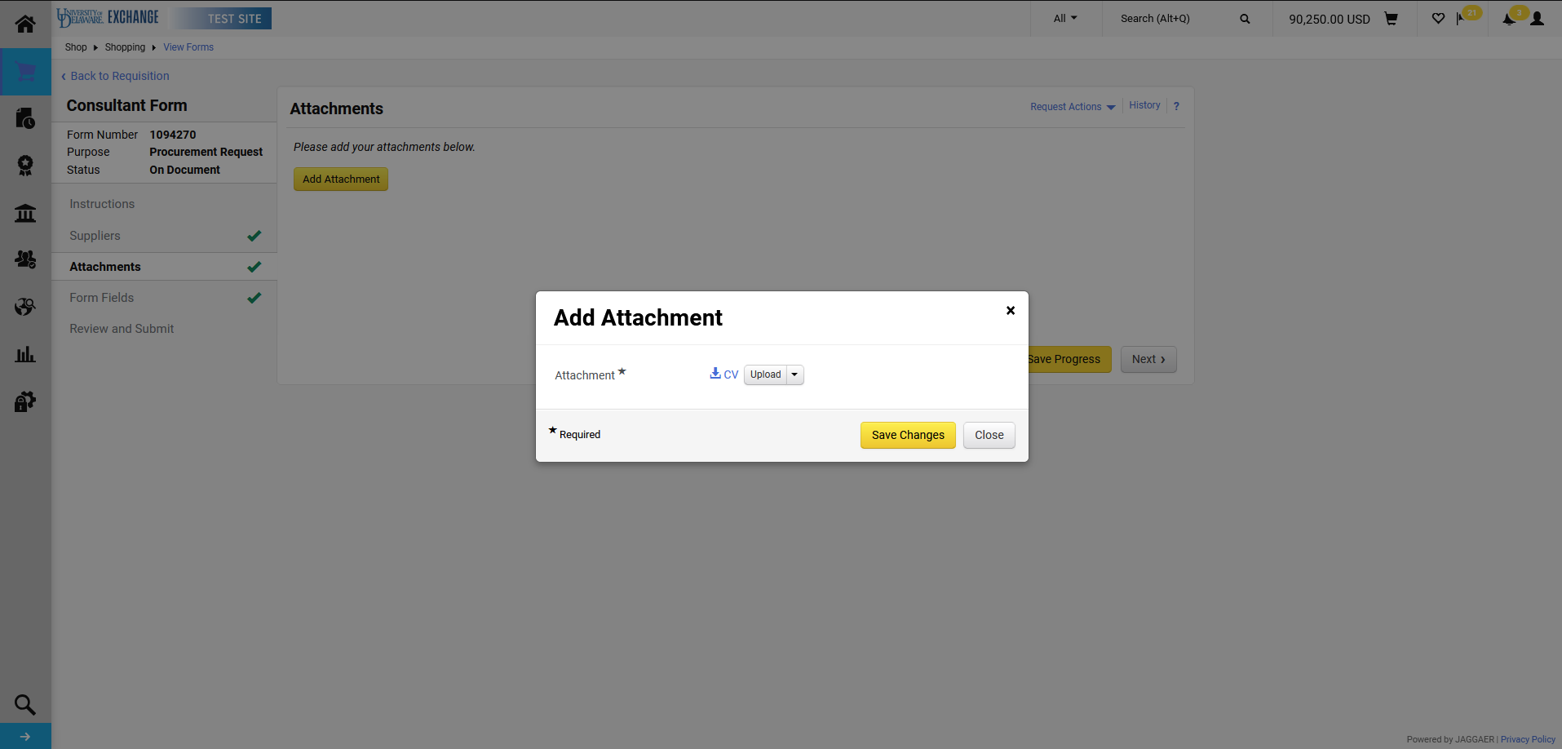
Click Save Changes again.

Slide 14
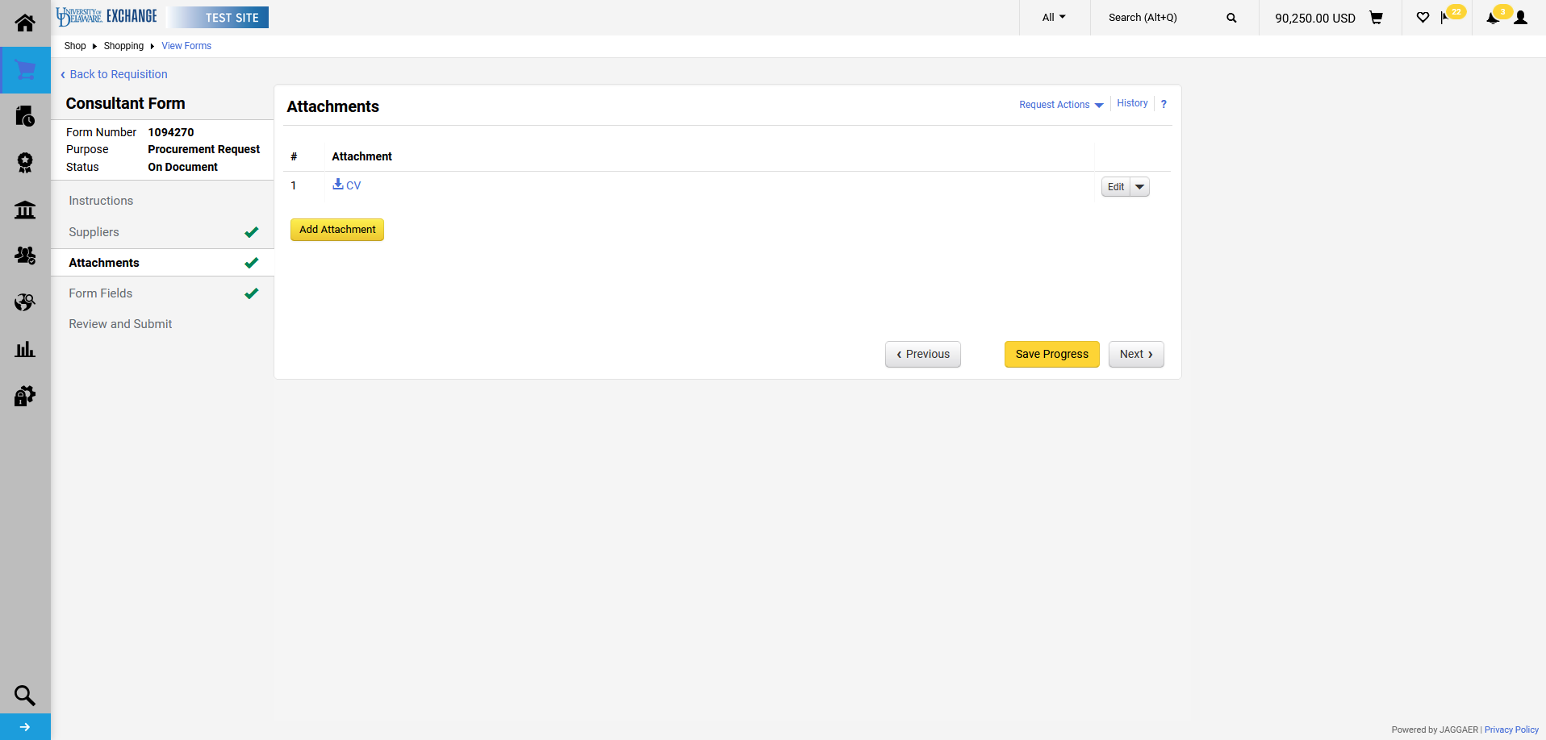
Repeat as needed for all documents.
Click Next when finished.

Slide 15
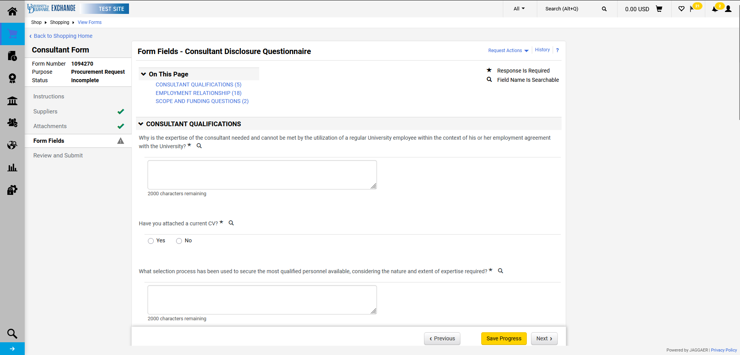
Questions on the Form Fields tab are organized by content. Additional requirements or questions may appear based on responses provided to each question.

Slide 16
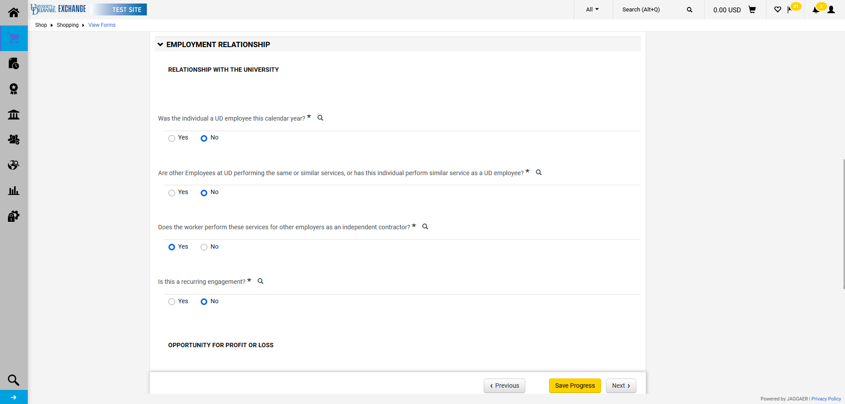
Responses to questions in the Employment Relationship section may trigger Human Resources (HR) review.

Slide 17
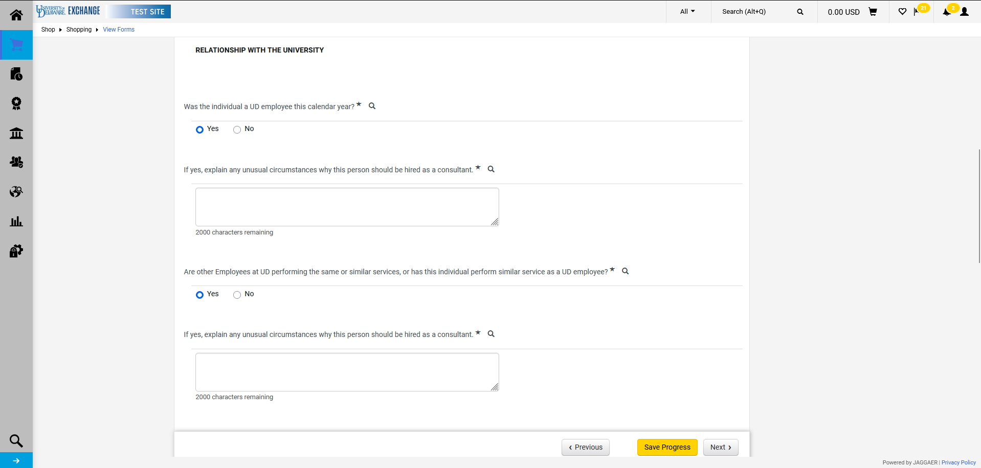
The responses provided will determine whether the ICED Questionnaire must be attached. There may be more than one warning to attach the questionnaire.

Slide 18
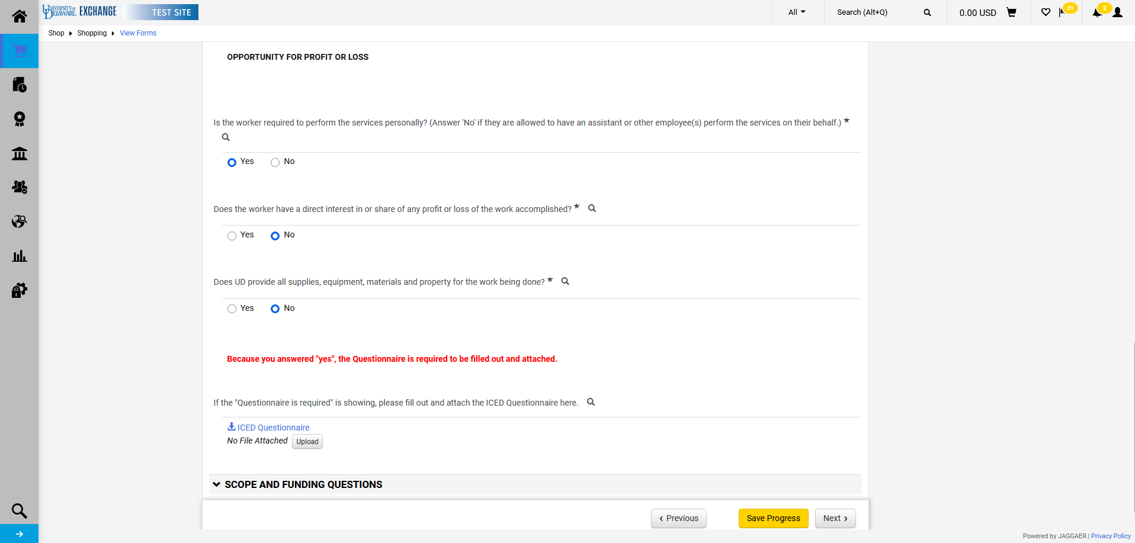
If required, the completed questionnaire must be uploaded at the prompt shown. The form will not be able to be submitted if it is only uploaded in the Attachments tab.

Slide 19
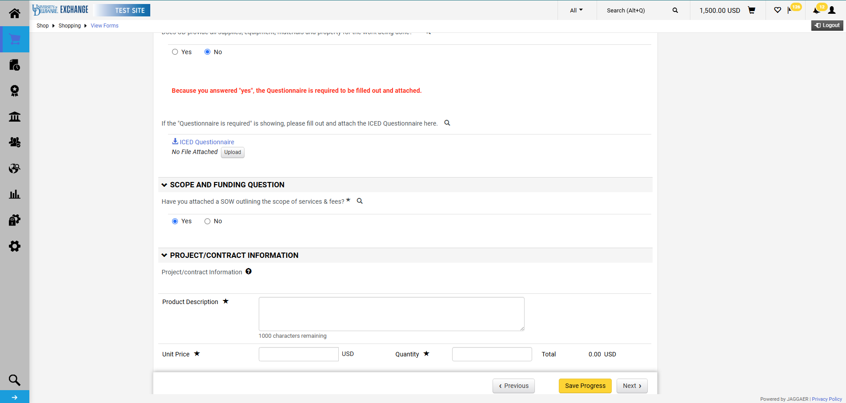
Once Scope and Funding is answered, the Project/Contract Information section will appear. This section is your requisition information (what will appear on the requisition, PO, and voucher).

Slide 20
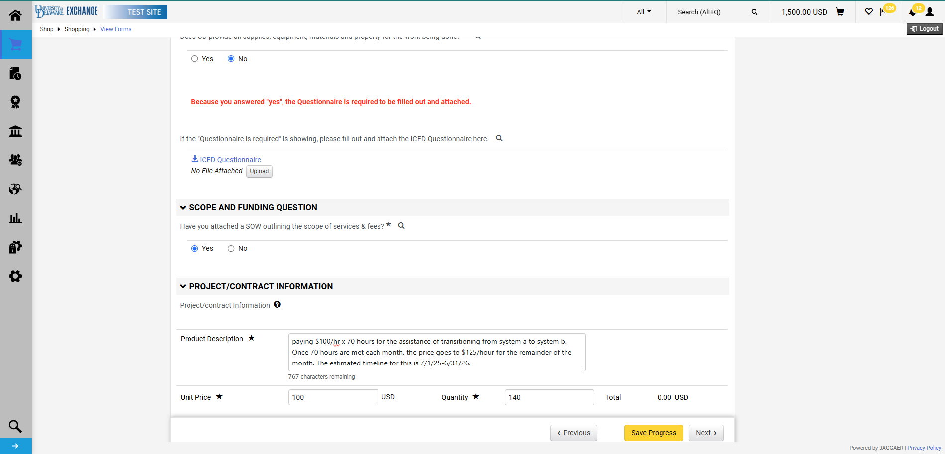
Make sure to add the contract timeline to the Product Description.
Once completed, click Next.

Slide 21
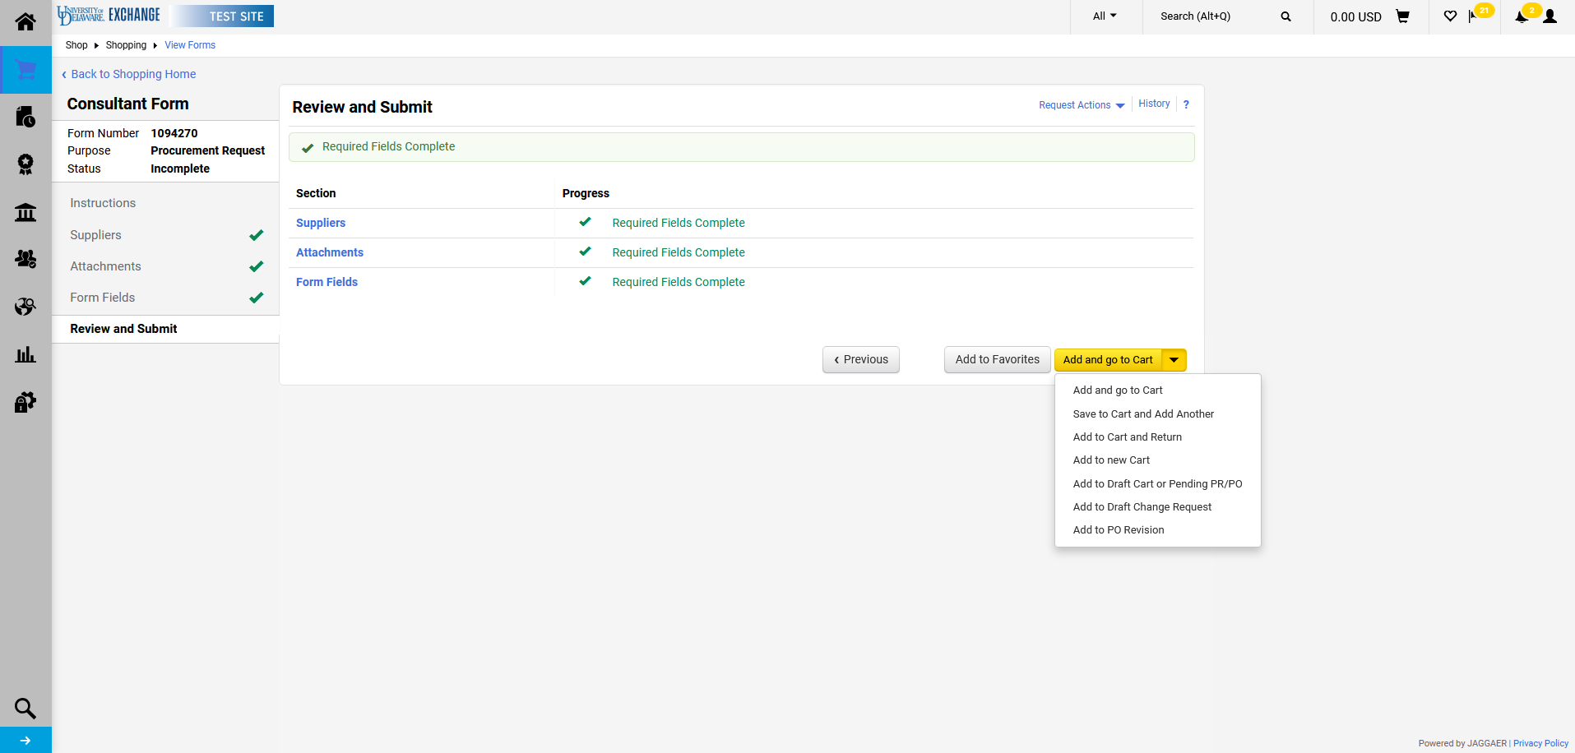
In this example, a second line is needed. To create a second line, click the dropdown arrow and select Save to Cart and Add Another.
If a second line is not needed, skip to slide 24.
A second line would be necessary for multiple rates, travel/per diem, etc.

Slide 22
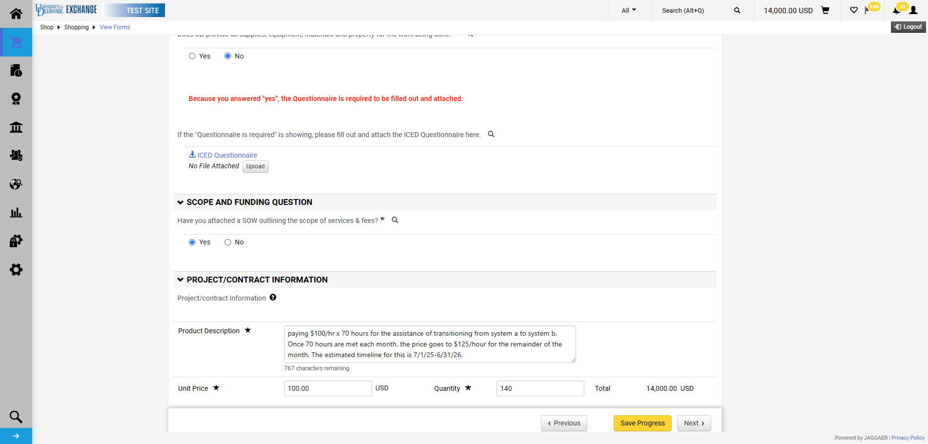
The second form is simply a copy of the first form and will prefill that form's data. Edit the fields to make any necessary changes to the second line, and click Next.

Slide 23
Once completed, click Add and go to Cart.

Slide 24
Cart & Checkout

Slide 25
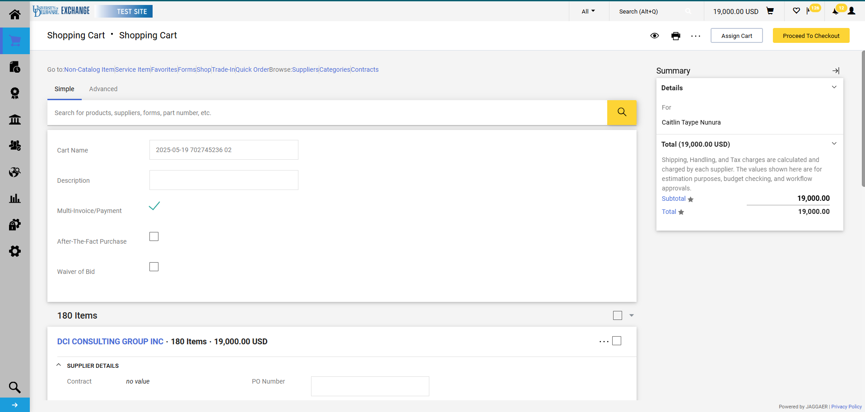
In cart, click Proceed To Checkout.

Slide 26
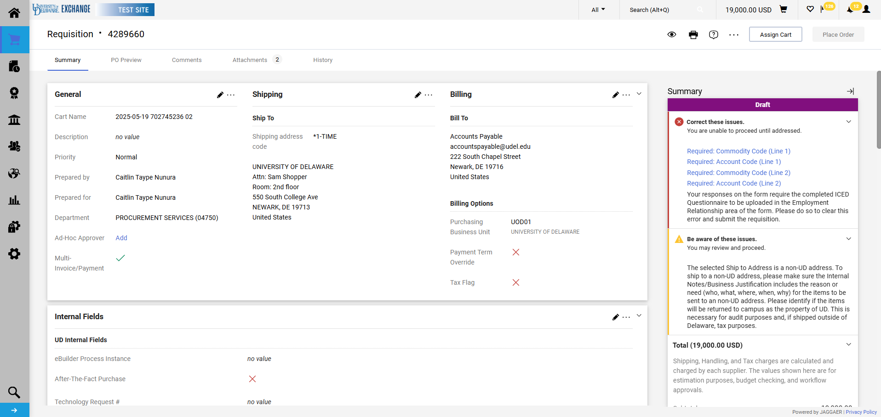
Warnings, errors, and omissions will appear in the Summary section at checkout. Ensure that all required and suggested fields are completed including funding source, commodity, account codes, and business justification.

Slide 27
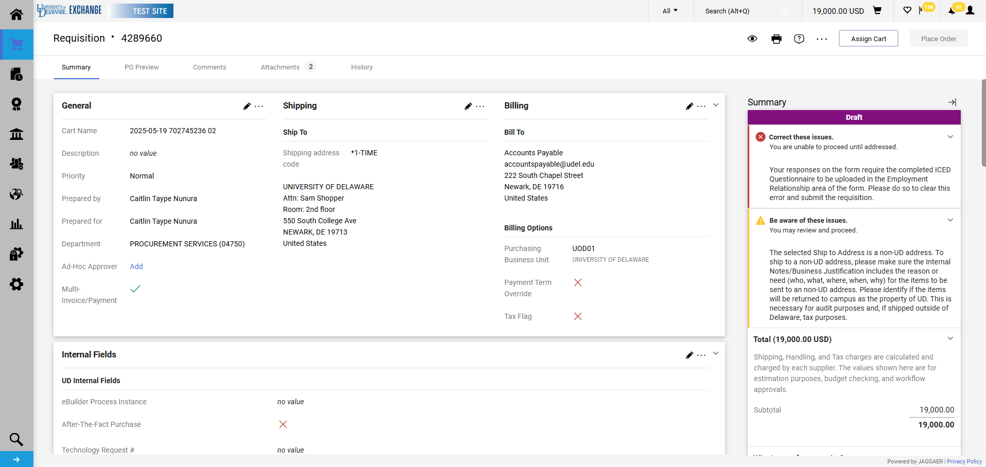
If the consultant will receive multiple payments per line, check the Multi-Invoice/Payment box so that the PO is set up as an amount based (blanket).
To do so, click the Pencil for the General section.

Slide 28
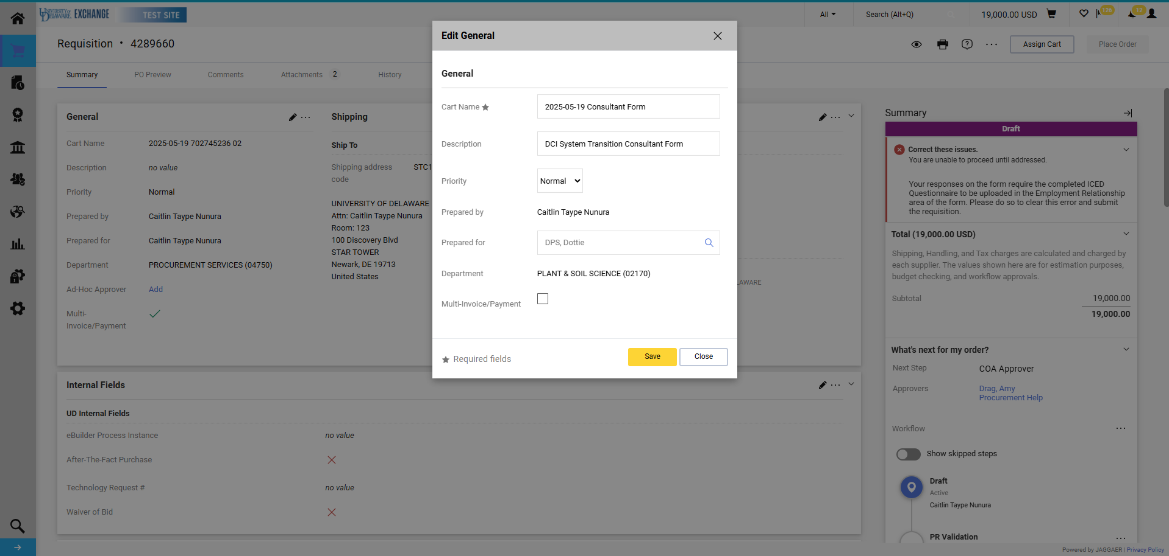
Click the Multi-Invoice/Payment box.
Click Save.

Slide 29
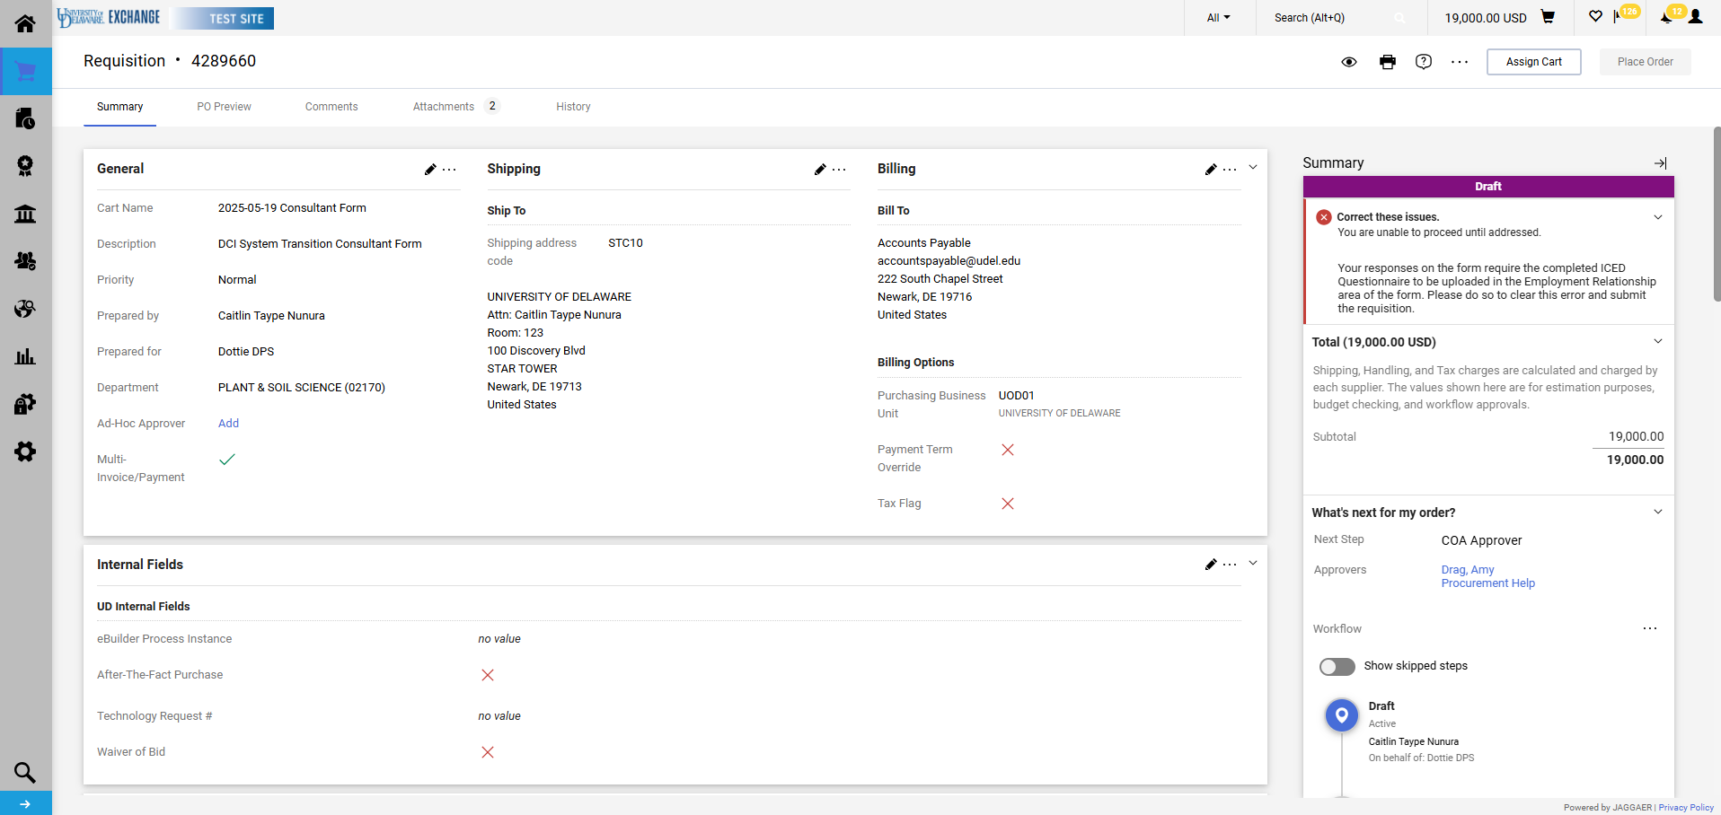
A checkmark should now be visible next to Multi-Invoice/Payment.

Slide 30
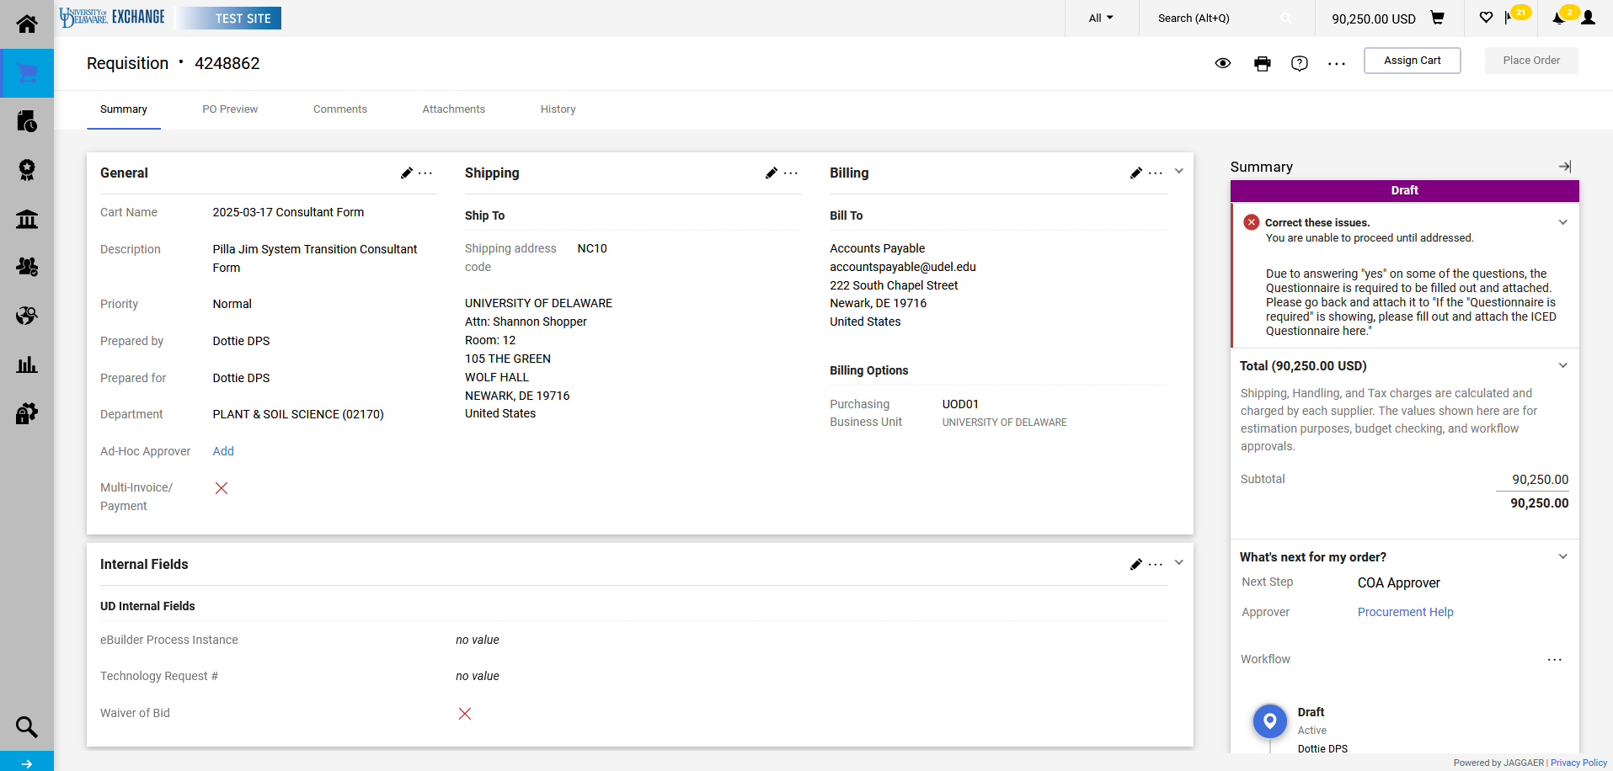
As indicated in slide 18, you will be unable to submit the requisition until the ICED form is uploaded to the required section. If you see this error, please return to the form(s) to do so.
If you have multiple lines, then you will need to add the questionnaire to all lines that trigger the requirement.

Slide 31
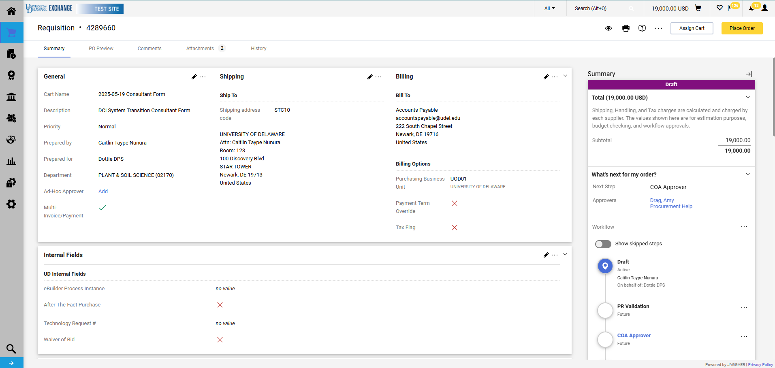
Once the completed questionnaire has been uploaded where required the checkout validation error will automatically clear. Click Place Order.

Slide 32
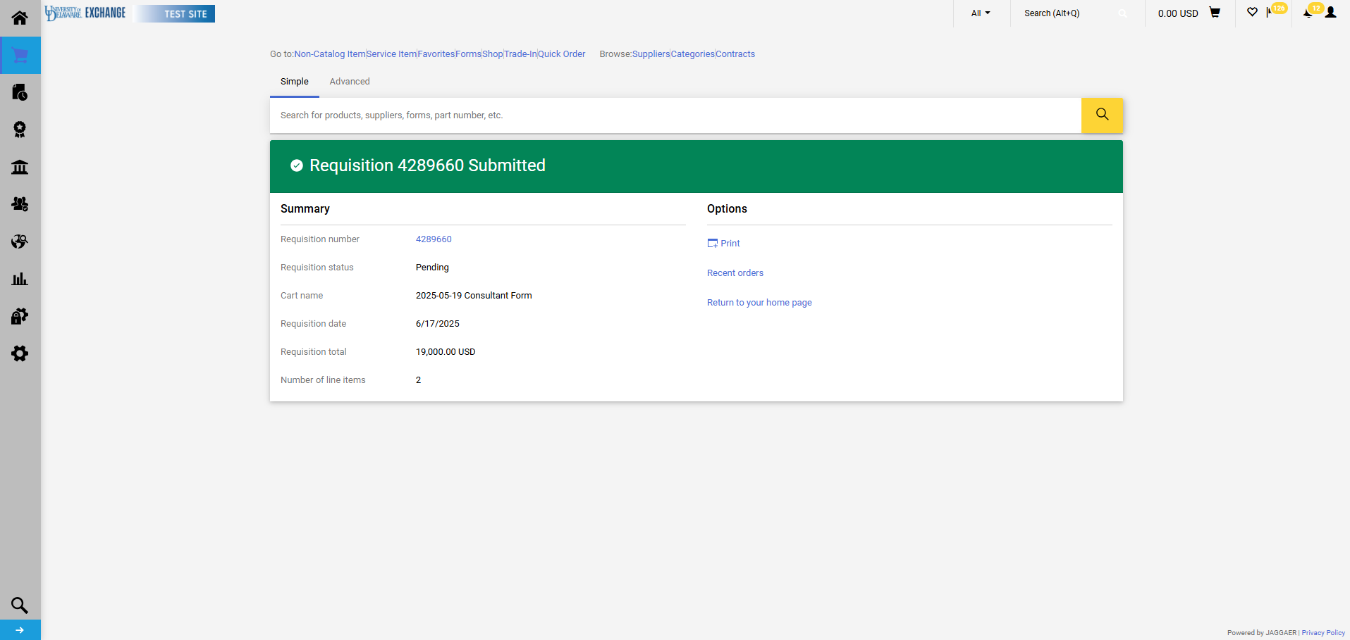
The requisition summary screen confirms that the requisition has been submitted.

Slide 33
Workflow
If grant-funded, the workflow will include review by the Research Office at the Grant Approval workflow step.
If the ICED Questionnaire is required, the workflow will include review by Human Resources at the Commodity Approval workflow step.
Procurement Services reviews all consultant form requisitions.
While ad-hoc approvers can be added to workflow by the submitter or any approver, this may delay the approval process.

Slide 34
Questions:
HR
Research Office
procurement@udel.edu
Resources:
Consultant Disclosure questions
ICED Form
Statement of Work (SOW) Form
Consultants for Research, Public Service or Instructional Activities
Procurement Services Website

