Slide 1
June 18, 2025 - Research Administration Conference
Notes:
LP

Slide 2
CONSULTANTS
Amy Drag, Director, Procurement Services
Susan Tompkins, Assistant Director, Contracts & Grants
Research Administration Conference

Slide 3
Advocacy, Change, and Effectiveness (ACE):
Advocacy, Change, and Effectiveness (ACE) initiative was launched in February 2023 by the Executive Sponsors to enhance institutional operations by addressing administrative inefficiencies.
The ACE committee selected “Consultants” as one of several initial projects due to the inefficiencies of the system (slow moving and ineffective).
The project team met 17 times over the course of nine months and conducted a detailed review of the current process, analyzed the existing steps, and identified duplicative and unnecessary protocols. An average of 110 research related consulting transactions are executed each year and a dozen typically require a deeper HR review for compliance
Research Administration Conference

Slide 4
Goals/Results
Goal: Simplify and standardize the process for engaging consultants for sponsored research.
Results: The project team recommended a new streamlined process to eliminate the Consultant Disclosure Webform and implement a smart form in UDX integrated with the requisition form simplifying the process while triggering the necessary HR compliance check.
By eliminating the CDW and its accompanying approver routing, the new process significantly shortens the total cycle time, eliminates duplicated approvals, and the manual flipping between the CDW and UDX process by department representatives. Approximately 6-10+ approval steps are eliminated with the removal of the CDW from the process. This will reduce cycle time by several weeks, if not months.
Status: These recommendations were approved by the Steering Committee and Executive Committee. The new form has been designed and developed. Testing has been in progress with a few departments on campus and ready to go LIVE…..
Considerations: The new process eliminates the Dean, Deputy Dean, or other similar positions from the approval routing. These leaders typically already sign off on consultant information in the proposal stage. This is a material change that will need to be managed with those stakeholders. In informal discussions with these leaders, some Deans have requested continued approval of consultants. These approvers can be manually added to the UDX requisition flow, but the project team strongly recommends a single process for all colleges. A future project could review alignment of process bringing on consultants for other functions at UD.
Research Administration Conference

Slide 5
Consulting Process [Current vs Future]
Unit completes supporting docs for consultant (CV/SOW)
Unit submits Consulting Disclosure Webform (CDW)
CDW Purpose Code Approval
CDW Dept/Dean Approval
CDW Contracts/Grant (C&G) Approval
CDW HR Approval
15 Steps
9+ People (multiple times)
2 Systems, 1 Paper
¹Approval is contingent on Accounting & Amount.
*No. of Approvers may be higher depending on Dept. submitting
Current Process
Procurement Approval & Signature of SOW
¹C&G Approval
¹Department Purchasing Specialist (DPS) Approval
Cost Object Approver (COA) Approval
Unit submits UDX Requisition
CDW Research VP Approval
PO is issued
RO receives signed SOW and Approves CDW
End of Consulting of Process
6-8 Steps
3-6 People
1 System, 1 Paper
¹Approval is contingent on Accounting & Amount
² Step only exists if triggered by req questions
**Ad-Hoc Approvers can be added
Unit completes supporting docs for consultant (CV/SOW)
Unit submits Requisition
Cost Object Approver (COA) Approval
¹Department Purchasing Specialist (DPS) Approval
¹C&G Approval
² HR Approval
Future Process
End of Consulting of Process
PO is issued
Procurement Approval & Signature of SOW
System Legend
UD Exchange
Webform
PDF,Word Form /
Outside of Systems
Research Administration Conference

Slide 6
Next Steps
February 2025
Approvals from Executive Sponsors followed by meetings with additional stakeholders.
Meet with the Dean’s Council and research Deans.
Issue a pre-process improvement survey
March 2025
Finalize the updates to website and any Research Office documents.
Complete user acceptance testing of the new smart form
April/May 2025
Issue memo to relevant stakeholders and newsletter updates detailing the new process
Offer training opportunities for folks to practice the new process [Pilot Group]
Summer 2025
Formally announce the process at the June Annual Research Conference
Training sessions will be scheduled for end of June and July
Fall 2025
Issue a post process improvement survey
Draft an updated policy to the existing “Policy on Consultants for Research, Public Service or Instructional Activities”.
Research Administration Conference

Slide 7
Training & Procurement Info
New Consultant Engagement Process Launching July 1, 2025
Beginning July 1, 2025, the University will implement a new process for engaging research consultants. As part of this change, the previous Consultant Services Agreement has been phased out, and the Consultant Disclosure Webform (CDW) will soon be discontinued.
In May, a new Smart Form, integrated into UDX with the requisition form, was piloted. This updated process is designed to simplify consultant engagement procedures, eliminate unnecessary steps, and minimize duplicative reviews and approvals.
Action Required: Starting July 1st, all users who previously used the CDW must transition to the new UDX Consultant Form.
In collaboration with the Research Office, the following training opportunities are available:
Training Session 1: June 23rd at 10:00 AM
Training Session 2: July 16th at 2:00 PM
Drop-In Sessions are also available for questions and feedback.
For full details and training information, visit: 👉 udel.edu/faculty-staff/procurement/purchasing
Research Administration Conference

Slide 8
UDX Consultant Form
Research Administration Conference

Slide 9
Definitions & Overview
Consultant – any non-University personnel who is engaged by the University for expertise required to fulfill University commitments and objectives for Research, Public Service or Instructional Activities.
Questionnaire – throughout this document and the Consultant Form you will see a questionnaire referenced. This is the Independent Contractor vs Employee Disclosure (ICED) questionnaire which is an HR document used to determine if a consultant should be onboarded as a supplier or employee.
Previously, two processes were required: first the Consultant Disclosure webform to authorize the engagement, then a requisition workflow to engage and pay the consultant.
With the new Consultant Form, the entire process has been combined into one approval workflow in UDX.
Departmental approvals will be required based on responses in the form
Note: Supplier must be active and fully approved in UD Exchange before the form can be completed.
Research Administration Conference

Slide 10
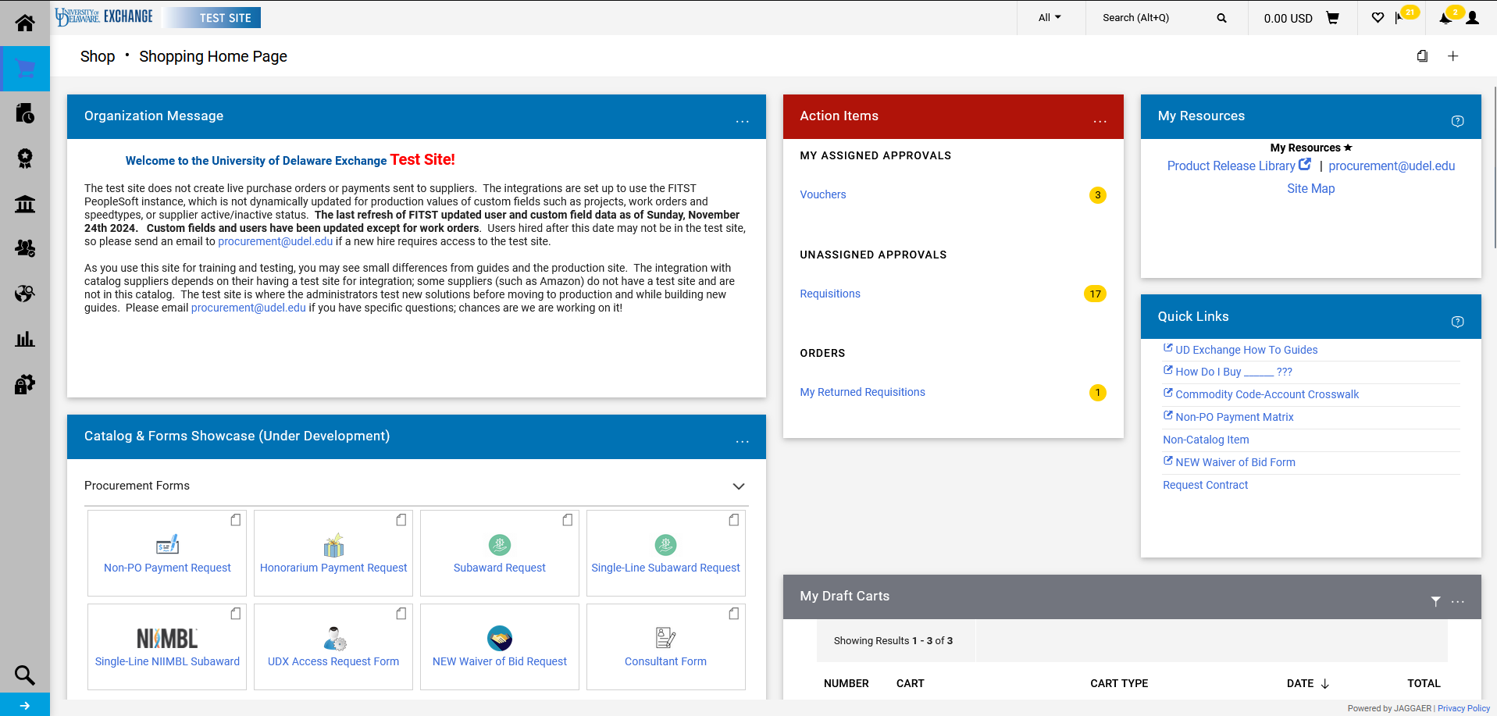
The Consultant Form can be found under the Procurement Forms section of the Catalog & Forms Showcase on the Shopping Home Page. Click on the form to open.

Slide 11
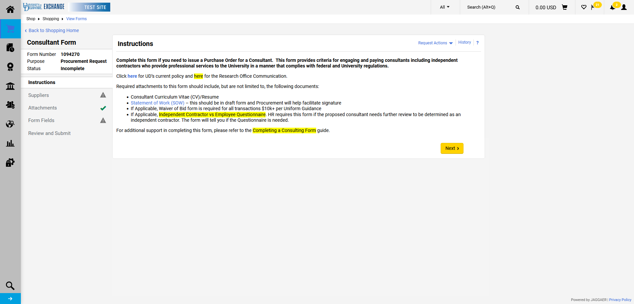
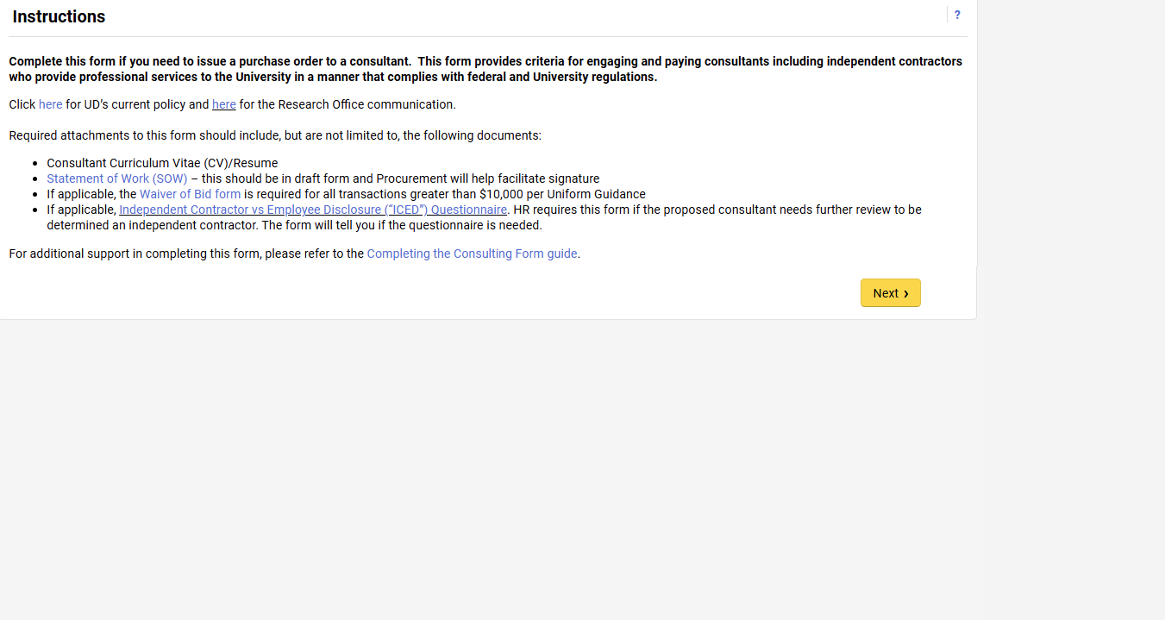
The first page is the Instructions page. Please read and click Next when ready to move forward.

Slide 12
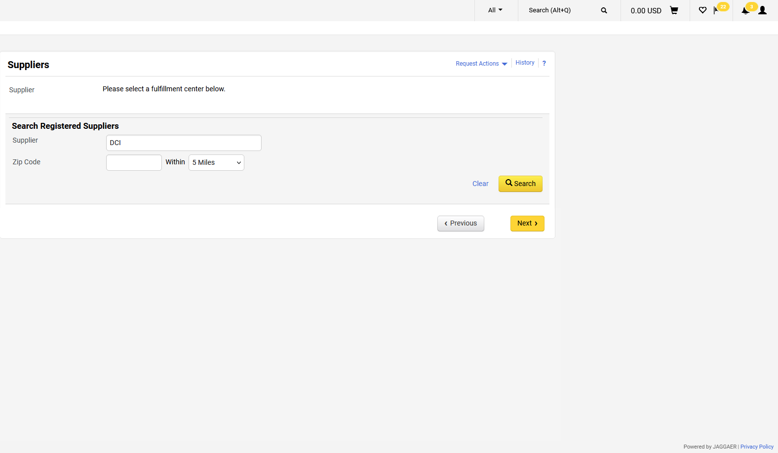
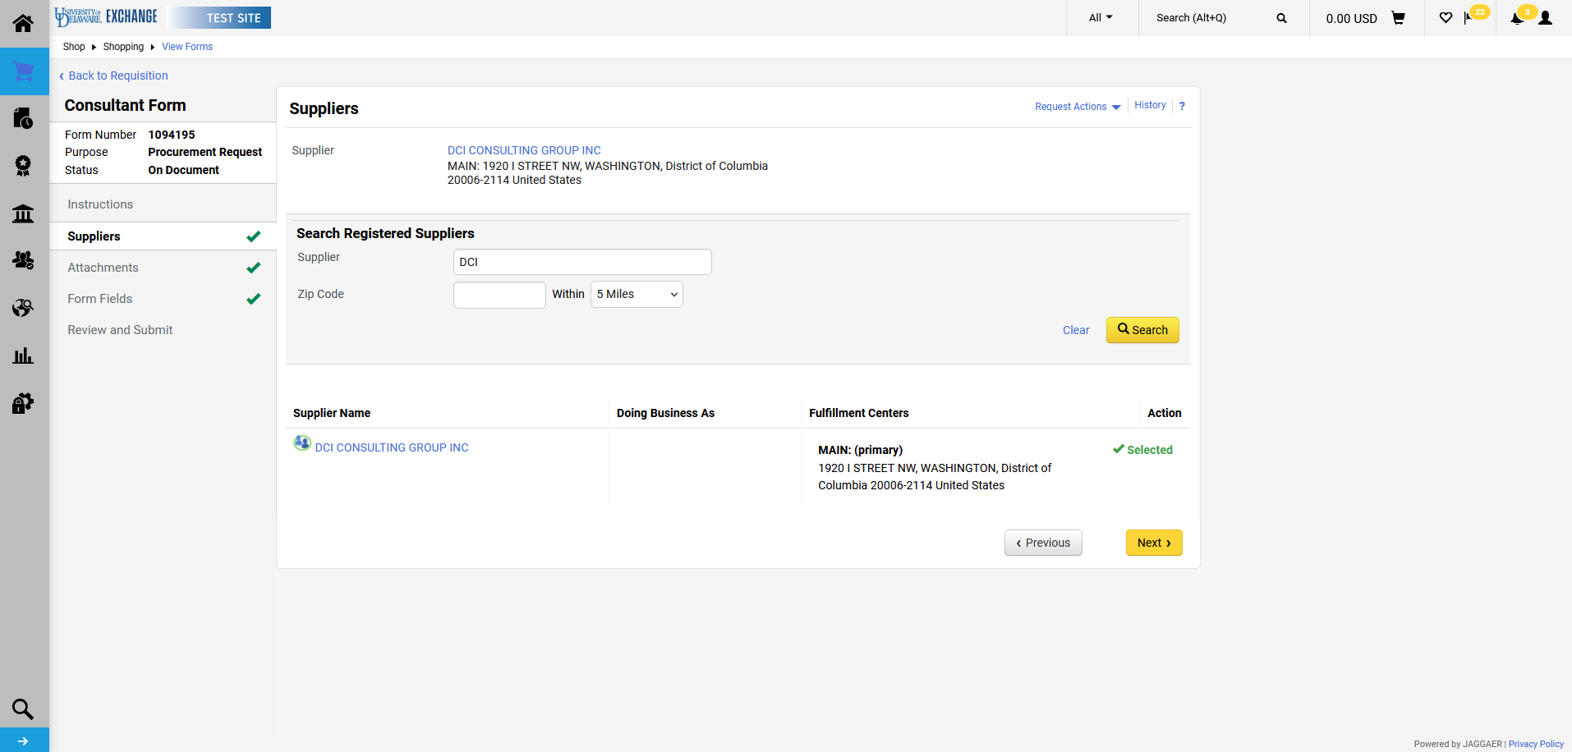
Enter Supplier information.
Click Search.

Slide 13
Select the correct fulfillment center for the supplier.
Click Next.

Slide 14
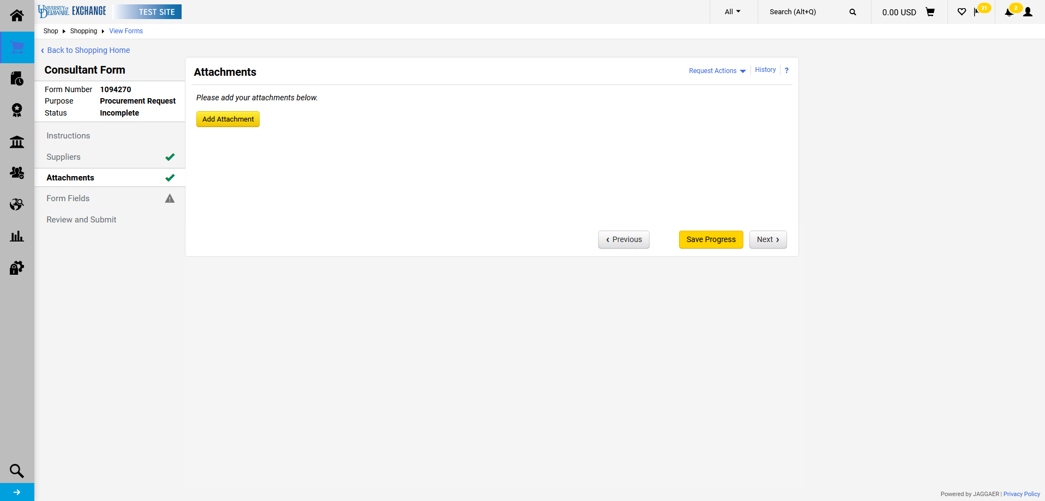
Click Add Attachment to attach pertinent documents such as CV/Resume, SOW, etc.

Slide 15
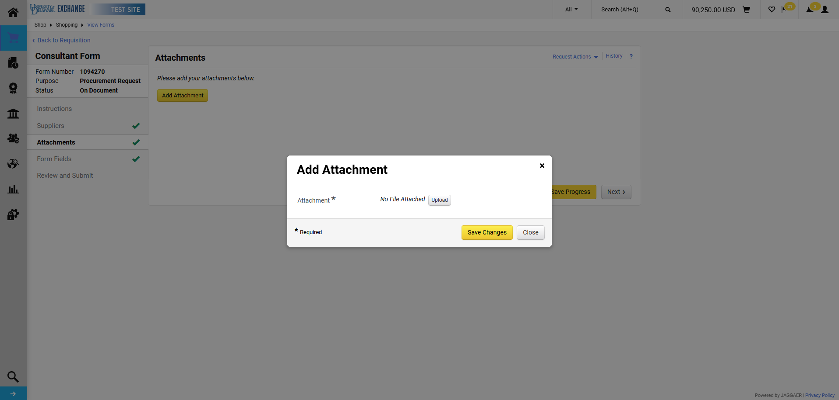
Click Upload to attach each item.

Slide 16
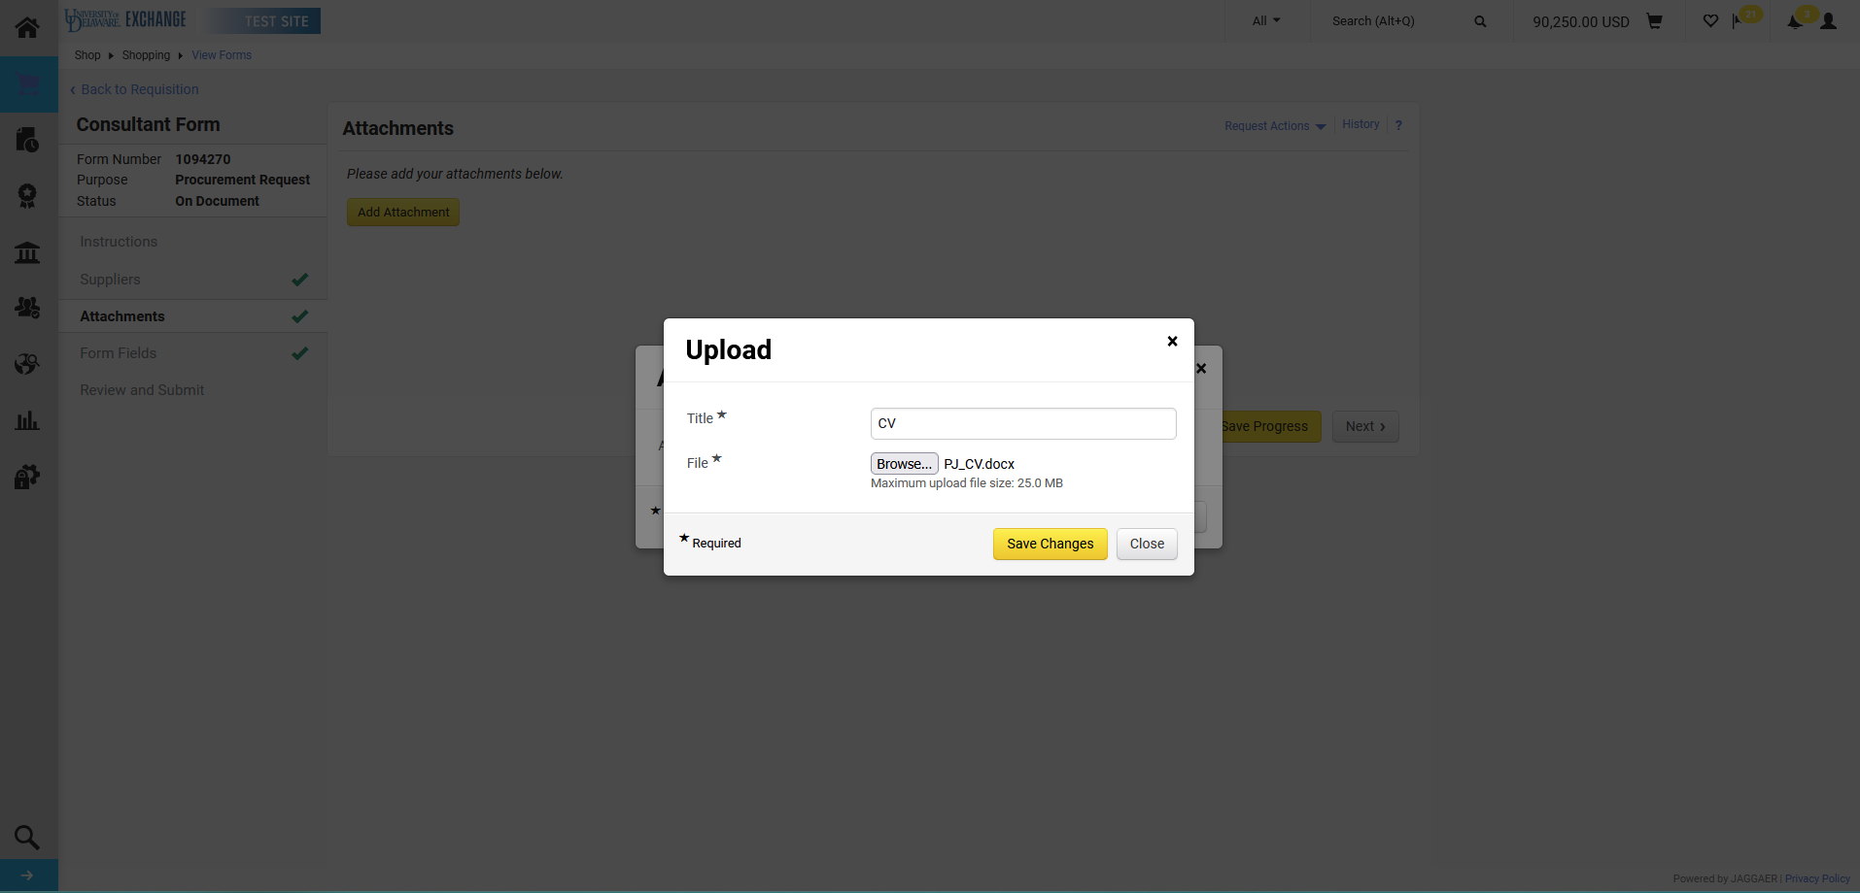
Attach the file and provide a Title. Click Save Changes.

Slide 17
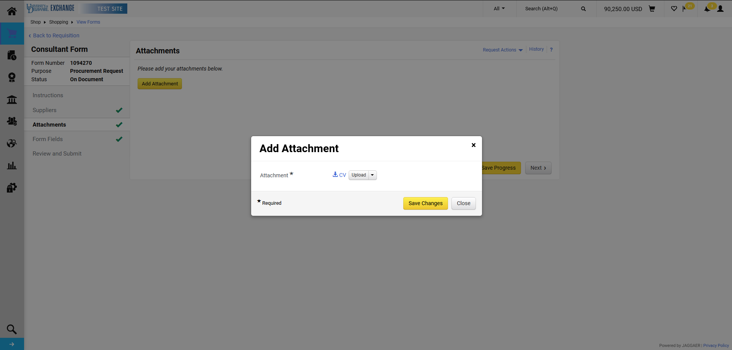
Click Save Changes again.

Slide 18
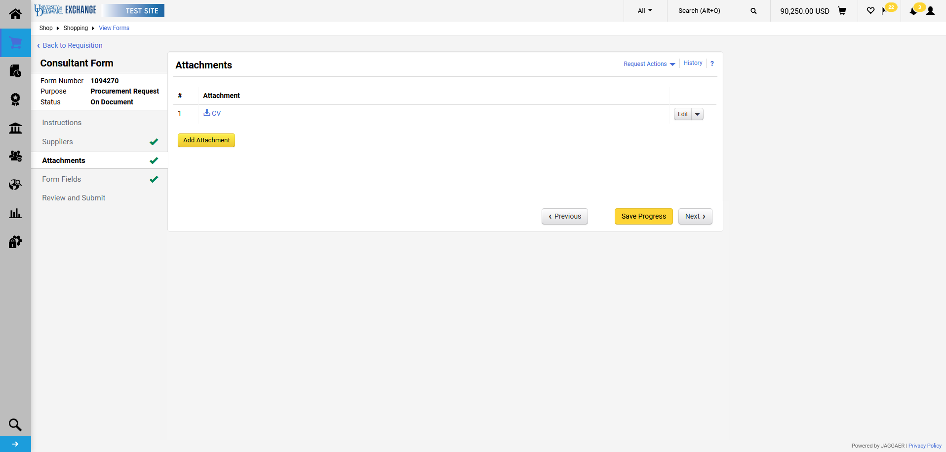
Repeat as needed for all documents.
Click Next when finished.

Slide 19
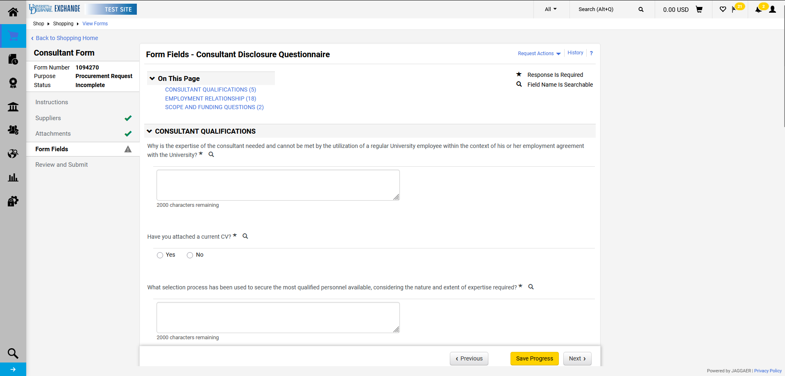
Questions on the Form Fields tab are organized by content. Additional requirements or questions may appear based on responses provided to each question.

Slide 20
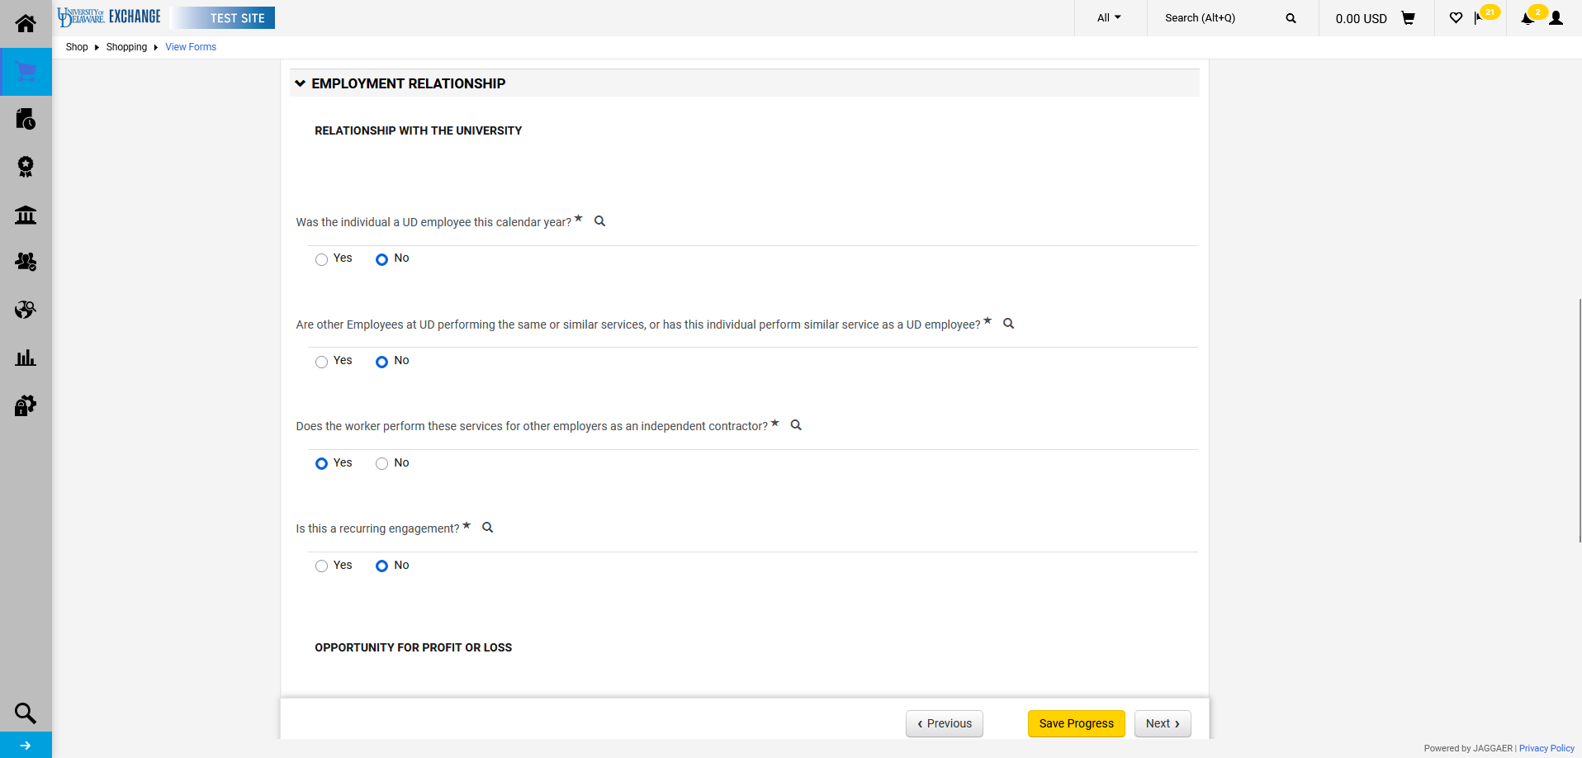
Responses to questions in the Employment Relationship section may trigger Human Resources (HR) review.

Slide 21
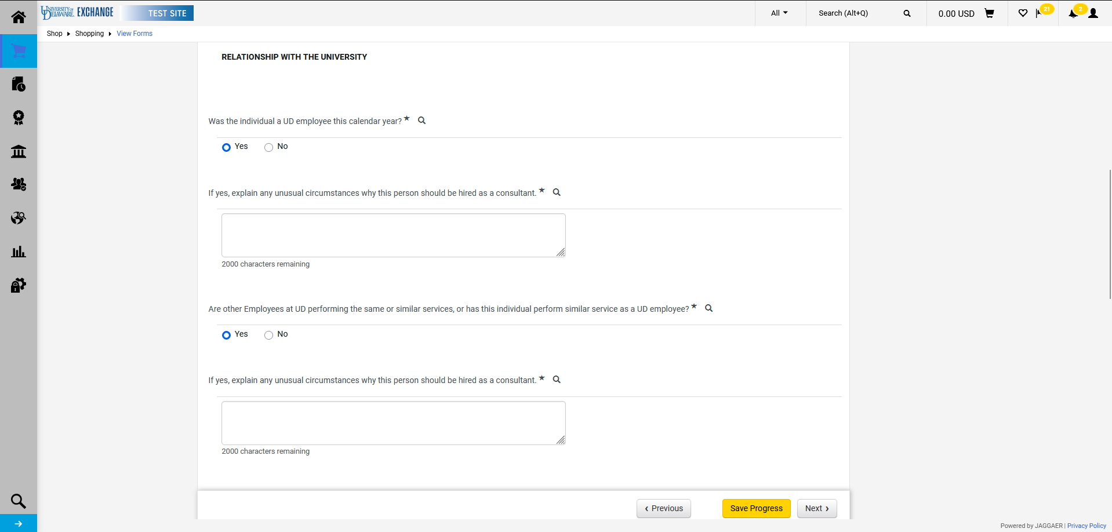
The responses provided will determine whether the ICED Questionnaire must be attached. There may be more than one warning to attach the questionnaire.

Slide 22
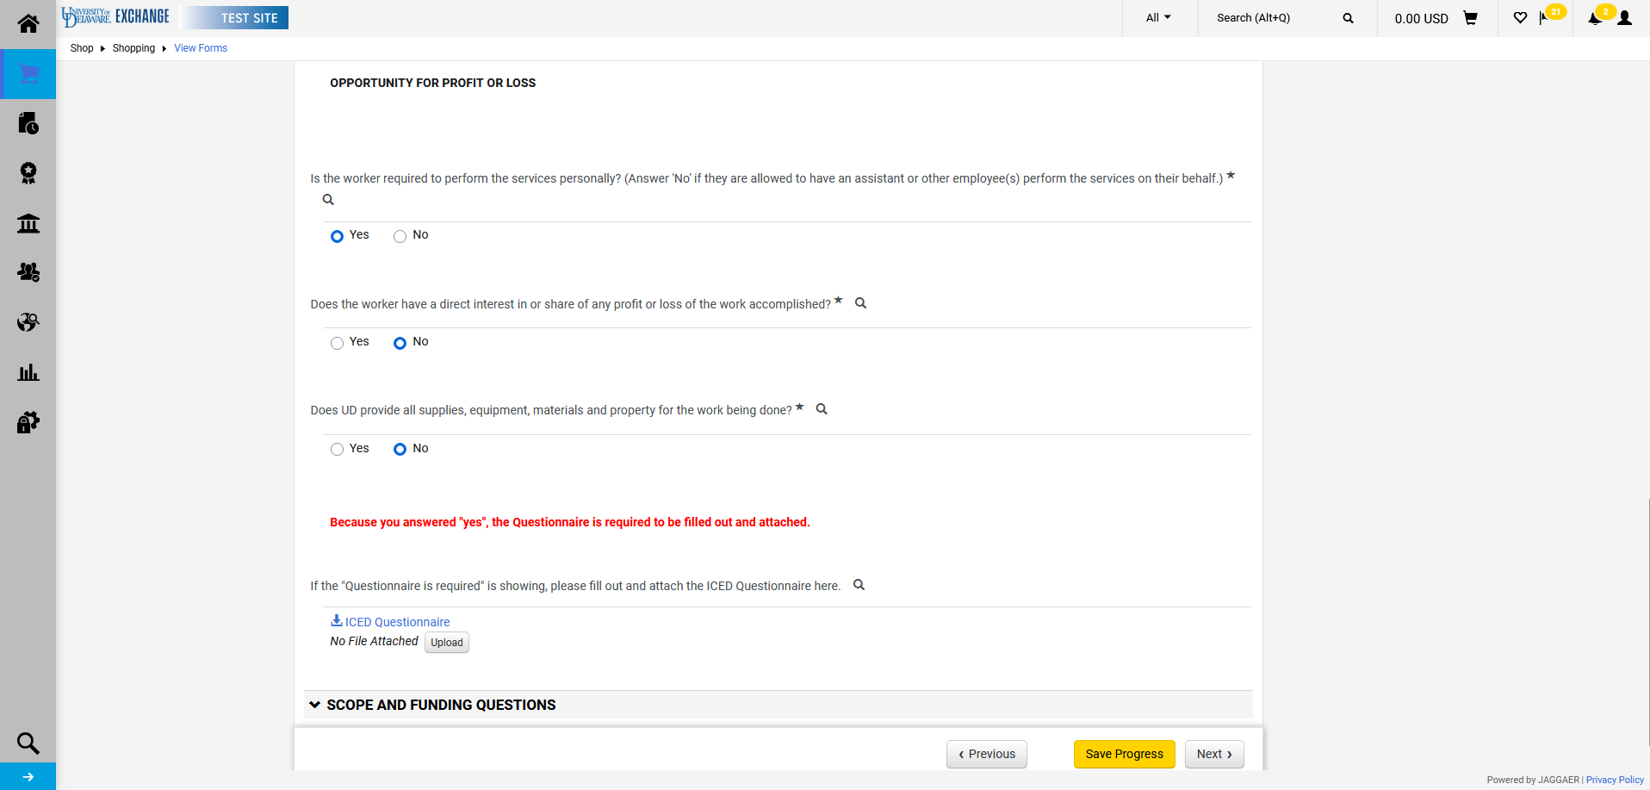
If required, the completed questionnaire must be uploaded at the prompt shown. The form will not be able to be submitted if it is only uploaded in the Attachments tab.

Slide 23
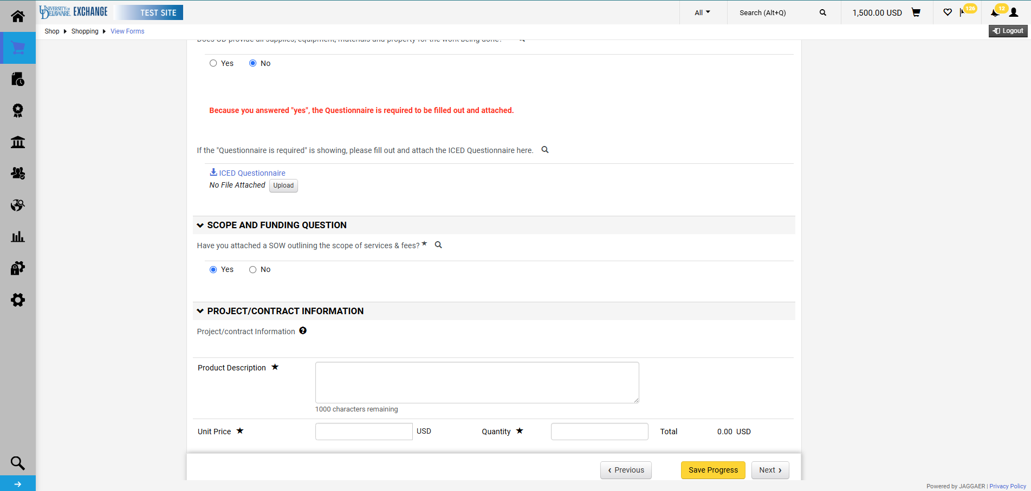
Once Scope and Funding is answered, the Project/Contract Information section will appear. This section is your requisition information (what will appear on the requisition, PO, and voucher).

Slide 24
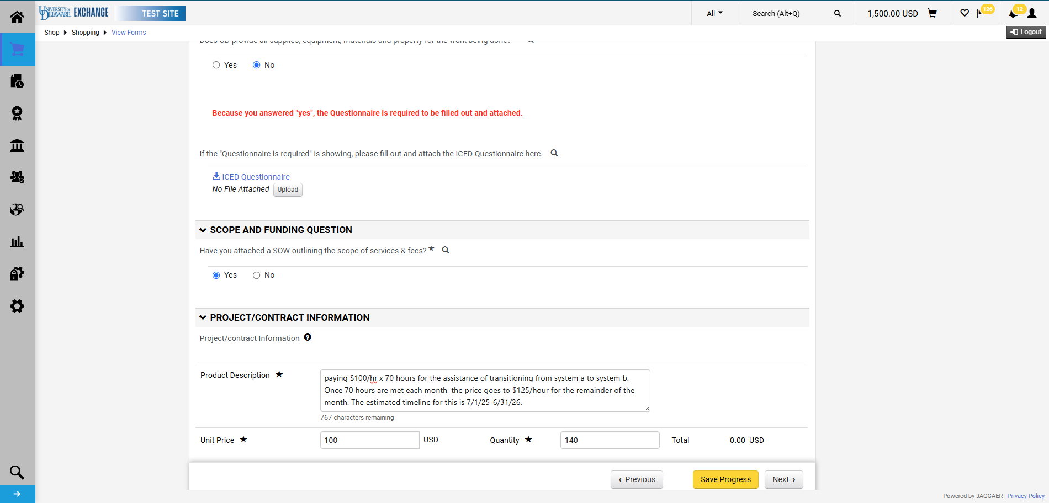
Make sure to add the contract timeline to the Product Description.
Once completed, click Next.

Slide 25
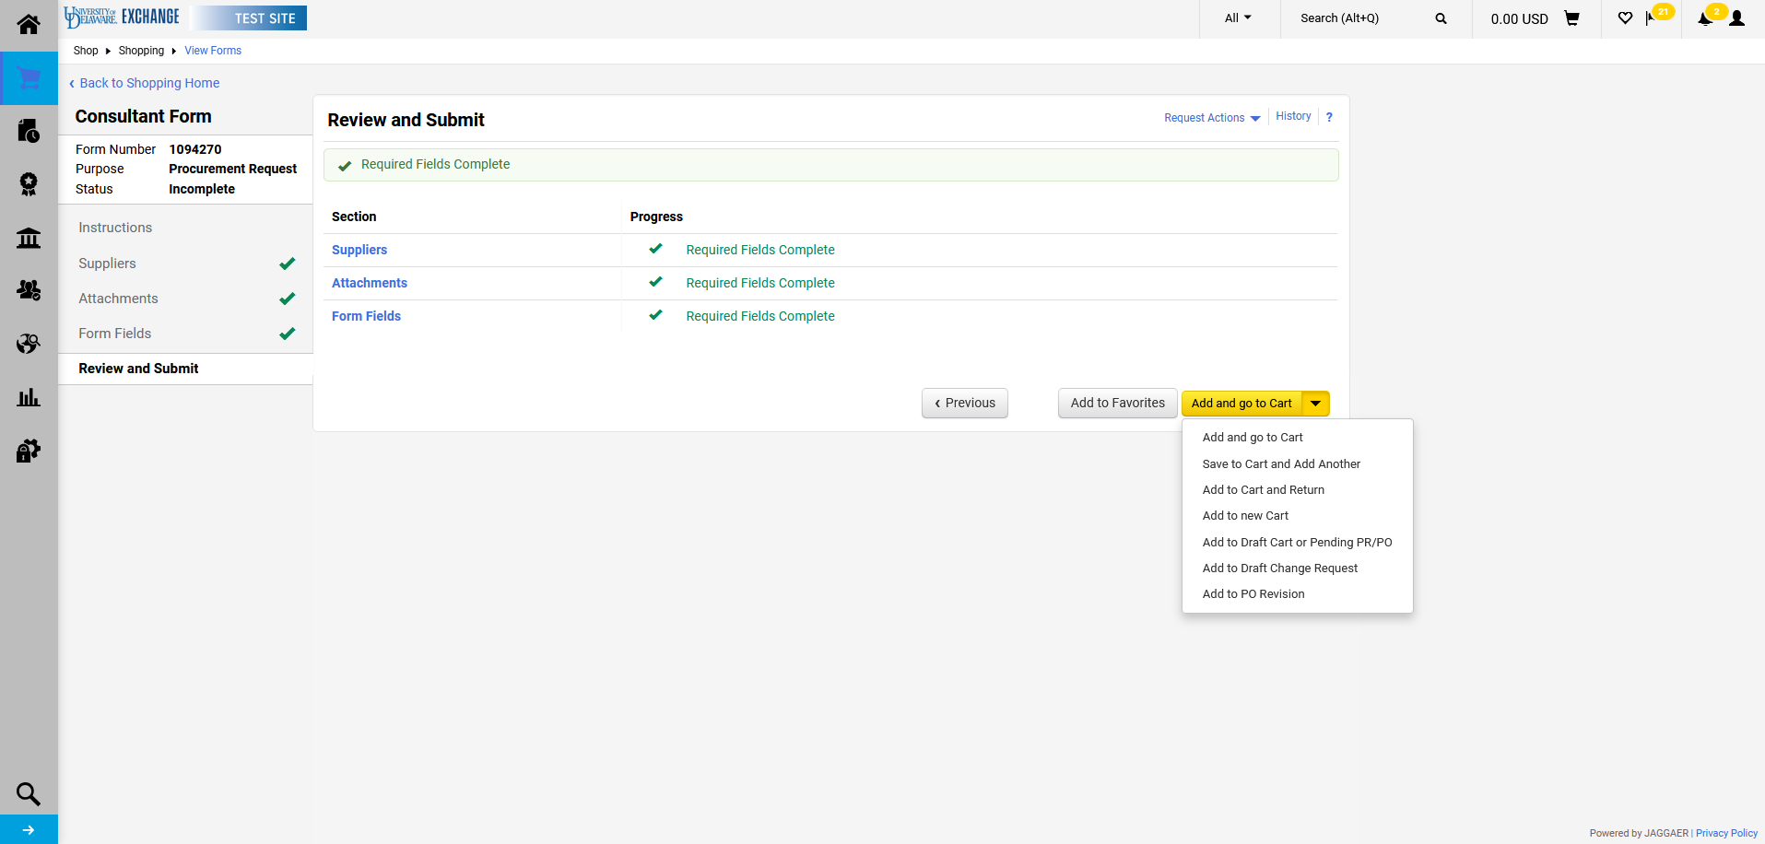
In this example, a second line is needed. To create a second line, click the dropdown arrow and select Save to Cart and Add Another.
A second line would be necessary for multiple rates, travel/per diem, etc.

Slide 26
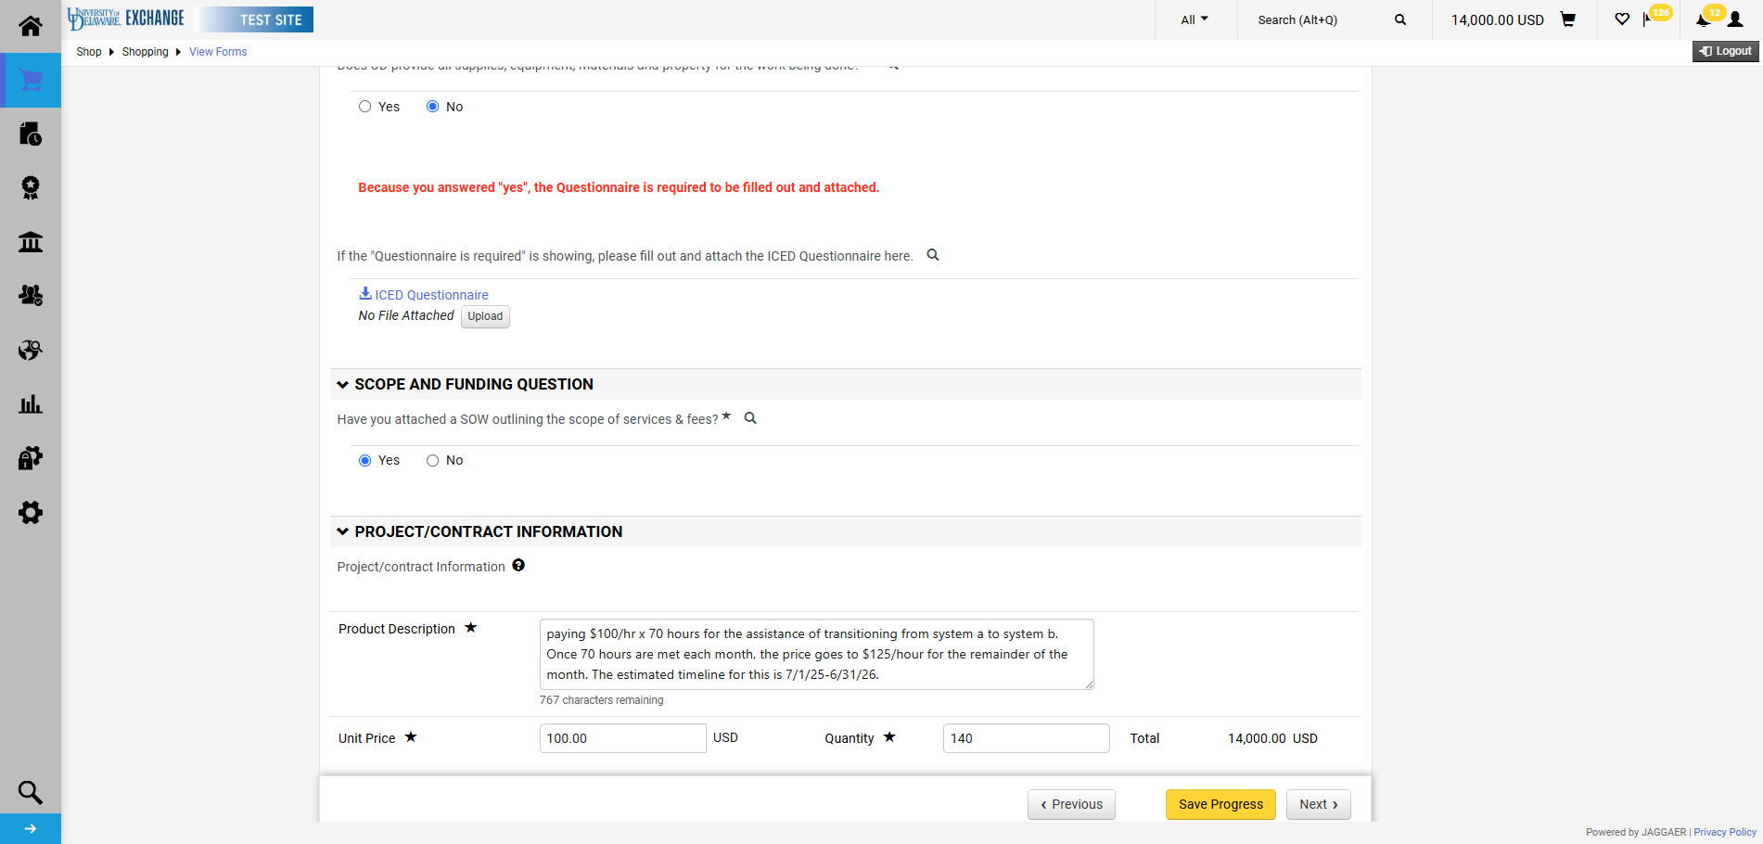
The second form is simply a copy of the first form and will prefill that form's data. Edit the fields to make any necessary changes to the second line, and click Next.

Slide 27
Once completed, click Add and go to Cart.

Slide 28
Cart & Checkout

Slide 29
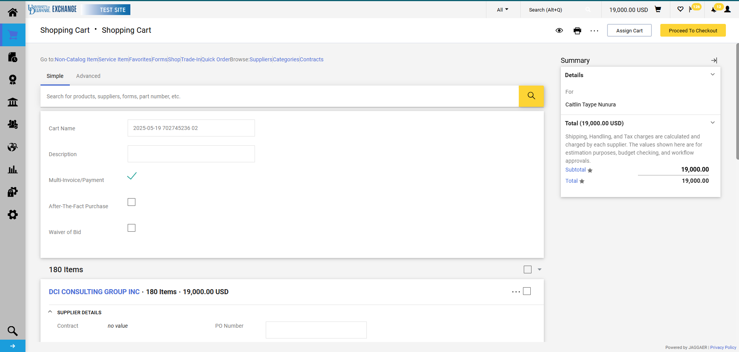
In cart, click Proceed To Checkout.

Slide 30
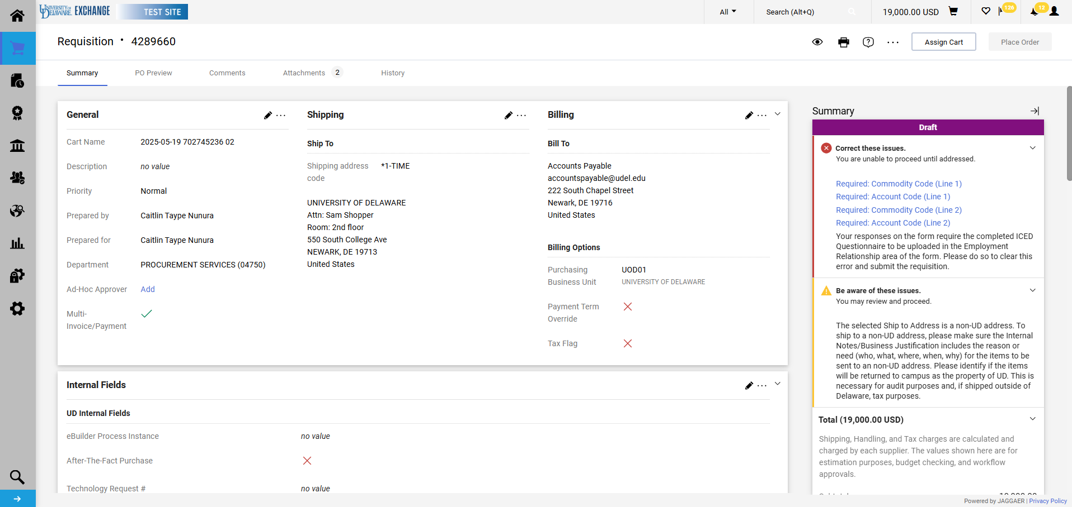
Warnings, errors, and omissions will appear in the Summary section at checkout. Ensure that all required and suggested fields are completed including funding source, commodity, account codes, and business justification.

Slide 31
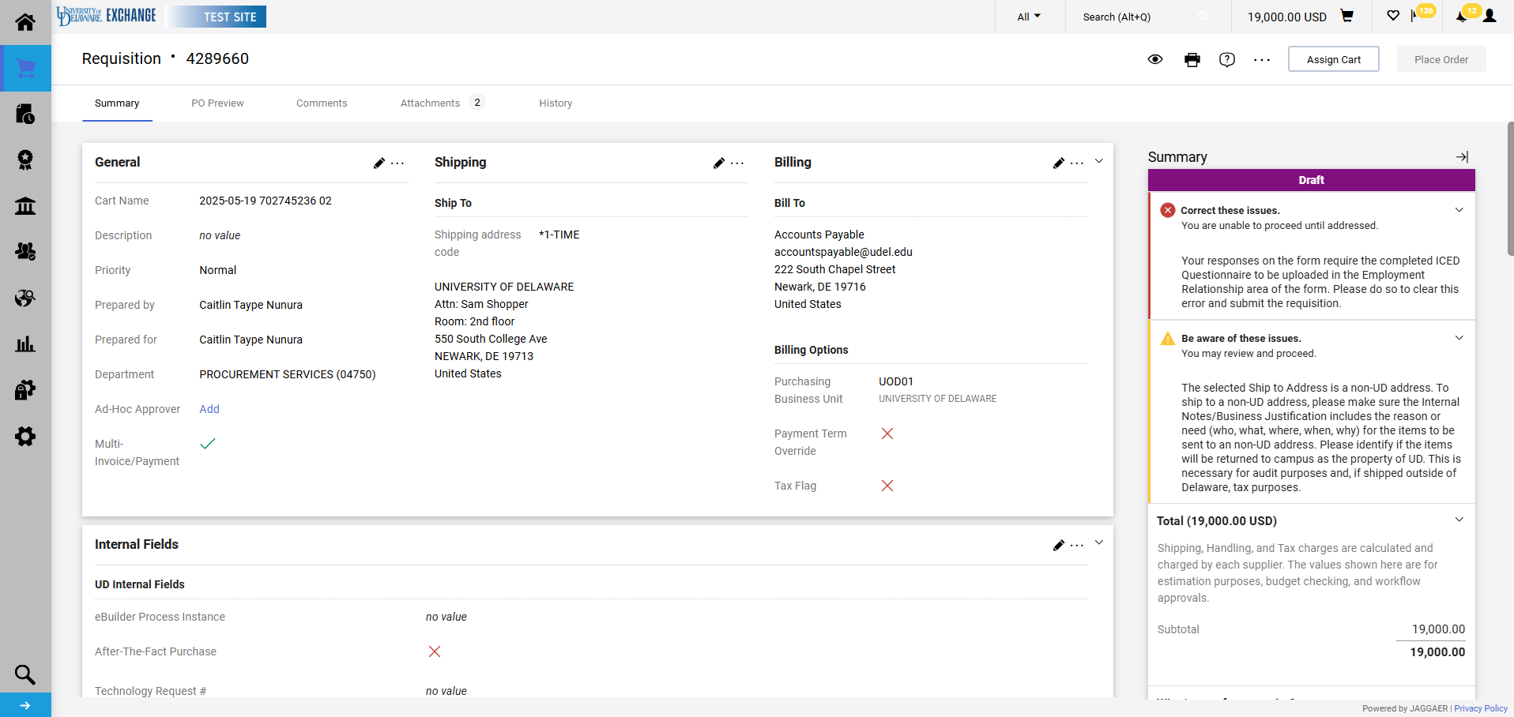
If the consultant will receive multiple payments per line, check the Multi-Invoice/Payment box so that the PO is set up as an amount based (blanket).
To do so, click the Pencil for the General section.

Slide 32
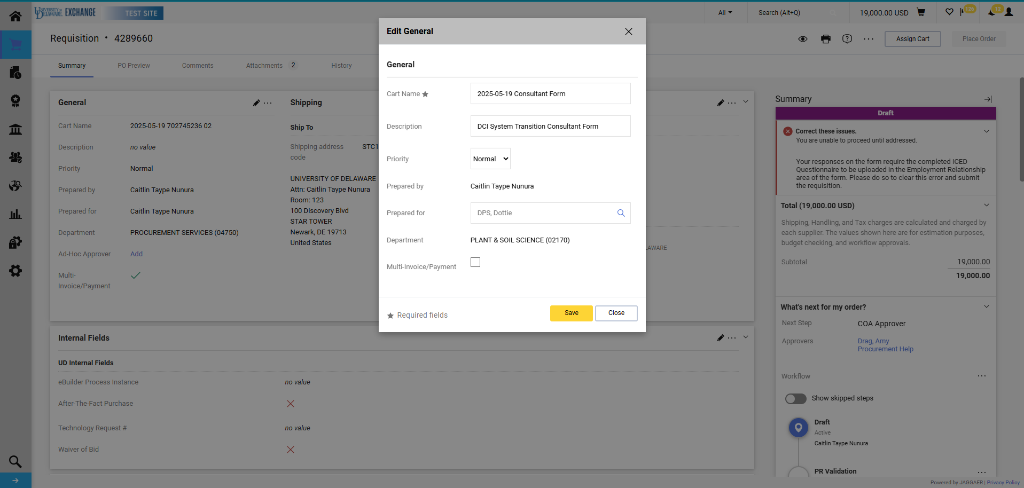
Click the Multi-Invoice/Payment box.
Click Save.

Slide 33
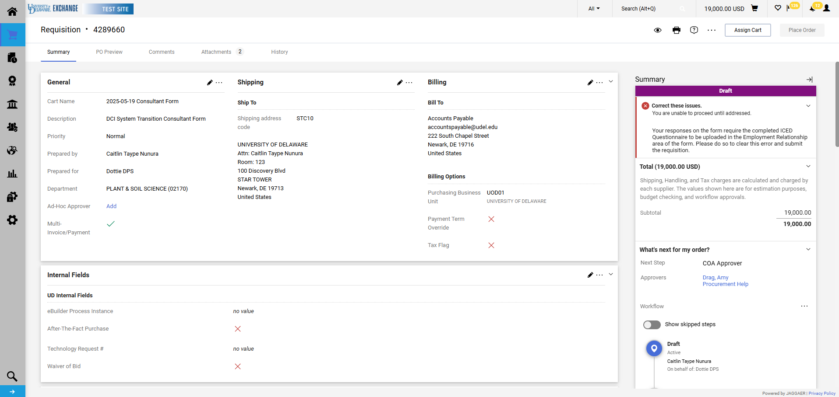
A checkmark should now be visible next to Multi-Invoice/Payment.

Slide 34
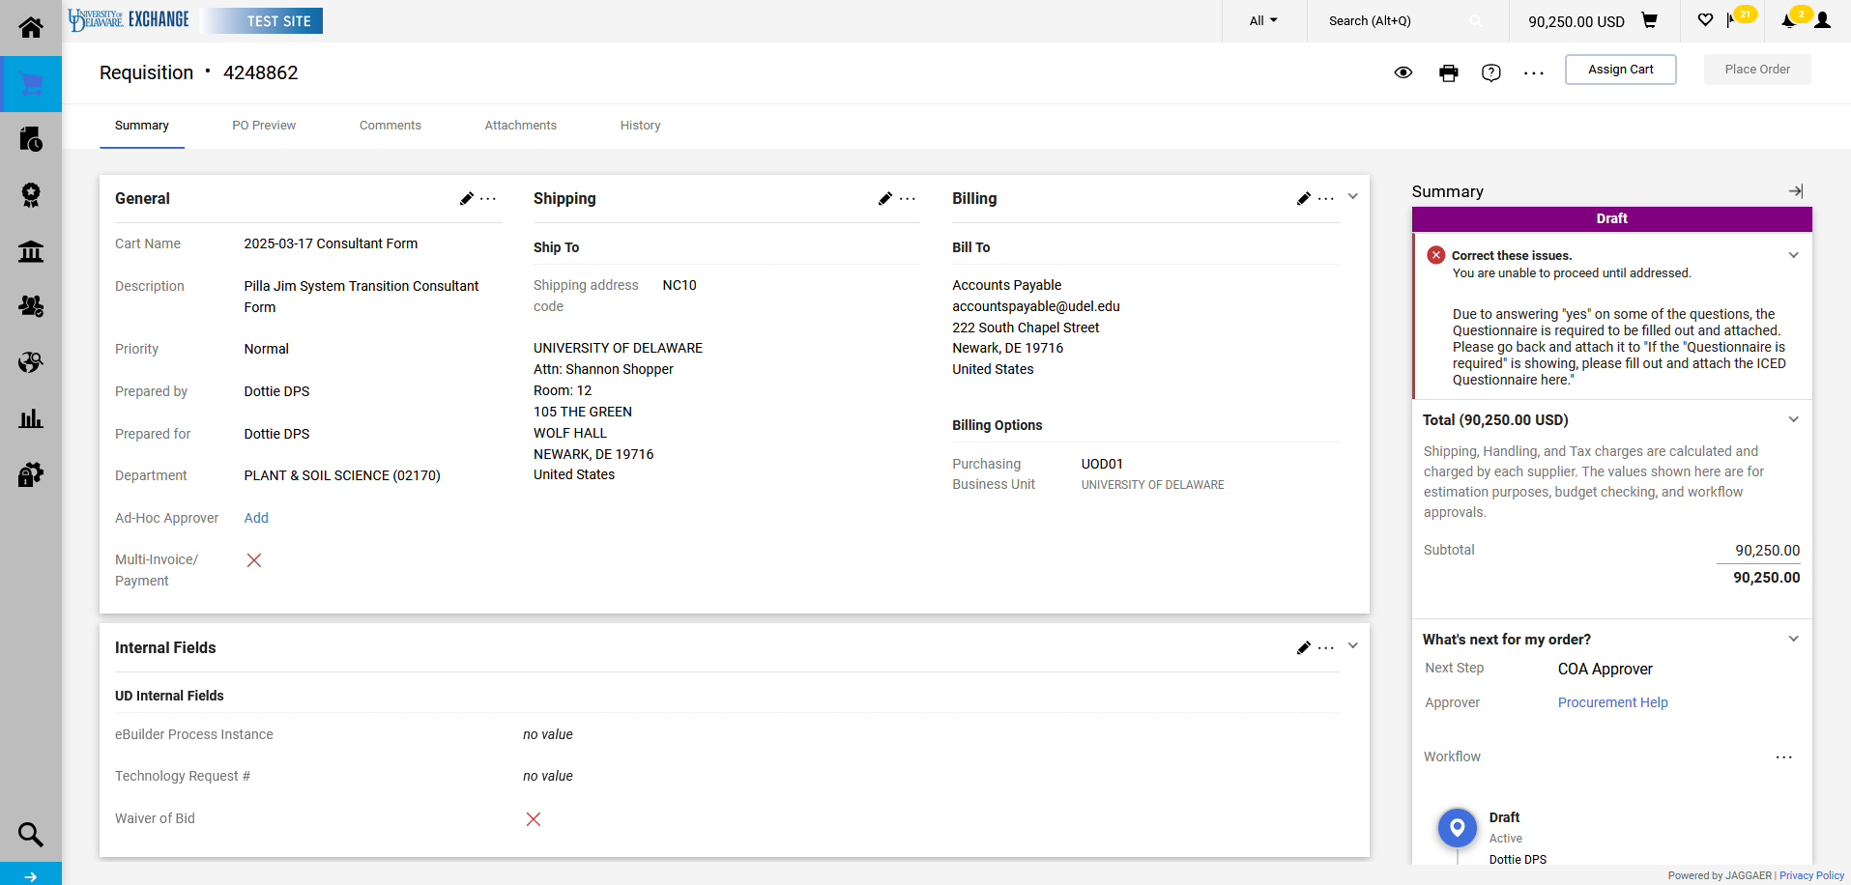
As indicated in slide 18, you will be unable to submit the requisition until the ICED form is uploaded to the required section. If you see this error, please return to the form(s) to do so.
If you have multiple lines, then you will need to add the questionnaire to all lines that trigger the requirement.

Slide 35
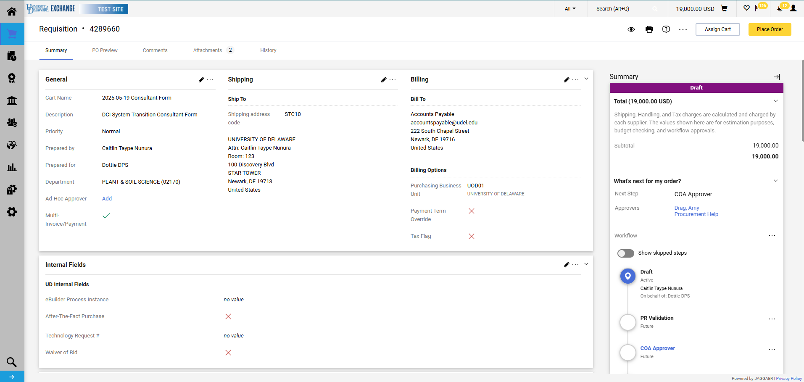
Once the completed questionnaire has been uploaded where required the checkout validation error will automatically clear. Click Place Order.

Slide 36
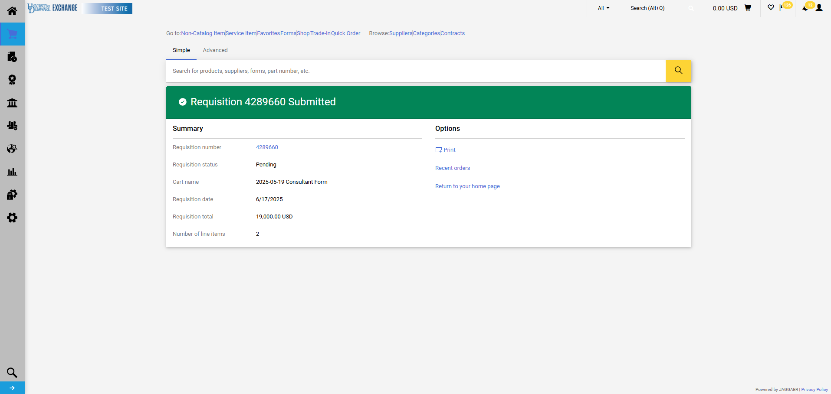
The requisition summary screen confirms that the requisition has been submitted.

Slide 37
UDX Consultant Workflow
If grant-funded, the workflow will include review by the Research Office at the Grant Approval workflow step.
If the ICED Questionnaire is required, the workflow will include review by Human Resources at the Commodity Approval workflow step.
Procurement Services reviews all consultant form requisitions.
While ad-hoc approvers can be added to workflow by the submitter or any approver, this may delay the approval process.
Research Administration Conference

Slide 38
Questions ??
Research Administration Conference

Slide 39
Resources:
Policy: Consultant for Research, Public Service or Instructional Activities
UDX Consultant Form Guide: https://www.udel.edu/faculty-staff/procurement/purchasing/
Independent Contractor vs Employee Determination Questionnaire: https://services.udel.edu/TDClient/32/Portal/Requests/TicketRequests/NewForm?ID=XKneBKqUP-0_&RequestorType=Service
Statement of Work Template: https://www.udel.edu/content/dam/udelImages/procurement/trainingresources/forms/StatementofWorkForm_2023v1.pdf
Procurement Services Info: https://www.udel.edu/faculty-staff/procurement/training-resources/
Research Administration Conference

Slide 40
Contacts
Amy Drag-Director, Procurement Services (adrag@udel.edu)
Susan Tompkins-Assistant Director, Contracts & Grants (sdt@udel.edu)
C&G (find your C&G at https://research.udel.edu/staff-directory/)
Research Administration Conference

