Slide 1
Land Leases
Paul Goeringer, Extension Legal Specialist, Department of Agricultural and Resource Econ
Delaware Ag Week – Risk Management Session
Jan. 11, 2017

Slide 2
Agriculture Law Education Initiative
The Agriculture Law Education Initiative (ALEI) is a collaboration of the Francis King Carey School of Law at the University of Maryland, Baltimore (UMB); the College of Agriculture & Natural Resources at the University of Maryland (UMCP); and the School of Agriculture and Natural Sciences at the University of Maryland Eastern Shore. ALEI is an initiative of the University of Maryland: MPowering the State.
Website: www.umaglaw.org
Twitter: @MdAgLaw
Facebook: www.facebook.com/MdAgLaw
Email: umaglaw@umd.edu

Slide 3
University of Maryland MPower
The University of Maryland: MPowering the State brings together two universities of distinction to form a new collaborative partnership. Harnessing the resources of each, the University of Maryland, College Park and the University of Maryland, Baltimore will focus the collective expertise on critical statewide issues of public health, biomedical informatics, and bioengineering. This collaboration will drive an even greater impact on the state, its economy, the job market, and the next generation of innovators. The joint initiatives will have a profound effect on productivity, the economy, and the very fabric of higher education.
http://www.mpowermaryland.com

Slide 4
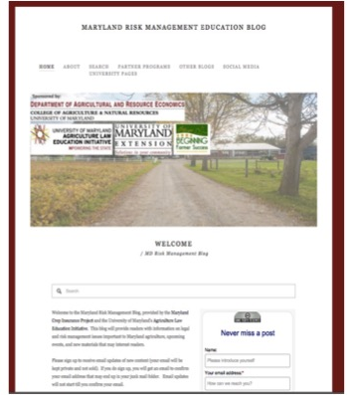
Md. Risk Management Blog
Updated periodically with timely legal, crop insurance, and farm policy information.
www.aglaw.umd.edu
Signup for updates on the site to get new posts emailed to you, or
Text 999066 to 1-781-262-3877 to signup

Slide 5
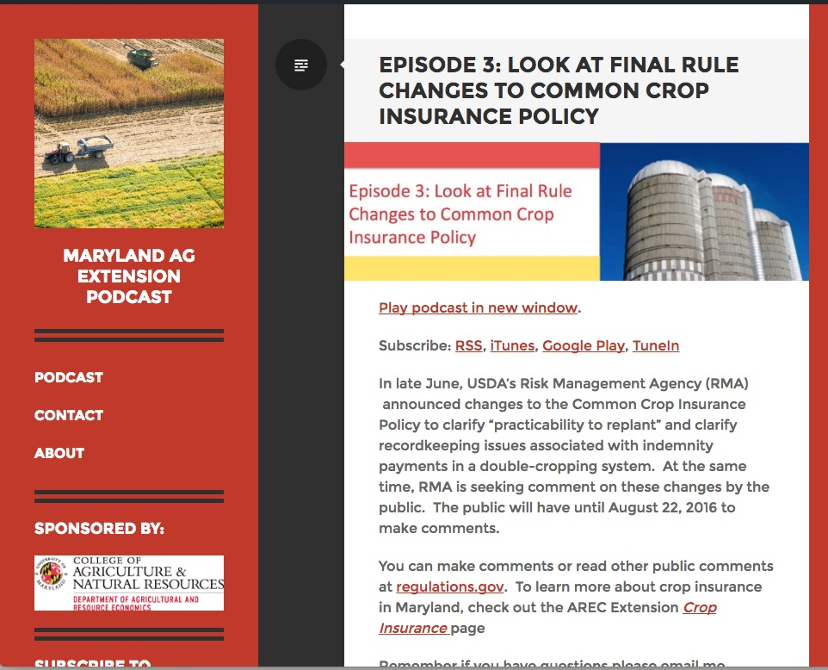
Podcast
New episodes weekly covering ag law, farm policy, etc
www.marylandagpodcast.org
Can find on iTunes, Google Play, and TuneIn

Slide 6
Disclaimer
This presentation is intended to provide general information and should not be construed as providing legal advice. It should not be cited or relied upon as legal authority. State laws vary and any attempt made to discuss laws of states other than Delaware is for general information to help the viewer better understand Delaware law. For advice about how these issues might apply to your individual situation, consult an attorney.

Slide 7
How many of you lease Farmland?

Slide 8
How many of you that lease have written leases?

Slide 9

Overview
According to 2012 Census of Ag, 53.4% (271,929 acres) of all farmland in DE is leased
No statistics exist for the percent that is leased with written leases.

Slide 10
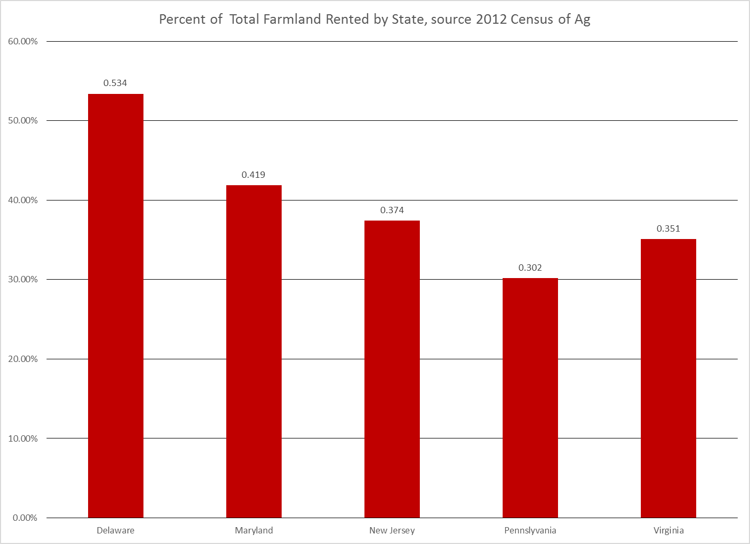
Overview

Slide 11
What does a valid lease require?

Slide 12
Overview
To be valid a lease needs:
  Valid contract
  Extent of the property to be leased
  Definite lease term/how long will the lease be for?
  Definite rental rate
Note none of this 4 requirements states the lease should be written, an oral lease could be valid if it meets the 4 requirements

Slide 13

Put the Lease in Writing
Who is this famous person and why do I have her picture here? (No it is not to give you something better to look at than my face for a minute)

Slide 14
Put the Lease in Writing
Answer: Marilu Henner was on Taxi and suffers from a condition called Hyperthymesia or the ability to remember specific events on specific days of her life – basically she recalls everyday of her life and what happened with complete accuracy.
Unless you are one of the few people in the world diagnosed with that condition, you probably should consider putting your leases into writing. Trend has been for leases to last multiple years and everyone needs a reminder of what was agreed to – unless you and the other party are Marilu Henner.

Slide 15
Put the Lease in Writing
No requirement that a lease be in writing, unless the lease is for a period longer than 1 year.
  Example 1, lease that runs from January 1, 2017 to December 31, 2017
    Not required to be in writing and can be oral
  Example 2, lease that runs from January 1, 2017 to December 31, 2017 and can continue after Dec. 31, 2017 until terminated by one of the parties
    Not required to be in writing
  Example 3, lease that runs from January 1, 2017 to December 31, 2019
    Needs to be in writing.

Slide 16
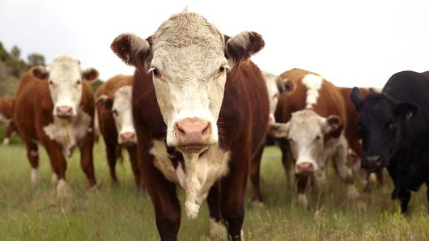
Put the Lease in Writing
DE assumes all leases without notice to terminate are like example #2
Regardless of writing or no writing.

Slide 17

Put the Lease in Writing
Sometimes “in writing” is not one document. Can be series of emails or letters that both parties can determine responsibility from.
Much safer to also to make one writing at the end.

Slide 18
Lease Termination
Lease may terminate on certain date, but DE law requires notice be given
Either party will need to follow proper termination process
If lease specifies process, then follow that process exactly
If lease doesn’t then must follow Delaware law and that requires 4 months written notice to terminate a farm lease (Del. Code Ann tit. 25 §§ 6702 to 6703).

Slide 19

4 Months From When?
Oral leases assumed to start on Jan. 1 and end on Dec. 31
  Notice by Sept. 1
Written leases date the lease is signed.
  4 months prior to end date

Slide 20
Lease Termination
What if you have crops growing when the lease terminates?
  Common law view was if the lease had a definite termination date then not entitled to harvest growing crops
  Are exceptions to this rule
    What is the practice in the area? Did landlord make some assurances?

Slide 21
Lease Renewal
Lease renewal is always the responsibility of the tenant
Lease can also extend automatically until notice of termination is given. Very common in agricultural leases.
Although not required, prior to 4 month deadline, discuss lease renewal with landlord/tenant

Slide 22
Insurance
General liability insurance
  Tenant will want to insure any of their equipment on the property, such as grain augers and tools
  Landlord will want to insure any buildings or permanent structures on the property
Crop Insurance
  Tenant will carry burden with cash rent and flex cash lease. Landlord may want to require certain coverage level on crops grown on leased property to insure payment of rent
  Tenant and landlord can split crop insurance costs based on the crop share

Slide 23
Good Husbandry Practices
Good husbandry practices is broad but means those agricultural practices that conserve fertility, usefulness, and value of the soil.
Idea is to prevent tenant from using property in way to reap quick profit but use land in way that sustains it.
Considered by many to be an implied duty in the lease
  Implied means does not have to be explicitly included in the lease
  We just assume it exists in the lease
  DE cases implying duty.

Slide 24
Failure to Pay Rent
DE creates statutory lien in growing crops for unpaid rent.
If another creditor has lien in crops, DE gives priority first to the landlord then other creditors.

Slide 25
Setting a Fair Rental Rate

Slide 26
Rental Rates
Three types of leases
  Crop-share lease
  Fixed cash lease
  Flex-cash lease
Each provides some form of economic gain
Each type requires varying levels of recordkeeping and monitoring
We will discuss all of these in the next session.

Slide 27
Fair Rental Rate?

Slide 28
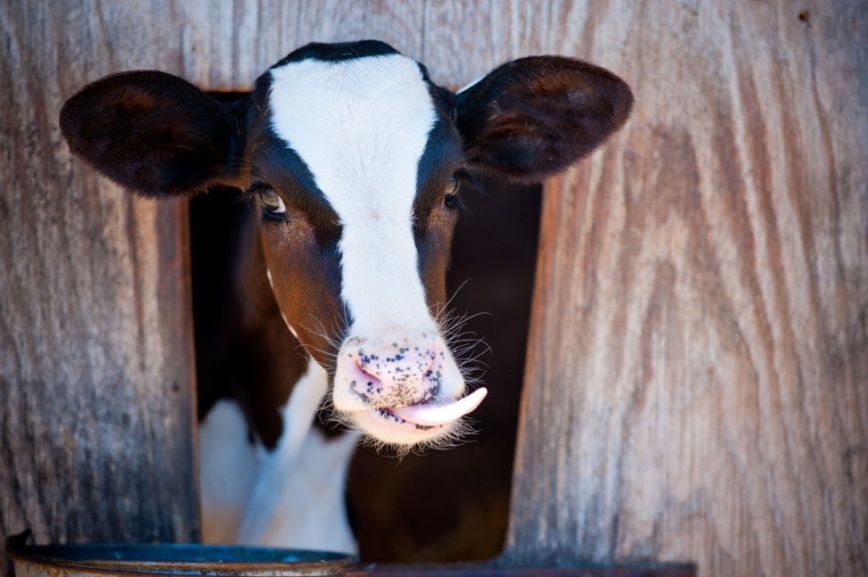
How to Calculate a Good Rent Price
Many may have no idea where to start in calculating rent.
Going to be a big deal to set a good rent:
  Needs to be at level farmer can afford
  Needs to be at a level that is good for landlord
  Potentially going to have to look at renegotiating this every year (not something we normally do in ag).

Slide 29
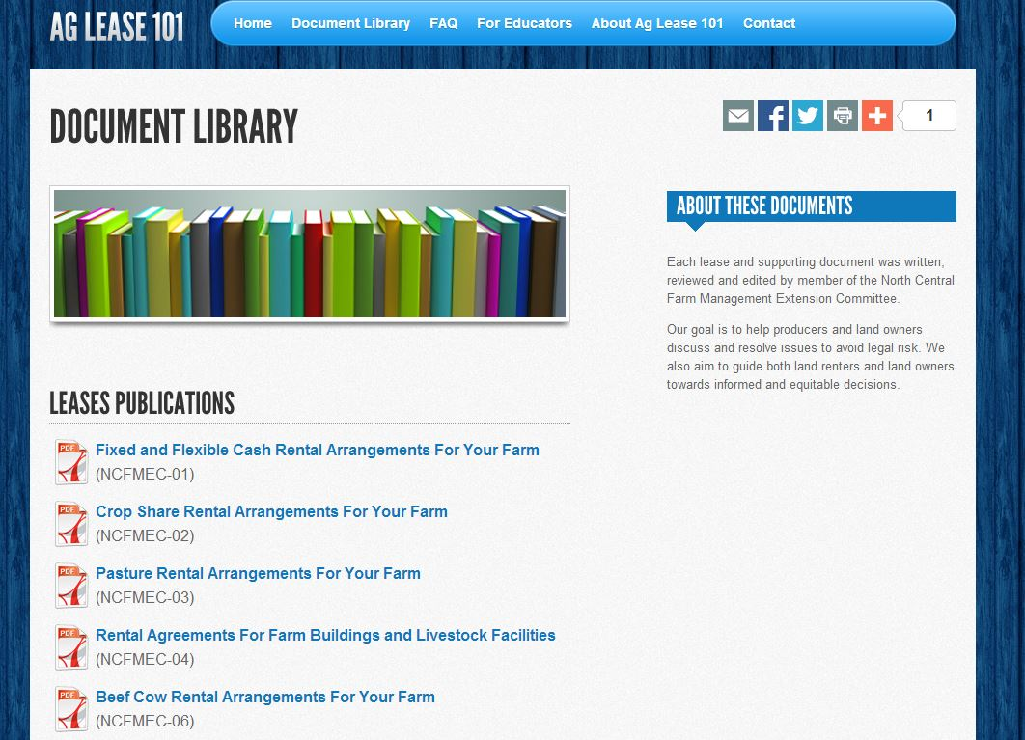
How to Calculate a Good Rent Price
Aglease101.org has worksheets available to help calculate this rent level
Has resources available to do cash, flex-cash, and crop-share rents

Slide 30
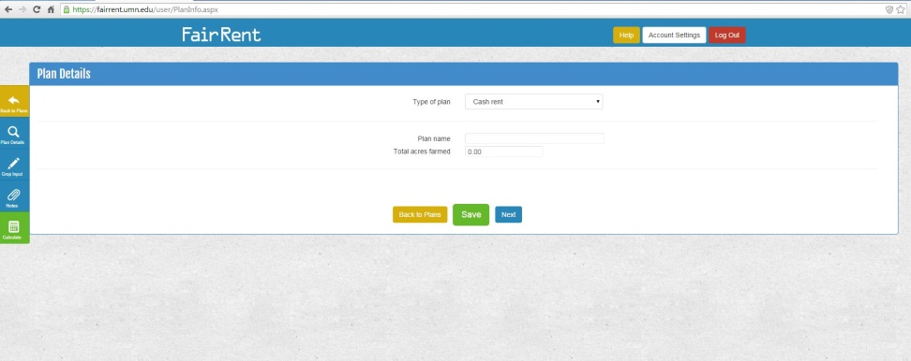
How to Calculate a Good Rent Price
Don’t like printing off a worksheet and using pen and paper?
Fairrent.umn.edu is new online resource that lets user input in factors and it spits out rent levels.

Slide 31
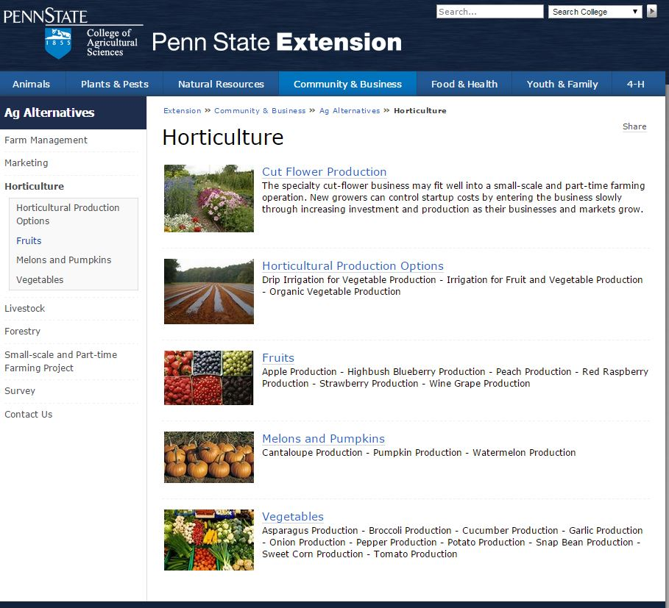
How to Calculate a Good Rent Price
Main drawback to both resources are you have to know your costs of production.
If no idea what those are, budgets exist to give you an idea of some costs of production.
Or can always talk to neighbors.
http://extension.psu.edu/business/ag-alternatives/horticulture

Slide 32
Revisiting Rental Rates
Big deal with cash rents
  Many farmers still paying same rate they got 20 years ago on a farm – not just in Maryland all over the US.
  Maybe in both parties interest to include language to recalculate the rental rate every 2 to 3 years.
    That way cash rental rate isn’t too low
    As tenant could help prevent other farmers coming in and offering landlord more rent

Slide 33
Revisiting Rental Rates
Same with flex-cash and crop-share rates, offer to revisit every 2 to 3 years just to make sure that:
  Base rental rate (if you have one) accurately reflects any increases in cash rent value
  Make sure all yield increasing expenses are covered (new tech. could come along not covered by original agreement).

Slide 34
Wrap-up

Slide 35
Wrap-up
Put your leases in writing
  Provides you with a written record of the agreement
  Reminder of what was agreed to
Notice to terminate lease is required
  Needs to be at least 4 months unless lease has specified another period.
  Give the proper notice

Slide 36
Wrap-up
Failure to pay rent
  DE law gives landlord lien in growing crops
DE courts have recognized the idea of the implied covenant of good husbandry practices
Do your math on calculating rental rates, don’t just walk in blindly
  Reevaluate periodically

Slide 37
Thanks!
Any Questions?
Email: lgoering@umd.edu
Phone: 301-405-3541
Twitter: @agLawPaul
Blog: www.aglaw.umd.edu

