Slide 1
Developing a Mission Statement
Transfer the Farm Education Series
Delaware Ag Week
Laurie Wolinski
University of Delaware Cooperative Extension
January 11, 2017

Slide 2




Thank You

Slide 3
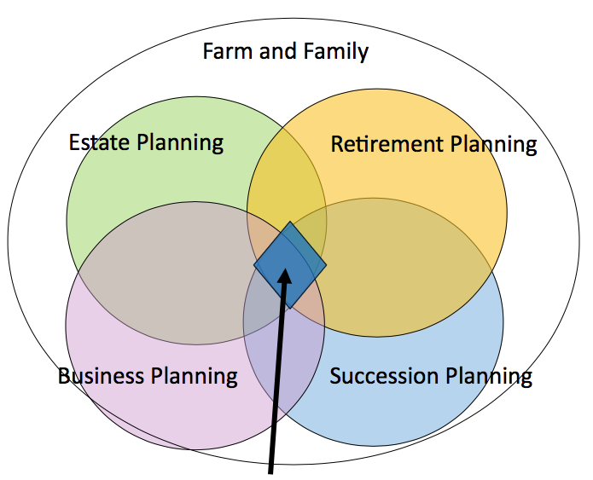
The Human (and Legal) sides of Farm and Family Risk Management
Mission Statements
Notes:
This graphic is representative of a multi-generation family business. The four circles intersect at blue diamond. That blue diamond is the file drawer for all the important and essential documents needed to make farm and family business planning successful. This is risk management.

Slide 4
Today’s Agenda
Review typical parts of a business plan
Concentrate on mission statements
Additional Resources

Slide 5
Why have a Business Plan?
Helps you set specific objectives
Allows you to share your ideas, plans and action items with family and employees
Helps in decision making (new rentals, new employees, capital purchases)
Share with lenders – requesting a loan
Know the value of your business
Strategy for growing your business
Strategy for transitioning your business
Notes:
Interactive - I’d like to hear from you how you’ve used your business plan
A written business plan is key here – if followed, a strength is that is removes questions and last minute decision making.

Slide 6
Do you know where your business will take you?
You’ve got to be very careful if you don’t know where you’re going, because you might not get there.
  – Yogi Berra
Notes:
Helps to answer questions concerning the future of your business- perceptions of others, what you are known for, etc.

Slide 7
Caring for a Business Plan?
A good business plan is not a static document, it is a living document. As such it needs to be nurtured.
  If you have a written business plan, take it out and review it.
    Have your goals and objectives changed?
    What about your strategy, have you adapted your strategy to fit today’s reality?
  If you haven’t put a plan on paper … maybe now is the time to get started!

Slide 8
Think about business planning as a two-stage process
  Stage One: Writing or Creating a business plan
    Should involve others
    Serve as a promotional document
    Be honest, not overly optimistic
    Tell your story – address relevant issues

Slide 9
Two Stage Process…
Stage Two: Implementing the business plan
  Includes steps required to implement
  A timeline or milestones

Slide 10
Typical Plan:
Executive Summary
  Mission Statement, Goals, Plan Summary, Capital Request
Business Description
  Overview, Location, Facilities, Business History
Operations
  Products, Services, Inventory, Risk Management
Marketing Plan
  Market Trends, Contracts, Pricing, Comp. Advantage
Management & Organizations
  Personnel Plan, Professional Services
Financial Plan
  Historical Performance, Asset Management, Benchmarks, Capital Request

Slide 11
Executive Summary: Mission Statement
Defines your business.
Is independent of time, space, people, or situation.
Is short and simple – one sentence is best.
Anchors the central principles in your life.
Is action oriented.
Is simple to live, yet is a life-long journey that is never finished.
Projects confidence and gives you energy.
It is not a VISION Statement.
Notes:
A mission statement serves as a set of guiding principles. Your mission statement reflects your own personality, and should be uniquely identifiable with you. Your mission is not what you do, it is who you are. If anyone of your peers can say the same statement in the same way as you, then you need to inject more of you in it. Stay away from the generic ("I help people lead better lives"). Your personality can be projected in how you phrase your statement, in the words you use, your tone of voice, etc.
Your Mission Statement describes the gift you bring to the world. Your Mission Statement is not a job or role description. The real test of your mission is if you can fulfill it alone on a desert island, on a crowded bus, at a party, at work, with your spouse, i.e. fulfilling it is independent of location, time or situation. Think of Tom Hanks in the movie "Castaway". If you were in his situation, how could you live your mission and feel success?
No more than 10 words.
The focus of the Mission Statement expresses the central theme of your life in a positive way, that which you would defend to be true at almost any cost. It also describes how people are touched or influenced by your presence.
Your Mission Statement is built around action verbs that describe your passions. A successful Mission Statement inspires you to act.
Your Mission Statement should cause people to be inspired and engaged when you say it. Your listener should also be able to connect what you say with who you are, clearly and immediately. The ultimate success of a Mission Statement is how well it creates "word of mouth". The best response is when your listener says "Tell me more!"
Your Mission Statement does not have to be grand or difficult. Living it every moment of every day, in all that you do, should be easy and simple, yet powerful and impactful. Your mission describes your journey, so it can never be "completed". If it can be completed, then it is more of a "vision" or "task".
Your Mission Statement should roll off your tongue easily, without tripping. You must be able to project it in such a way that when you say it, you feel empowered, clear and successful.

Slide 12
Is it achievable?
For you and for your employees, alike.
If your company really expects your employees to “live” its mission, then you need to create a mission statement which you and your employees can ACTUALLY achieve.
Notes:
Is it practical? Workable, reasonable?

Slide 13
Farming looks mighty easy when your plow is a pencil and you're a thousand miles from the corn field.
-Dwight D. Eisenhower
Notes:
I would argue that the same is true for a mission statement…be certain is something that you and your employees and family can live with!

Slide 14
Organizing your Thoughts for your
Mission Statement
What would you like your company to be known for in the future?
Companies typically have an internal and external purpose?
To whom do you want the mission statement to communicate?
Begin with a story about your farm…
Notes:
Storytelling is often a very passionate practice…so tell stories – it will help generate a good vibe. Story telling also helps describe/document how the farm has changed over the years – from generation to generation. An internal purpose is to be profitable. An external purpose is to be a steward of the land or to provide food and fiber for the agriculture industry.

Slide 15
Organizing your thoughts for your
Mission Statement
Phrase that describes what your farm business does
For whom
Value and/or Unique
What we do
Notes:
Another approach….

Slide 16
Thoughts for Mission Statements
Action words
Expression of value to customer

Slide 17
Example Mission Statement
The mission of MLF is to provide quality instruction while maintaining the highest standard of safety and well-being for both the horse and rider. We offer a friendly, relaxed atmosphere providing a tranquil environment for harmony between horse and rider. We will work with any breed of horse and any level of rider to develop the best partnership plus we have the unique ability to cater to youth and adult riders alike.
Notes:
What does this statement tell the reader/consumer about MLF?

Slide 18
Example Mission Statement
Action Word
The mission of MLF is to provide quality instruction while maintaining the highest standard of safety and well-being for both the horse and rider.
We offer a friendly, relaxed atmosphere providing a tranquil environment for harmony between horse and rider.
We will work with any breed of horse and any level of rider to develop the best partnership plus we have the unique ability to cater to youth and adult riders alike.
Values

Slide 19
Example Mission Statement
It is our mission at Snowdrift Farm to cultivate an organic community that encourages the creation and use of handcrafted soaps and body care products, and other handmade and small batch products. We strive to operate our Company honorably, with creativity and profitably, and with the utmost respect for those our products and services touch.

Slide 20
Example Mission Statement
Action Word
It is our mission at Snowdrift Farm to cultivate an organic community that encourages the creation and use of handcrafted soaps and body care products, and other handmade and small batch products.
We strive to operate our Company honorably, with creativity and profitably, and with the utmost respect for those our products and services touch.
Values

Slide 21
Example Mission Statement
Internal
Our mission is to provide a better life for everyone involved in Valley Farms. We seek to maximize returns and create value for those involved while at the same time be good neighbors in our community.
External

Slide 22
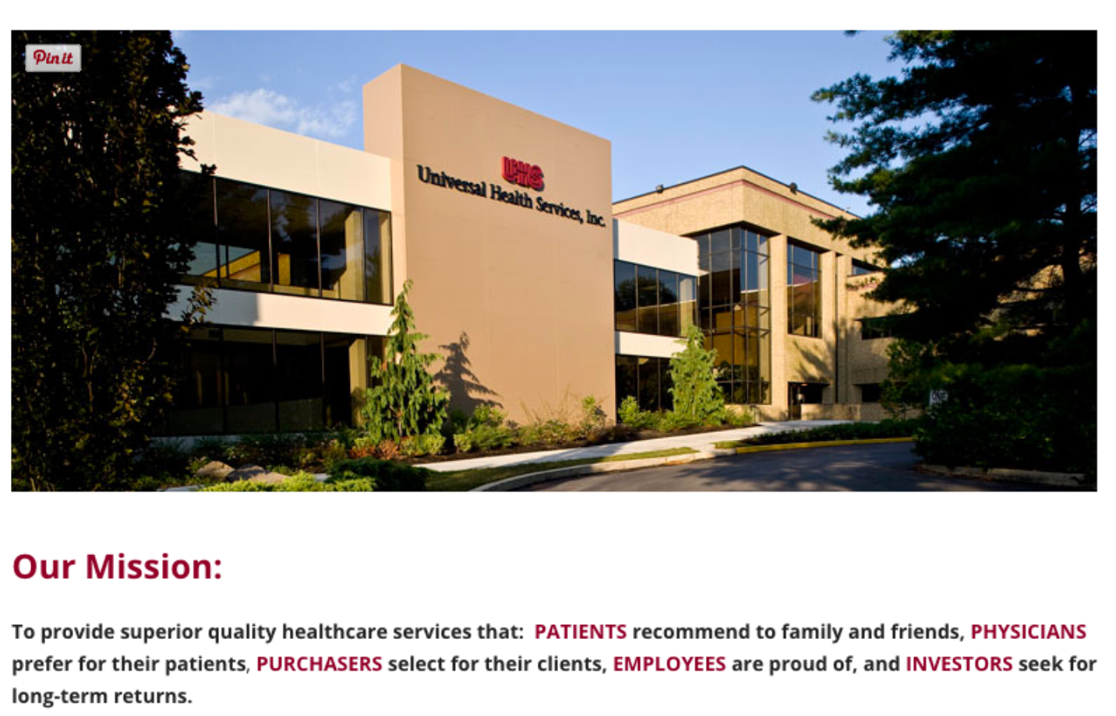
Example Mission Statement

Slide 23
Example Mission Statement
Google’s mission is to organize the world’s information and make it universally accessible and useful.

Slide 24
Example Mission Statements
Nike: "To bring inspiration and innovation to every athlete in the world."
Starbucks: "To inspire and nurture the human spirit — one person, one cup and one neighborhood at a time."
Chevron: "To be the global energy company most admired for its people, partnership and performance."
Amazon: "To be the most customer-centric company in the world, where people can find and discover anything they want to buy online."
Intel: "Delight our customers, employees and shareholders by relentlessly delivering the platform and technology advancements that become essential to the way we work and live."
eBay: "Provide a global trading platform where practically anyone can trade practically anything.”
- See more at: http://www.businessnewsdaily.com/3783-mission-statement.html#sthash.A7zclnlQ.dpuf

Slide 25
One more thought about a Mission Statement
Do you run your company?
Do not outsource the writing of your mission statement…it completely defeats the purpose.

Slide 26
Exercise
Developing a mission statement

Slide 27
Resources

Slide 28
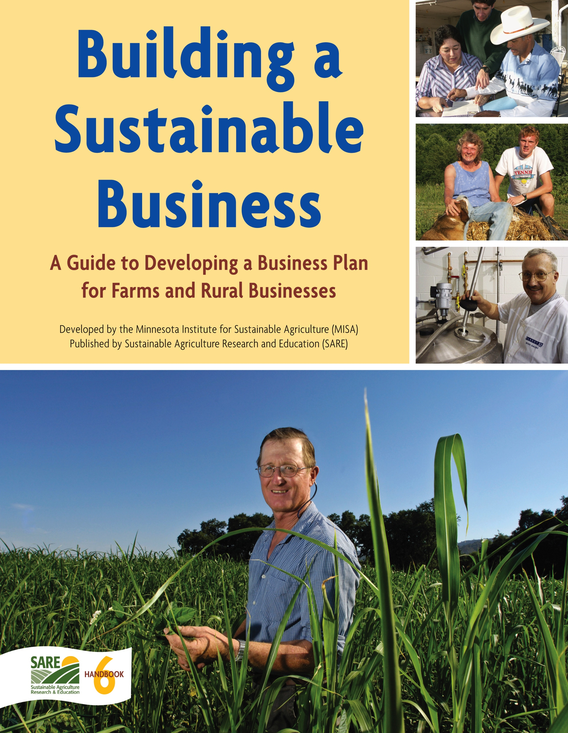
SARE
Downloadable by going to:
http://www.sare.org/Learning-Center/Archives/SARE-en-Espanol/Building-a-Sustainable-Business

Slide 29
https://www.agplan.umn.edu/

Slide 30
AgPlan is powerful website developed to help rural businesses develop a business plan. AgPlan is free of charge for anyone to use individually or in educational programs.
https://www.agplan.umn.edu/
Notes:
Reviewers, too

Slide 31
IFSaM
  Interpreting Financial Statements and Measures
  Balance Sheet
  Income Statement
  Statement of Owners Equity
  Statement of Cash Flow
  Ratio of Measures
  Liquidity Measures
  Solvency Measures
  Profitability Measures….and more
http://ifsam.cffm.umn.edu/

Slide 32
More Resources:
  The Farm Whisperer
  Inspired Questions for Farmers App
  By David Specht

Slide 33

http://www.inspired-questions.com/

Slide 34
Completing the Evaluation
helps us to provide programs that help you manage your risk!

Slide 35
Questions?
Thank you for attending and participating!
Laurie Wolinski
Lgw@udel.edu
302-831-2538

Slide 36
In the words of Walt Disney:
The way to get started is to quit talking and begin doing.
  - Walt Disney
Notes:
Well – this true. However, when farm transfer is the discussion at hand, you do need to begin but by all means – keep talking!

