Slide 1
Goal Setting
Paul Goeringer, Extension Legal Specialist, Department of Agricultural and Resource Economics
Delaware Farm Succession Planning Workshop
Nov. 3, 2015

Slide 2
Agriculture Law Education Initiative
The Agriculture Law Education Initiative is a collaboration between the University of Maryland Francis King Carey School of Law and College of Agriculture & Natural Resources, University of Maryland, College Park. Through the University of Maryland Extension - the statewide, non-formal agriculture education system - the collaboration partners with the School of Agricultural and Natural Sciences, University of Maryland Eastern Shore.
Website: www.umaglaw.org
Twitter: @MdAgLaw
Facebook: www.facebook.com/MdAgLaw
Email: umaglaw@umd.edu

Slide 3
University of Maryland MPower
The University of Maryland: MPowering the State brings together two universities of distinction to form a new collaborative partnership. Harnessing the resources of each, the University of Maryland, College Park and the University of Maryland, Baltimore will focus the collective expertise on critical statewide issues of public health, biomedical informatics, and bioengineering. This collaboration will drive an even greater impact on the state, its economy, the job market, and the next generation of innovators. The joint initiatives will have a profound effect on productivity, the economy, and the very fabric of higher education.
http://www.mpowermaryland.com

Slide 4
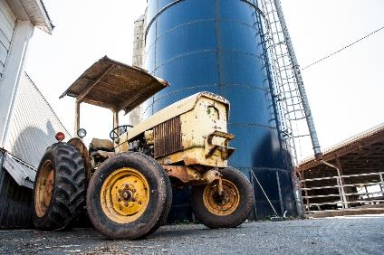
Overview
Transition/succession planning is going to require a road map
Setting goals will help keep you on track in this process.

Slide 5
What are Goals?

Slide 6

What Are Goals?
Goals are statements of what you hope to achieve
Goals will change based on circumstances and over time.
Will have reevaluate and updated

Slide 7
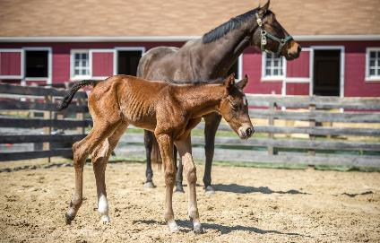
What are Goals?
Goals will be unique to you and your family
Goals will reflect your values and beliefs
Potentially mean compromise between you and your family

Slide 8
Goals will also provide roadmap

Slide 9

Where are you?

Slide 10
Where are you?
Ex: What is the financial status?
  Can you support 2 families? 1 in “retirement” and another growing family?
    Will you be able to do this by renting farmland to 2nd generation?
    Is supporting 2 families not possible?
  Do you need to diversify the operation?

Slide 11
Develop SMART Goals

Slide 12

SMART Goals
SMART Goals are:
  Specific
  Measurable
  Action-oriented
  Reasonable
  Timely

Slide 13
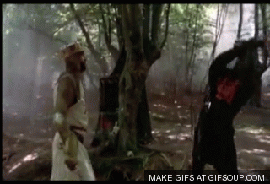
SMART Goal Example
Diversify farm operation to include agritourism operation to increase farm income by $20,000/year by fall of 2016

Slide 14
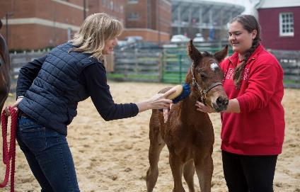
Prioritize Goals
What goals are important?
Do short term goals help you achieve long term goals? Do they impede long-term goals?
What goals are important?

Slide 15
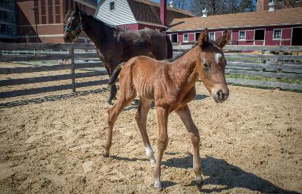
Implement goals
Set the roadmap for implementing
Work with family and other stakeholders to achieve goals
Look for potential problems in implementing

Slide 16
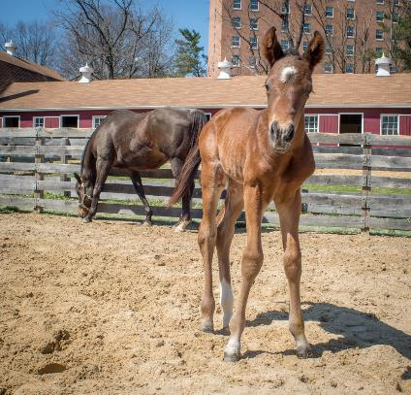
Reevaluate
Recognize that life changes and goals may too
Take time to see if goals are being met or need to reevaluate

Slide 17
Thanks!
Any Questions?
Email: lgoering@umd.edu
Phone: 301-405-3541
Twitter: @agLawPaul
Blog: www.aglaw.umd.edu

