Slide 1
Fundamentals of Succession Planning
Ashley Newhall
Extension Legal Specialist
Delaware Farm Transition Workshop
November 3, 2015

Slide 2
Disclaimer
This presentation is intended to provide general information about estate planning laws and should not be construed as providing legal advice. It should not be cited or relied upon as legal authority. State laws vary and no attempt is made to discuss laws of states other than Delaware. For advice about how these issues might apply to your individual situation, consult an attorney.

Slide 3
University of Maryland MPower
The University of Maryland: MPowering the State brings together two universities of distinction to form a new collaborative partnership. Harnessing the resources of each, the University of Maryland, College Park and the University of Maryland, Baltimore will focus the collective expertise on critical statewide issues of public health, biomedical informatics, and bioengineering. This collaboration will drive an even greater impact on the state, its economy, the job market, and the next generation of innovators. The joint initiatives will have a profound effect on productivity, the economy, and the very fabric of higher education.
http://www.mpowermaryland.com

Slide 4

Agriculture Law Education Initiative
The Agriculture Law Education Initiative is a collaboration between the University of Maryland Francis King Carey School of Law and College of Agriculture & Natural Resources, University of Maryland, College Park. Through the University of Maryland Extension - the statewide, non-formal agriculture education system - the collaboration partners with the School of Agricultural and Natural Sciences, University of Maryland Eastern Shore.
Website: www.umaglaw.org
Twitter: @MdAgLaw
Facebook: www.facebook.com/MdAgLaw
Email: umaglaw@umd.edu

Slide 5
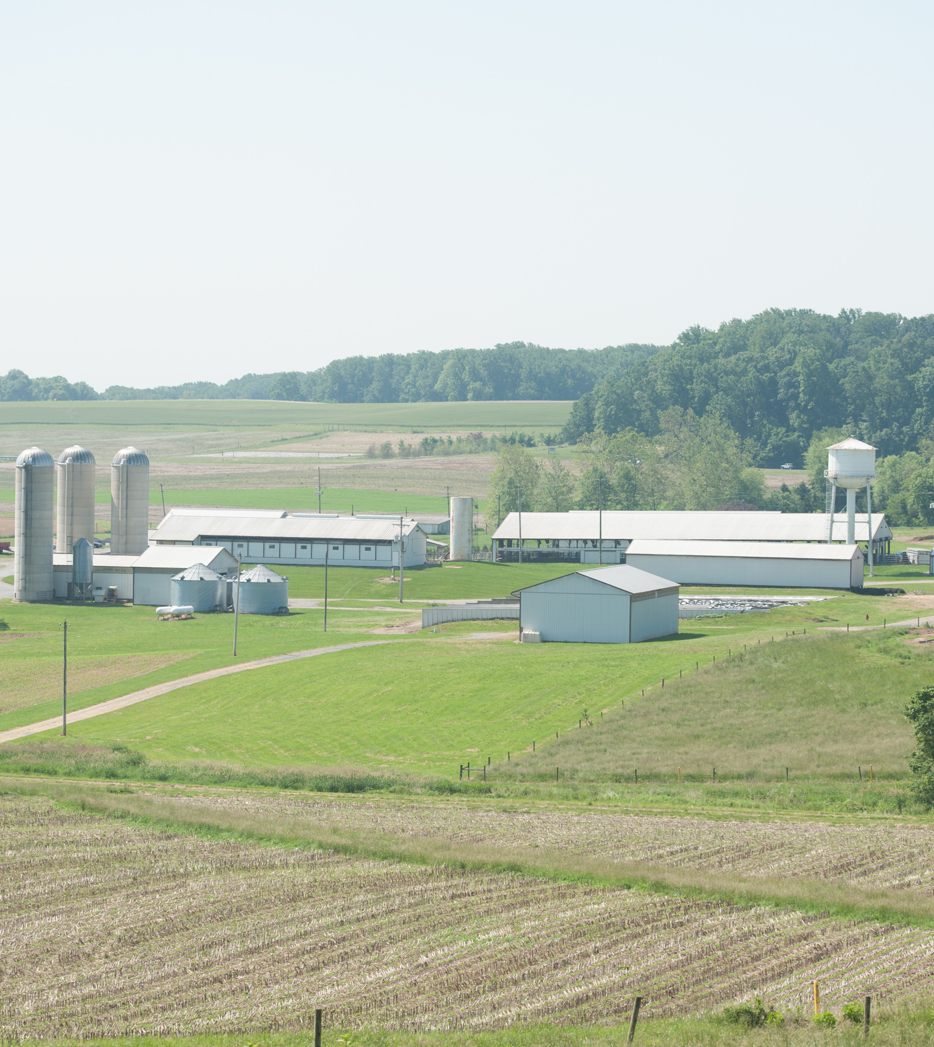
Overview
Estate planning is considered the process of arranging for an orderly transfer of your assets upon your death.
An estate plan is not just one single document, but can include multiple documents that effectively transfers your property at death and achieve other goals.

Slide 6
Develop The Estate Plan
Guardian nomination for minor children
Beneficiary designations
Powers of attorney
  Business
  Healthcare
Advanced directive for health care
Will
Trust (?)
Life insurance (?)

Slide 7
Wills
  A written document that provides instructions on how you want your property and resources to be transferred upon your death
Wills can also provide for other besides how to distribute your property
  For parents with minor children, those under the age of 18, you can appoint a guardian to raise your minor children
  You also appoint the executor/personal representative, or the person in charge of making sure your property is distributed according to the terms of your will

Slide 8
Changing the Will
A will can be changed or amended by drafting a codicil that amends the earlier will or the person can draft a new will.
  The codicil, or document amending the prior will, will need to meet all the requirements of a valid will to be valid
If you do write a will, you should keep it up to date depending on major changes that happen in your life.
  Such as:
    Marriage or divorce
    The birth of a child
    Moving to another state – laws related to estate planning vary among the states and you will want to make sure your will complies with the laws of your new state
    Acquiring new property

Slide 9
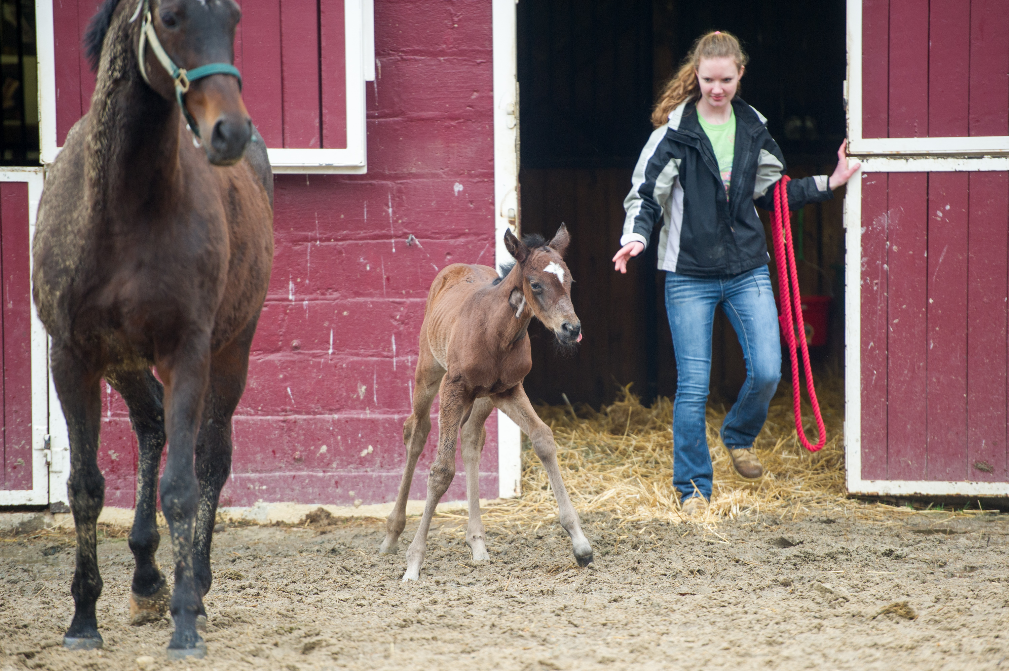
What You DON’T Want To Happen
If you fail to make a change to your will when a new life event takes place, it may not end up the way you had originally intended.
EXAMPLE:
  Farmer bequests the Farm to Daughter X. However, Daughter X is deceased at the time the Farmer dies and now the farm will go to Daughter X's heirs.

Slide 10
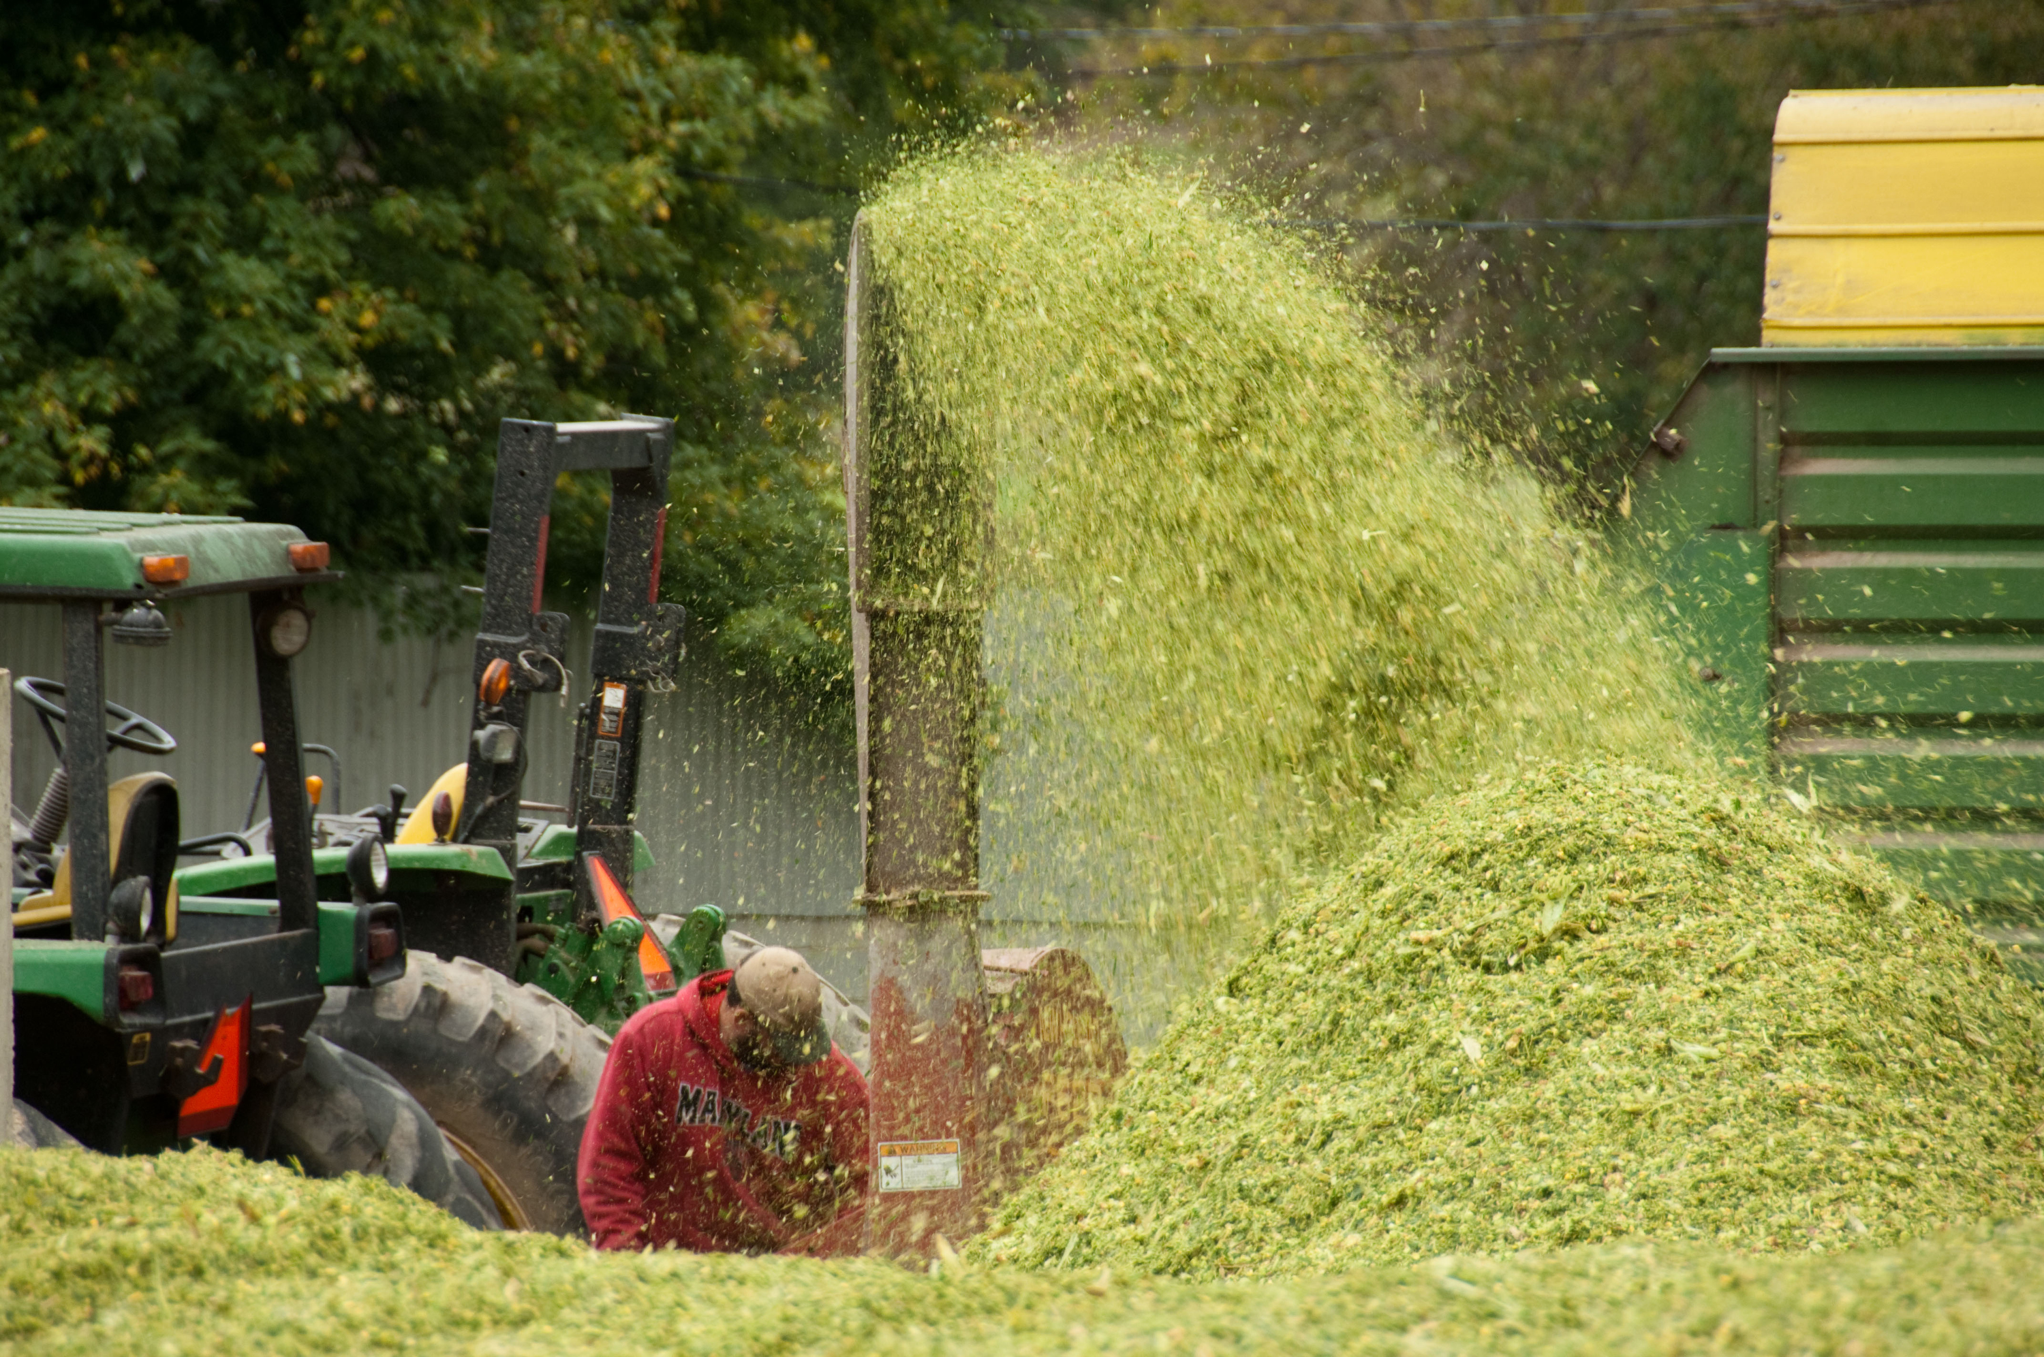
What You Also DON’T Want To Happen
SOLUTION?
  The way to avoid this issue is to draft the will so it says "to Daughter X, if she survives me"

Slide 11
Trusts
  A legal agreement between you (grantor) and a manager of the trust (trustee) for the benefit of a third party (beneficiary).
People who should consider using a trust
  Those with estates approaching federal estate tax limits, for 2014 that is estates over $5.43 million
  Those with children or a disabled family member to provide for their care if the parents were to unexpectedly pass away
  Family members that can no longer manage their own affairs, such as an elderly parent

Slide 12
Types of Trusts
Testamentary Trust – trust created in a will upon the death of the grantor
  Typically used to provide for the benefit of minor children or disabled family members
Living Trust – Is created during the trustor’s life and continue after the trustor’s death. Used by many people as a way to avoid the probate process upon their death (nothing WRONG with probate)
  Can either be revocable or irrevocable
    Revocable – You retain control of the trust to change the beneficiaries, trustee, terms, and can even choose to dissolve the trust
    Irrevocable – permanent and retain no power to change the trust

Slide 13
Developing the Estate Plan
Pros of Wills
Pros of Living Trusts
Control property till death
Can direct who gets property
Select executor and guardians
Once property distributed will no longer needed
Eliminates need for probate
Not public info
Difficult to contest
Do not need guardian to hold assets for minors

Slide 14
Develop Estate Plan
Cons of Wills
Cons of Living Trusts
Have to probate it
Easily contested (even with no contest clause)
Takes time and public process
State specific
Potentially have trustee fees
Adds complexity to asset management
Need to coordinate with other estate tools
Still need a will

Slide 15
Prenuptial Agreements
How This Document Can Protect The Future Of Your Farm

Slide 16
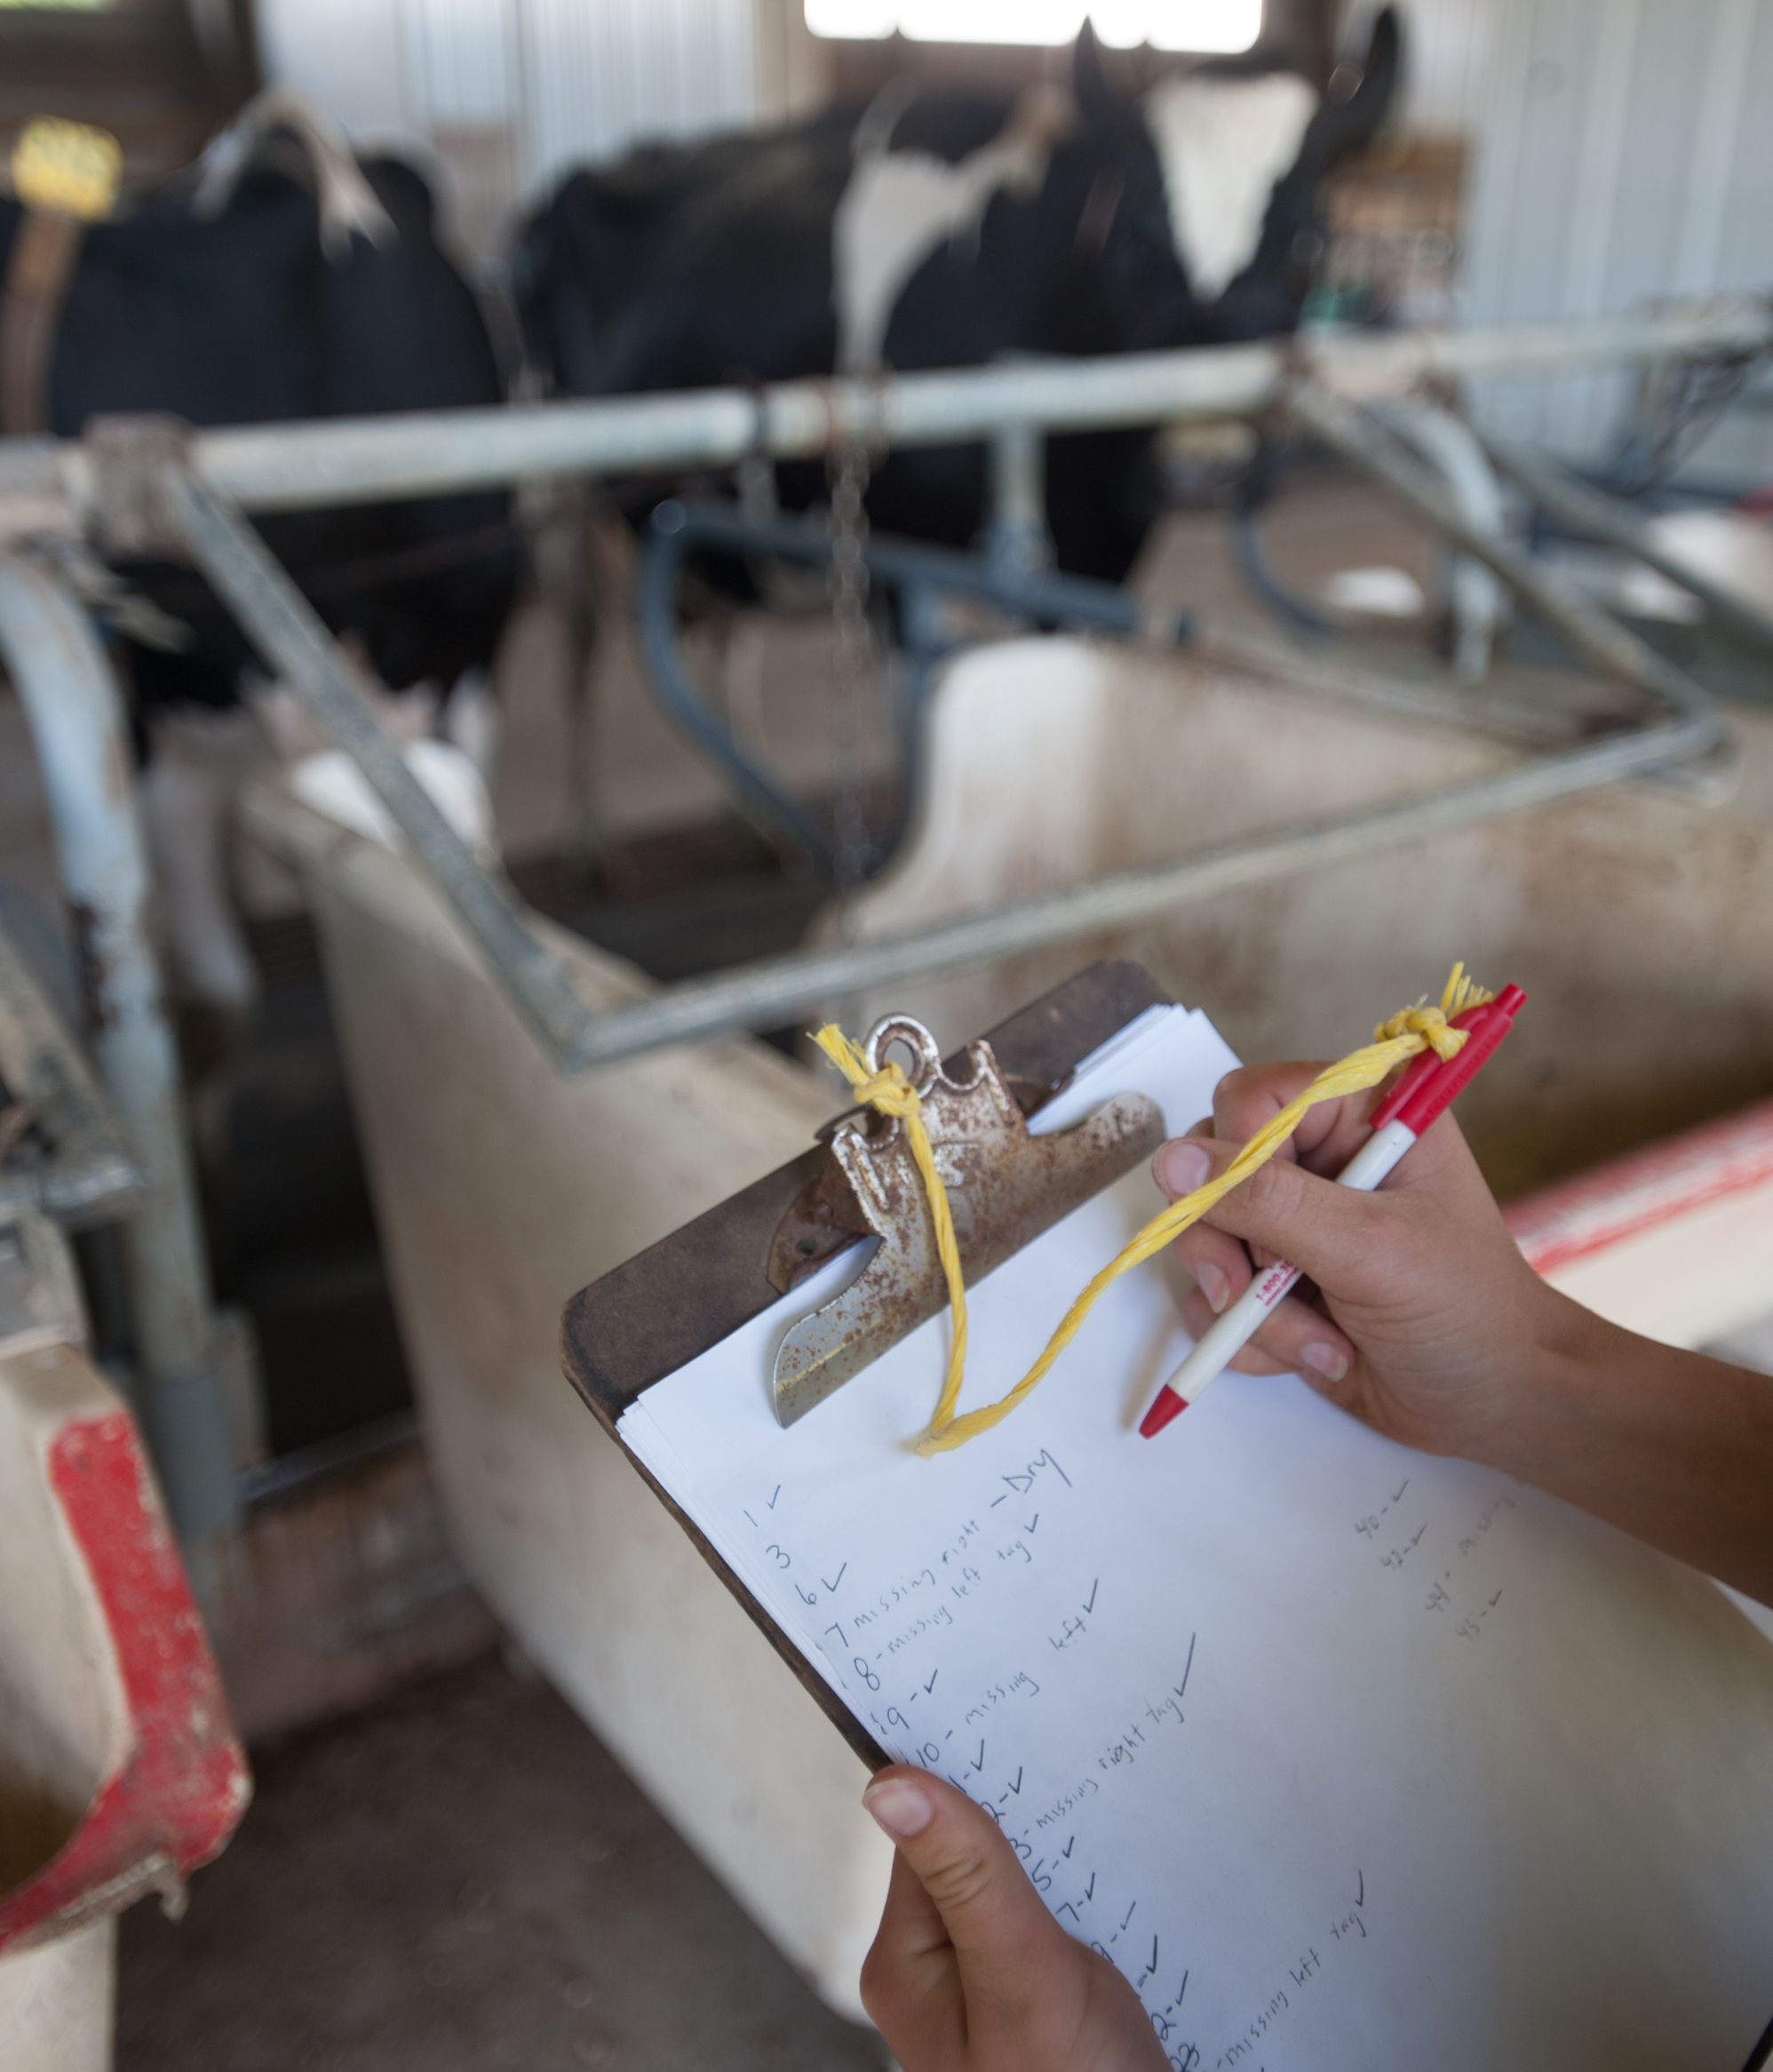
What are Prenuptial Agreements
An agreement between two parties where the two parties can address a wide variety of issues.
Lists both assets and liabilities and how those will be dealt with at the event of a marriage dissolution.
A smart agreement to make if one party has an interest in a farm, company, or even a home that was bought prior to marriage in order to protect his/her interest from future claims in the event of a divorce.

Slide 17
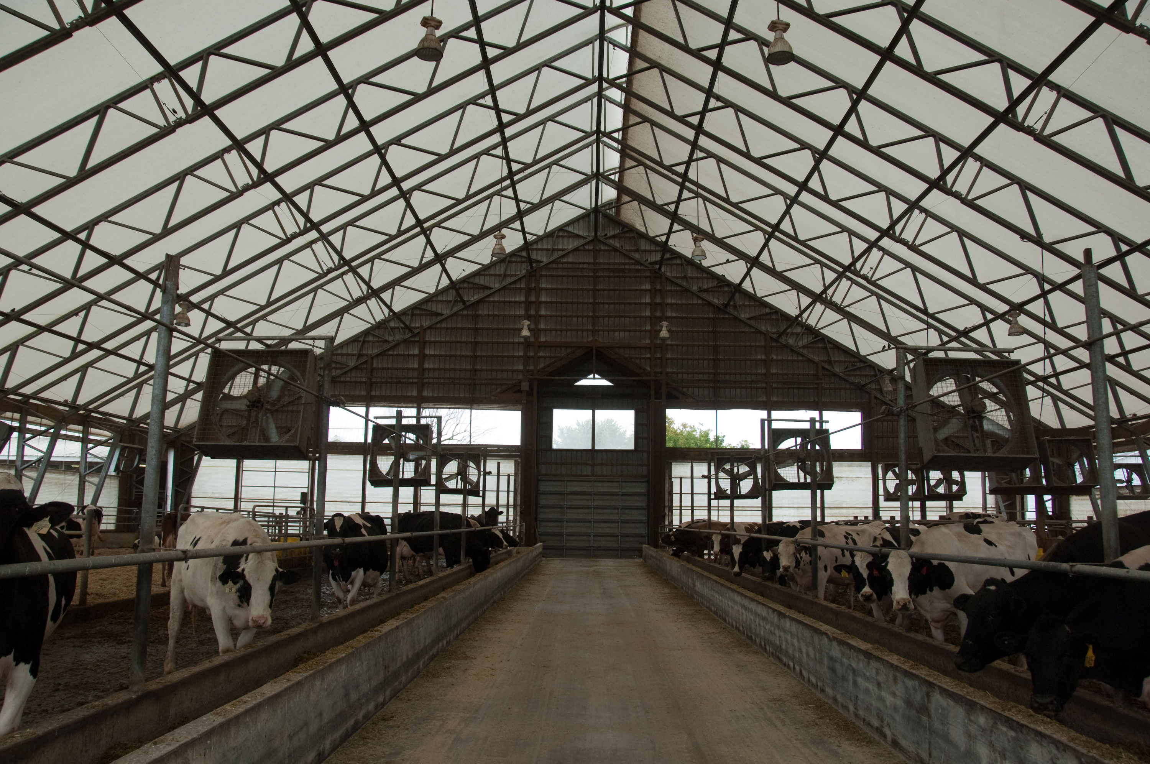
Prenuptial Agreement
EXAMPLE:
  Parents own Family Farm and in their will, Family Farm passes to Son. Son enters into a prenuptial agreement with Wife. States that in the event of a divorce, Son will keep rights to Family Farm and Wife will have no rights or claims to Family Farm.

Slide 18
Equitable Considerations
Should you treat all children equally when developing your estate plan?

Slide 19
The “Farm Kid/City Kid” Conundrum
The Issue:
  One kid stays on farm (Farm Kid) while one kid moves away and have no desire to return to the farm although he/she may still have emotional ties to the farm (City Kid)
  Parent wants to avoid conflict between children by treating them equally and gives both children equal shares. This almost guarantees conflict (Farm Kid feels he has more rights to the farm since he works and lives there)

Slide 20
The “Farm Kid/City Kid” Conundrum Answer
The Answer:
  Well, one way to deal with the conflict is to have a greater amount of farm assets pass to the Farm Kid. To compensate for that, the parent may want to allocate more financial assets to the City Kid (investments, life insurance policies, etc.)
  This is only one possibility-the KEY is COMMUNICATION

Slide 21
The Problem of “Sweat Equity”
The Issue:
  One child works side-by-side on farm where, where he is not compensated at the market rate, there is an expectation that one day the child will inherit the farm.
  The issue arises when that child puts in a significant amount of effort on the farm expecting to take over as the next generation but the actual result is that he and his off-farm siblings are given equal shares but he/she continues to run and manage the farm
  The argument here is that this passing of farm assets is unfair because the off-farm siblings are receiving the benefits of the farm child’s hard work while he manages and works the farm but shares the same amount of financial benefit as his/her siblings.

Slide 22
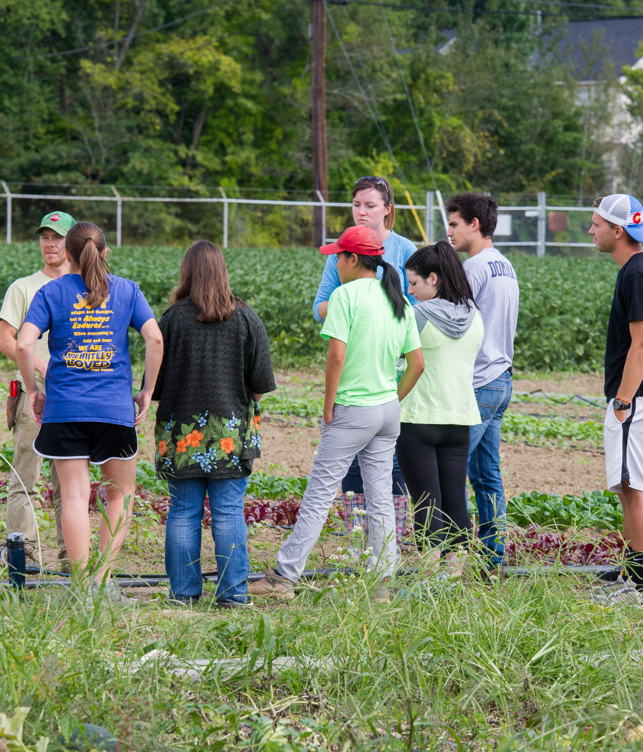
The Problem of “Sweat Equity” - Answer
The Answer:
  Again, there is never a one-size-fits-all resolution to the issue.
  One way to resolve the issue is to have NO “sweat equity” arrangement at all (no children work for reduced wages to inheret the farm)
  Alternatively, set up an ownership farm structure that allows the next generation to build appropriate ownership
    EXAMPLE: compensate child and allow him/her to invest as he or she chooses in order to grow the business (the more investment, the larger ownership share)

Slide 23
Business Entities
May allow for a smoother transfer of ownership

Slide 24
Types of Business Entities
Limited Partnerships:
  A farm business could be placed into a limited partnership with the parents being made limited partners and the successor generation made general partners. Revenues could then be shared with the parents as a form of retirement income.
  A partnership agreement can also specify that limited partners have limited or no rights of participation in the management of the entity which means that the farm operation can be placed in a limited partnership with the management being placed in the hands of the on-farm children (labeled general partners) and the off-farm children being labeled limited partners.

Slide 25
Business Entities Continued
Corporations:
  One of the most desirable advantages of forming a corporation would be the ease in which real property could be transferred.
  If the owner wanted to transfer the property over time, he would need to transfer an interest in the property over time (which would incur transaction costs and complicate title) where if the farm is a corporation, he could simply convey the individual shares in the corporation
Limited Liability Companies:
  An LLC also gives the producer great flexibility in planning for the future of the business through the use of an operating agreement.
  An operating agreement can be specifically tailored to the needs of the LLC dictating the specific needs of all players of the operation, even accounting for off-farm children who may be allowed to only participate in revenues and not management/decision making.

Slide 26
Operating Agreements
Sets forth the LLC structure
it is the main governing document of the LLC, above all others
Delaware legal premise known as freedom of contract gives the organizers of an LLC, who construct this unique document, enormous flexibility in defining the rights and responsibilities of the LLC members.
  This means it allows you to create an entity as well as define the relationship among its members as you see fit for your specific situation.

Slide 27
Operating Agreements
Since the Operating Agreement is a contract, it must be agreed to by all participating parties.
Section 18-101 of the Delaware Limited Liability Company Act states that an LLC's Operating Agreement may be "written, oral, or implied," typically people write it out and have it signed before a notary public, with a copy of the notarized document provided for each signer.

Slide 28
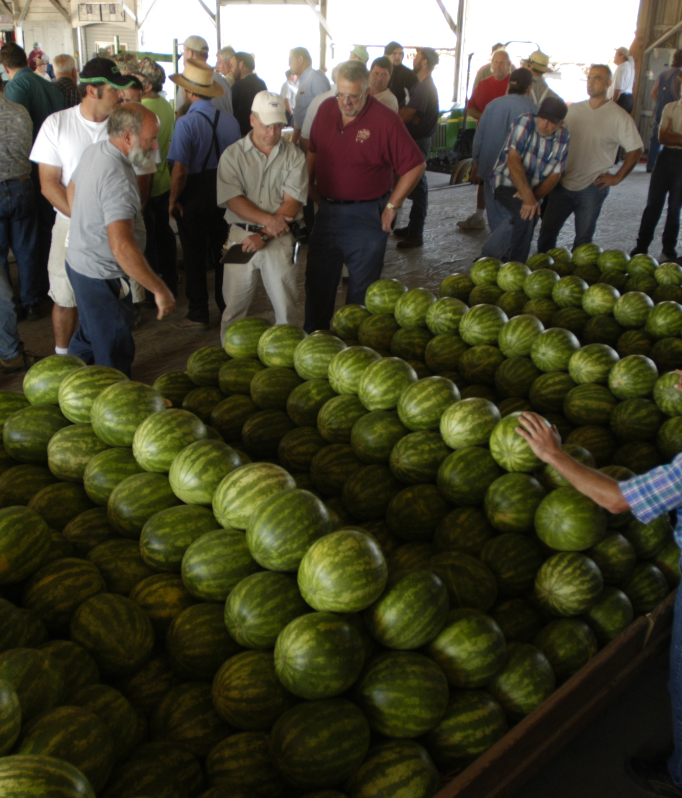
Operating Agreements benefits
Can set out who is doing the managing, decision making, etc. to ease conflict in the future
Can also dictate what happens in the occurrence of a death or sell-buy instances when someone wants out

Slide 29
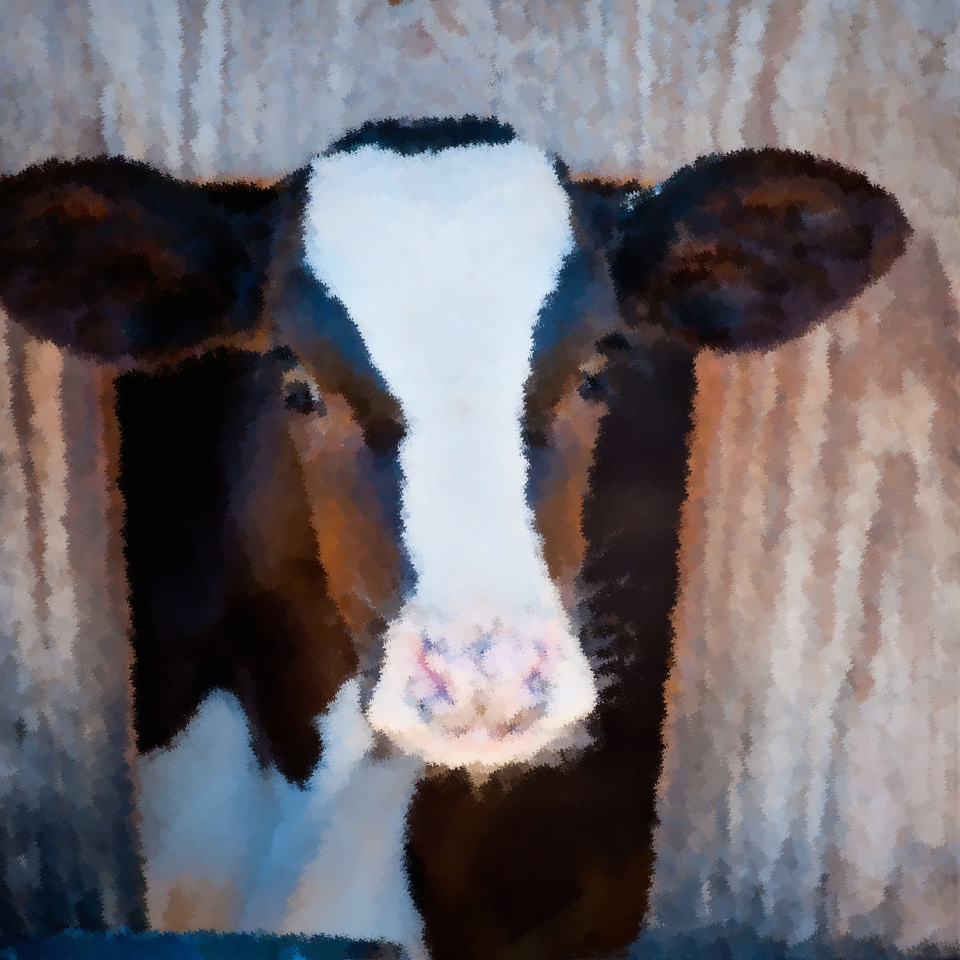
Follow The Rules: Business Entities
Is your operation incorporated, a partnership or some other form of business entity?
If your answer is YES, you also need to remember to follow the rules of your specific business entity
If your business is not in compliance when an owner passes, it may cause major headaches for those who are left to take care of the business

Slide 30
Wrap up

Slide 31
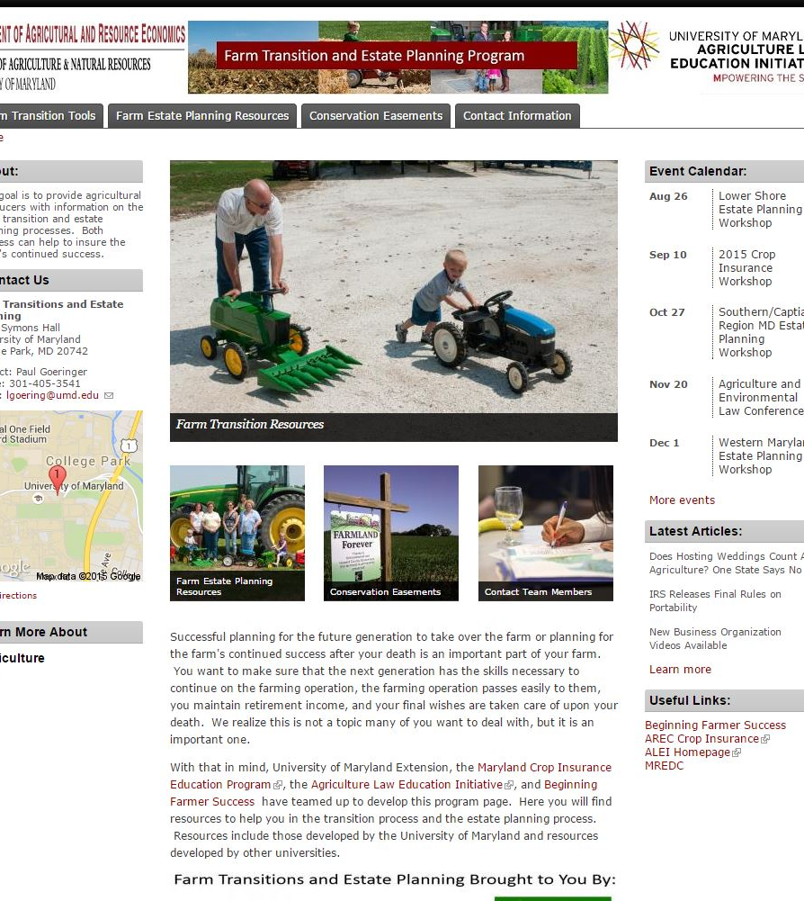
Resources Available
Over summer launched: UME page Farm Transition and Estate Planning
https://extension.umd.edu/agtransitions

Slide 32
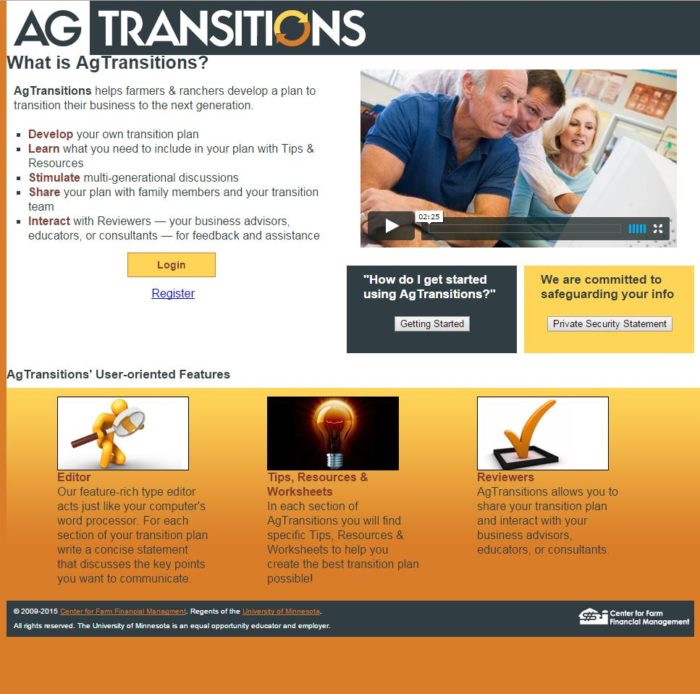
U of MN Resources Available
Through University of Minnesota’s Center for Farm Financial Management: AgTransitions
https://www.agtransitions.umn.edu/

Slide 33
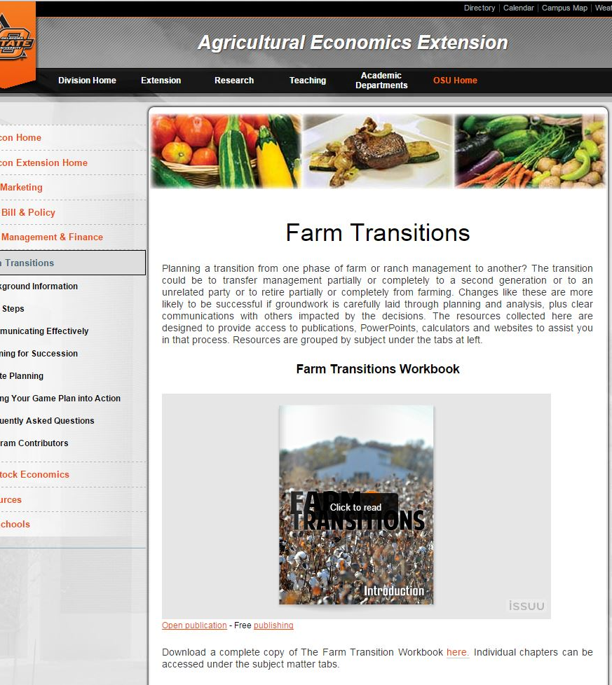
Resources Available
Through Oklahoma State University Extension: Farm Transitions
http://agecon.okstate.edu/farmtransitions/

Slide 34
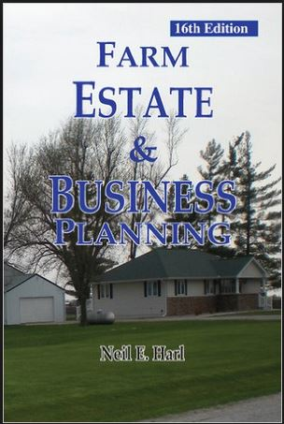
Iowa State Resources Available
This one is not free
Book by Neil Harl at Iowa State
Walks you through the process
Book is $25 to $25 http://www.agrilawpress.com/shop/farm-estate-and-business-planning/

Slide 35
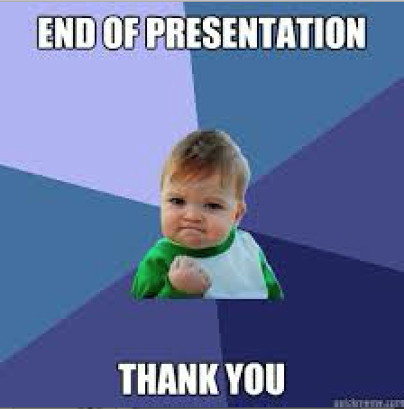
Last Slide
Have I overwhelmed you?
Point is not to be scared but prepared
Talk to your stakeholders and work with qualified professionals to have an effective transition and estate plan

Slide 36
Thanks
Any Questions?
Contact info:
Email: aellix@umd.edu
Phone: 301-458-5125
Website: aglaw.umd.edu
Twitter: @Legally_Ashley

