Slide 1

Conserve Water for Food

Slide 2

How do you use water?
I need water for…
Think about the many ways you rely on water.
List them on the notepad to the right.

Slide 3
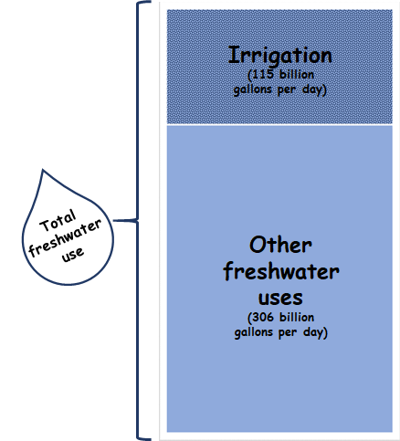
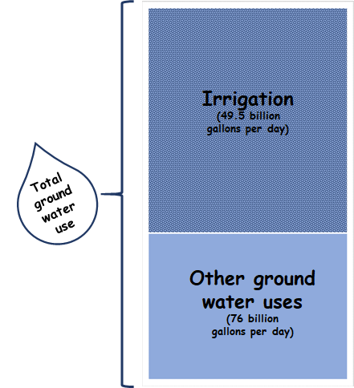
How does your community use water?
Did your list include the water used to grow your food?
Of all of the freshwater used in the United States for household needs, energy production, and other industrial purposes, nearly 42% is used for growing edible agricultural products.
Water is used for raising livestock, aquaculture, and especially for irrigation of produce fields. Irrigation fulfills agricultural water needs where direct rainfall is insufficient.
Irrigation accounts for nearly 70% of freshwater withdrawals from groundwater sources.

Slide 4
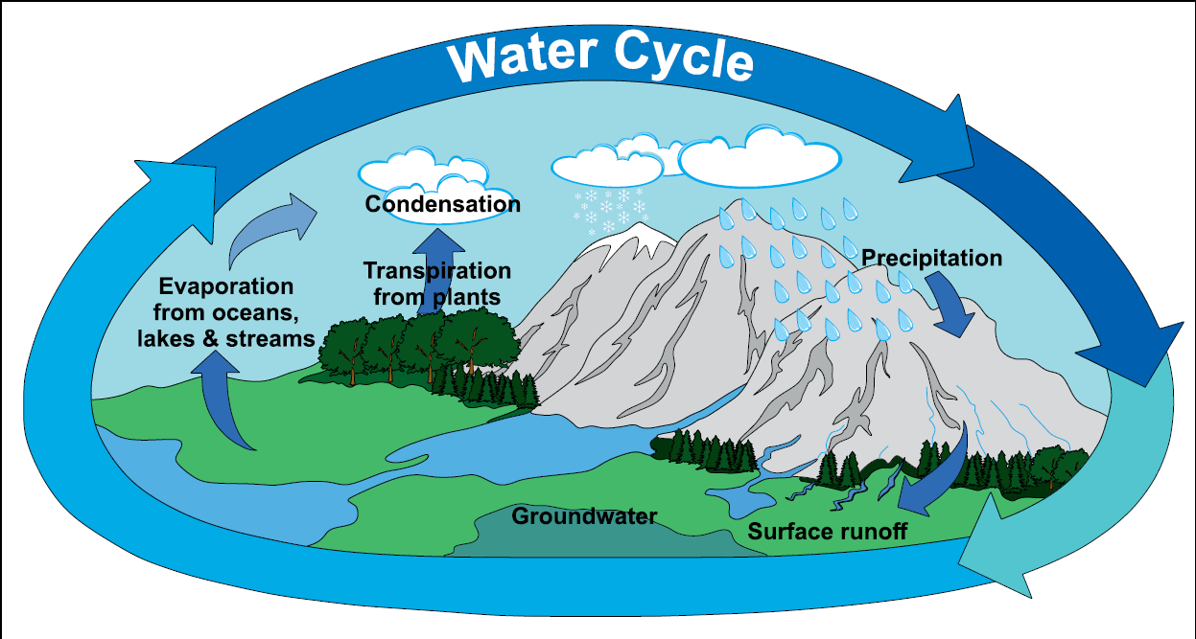
The Water Cycle
Consider the familiar water cycle and its relationship to safe and sustainable food production.
Where do we find water?
Where does it travel?
What does it contain?
Do we have enough?
Shutterstock 543156805

Slide 5
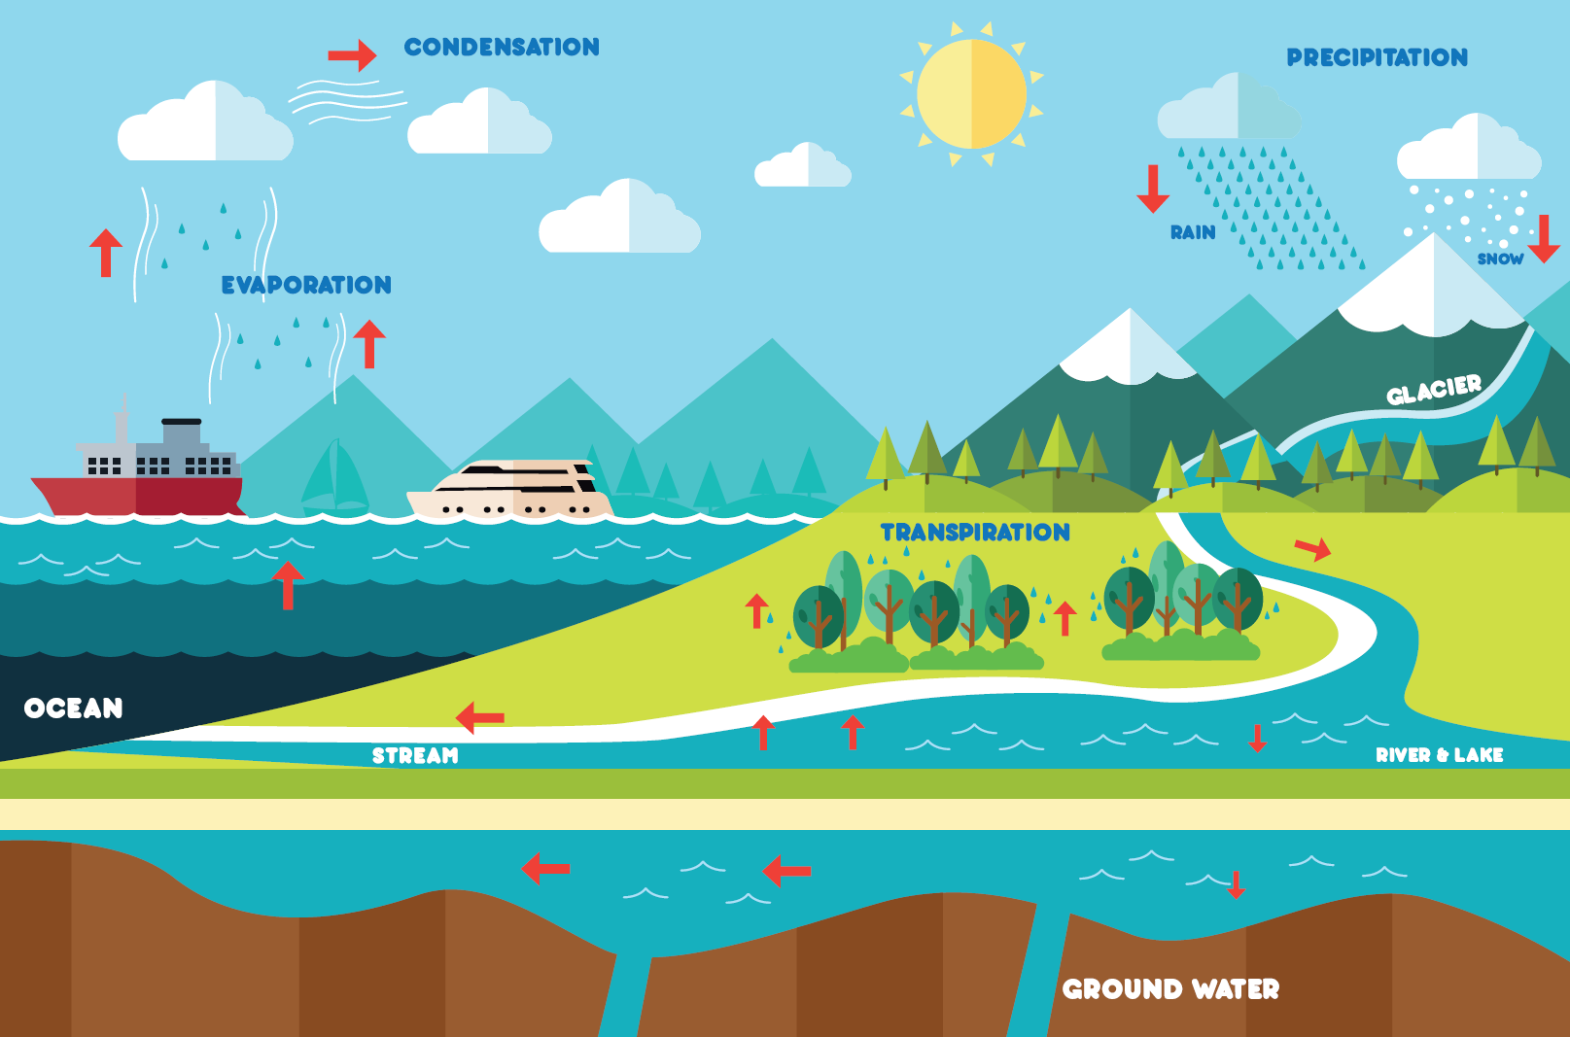
Keeping it fresh
Food crops are irrigated with freshwater, not salty water. Freshwater makes up only about 3% of all of the available water on Earth. Sort the following water types into the appropriate category of either freshwater or salty water.
Click and drag the water sources listed in the boxes to below the appropriate heading.
Glacier
Lake
River
Groundwater
Ocean
Rain
Stream
Snow
Fresh Water
Salt Water
Shutterstock 236708653

Slide 6
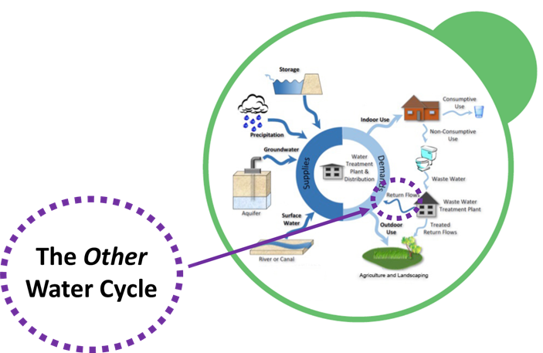
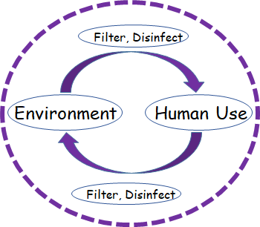

Water supply and demand
Water resources are limited.
We do not create new water.
Water is recycled and reused.

Slide 7
Water scarcity
If all the water that was ever on the Earth is still on the Earth, why are we now concerned if we will have enough water to safely grow food?
The demand for freshwater from all sources has increased with the increase in the human population. This demand is expected to continue to increase.
More people require more water for growing food as well as for drinking, sanitation, energy, and other industries. Groundwater supplies are declining.
We can’t create more water, so we must use our available water responsibly.

Slide 8
Human activity and Climate changes
Environmental water resources are impacted by interconnected challenges:
Human activity increases demand for water and impacts the quality of water due to output of contaminants such as human waste, personal care products, pharmaceuticals, industrial waste, and other byproducts of daily consumption and disposal. Water must be treated to remove contaminants before being returned to the environment in order to prevent the spread of contaminants wherever the water flows. This is particularly important for water used to irrigate food crops. Water can be filtered to remove contaminants and disinfected to inactivate microorganisms.
Climate change impacts long-term patterns of regional temperatures and rainfall. Rain shortages in some regions can lead to drought conditions; whereas other regions may have increased flooding due to more frequent or extreme rain events. Droughts and floods impact the food supply. Drought conditions inhibit plant growth and leave crops vulnerable to damage by pests (both visible and microscopic). Excessive rain can kill crops and spread contamination as water flows to agricultural fields. Temperature increases accelerate snow and glacial melt which impacts fresh water storage.
Environmental water quality must be protected to minimize contamination of agricultural fields – whether from heavy rain events or with irrigation.

Slide 9
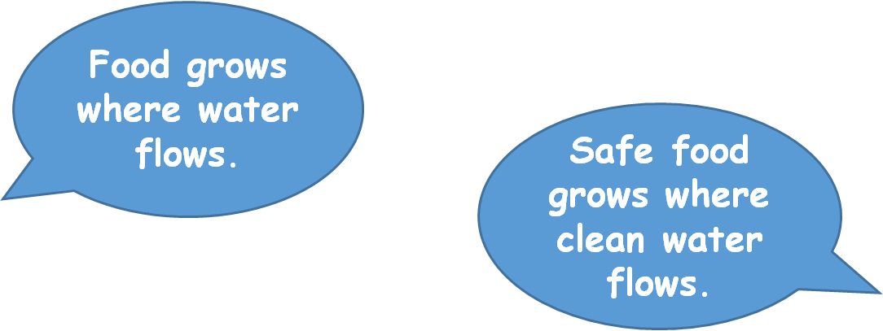
Water for Food

Slide 10
Importance of safe irrigation water
Essential questions:
What is contamination?
What is the risk of irrigating food crops with contaminated water?
How clean is clean enough?
Which water is clean enough?
How would you determine this?

Slide 11
Foodborne pathogens
Water that is safe has minimal contamination with pathogens or other pollutants
Pathogens are microorganisms that can cause disease
Not all microorganisms are pathogens or harmful
Pathogens can include bacteria, viruses, and parasites
Pathogens transmitted through consumption of contaminated foods typically cause gastroenteritis (diarrhea, vomiting). Some can cause flu-like symptoms or affect other bodily systems (nervous system, kidney, liver, brain).

Slide 12
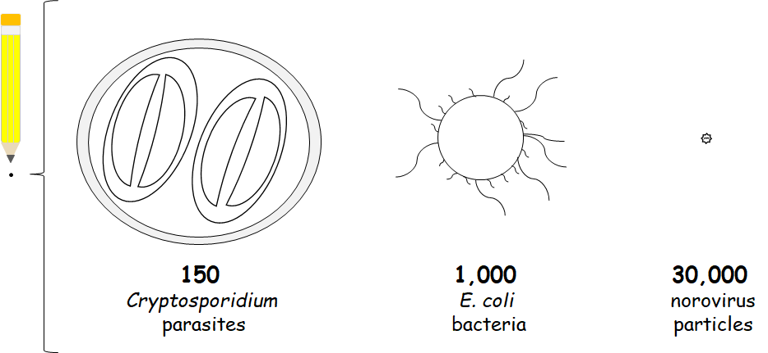
An area the size of a pencil tip could fit approximately:

Slide 13
The fecal-oral route of disease transmission
Infected individuals can shed the pathogens in their feces
Animals (wild, livestock, domestic) may also shed pathogens (with or without symptoms)
Many foodborne diseases are zoonotic – meaning they are spread between animals and humans
Good hygiene and waste management is important to reduce spread between individuals and the environment
Pathogens can be spread in the environment through movement of soil, air, and especially water
Pathogens can persist in the environment and end up on food

Slide 14
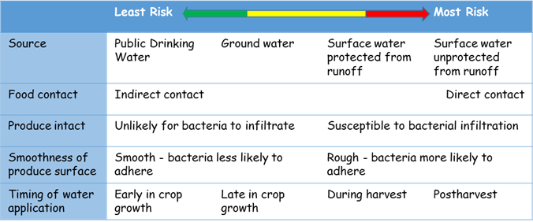
Reducing safety risks of irrigation water
Water Source
Groundwater is generally considered a lower contamination risk (and lowest variability of risk) than surface water due to natural filtration and reduced exposure to pollutants
Irrigation Method
Less contact with edible tissue reduces risk of pathogen spread to the food
Water Treatment
Water can be filtered and/or disinfected to reduce microbial load
Relative Likelihood of Produce Becoming Contaminated with Pathogens of Public Health Concern from Agricultural Water

Slide 15
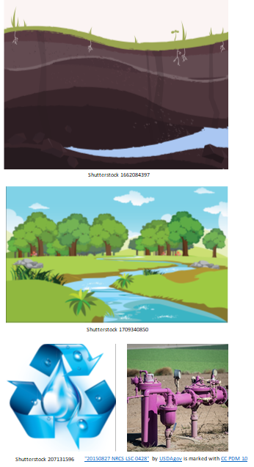
Assess the Risk - Water Sources
Irrigation water can be drawn from:
Ground water (below ground surface)
Surface water (lakes, rivers, streams)
Recycled water (after human use)
Which water source do you think has the lowest risk for contamination without treatment?
Drag and drop the orange box on your selection.

Slide 16
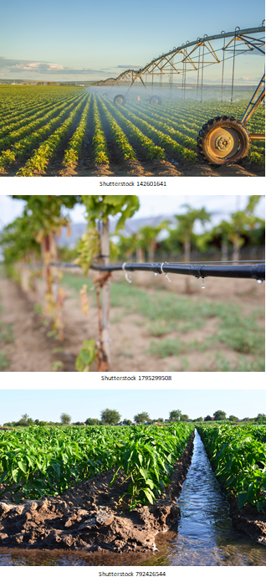
Assess the Risk - Irrigation Methods
Irrigation water can be drawn from ground, surface, and recycled water sources and applied to food crops by:
Overhead spray
Drip near the ground surface
Furrow or flooding of trenches
Which irrigation method do you think has the greatest risk of spreading contamination to the food if the water were contaminated?
Drag and drop the orange box on your selection.

Slide 17
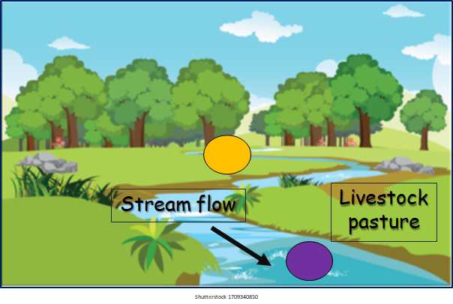
Assess the Risk – Pathogen Movement
A producer grows food crops on this land and uses the stream water for irrigation.
Should the grower draw water from the region of the stream marked with the orange oval or purple oval to minimize risk of contamination?
Explain your answer:

Slide 18
How is water quality evaluated?
Water to be used for irrigation can be sampled and analyzed for the number of bacteria that are present in the water
Bacteria that are typically found in the intestinal tracts of humans and animals are counted during the analysis and serve as indicators of potential exposure of the water to fecal matter from humans or other animals
These ‘indicator’ microorganisms are called fecal coliforms and include the bacterium Escherichia coli (E. coli)
Fecal coliforms are part of healthy digestive system and may not cause harm to humans; however, their presence in water may indicate that water has been exposed to fecal contamination that could contain microorganisms that are harmful

Slide 19
Rules for food
Producers of edible food must follow laws related to safe food production.
These laws address strategies to reduce the risk of pathogen contamination of edible crops through best practices for care of soil, water, harvesting and packing equipment surfaces, and food handler hygiene
The regulations are outlined the Produce Safety Rule which is part of the Food Safety Modernization Act (FSMA)
The United States Food and Drug Administration (U.S. FDA) has authority to assure growers follow these rules

Slide 20
How is water analyzed?
A sample of water to be evaluated is collected in a sterile container
The water sample is diluted in a series in sterile liquid of known volume to reduce the number of bacteria in the original test sample because too many bacteria would not be countable at the end step
Each of the dilution samples are spread in a petri plate over a nutrient medium containing agar that makes the medium a gel-like solid
The plates are incubated (stored for a period of time at the best temperature for bacterial growth)
Bacteria use the nutrients to grow and multiply over 24 to 48 hours
The bacteria multiply enough to form a visible colony of growth
Each colony is counted and represents one bacterium that was originally plated from each dilution

Slide 21
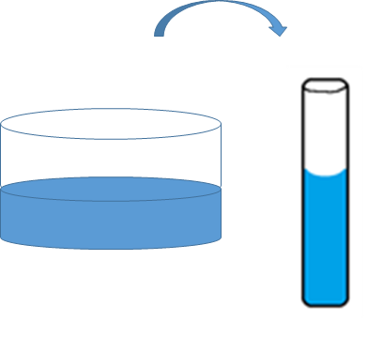
Evaluate the water sample
Collect the sample
Use a sterile container to collect the water to be tested. Transfer a small amount to be tested for bacteria.
Why should the containers be sterile?
Answer:

Slide 22
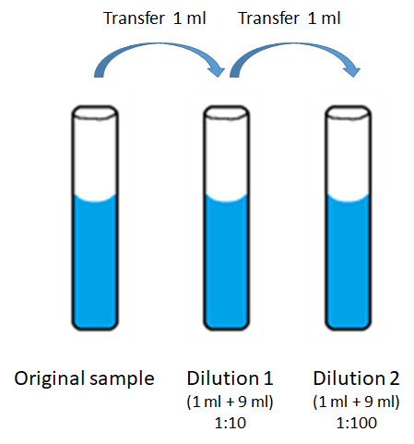

Evaluate the water sample
Dilute the sample
The original sample (1 ml) is diluted in 9 ml sterile medium. This is equal to 1 ml in a total of 10 ml (a 1:10 dilution). Therefore, Dilution 1 is a 1:10 dilution of the original sample.
Dilution 1 (1 ml) is diluted in 9 ml sterile medium to make Dilution 2. Dilution 2 is a 1:10 dilution of Dilution 1. Therefore, Dilution 2 is a 1:100 dilution of the original sample.
Which tube will have the highest number of bacteria? Click on the green check mark and place it in the appropriate box.
Original sample tube
Dilution 1
Dilution 2

Slide 23
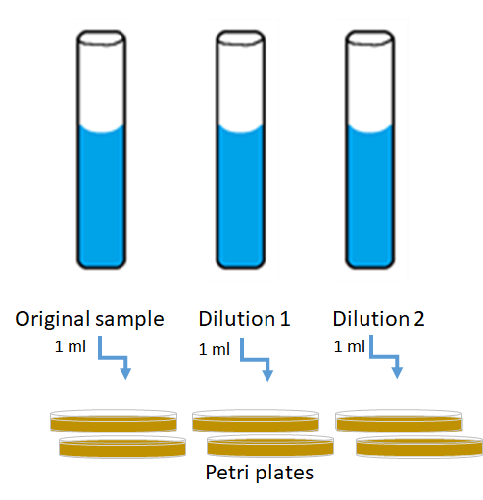
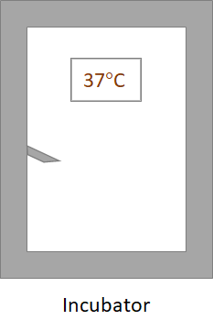

Evaluate the water sample
Plate the samples in duplicate and Incubate the plates

Slide 24
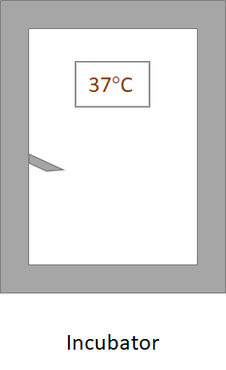
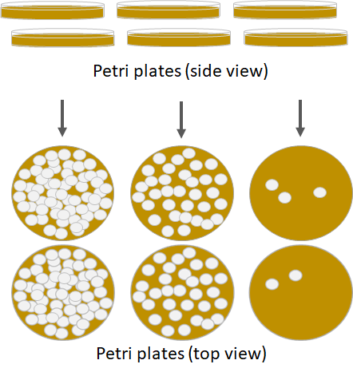
Evaluate the water sample
Count the bacterial colonies after incubation
Click and drag the labels in the purple boxes to below the appropriate set of petri plates based on the number of colonies.
Click on the green box and overlay it on the set of plates that can be accurately counted and have between 30 and 300 bacterial colonies.
Original sample
Dilution 1
Dilution 2

Slide 25
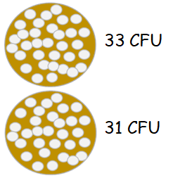
Data calculations
The colonies on the plates from Dilution 1 can be counted accurately because they are not overcrowded and overlapping each other.
The duplicate plates have 33 and 31 CFU. This is an average of 32 CFU/ml:
Show the math:
Dilution 1 is a 1:10 dilution of the original sample (or 1/10 of the original sample). Multiply the average CFU of Dilution 1 by 10 to calculate the number of bacteria in the original 1 ml sample:
Show the math:
The original sample is tested and calculated to have contained 320 CFU per one milliliter. How many bacteria would there be in 100 ml?
Show the math:

Slide 26
Irrigation water standards
Water used for irrigation of food crops should have no more than 126 colony forming units of generic E. coli in 100 milliliters of water.
Does the original water sample meet the standard?
Explain your answer:

Slide 27
What are the options?
There has been too little rain to support crop growth.
If the plants are not irrigated, they will not grow or produce enough food.
The number of generic E. coli bacteria in the water planned for irrigation use exceeds the allowable standards.
Click and drag the green check mark next to all acceptable options (copy the check mark as needed if there is more than one correct answer):
Let the crop wither without water
Irrigate with the water anyway and hope for the best
Seek another water source if time permits
Treat the water to reduce the bacterial population

Slide 28
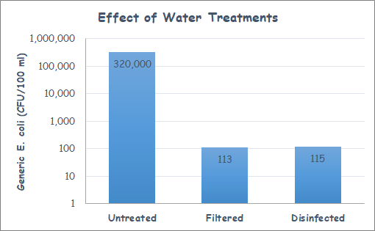
Water treatment
Do either of the treatments (filtration or disinfection) reduce the bacteria count enough to meet standards?
Explain your answer:

Slide 29
Key Terms: Drag and drop the words in the green boxes to the blue box with the corresponding definition.
Climate change
Disinfection
Fecal coliform
Filtration
Fresh water
FSMA
Gastroenteritis
Groundwater
Irrigation
Pathogen
Recycled water
Zoonoses
Type of bacteria found in intestinal tracts of humans and animals.
Method to remove contaminants from water
Method to inactivate biological contaminants in water
Illness characterized by diarrhea and/or vomiting
Water found in rivers, streams, lakes
Water used by humans and cleaned for reuse or return to the environment
Water found under the ground
Long-term change in temperature or other climate factors
Food Safety Modernization Act - rules for food safety
Microorganism capable of causing disease
Practice of watering food crops in the absence of sufficient rainfall
Diseases that can be transmitted between humans and other animals

Slide 30

