Slide 1


Food and Water Safety for
One Health
CONSERVE is a Center of Excellence supported by the United States Department of Agriculture-National Institute of Food and Agriculture, Grant number 20166800725064. Any opinions, findings, conclusions, or recommendations expressed in this work are those of the author(s) and do not necessarily reflect the view of the U.S. Department of Agriculture.

Slide 2
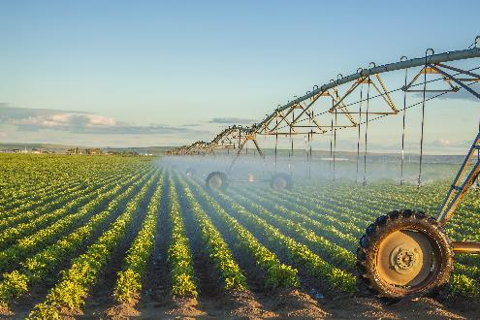
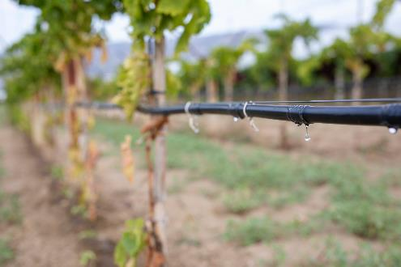
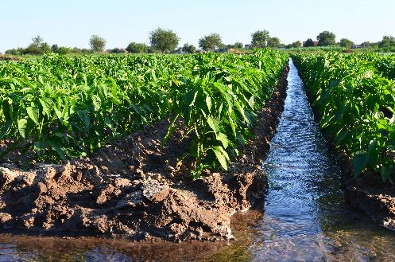
Food and Water Safety Topics
Impacts of microbiological source of illness
Microbiology basics
Food microbiology and control strategies
Surveillance for foodborne illness
Outbreak investigations
Sources of contamination
Water as a critical resource
Food safety and environmental water connection
Water resources: changing needs and response
Shutterstock 142601641
Shutterstock 1795299508
Shutterstock 792426544

Slide 3
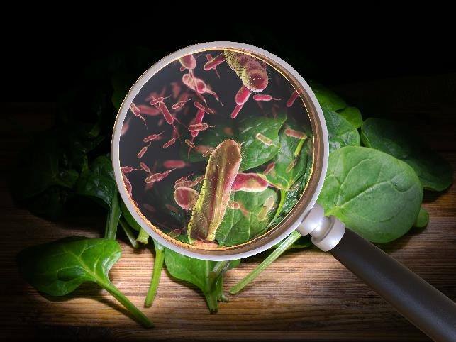
Foodborne Illness – Microbiological Origin
Consumption of microbial contaminants from food or drinking water
Over 250 different foodborne disease agents
Emerging microorganisms
  Mutations
  Improved detection and characterization
Illness caused by
  Infection
  Intoxication
Shutterstock 1422733511
Notes:
https://www.shutterstock.com/image-photo/contaminated-food-concept-tainted-meal-poisoning-1422733511

Slide 4
Estimated Annual Public Health Impact of Foodborne Illness in the United States
Centers for Disease Control and Prevention (CDC)¹
47.8 million illness cases, of which, an estimated
  9.4 million illnesses caused by 31 known pathogens
  38.4 million illnesses caused by unspecified agents
128,000 hospitalizations
3000 deaths
Estimates
  Generated by public health data
  Account for underreporting
¹ Scallan et al., 2011. Foodborne illness acquired in the United States – Major Pathogens. Emerg. Infect. Dis.

Slide 5
Perspective
Quantity of food produced and consumed
  Rarity of illness
Many dedicated to protection of foods
  Industry
  Government (regulation and research)
  Academia
  Public health
Microorganisms
  Vast majority harmless, essential to immune and digestive function
  Pathogen – capable of causing illness

Slide 6
Foodborne Illness Cases and Outbreaks
Case
  An instance of a particular foodborne disease
Outbreak
  Two or more cases of a similar illness resulting from consumption of the same food
  Exceptions in which just one illness case constitutes an outbreak due to severity of illness
    Chemically-related foodborne illness
    Clostridium botulinum poisoning (botulism)

Slide 7
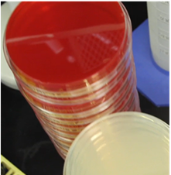
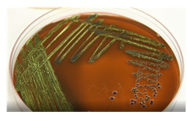
Microbiology Basics
Microorganisms and their byproducts
  Bacteria
  Virus
  Parasites
  Microbial toxins
Infection vs. Intoxication
Microbial growth in food

Slide 8
Foodborne Bacteria
Prokaryotic cells
Circular DNA genome
Some carry extra DNA on a plasmid
  Nonessential DNA
  May encode genes for resistance and virulence
Cytoplasmic space contained by membrane and wall
  Two main types distinguishable by stain
Surface molecules and structures interact with surroundings, aid identification
  Flagella provide motility
  Pili aid attachment to surfaces
  Surface molecules – antigens – can aid characterization, trigger host immune response to foreign molecule, mimic host cells to evade immune response
Note that each of these structures can be used to detect and identify bacteria
Shutterstock 1523599223
Notes:
https://ccsearch.creativecommons.org/photos/0160e931-509c-4468-800f-cc6f70573870
https://api.creativecommons.engineering/v1/thumbs/0f6fe982-47b2-4210-a03b-32ea62ad0558
https://www.shutterstock.com/image-vector/bacterial-cell-anatomy-labeling-structures-on-1523599223

Slide 9
Foodborne Bacteria
Some bacteria form spores
  Provides for dormancy in stressful conditions
    Unfavorable temperatures
    Limited water or nutrients
  Spore state allows for survival but not growth (preserved metabolic function)
  Spores can germinate and outgrow to vegetative, metabolically-active state with the return of favorable nutrient and environmental conditions
Shutterstock 1713397150
Notes:
https://www.shutterstock.com/image-vector/stages-endospore-formation-cell-division-engulfment-1713397150

Slide 10
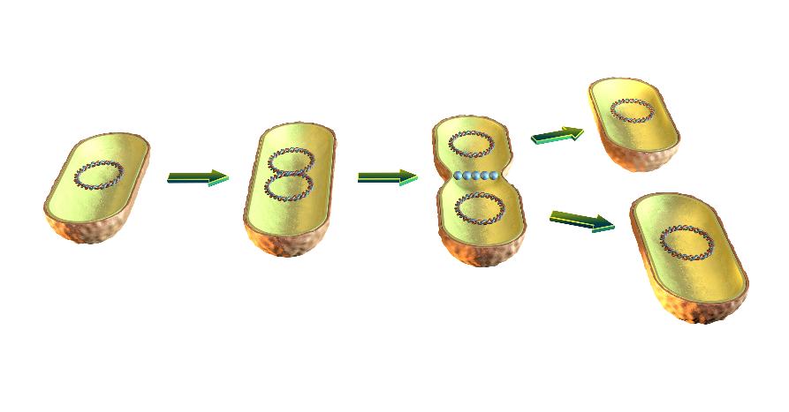
Foodborne Bacteria
Capable of growth and replication in food
  Given appropriate conditions
    Nutrients
    Water availability
    Temperature
    pH
    Atmospheric conditions
  Food characteristics can be modified to inhibit growth
Capable of growth in host
Shutterstock 711055639

Slide 11
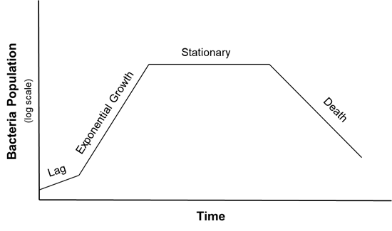
Foodborne Bacteria
Stages of growth of bacterial population
  Lag
    Adjustment to environmental conditions
  Exponential growth
    Bacterial growth and multiplication
  Stationary
    Depletion of nutrients
    Accumulation of waste
  Death
Time scale
  Varies by bacteria
  Varies by environmental conditions
  Doubling time can be as short as 20 minutes
Notes:
Lag phase: bacteria initially adjust to the new environment, so they appear not able to replicate but the cells might grow in volume; Log (exponential) phase: cells start dividing regularly by the process of binary fission. The culture reaches the maximum growth rate, which could be estimated by generation time or doubling time, i.e., the time per generation; Stationary phase: the number of cells undergoing division seems to be equal to that being dead due to the exhaustion of nutrients. Dead phase: bacteria lose the ability to divide and the number of dead cells exceeds that of live cells.

Slide 12
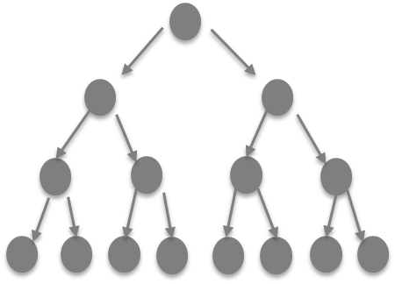
Foodborne Bacteria
Exponential growth phase
Rapid increase in bacterial populations
Low level of initial contamination can become problematic
Control conditions to minimize growth
  Temperature ‘Danger Zone’ (40 to 140°F)
  Refrigerate (below 40°F) to inhibit growth
  Keep warm (above 140°F) to inhibit growth

Slide 13
Foodborne Bacteria – Major Pathogens of Concern
Campylobacter
Salmonellae
Escherichia coli O157:H7 (and other shigatoxigenic (STEC) E. coli)
Staphylococcus aureus
Listeria monocytogenes
Clostridium perfringens
Clostridium botulinum
Bacillus cereus
Shutterstock 541889974
Notes:
https://www.shutterstock.com/image-vector/types-bacterial-bacteriadifferent-forms-bacteria-classification-541889974

Slide 14
Foodborne Bacteria – Infection vs. Intoxication
Infection
  Bacteria enter digestive system
  Disrupt host cell structure, signaling and transport of ions in and out of cell to cause gastroenteritis symptoms (diarrhea)
  Some invade cell (Examples: Salmonella, Listeria)
  Others noninvasive
Intoxication
  Preformed toxin causes illness symptoms
    Examples: C. botulinum, C. perfringens, S. aureus, B. cereus
Infectious and Toxigenic
  Some bacterial virulence attributed to both infection of host and release of toxins
    (Example: shiga-toxigenic E. coli – toxin encoded by virus genome incorporated into the bacterial genome)

Slide 15
Foodborne Virus
Virus structure
  Genomic material – DNA or RNA (RNA for common foodborne viruses)
  Capsid – protein outer layer
Virus replication
  No growth in food
  Can only replicate in host using host cell molecules needed for replication

Slide 16




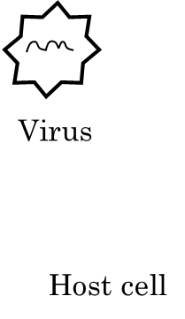
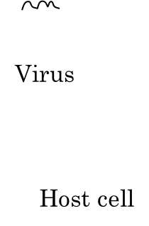



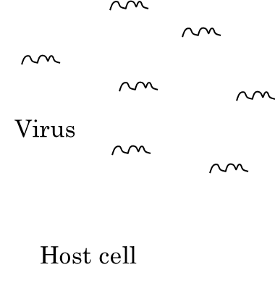
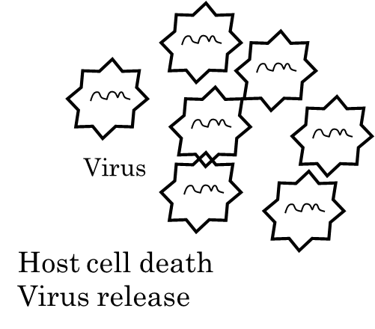
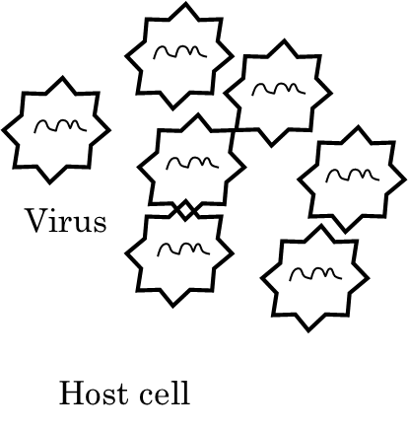
Virus Infection and Replication
1
2
3
6
5
4
Notes:
2. Virus enters cell; 3. uncoating of virus to release genomic material; 4. viral genome replicated; 5. virus genome encapsidated; 6. virus released and host cells dies

Slide 17
Foodborne Virus – Major Pathogens of Concern
Norovirus
  Estimated public health impact of approximately 20 million illnesses annually, of which an estimated 5.5 million are derived from contaminated food
Hepatitis A virus
  Less than 2,000 annual illnesses in the United States
  30% hospitalization rate
Norovirus by the Numbers
20,000,000
Illnesses
109,000
Hospitalizations
900
Deaths
Burden of norovirus in the United States. Estimated annual number of illnesses and associated outcomes for norovirus disease in the U.S., across all age groups.
Source: CDC
Notes:
Source: CDC

Slide 18
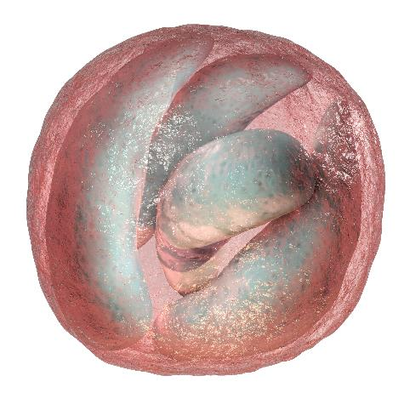
Foodborne Protozoa
Protozoa structure
  Oocyst outer layer
  Sporocysts internal compartments
  Sporozoite
Protozoa do not grow in food
Potential sources:
  Contaminated environmental water
  Cattle
Cryptosporidium parvum oocyst, 3D illustration. Cryptosporidium is a protozoan, microscopic parasite, the causative agent of the diarrheal disease cryptosporidiosis
Shutterstock 1245396574
Notes:
https://www.shutterstock.com/image-illustration/cryptosporidium-parvum-oocyst-3d-illustration-protozoan-1245396574
https://www.cdc.gov/dpdx/cryptosporidiosis/index.html

Slide 19
Foodborne Protozoa – Major Pathogens of Concern
Cryptosporidium species, especially
  Cryptosporidium hominis
  Cryptosporidium parvum
Cyclospora cayetenensis
Toxoplasma gondii
Estimated over 200,000 annual foodborne illnesses in the U.S. due to parasites
https://www.cdc.gov/foodborneburden/pdfs/scallan-estimated-illnesses-foodborne-pathogens.pdf
Notes:
Source: CDC

Slide 20
Foodborne Pathogens
Commonly zoonotic
Fecal-oral route of transmission
  Pathogen shed in feces of infected individual
  Inadvertently spread to other individuals through consumption of contaminated food or water
Potential transfer between animals and humans
  Direct contact with animals and between humans
  Transfer of contaminants to environment (water, soil) and ready-to-eat foods
  Contact with contaminated surfaces
Persist in environment
Resistant to removal from ready-to-eat foods

Slide 21
Food Production – Farm to Fork
Food can become contaminated with pathogens at all stages of handling from production to processing, distribution, and final preparation
Shutterstock 1942119285
Notes:
https://www.shutterstock.com/image-vector/food-chain-production-194219285

Slide 22
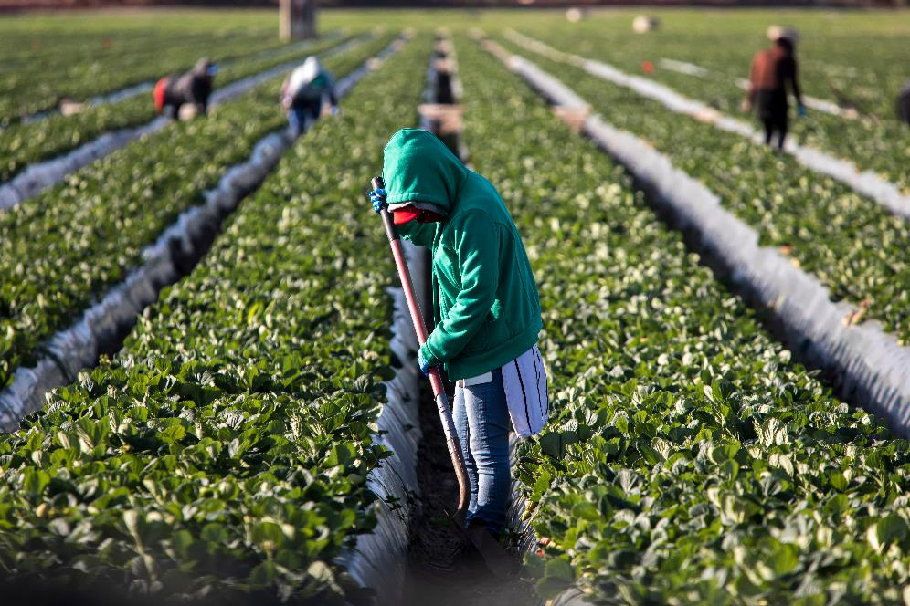
Foodborne Pathogens – Routes of Contamination
Production
  Water
  Soil
  Air
  Equipment
  Food handlers
  Animals and insects
Shutterstock 1622521543
Notes:
https://www.shutterstock.com/image-photo/woman-farm-worker-green-sweatshirt-strawberry-1622521543

Slide 23
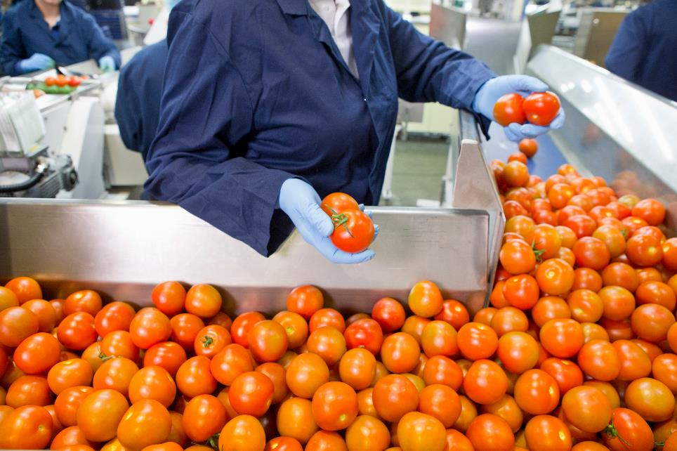
Foodborne Pathogens – Routes of Contamination
Processing
  Ingredients
  Equipment
  Processing environment
  Food handlers
Shutterstock 1586691583
Notes:
https://www.shutterstock.com/image-photo/quality-control-worker-sorting-ripe-red-1586691583

Slide 24
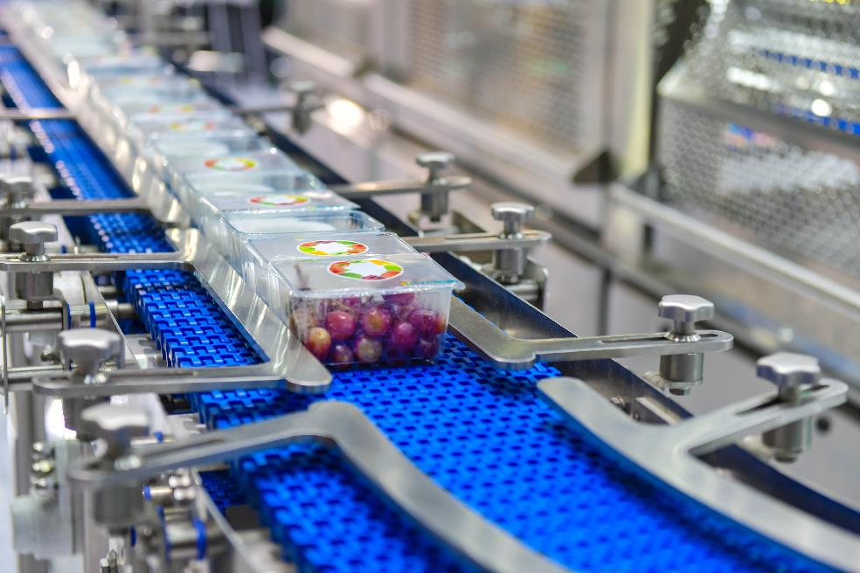
Foodborne Pathogens – Routes of Contamination
Packaging
  Equipment
  Packaging materials
  Packaging environment
  Food handlers
Insert visual for packaging
Shutterstock 1285882819
Notes:
https://www.shutterstock.com/image-photo/food-products-boxs-transfer-on-automated-1285882819

Slide 25
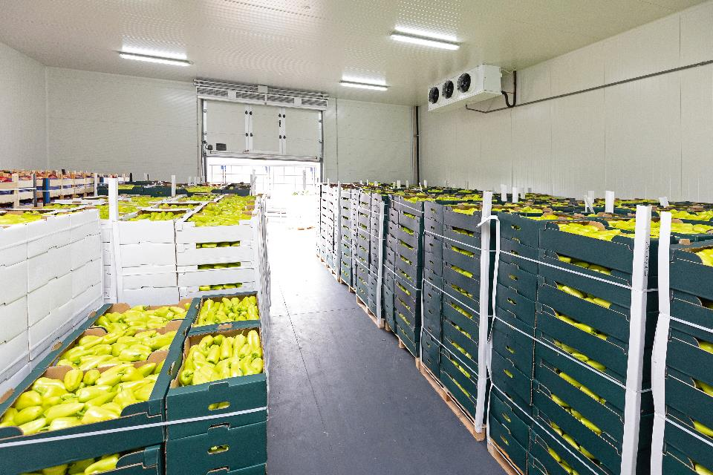
Distribution
Cleanliness of distribution vehicles
Storage facilities
  Cleanliness
  Temperature control
  Atmosphere control
Shutterstock 1695432844
Notes:
https://www.shutterstock.com/image-photo/green-peppers-boxes-cold-storage-warehouse-1695432844

Slide 26
Consumer Role
Storage (before and after preparation)
  Temperature
  Time
Handling and Preparation
  Personal hygiene
  Surface cleanliness
  Avoid cross contamination
  Cook to recommended temperature for safety
Clean
Cook
Raw
Separate
Cooked

Slide 27
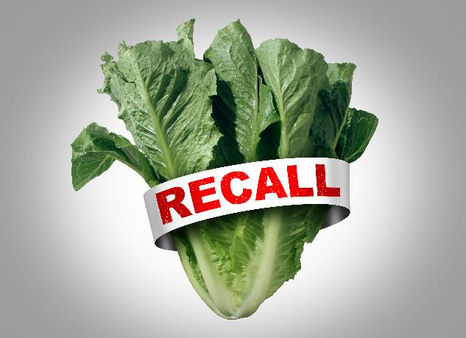
Foods Most Often Associated with Foodborne Illness
Raw produce
  Leafy greens
  Berries
    Potential issues: Field contamination, strategies to remove contamination lacking
Animal-derived foods
  Poultry
  Beef
  Eggs
  Seafood
  Dairy
    Potential issues: Insufficient heating, storage, reheating, cross-contamination
Ready-to-Eat (RTE)
  Deli-meat
    Potential issues: Insufficient processing, post-process contamination
Shutterstock 1766380025
Notes:
https://www.shutterstock.com/image-illustration/salad-recall-romaine-lettuce-e-coli-1766380025

Slide 28
Foodborne Pathogen Control
Prevent contamination of food
  Hygiene
  Environmental controls
Suppress bacterial growth in food
  Acidity (pH)
  Water activity (A_{w})
  Atmospheric controls within package and storage
  Storage temperature
Inactivate in food
  Thermal conditions (time/temperature)
  Pressure
  Ultraviolet light
  Ozone
  Irradiation

Slide 29
Foodborne Illness Symptoms
Predominantly acute gastroenteritis
  Diarrhea (sometimes bloody) (> 3 or 4 loose stools within 24-hour period)
  Vomiting
  Abdominal pain
  Sometimes fever
  Body aches
Other systems can be affected
  Neurological (botulism)
  Renal (hemolytic uremic syndrome (STEC))
  Hepatic (hepatitis A viral infection)
  Meningitis (listeriosis)
  Fetal health (listeriosis)

Slide 30
Foodborne Illness Timing
Incubation period
  Time between exposure and onset of symptoms
  Typically 12 to 72 hours
  Can be few hours (B. cereus intoxication)
  Can be more than 30 days (hepatitis A virus)
Duration
  Acute symptoms most common; often self-limiting
  Chronic sequelae possible
    Reactive arthritis (Salmonella)
    Kidney function (STEC)
    Guillaine-Barré Syndrome (Campylobacter)

Slide 31
Foodborne Illness – Contributing Factors
Host susceptibility
  Immunocompromised
  Age (very young, elderly)
  Pregnancy
  Other underlying health conditions
Carriers – asymptomatic hosts can transmit disease agents
Pathogen characteristics
  Virulence traits
  Infectious dose
  Interaction with other microorganisms
  Antimicrobial resistance
  Antimicrobial can exacerbate symptoms in some cases (STECs)

Slide 32
Foodborne Illness – Clinical Prevention and Treatment
Prevention
  Vaccination (hepatitis A virus)
Treatment
  Typically self-limiting
  Symptom management – rehydration therapy
  Antibiotics for susceptible bacteria
  Antimicrobial for some protozoa

Slide 33
Public Health – Many Components
Public Health
Surveillance
Investigation
Research
Prevention

Slide 34
Foodborne Disease Surveillance Functions
Detect disease
Prevent spread of disease
Study disease to strengthen scientific understanding
Provide administrative guidance

Slide 35
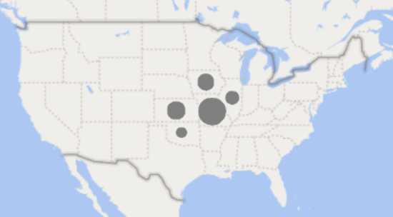
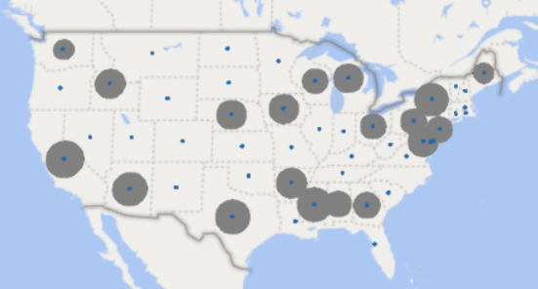
Foodborne Outbreak Scenarios
Localized
  Usually associated with a specific event or population
  Outbreak may be more obvious
Widespread
  Contamination of widely-distributed food product
  Outbreak may be more difficult to detect

Slide 36
Foodborne Illness Surveillance
Population Survey
Exposure
Physician Survey
Person seeks care
Laboratory Survey
Case reported to Health Department/CDC
Surveillance
Conducts tests
Specimen obtained
Illness
Confirm case
An increase in reported illnesses above baseline (typical levels for a region) may indicate an illness outbreak
Visual adapted from http://www.cdc.gov/foodnet/surveillance_pages/burden_pyramid.htm

Slide 37
Surveillance Methods
Passive surveillance
  Physicians or laboratories report illnesses or laboratory results to public health agencies.
Sentinel surveillance
  Selected reporting units (ex: a large hospital network with physicians and laboratory resources) report high-quality data on a specific disease to public health agencies.
Active surveillance
  Health agencies contact physicians and laboratories to assure reportable diseases have been recognized, specimens analyzed and illnesses reported and conduct further investigations as needed.

Slide 38
Foodborne Outbreak Surveillance – Public Health Agencies
Local Health Departments
    Patient complaints
    Laboratory analyses - individual specimens
    Provide data to State Health Departments
State Health Departments
    Foodborne outbreak reports
    Laboratory analyses – comparison of isolates
    Provide data to Federal Health Agencies
Federal Health Agencies
      Centers for Disease Control and Prevention (CDC)
      Food regulatory agencies
          United States Department of Agriculture (USDA)
          Food and Drug Administration (FDA)
        Maintain foodborne illness outbreak data networks
Notes:
https://www.cdc.gov/surveillancepractice/index.html

Slide 39
Public Health Agencies – Dual Role for Food Safety
Illness Surveillance – Epidemiologists
  Detect illnesses
  Prevent spread of illness
Illness Prevention - Inspectors
  Food establishment inspections
  Assure legal standards for food handling upheld

Slide 40
Disease Reporting
National Notifiable Diseases Surveillance System
Public Health Departments
States & Territories
CDC
Surveillance also applies to diseases not transmitted through food
Select agents must be reported immediately
Illness outbreak data networks for foodborne diseases
      PulseNet – connect cases of bacterial origin
      CaliciNet – connect cases of norovirus
      FoodNet – monitor foodborne illness trends
https://wwwn.cdc.gov/nndss/document/NNDSS_Infographic.pdf

Slide 41



PulseNet USA
Recognizing Outbreaks – Connecting Disease Cases in U.S.
Bacterial isolates recovered from patient, implicated food and/or environment compared according to genetic profiles
Technology: Pulsed Field Gel Electrophoresis (PFGE)
Similar PFGE profiles among isolates suggests cases may be related to same outbreak
PulseNet USA Participants
Public Health Laboratories
  All 50 States & Puerto Rico
Regulatory Laboratories
  Food & Drug Administration (FDA)
  U.S. Department of Agriculture (USDA)
https://www.cdc.gov/pulsenet/participants/usa.html

Slide 42
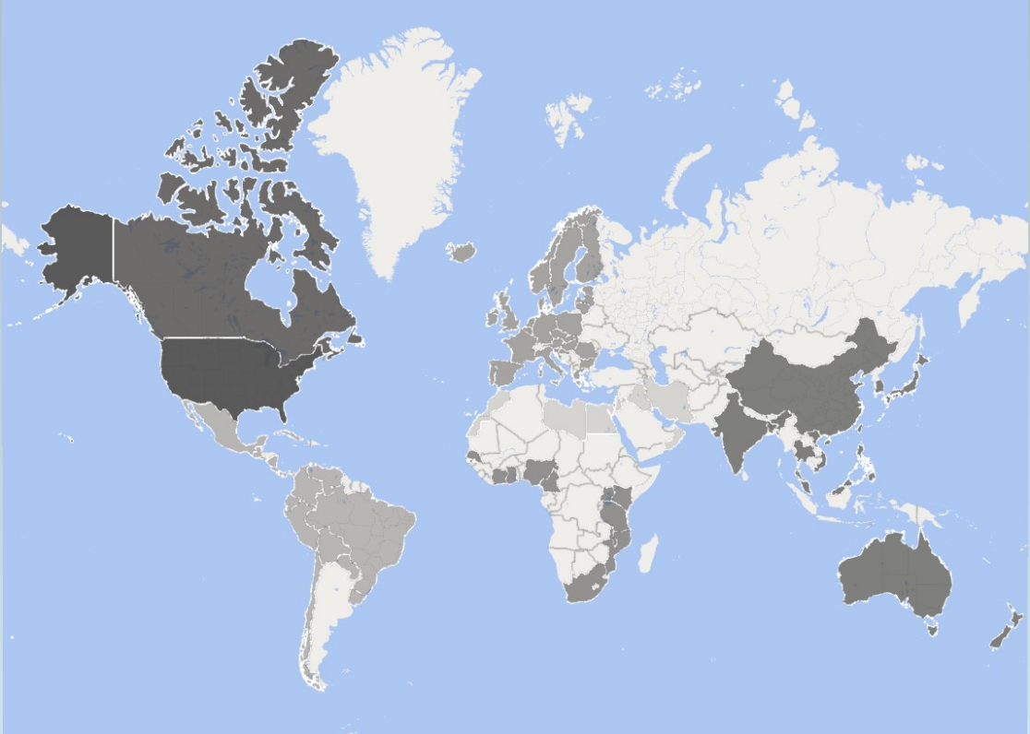
PulseNet International
Global Connections – Partners in Foodborne Disease Detection
https://www.cdc.gov/pulsenet/
Notes:
Shading represents regions.

Slide 43
Objectives of PulseNet
Detect foodborne disease case clusters by PFGE
Allow for real-time communication among state, local health departments, and international partners
Facilitate early identification of common source outbreaks
Help food regulatory agencies identify areas where implementation of new measures are likely to increase the safety of the food supply

Slide 44
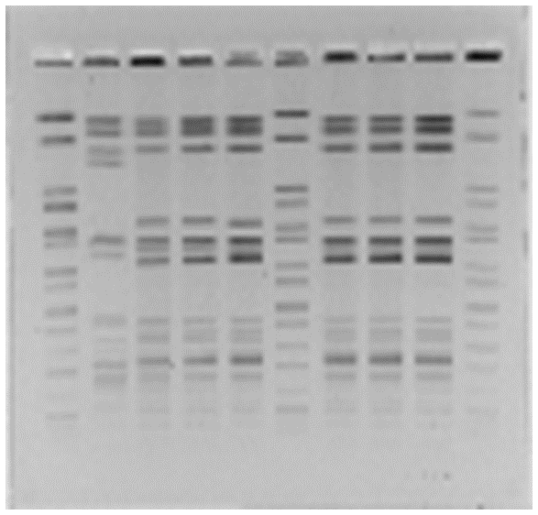
Principles of PFGE
Bacterial Isolates
1
2
3
4
5
6
7
8
9
10
Larger DNA fragments →
Bacterial isolates are obtained from patients, implicated food, environmental sources
DNA is isolated
DNA is cut into fragments with an enzyme
DNA fragments are loaded into a gel matrix
An electric current is applied to make the DNA fragments migrate through the gel
Fragments separate by size (small fragments travel more easily and therefore farther in the gel)
Isolates with the same genetic sequence will have the same fragment patterns
Smaller DNA fragments →

Slide 45
CaliciNet
Foodborne Norovirus National Surveillance Network
Network
  Federal, State, Local Health Agencies in the U.S.
State and local agencies electronically submit
  Epidemiological norovirus data
  Laboratory norovirus data (including virus genetic sequences)
Purpose and Importance
  Link isolates to common source
  Monitor circulating strains of norovirus
  Identify new or emerging strains of norovirus
  Norovirus is the leading cause of acute gastroenteritis and foodborne disease in the U.S.
Network name derivation
  Norovirus is a member of the Caliciviridae family of viruses
https://www.cdc.gov/norovirus/

Slide 46
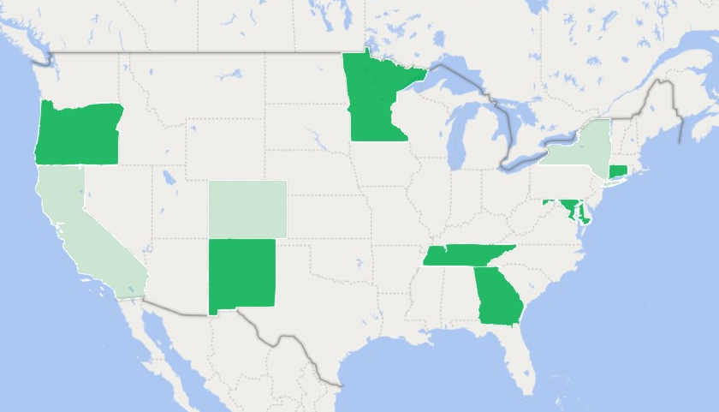
FoodNet
Foodborne Diseases Active Surveillance Network
FoodNet Partners
  CDC
  USDA
  FDA
  10 reporting sites in U.S.
Foodborne illness etiologies monitored
  Salmonella
  Shigella
  Campylobacter
  Escherichia coli O157
  Listeria monocytogenes
  Yersinia enterocolitica
  Vibrio
  Cryptosporidium
  Cyclospora
https://www.cdc.gov/foodnet/sites.html
Notes:
10 states report. Three lighter shaded states have partial participation among counties.

Slide 47
Objectives of FoodNet
Determine the burden of foodborne illness in the United States
Monitor trends in the burden of specific foodborne illness over time
Attribute the burden of foodborne illness to specific foods and settings
Develop and assess interventions to reduce the burden of foodborne illness

Slide 48
Surveillance Data Limitations
Not all foodborne pathogens are reportable diseases
Patients do not always seek medical care
Not all reported cases are foodborne; transmission can be
  Person-to-person
  Due to direct animal contact
  Environmental (water, soil, air)

Slide 49
Foodborne Illness Outbreak Investigations
An increase in reported illness cases may indicate an outbreak is occurring.
What else may account for the increase?
Real increase
Increase in population size
Changes in population characteristics
Outbreak
Artificial increase
Increased examination of stools
New testing protocol
Changes in reporting procedures

Slide 50
Foodborne Illness Outbreak Investigation
Verify the diagnosis, laboratory investigation
  Patient symptoms
  Laboratory test results of clinical samples (stool or vomitus) to detect suspected bacteria, virus, parasite
  Laboratory tests to identify and characterize pathogen in clinical samples
Epidemiological investigation to determine
  Connections among illness cases as compared to controls (individuals who did not get sick, but may have had similar exposures)
  Likely source of exposure (‘transmission vehicle’)
Confirm the outbreak
Define the outbreak
  Symptoms
  Etiological agent
  Exposure time period

Slide 51
Foodborne Illness Outbreak Investigation
Obtain unopened sample of suspected transmission vehicle (food, beverage)
Conduct laboratory analyses of food sample for presence of same pathogen implicated in illness outbreak
Conduct traceback investigation to determine
  Original source of implicated food
  Extent of distribution of implicated food to consumer
Recall potentially contaminated food from commerce
Destroy recalled contaminated food
Investigate potential sources of contamination and/or process failure throughout food chain
Implement necessary changes (technical, regulatory) to prevent recurrence

Slide 52
Food Contamination Revisited
Any food or beverage can be a disease transmission source if mishandled and contaminated just before consumption
Processing (inhibitory ingredients, thermal treatment, etc.), packaging, and basic protections from intentional and unintentional contamination can help reduce and minimize some risks to negligible levels prior to reaching consumer
For products lacking a final ‘kill step’ (treatment to inactivate pathogens), contamination of prevention is essential
Raw produce
  Delicate products, difficult to remove or inactivate contaminants
  Environmental exposure – soil, water, airborne contaminants
  Pathogens can persist on plant tissue and in the environment, including in water

Slide 53
Human
Environment
Animal
One Health

Slide 54
One Health Initiative
Recognizes that human, animal, and environmental health are connected
Collaborative approach across sectors and disciplines at local, regional, national and global levels
Goal – achieve optimal health outcomes for humans, animals, and the environment
One Health approach:
  Monitor and control public health threats
  Study disease spread among humans, animals, and the environment
  Recognize emerging human disease threats based on health changes in animals or environment
https://www.cdc.gov/onehealth/basics/index.html

Slide 55
Factors Affecting Human and Animal Health
Changes in climate and land use
Human population growth and expansion
Increased travel and trade
Disease Spread
60% of diseases are zoonotic
Not all are foodborne
Adapted from https://www.cdc.gov/onehealth/basics/index.html

Slide 56

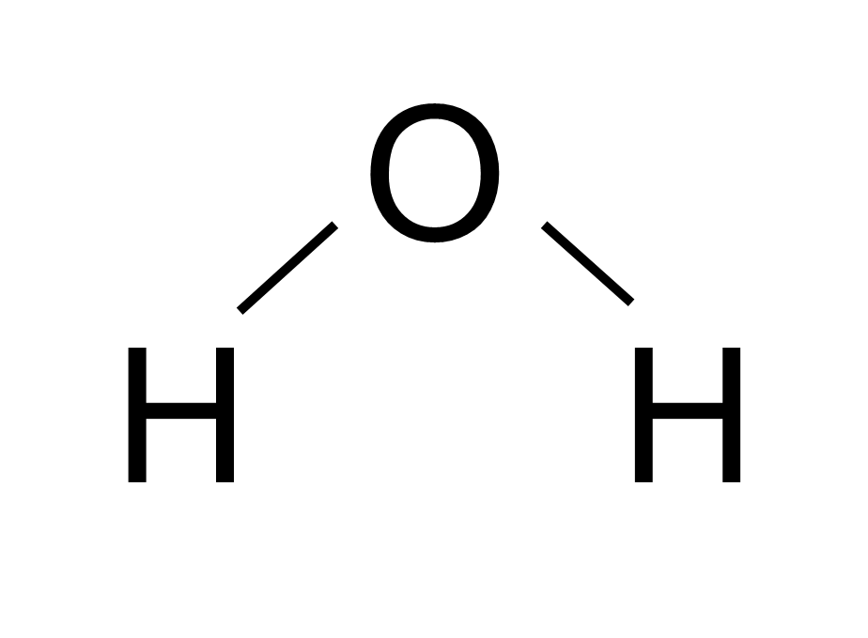
Water
For Safe, Sustainable Food Production
O
H
H

Slide 57
Water Uses for the Production and Processing of Food
Drinking water
Food or beverage ingredient
Cleaning
  Equipment
  Food handler hygiene
Transport
Application of fertilizer, pesticides
Irrigation

Slide 58
Water for Food
Food grows where water flows.
Safe food grows where clean water flows.

Slide 59
The Water Cycle
Consider the familiar water cycle and its relationship to safe, sustainable food production
Where do we find water?
Where does it travel?
What does it contain?
Do we have enough?
Shutterstock 543156805
Notes:
Consider the familiar water cycle – but from perspective of agriculture, safe, sustainable food production

Slide 60
Water Sources
Earth surface is approximately 71% water
  2.5 % is freshwater
  97.5 % is saltwater
Land-based agriculture operations rely on freshwater
  Edible plants
  Livestock production
Water sources for agriculture
  Rain
  Ground water
  Surface water
  Recycled water
Earth’s Water
Freshwater
Visual based on data from https://water.usgs.gov/edu/

Slide 61
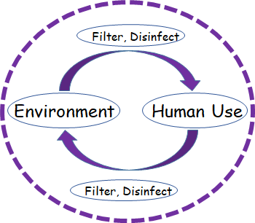
Water Supply and Demand
Water resources are finite.
We do not create new water.
Water is recycled and reused.
The Other Water Cycle
Visual adapted from One Water concept. Image by Dr. Allegra D. DaSilva. Courtesy of Stantec and WateReuse Association.

Slide 62
Water
So, if all the water that was ever on the Earth is still on the Earth …
… why are we now concerned if we will have enough water to safely grow food?

Slide 63
Rainfall
Rain doesn’t always fall over land
  Or where food is produced
Rainfall amounts vary by
  Region
  Season
  Year
Rainfall is an insufficient direct water source to meet agricultural needs (past, current, and future)
Notes:
Reliability for rainfall already a factor

Slide 64
Irrigation Water
Irrigation fulfills agricultural water needs where direct rainfall is insufficient
Ground and surface water
Considerations for irrigation water
  Type
  Availability
  Accessibility
  Purity
  Sustainability
Notes:
Considerations

Slide 65
Water Quantity and Quality
Interconnected challenges
Increased demand for water resources
  Human population growth
  Competing needs for water
Changing water resources and availability
  Climate change
  Contamination

Slide 66
Global Human Population and Water Use Continues to Rise
Projected world population in 2050: 9 billion
Approximately 25% increase over 2020 population
Total water use in the United States increased with increase in U.S. population over period of 1950 to 2010
Population Division of the Department of Economic and Social Affairs of the United Nations Secretariat (2007)
Visual adapted from https://water.usgs.gov/edu/wateruse-fresh.html
Maupin, et al. 2014. Estimated use of water in the United States in 2010. U. S. Geological Survey Circular 1405, 56 p., http://dx.doi.org/10.3133/cir1405.

Slide 67
Projected Agricultural Water Demand
Food Production 60%
Water for Agriculture 19%
Anticipated increased need in food production and agricultural water usage to support projected global human population increase to feed 9 billion people by 2050
Institute of Food Technologists. June 2015. Food Technology

Slide 68
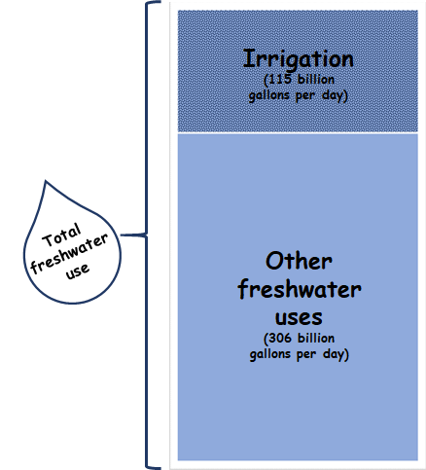
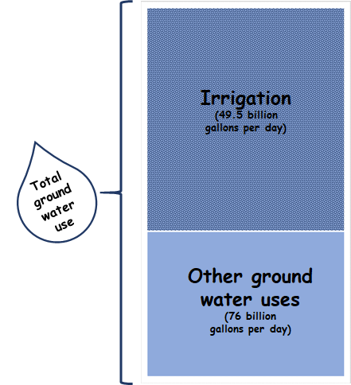
Surface and Groundwater for Irrigation and Other Industries
United States, 2010
Irrigation: 115,000 million gallons surface and groundwater per day
Nationwide average: Irrigation accounts for 64% groundwater withdrawals
Maupin, et al. 2014. Estimated use of water in the United States in 2010. U. S. Geological Survey Circular 1405, 56 p., http://dx.doi.org/10.3133/cir1405.

Slide 69
Groundwater Depletion
Groundwater is being depleted throughout United States
Rainfall is not replenishing (recharging) groundwater sufficiently
Salt water infiltration also an issue
Konikow, L.F. 2013. Groundwater depletion in the United States (1900-2008): U.S. Geological Survey Scientific Investigations Report 2013-5070, 63 p., http://pubs.usgs.gov/sir/2013/5079.
Notes:
Notably agriculture use steady in spite of population increases due to technological advancements/conservation efforts

Slide 70
USGS Water Science Public Opinion Survey* – Global Perspective
What will be the biggest water problems in the coming years?
Region | Not enough water | Polluted water | Unsafe drinking water | Water system infrastructure breakdown | No major problems | Number of survey responses to-date
Africa | 144 (36%) | 91 (23%) | 46 (11%) | 56 (14%) | 64 (16%) | 401
Asia | 642 (34%) | 674 (35%) | 237 (13%) | 169 (9%) | 167 (9%) | 1,889
Australia/NZ/P | 3,149 (83%) | 334 (9%) | 124 (3%) | 75 (2%) | 127 (3%) | 3,809
Canada | 1,085 (33%) | 1,134 (35%) | 456 (14%) | 117 (4%) | 471 (14%) | 3,263
Central America | 123 (34%) | 123 (34%) | 31 (9%) | 16 (4%) | 69 (19%) | 362
South America | 648 (41%) | 483 (31%) | 236 (15%) | 88 (6%) | 123 (8%) | 1,578
Europe | 86 (24%) | 67 (19%) | 50 (14%) | 83 (23%) | 75 (21%) | 361
Far East | 327 (58%) | 110 (20%) | 59 (10%) | 18 (3%) | 48 (9%) | 562
Middle East | 201 (37%) | 124 (23%) | 110 (20%) | 37 (7%) | 72 (13%) | 544
United States | 26,672 (28%) | 38,035 (40%) | 14,301 (15%) | 5,785 (6%) | 9,705 (10%) | 94,498
Public survey data collected as of November 2021 at https://water.usgs.gov/edu/activity-problem.php
Notes:
Open activity available at website – global perspectives on water issues

Slide 71
Climate and Water Resources
Terminology
Climate
  Long-term averages of temperature, humidity, and rainfall patterns
Weather
  Short-term local atmospheric conditions

Slide 72
Climate Change and Water
Increase in global temperatures
  Glacial melt leads to rising sea levels (flood)
  Warm air holds more moisture leading to more intense storms (flood)
  Salt water intrusion to fresh water and subsequent plant stress
  More extreme cold and heat waves and longer duration
    Heating in Arctic changes jet stream
    Arctic oscillations more extreme (more extreme cold further south; heat waves further north)
    Air trapped in troughs making duration of extreme events longer
  Drought

Slide 73
Climate change – food safety impacts
Drought
  Insufficient water for plant growth
  Plant stress – greater susceptibility to pathogen infiltration
Temperature ranges and extremes
  Greater global range of potential pathogen growth
Flood
  Runoff of contaminants from surfaces into agriculture production fields
  Less solar inactivation of surface microorganisms

Slide 74

Pathogen Increases Related to Extremes
Fecal Contamination of Agricultural Soils Before and After Hurricane-Associated Flooding in North Carolina
M. J. Casteel, M. D. Sobsey, J. P. Mueller
Journal of Environmental Science and Health Part A, 41: 173-184, 2006
DOI:10.1080/10934520500351884
Climate change-induced increases in precipitation are reducing the potential for solar ultraviolet radiation to inactivate pathogens in surface waters
C. E. Williamson, S. Madronich, A. Lal, R. G. Zepp, R. M. Lucas, E. P. Overholt, K. C. Rose, S. G. Schladow, J. Lee-Taylor
Scientific Reports 7: 13033, 2017
DOI:10.1038/s41598-017-13392-22017

Slide 75
Foodborne Illness Outbreaks Associated with Environmental Water -
Examples
Salmonella in alfalfa sprouts, 140 illness cases in 26 states, 2010 to 2011
  Environmental water run-off sample yielded strain indistinguishable from outbreak strain (https://www.cdc.gov/salmonella/2010/alfala-sprouts-2-10-11.html)
Salmonella in tomatoes, 510 illnesses in 26 states in 2002, 72 illness cases in 16 states in 2005
  Outbreak strain isolated from pond irrigation water in 2005 outbreak (https://pubmed.ncbi.nlm.nih.gov/17475091/)
Escherichia coli O157:H7, 62 illness cases in 16 states and the District of Columbia, 2018 to 2019
  Outbreak strain found in sediment collected within agricultural water reservoir (https://www.cdc.gov/ecoli/2018/o157h7-11-18/index.html)

Slide 76
Various Strategies to Address Agricultural Water Scarcity
Crops
  Location of planting
  Drought resistant plants
Environment
  Soil bacteria amendments to aid moisture retention
Irrigation water management
  Optimize method and timing of application
  Use of nontraditional water sources
Notes:
https://www.udel.edu/udaily/2018/October/soil-microbe-fights-drought/

Slide 77
Irrigation methods
Surface irrigation
  Flood/Furrow
    Water applied to top of channel between row crops, flows along channel
  Drip irrigation
    Water is applied close to the soil surface
Subsurface irrigation
  Water is applied below soil surface
Overhead irrigation
  Water is applied from above the plant
Shutterstock 142601641
Shutterstock 1795299508
(L) Adobe Stock Images
(R) iStock Photos
Shutterstock 792426544

Slide 78
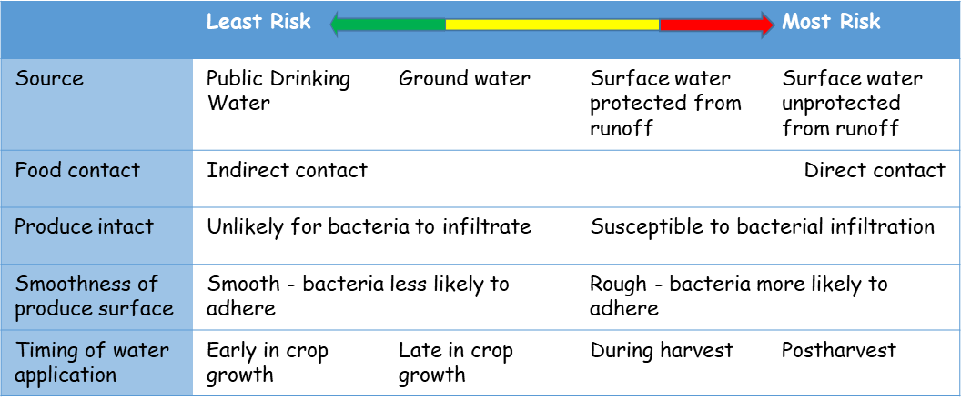
Irrigation Water and Safety of Raw Agricultural Commodities
Water Source
  Groundwater generally considered lower contamination risk (and lowest variability of risk) due to natural filtration and reduced exposure to pollutants
Irrigation Method
  Least contact with edible tissue reduces risk
Adapted from US FDA. 2015. Final Qualitative Assessment of Risk to Public Health from On-Farm Contamination of Produce

Slide 79
Nontraditional waters
Any water source other than groundwater including agricultural runoff, treated wastewater, recycled water, produced water, untreated surface water*, and brackish surface water and groundwater (USDA, 2017)
*Untreated surface water is included because of potential impact of quality due to external environmental factors such as runoff; however, surface water is used in agriculture.

Slide 80
Wastewater
  Used water discharged from homes, businesses, industry, and agricultural facilities
Raw water
  Surface or groundwater that has not been treated by an approved process
Graywater
  Domestic wastewater reused on site
Recycled
  Treated domestic wastewater used more than once before reentry into water cycle
Reclaimed
  Treated municipal wastewater that meets state-specific water quality standards and is intended for reuse

Slide 81
Reclaimed Water Use in the United States
Reclaimed
The U.S. produces approximately 32 billion gallons of municipal effluent per day. Approximately 7 to 8 % is reclaimed.
Visuals based on US EPA. 2012. Guidelines for Water Reuse. EPA/600/R-12/618 | September 2012

Slide 82
Fit for Purpose
Wastewater treatment and final quality is tailored to reuse application
Agriculture reuse could include food crop vs. nonfood crop
Primary Treatment
Tertiary Treatment
Advanced Treatment
Secondary Treatment
Water Quality
Visual adapted from EPA, 2012 Guidelines for Water Reuse. Figure 1-3 Treatment technologies are available to achieve any desired level of water quality
https://nepis.epa.gov/Exe/ZyPDF.cgi/P100FS7K.PDF?Dockey=P100FS7K.PDF

Slide 83
Water Standards for Raw Edible Agricultural Commodities
Food products regulated by the United States Food and Drug Administration (FDA)
Food Safety Modernization Act (FSMA) of 2010
  Established the Produce Safety Rule (PSR)
    Standards for the Growing, Harvesting, Packing, and Holding of Produce for Human Consumption
    Final rule effective 2016
    Established requirements for agricultural water
      Water applied to growing produce (other than sprouts) must contain no more than 126 colony forming units (CFU) of generic E. coli per 100 mL of water
      90% of water samples tested must contain no more than 410 CFU of generic E. coli in 100 mL
https://www.fda.gov/food/food-safety-modernization-act-fsma/fsma-final-rule-produce-safety

Slide 84
Indicator Microorganism
Generic Escherichia coli (E. coli) is found in gastrointestinal system of animals
Used as an indicator of fecal contamination
It does not necessarily indicate presence of pathogenic E. coli (such as STEC E. coli O157:H7)
Relatively rapid and affordable bacteria to test as general indicator of water quality

Slide 85
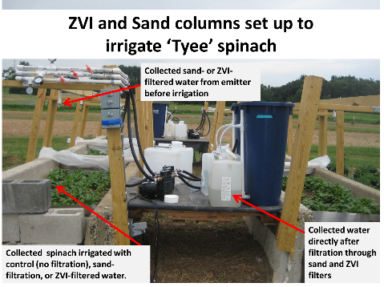
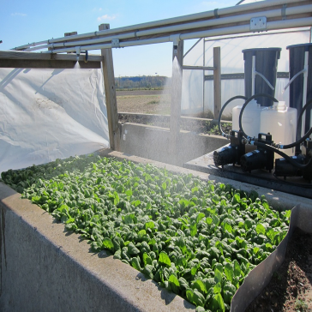
Treatment Technologies Investigated to Meet Water Quality Standards in the Field
Filtration
  Sand mixed with ZVI (zero-valent iron)
Disinfection
  Chlorination
  May require prior filtration to remove organic material that diminishes efficacy
Ultraviolet light
  May require prior filtration as turbidity limits efficacy
Images by K. Kniel

Slide 86
Water Contamination – Other Human Impacts
Contaminants other than microorganisms
  Pharmaceuticals
  Hygiene products
  Industrial
Indicator of human activity
  Caffeine

Slide 87
Food and Water Safety: One Health
Summary
Food can serve as transmission vehicle for pathogenic bacteria, viruses, parasites and result in foodborne illness
Pathogens can enter the food supply at any stage including production, processing and final handling, through contaminated handlers, contact surfaces, and environmental sources (animals, plant, soil, water)
Foods are monitored for safety throughout handling systems
Public health systems monitor and respond to foodborne illnesses

Slide 88
Food and Water Safety: One Health
Summary
Food crops require irrigation in absence of adequate rainfall
Irrigation water for food crops must meet regulatory standards for bacterial contamination
Water availability for growing foods is strained by increasing human population, water demand, pollution, and climate change effects
Water scarcity necessitates reuse of water to irrigate food crops
Water reused for irrigation can be treated to meet regulatory quality standards

