Slide 1
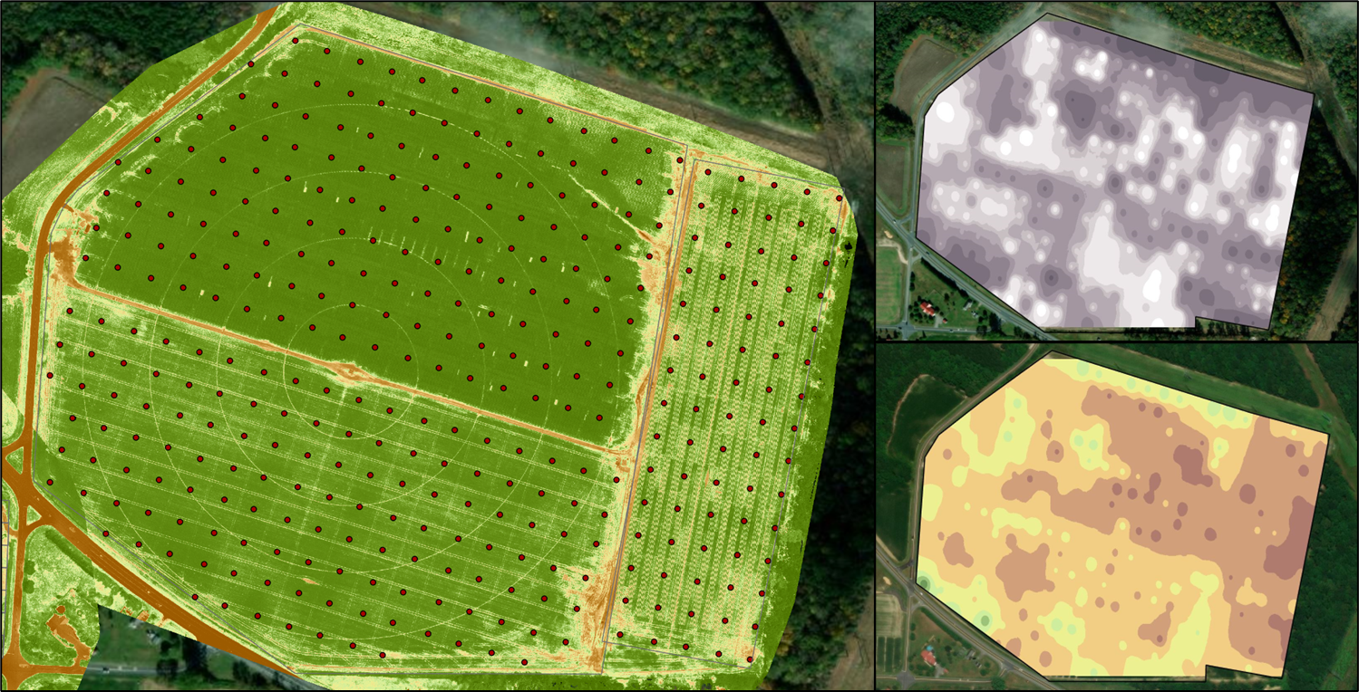
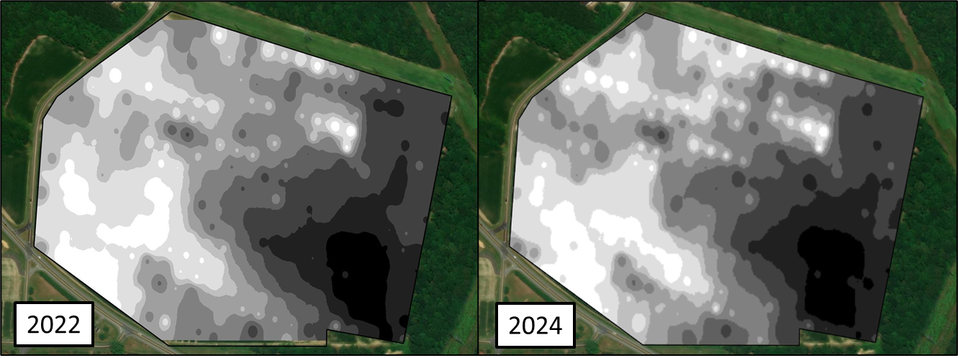
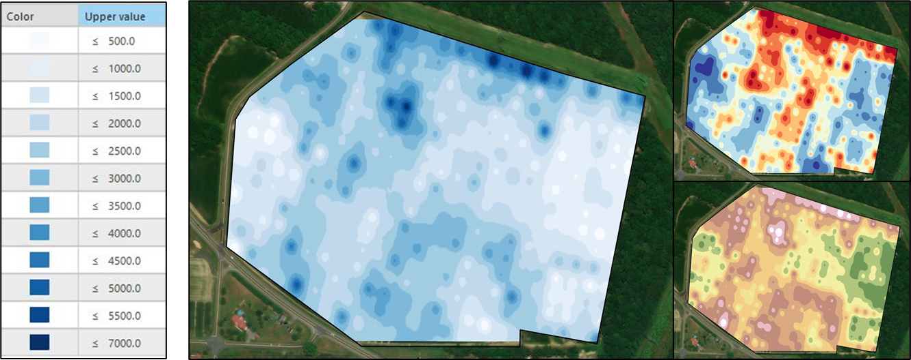
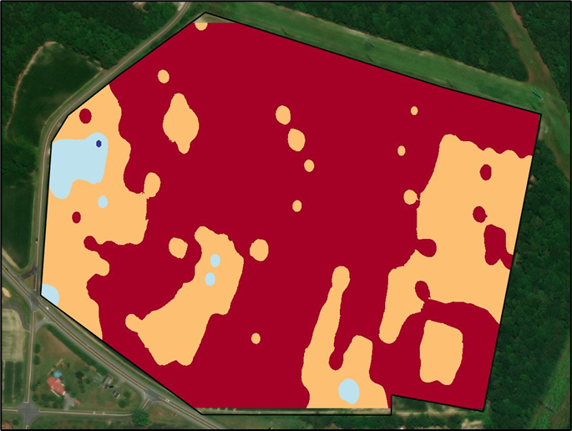
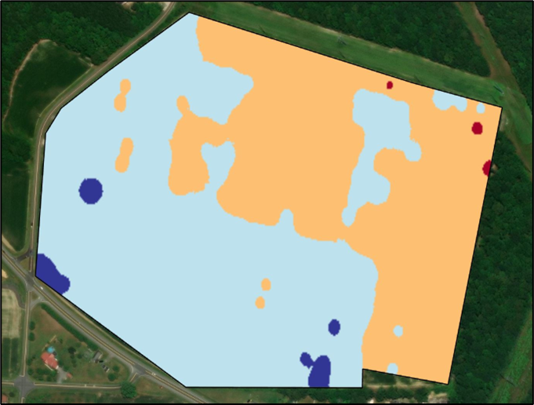
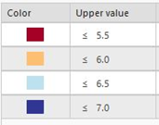


Grid Sampling Coastal Soils for Variable Rate Applications
Jarrod Miller and James Adkins, University of Delaware
¼ Acre Grid Samples
Organic Matter
CEC
Variability in soil land landscape characteristics reduces yield response to management techniques, particularly regarding seeding rates and fertilizer additions. One method to uncover soil variability and crop response is to use precision soil sampling, including either grid or zone methods. At the Warrington Irrigation Research farm ¼ grid samples have been taken in 2022 and again in 2024 to examine the success of variable rate applications. All samples were run at the University of Delaware Soil Testing Lab.
Manganese
Between both years, almost all nutrients measured were within1-10ppm of their ranges. This included all micronutrients and sulfur. There was variability in B measured, while Ca, Mg, K, and P were all a part of variable rate applications and changed accordingly.
Variable Rate Liming Results
pH
2022
VR Lime
B-pH
Lime rates were based on University of Delaware recommendations, including the use of soil pH, buffer pH, and a target pH of 6.2. This led to lime rates of <500 to >7000 lbs per acre. Higher buffer pH may have reduced lime along the north pivot more than necessary, but variable rate applications evened out the south pivot.
2024

