Slide 1
Partner Agencies
United Way of Delaware

Slide 2
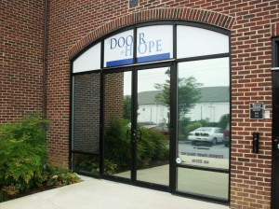
A Door of Hope (722)
A Door of Hope is a life-affirming non-profit ministry that promotes making health life choices.
Newark
218 East Main Street, Suite 114 Newark DE 19711 (302) 737-5433 Tues-Fri 9-4

Slide 3
AIDS Delaware (718)
Confidential HIV Testing
Case Management and Counseling
Education and Outreach
Support Groups
Special Programs for Youth
Doctors and Clinics
Helpful Telephone Numbers
Answers to Frequently Asked Questions

Slide 4
Alzheimer’s Association, Delaware Chapter (775)

Slide 5
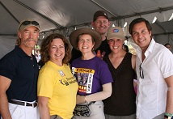
American Cancer Society, South-Atlantic Division (105)
You Can Volunteer Today For a Cancer Free Tomorrow
You can join the movement for more birthdays and fight back against cancer by enrolling in a new research study called the Cancer Prevention Study - 3 (CPS-3).

Slide 6
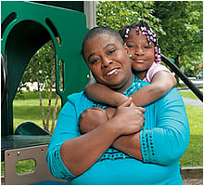
American Diabetes Association, Delaware (700)
A Mother’s Plea
My name is Latesha Taylor and I'm scared for my child's future.
Every day my 9-year old daughter Loretta goes to school – her life is at risk.

Slide 7
American Heart Association, Pennsylvania Delaware Affiliate (701)
Make the Effort to Prevent Heart Disease with Life's Simple 7
Get Active
Control Cholesterol
Eat Better
Manage Blood Pressure
Lose Weight
Reduce Blood Sugar
Stop Smoking

Slide 8
American Lung Association of Delaware (714)
When you join the American Lung Association in the fight for healthy lungs and healthy air, you help save lives today and keep America healthy tomorrow.
Our Mission: To save lives by improving lung health and preventing lung disease.

Slide 9
American Red Cross of the Delmarva Peninsula (110)

Slide 10
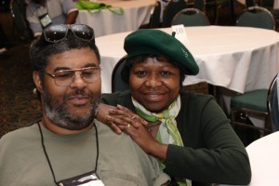
ARC of Delaware (250)
Mission
The Arc of Delaware promotes and protects the rights of people with intellectual and developmental disabilities and actively supports their full inclusion and participation in the community throughout their lifetimes.

Slide 11
Bernard & Ruth Siegel,
Jewish Community Center (411)
The Jewish Community Center provides the Delaware Valley with diverse and extensive services. The center provides members and the entire community with a central place in which individuals, families, groups, and organizations can best express their interest and have their social, educational, cultural, fitness, and recreational needs met.

Slide 12
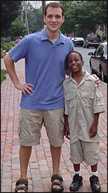
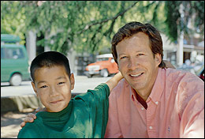
Big Brothers Big Sisters of
Delaware, Inc. (140)
Big Brothers Big Sisters of Delaware
Making a Big Difference, One Child at a Time

Slide 13
Boy Scouts of America, DEL-MAR-VA Council, Inc. (150)
The Boy Scouts of America has been shaping the lives of our youth since 1910.

Slide 14
Boys & Girls Clubs of Delaware, Inc. (160)
Mission Statement The Boys & Girls Clubs of Delaware is part of a nationwide movement whose mission is to inspire and enable all young people, especially those who need us most, to realize their full potential as productive, responsible, and caring citizens.

Slide 15
Brandywine Counseling, Inc. (165)
We Provide Education, Advocacy, Prevention and Treatment for Drug Rehabilitation, Anger Management and Mental Health Advocacy Initiatives.

Slide 16
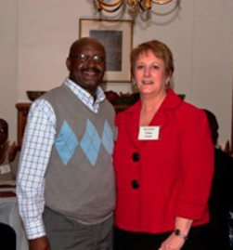
CareLink Community Support Services (392)
Serving Individuals Who Need Specialized Supports to Achieve Recovery
For over 50 years, CareLink Community Support Services has been dedicated to helping people with disabilities to live in the community with dignity and independence.

Slide 17
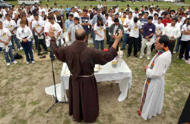
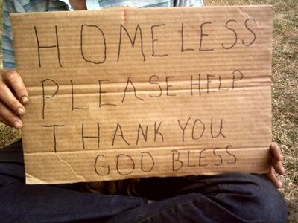
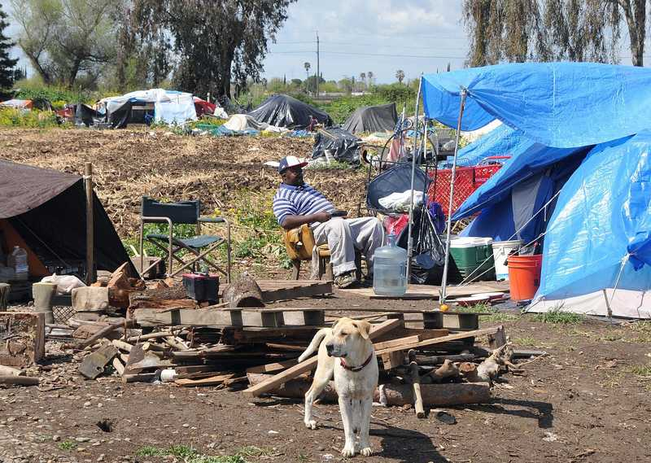
Catholic Charities, Inc. (170)
Emergency Shelter
On any given night, there are about 1,800 homeless persons in Delaware. Our Emergency Shelter provides housing and three daily meals to 10 adults for a maximum of 30 days. A case manager works with each resident to obtain income and locate affordable housing opportunities. We also help with medications, laundry, clothing, and transportation.

Slide 18
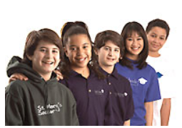
Catholic Youth Ministry (180)
CYM receives some funding from the Catholic Diocese of Wilmington, but CYM is largely dependent upon the generosity of contributors like yourself. One way you can contribute to CYM is through the United Way of Delaware.

Slide 19
Cheer (475)
The CHEER Community Center is a multi-purpose facility located in Georgetown, Delaware. It’s mission is to provide services throughout Sussex County for person’s 50 and over.

Slide 20
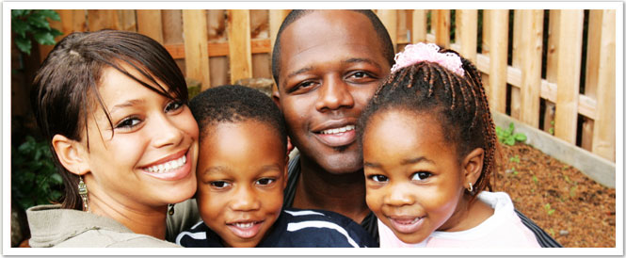
Children and Families First (299)
Strengthening Families, Building Community Since 1884, Children & Families First has offered hope to people in need. Each year, we serve thousands of children and families across Delaware.

Slide 21
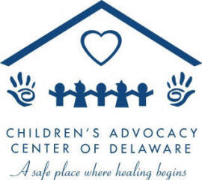
Children’s Advocacy Center of Delaware (9293)
Our Mission
The mission of The Children’s Advocacy Center (CAC) is to reduce the devastating long-term effects that child abuse has on children, their families and society through immediate, coordinated, child focused services, education, and advocacy.

Slide 22
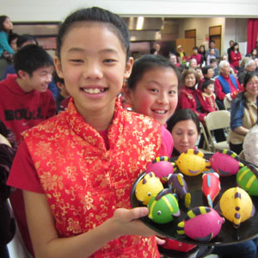
Chinese American Community Center (9309)
Chinese American Community Center (CACC, 德立華華美聯誼中心), in Hockessin, Delaware, is a non-profit, non-sectarian, not partisan and independent organization founded in 1982 which encompasses Delaware, southeastern Pennsylvania, and southern New Jersey.

Slide 23
Christina Care Visiting Nurse Association (539)
As the largest accredited home-health agency in Delaware, we are committed to helping Delawareans live independently, manage chronic diseases, understand and manage their medications and obtain home health care that is affordable and of the highest quality.

Slide 24
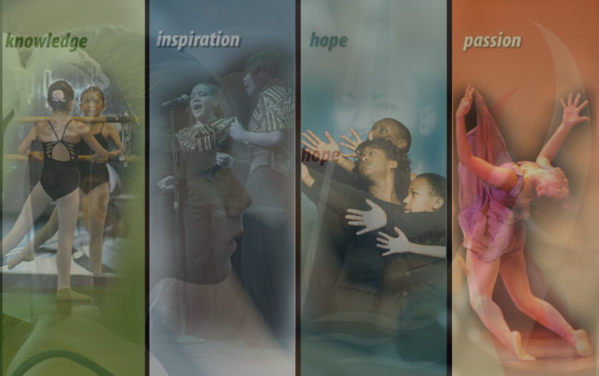
Christina Cultural Arts Center, Inc. (210)
Christina’s mission is to make an education inclusive of the arts affordable and accessible to your from low-income families in a safe environment conductive to learning.

Slide 25
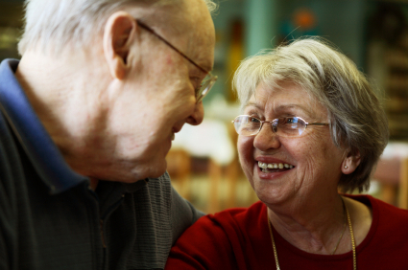
Clarence Fraim Senior Center of Delaware (9121)
To provide wellness, referral, cultural, educational, recreational, and social programming to older adults with emphasis on offering lifestyle options for healthy and independent living.

Slide 26
Claymont Community Center (215)
The Claymont Community Center’s mission is to unite the efforts of human service agencies, government, and other community organizations in serving the human and enrichment needs of the residents of Claymont and Brandywine Hundred. The center hosts over 30 diverse health, social, educational, recreational, and other community programs.

Slide 27
Community Legal Aid Society, Inc. (220)
To provide civil legal services to people with low-incomes, people with physical and/or mental disabilities and individuals age 60 and over.
Poverty Law Program
Disabilities Law Program
Fair Housing Program

Slide 28
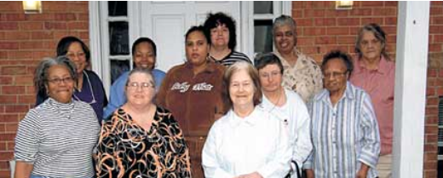
Connections Community Support Programs, Inc. (9014)
Recovery is possible with the right Connections. Find help.
Connections Community Support Programs, Inc. provides a comprehensive array of healthcare, housing, and employment opportunities that help individuals and families achieve their own goals and enhance our communities.

Slide 29
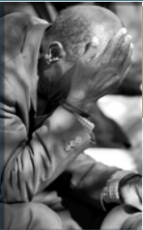
ContactLifeline, Inc. (230)
Our Mission Our mission is to keep people alive and safe, to help them through crises, and to connect them with relevant community resources.

Slide 30
Delaware Adolescent Program Inc. (240)
DAPI is a private non-profit agency dedicated to both pregnancy prevention and care and support for pregnant and parenting teens. DAPI enables these young women to continue their education in a nurturing and supportive environment that helps prepare them for the challenges of being a teen parent.

Slide 31
Delaware Association for Children of Alcoholics (716)

Slide 32
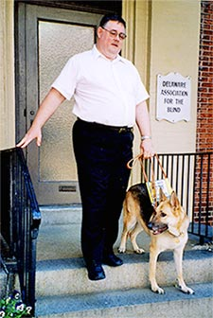
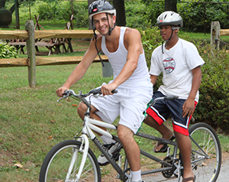
Delaware Association for The Blind (717)
MISSION
Improve the quality of life for blind and visually impaired children and adults in Delaware through a variety of education, counseling and recreation programs.

Slide 33
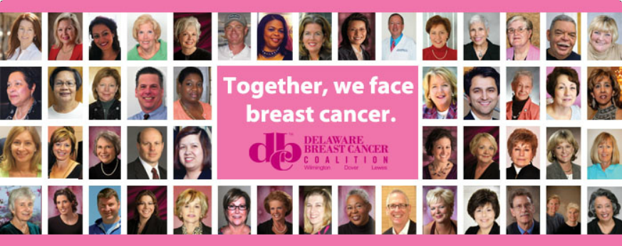
Delaware Breast Cancer Coalition (9311)
Mission
The mission of the Delaware Breast Cancer Coalition, Inc. is to empower our community by raising awareness of breast health issues through outreach, education and support services, in order to facilitate the early detection and treatment of breast cancer.

Slide 34
Delaware Center for Justice, Incorporated (260)
The Delaware Center for Justice, Inc. is a non-profit United Way agency, dedicated to creating a safer, more secure Delaware by seeking to achieve and preserve a high quality of justice. We fulfill our mission through an extensive range of programs and services, public education, research, and advocacy.

Slide 35
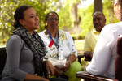
Delaware Ecumenical Council on Children and Families (9374)
We engage, support and assist congregations, groups and individuals of the faith communities in meaningful programs to improve the health, safety and wellness of Delaware children, elderly and families.

Slide 36
Delaware Futures, Inc. (9299)
Delaware Futures provides academic, social and motivational support and cultural enrichment that empowers economically disadvantaged high school students to recognize and fulfill their unrealized potential and become matriculated college students.

Slide 37
Delaware Guidance Services for Children and Youth, Inc. (265)
Mission
Delaware Guidance Services for Children & Youth, Inc. exists to provide quality mental health services for children, youth, and their families. We believe that all children have a right to good mental health and should have access to quality therapeutic care, regardless of their ability to pay.

Slide 38
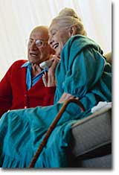
Delaware Helpline, Inc. (241)
DELAWARE HELPLINE
is a free online service which provides information on state government agencies and referrals to community resources and provides a one-stop state government directory service with linkage to appropriate offices, legislators and state employees.

Slide 39
Delaware HIV Consortium, Inc. (9467)
Mission
The Delaware HIV Consortium is dedicated to eliminating the spread of HIV/AIDS through its leadership to ensure a high-quality, seamless continuum of care for all people infected and affected in Delaware.

Slide 40
Delaware Parents Association, Inc. (9217)
"Helping Parents Build Strong Families”
Delaware Parents Association’s mission is to provide a safe place for parents, youth, and caregivers to obtain information on parenting skills, youth development, substance abuse prevention, effective communication and advocacy skills.

Slide 41
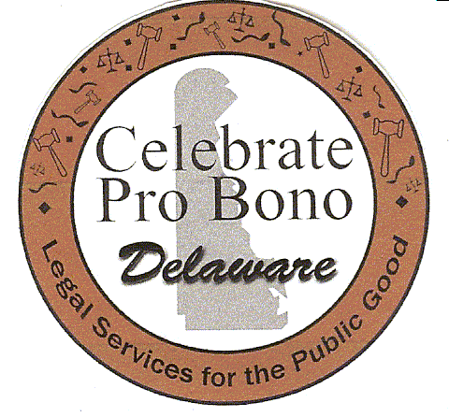
Delaware Volunteer Legal Services, Inc. (9027)
To provide quality pro bono legal services to indigent Delawareans with meritorious civil legal problems.

Slide 42
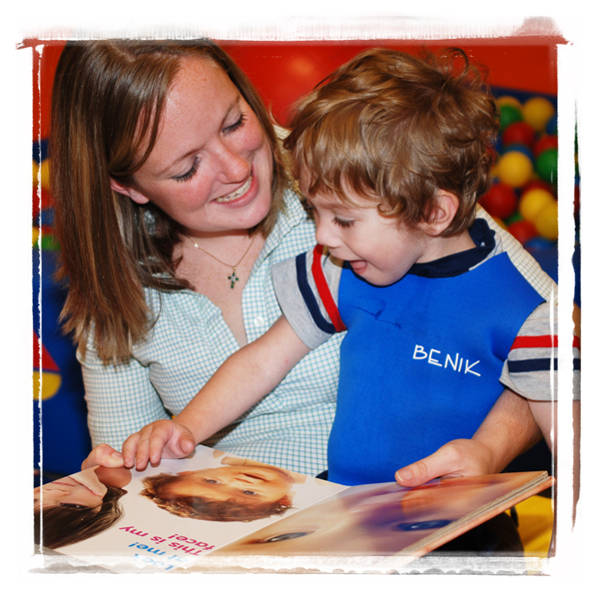
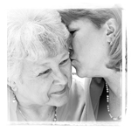
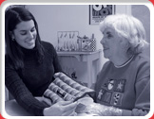
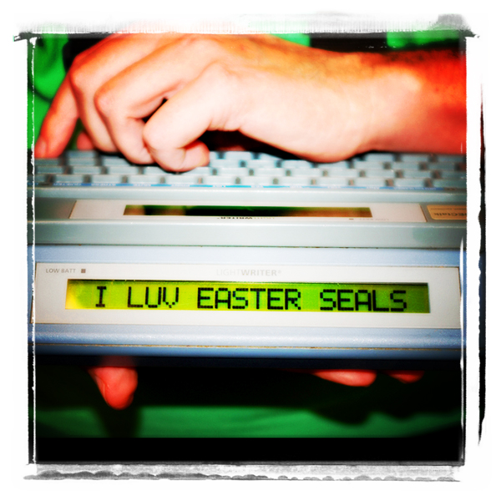
Easter Seals Delaware and Maryland’s Eastern Shore (9030)
Easter Seals Delaware and Maryland's Eastern Shore provides exceptional services to ensure that all people with disabilities or special needs and their families have equal opportunities to live, learn, work and play in their communities.

Slide 43
Edgemoor Community Center (706)
The Edgemoor Community Center’s mission is to provide affordable and accessible services which will help improve the quality of life for community members of all ages through a broad range of child care, recreational, and family support services.

Slide 44
Elwyn Delaware (705)
Elwyn has been providing services to people with special needs for 160 years.
Maximizing potential through personal commitment, collective talents and innovation, Elwyn supports individuals with diverse challenges in shaping distinctive, meaningful lives.

Slide 45
Gateway House, Inc. (715)
To provide Single Room Occupancy, permanent housing with Supportive Services for homeless men using HUD McKinney Act funds such that the men develop significantly improved lifestyles from those which led to their being homeless.

Slide 46
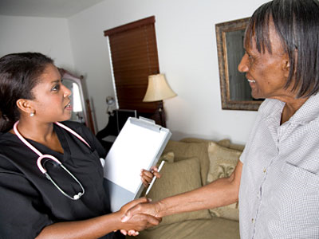
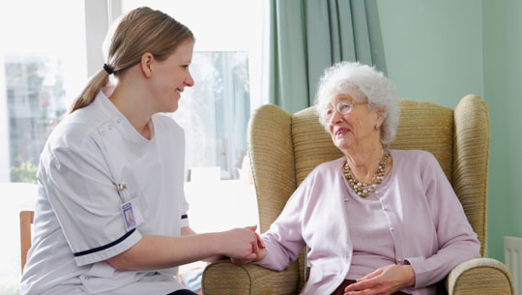
Generations Home Care, Inc. (310)
Generations Home Care is committed to providing exceptional care for our patients in order to promote their independence, improve their quality of life and help them remain in the comfort of home.

Slide 47
Girl Scouts of the Chesapeake Bay Council, Inc. (320)
Girl Scouting builds girls of courage, confidence, and character, who make the world a better place.

Slide 48
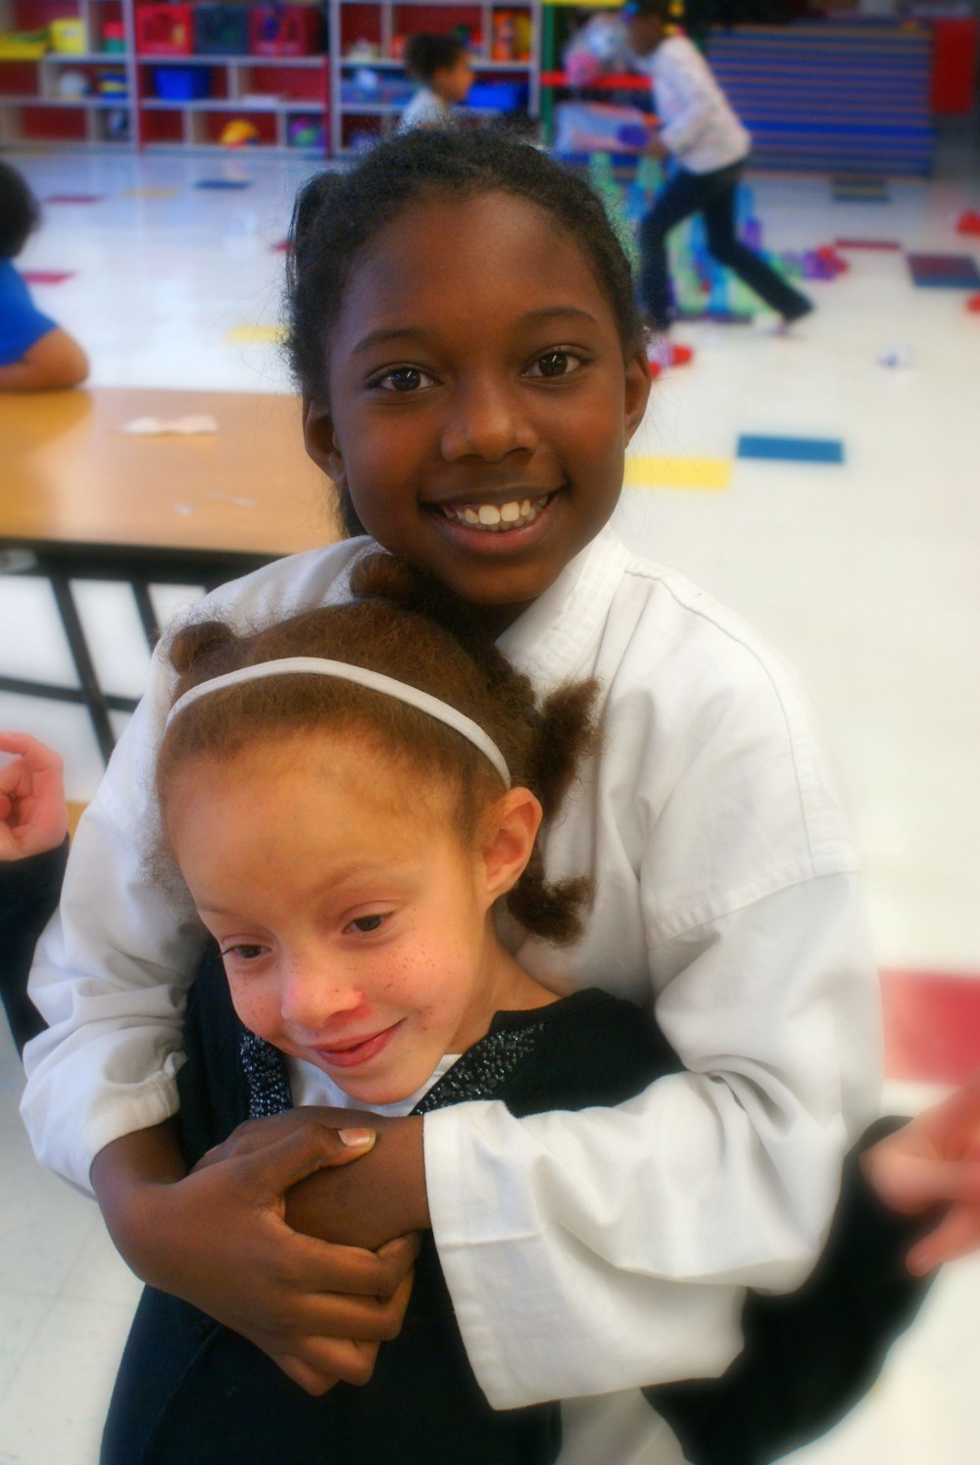
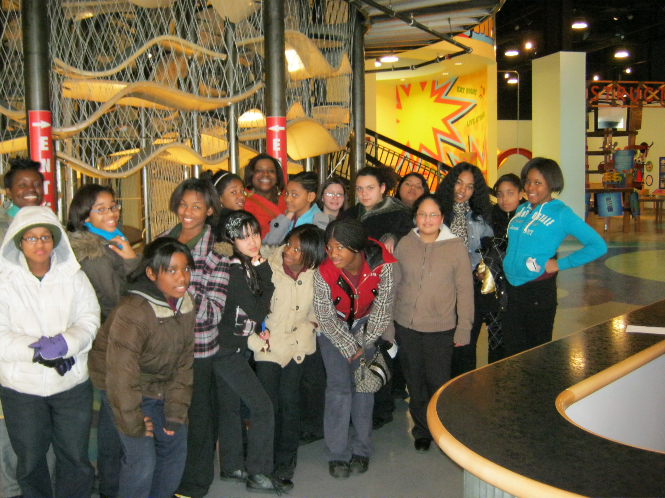
Girls Incorporated of Delaware (330)
Strong, Smart and Bold
Girls Inc. responds to the changing needs of girls and their communities through research-based programs and advocacy that empower girls to reach their full potential and to understand, value, and assert their rights.

Slide 49
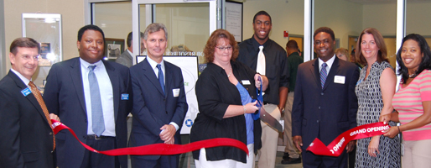
Goodwill Industries of Delaware and Delaware County, Inc. (733)
Mission: To improve the quality of life for people with barriers to self-sufficiency through the Power of Work.

Slide 50
Harrington Senior Center, Inc. (370)
The Harrington Senior Center was founded in July 1967. We offer a diversity of programming for person 50 and over.

Slide 51
Hilltop Lutheran Neighborhood Center, Inc. (375)
Hilltop Lutheran Neighborhood Center is a not-for-profit United Way agency providing educational and social development programs for children and teens in the community.

Slide 52
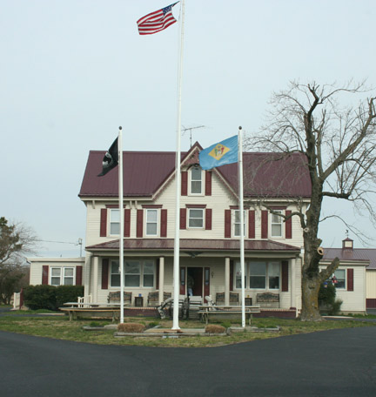
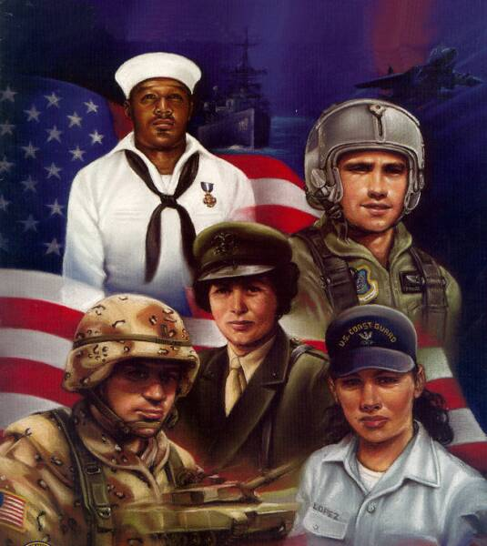
The Home of the Brave Foundation (787)
Veterans of the United States have a long history of going to extreme efforts to care for their fallen comrades on the battle field. The Home of the Brave intends to extend that tradition to those veterans who have fallen since their return to civilian life and are now homeless.

Slide 53
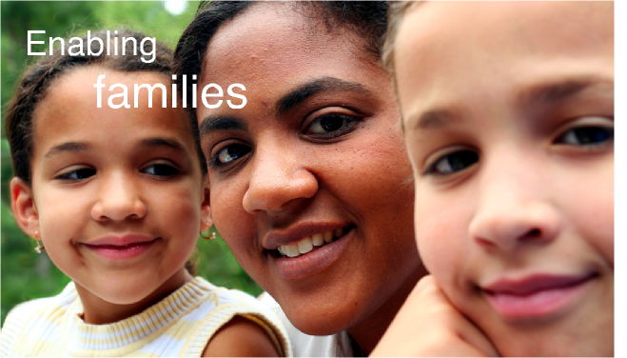
Homeward Bound, Inc. (445)
Homeward Bound provides shelter to homeless families with children through the Emmaus House Program. Families are given the opportunity to stay together as they work on getting back into their own place.

Slide 54
Jewish Family Services of Delaware, Inc. (412)
The mission of JFS is helping people improve
their lives and life prospects.

Slide 55
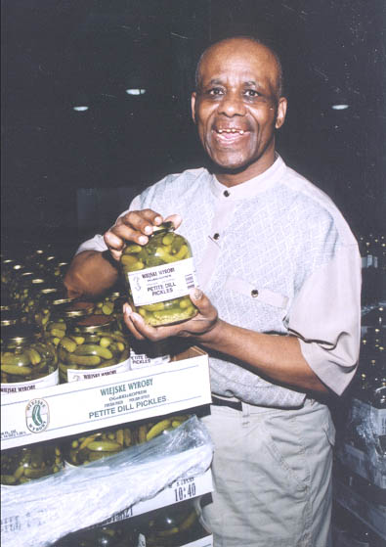
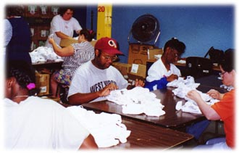
Kent-Sussex Industries, Inc. (340)
The mission of KSI is to assist people with disabilities in the pursuit of their potential in employment and meaningful participation in their communities.

Slide 56
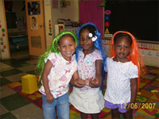
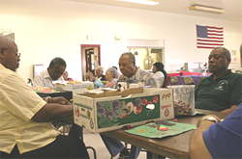
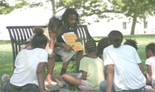
Kingswood Community Center, Inc. (400)
Kingswood Community Center’s mission is to enable people in Northeast Wilmington and surrounding communities to achieve their potential economic, social and personal well-being.

Slide 57
La Esperanza, Inc. (9462)
Provides support to the increasing number of immigrant workers arriving in Sussex County from Mexico and Guatemala. Since then, we have evolved into a multi-service support organization that assists with the assimilation of Latinos into the broader Sussex County population.

Slide 58
Latin American Community Center, Inc. (415)
Mission
To advocate for and assist the Latino Community by offering services in a continuum of care that promotes empowerment and an enhanced quality of life while celebrating our diverse cultures.

Slide 59
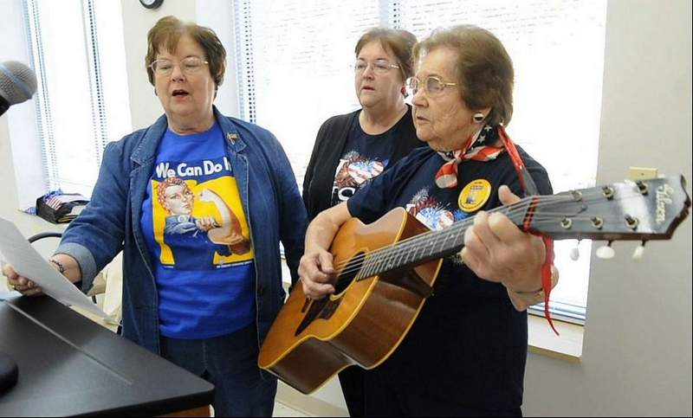
Laurel Senior Center, Inc. (416)
Offers a wide spectrum of services to persons aged 55 or older, regardless of race, creed, or income.

Slide 60
Legal Services Corporation of Delaware, Inc. (9283)
Our mission is to use the practice of law to help low-income families in Delaware. We emphasize protection of those rights that are crucial to the viability of a stable family.

Slide 61
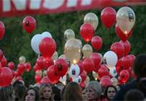
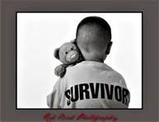
Luekemia & Lymphoma Society, Delaware Chapter (9046)
The mission of The Leukemia & Lymphoma Society (LLS) is:
Cure leukemia, lymphoma, Hodgkin's disease and myeloma, and improve the quality of life of patients and their families.

Slide 62
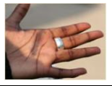
Limen House, Inc. (422)
Our mission is to offer a threshold to recovery and break the cycle of addiction in service to our community. We provide counseling, structure, and life skills in a community setting. Based on principles of Alcoholics Anonymous.

Slide 63
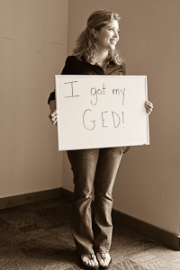
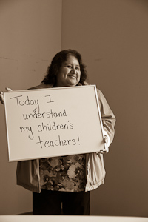
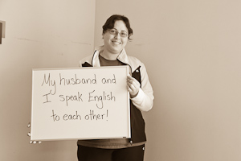
Literacy Volunteers Serving Adults Northern Delaware, Inc. (707)
Literacy Volunteers Serving Adults offers targeted instruction to adults with limited literacy and English language skills. LVSA assists adult learners to realize their potential as confident, self-sufficient, and productive employees, family members and contributors to their communities.

Slide 64
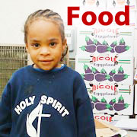
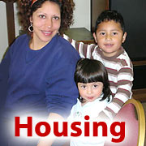
Lutheran Community Services, Inc. (719)
“Sharing God's Blessings by Helping Others in Need”
Lutheran Community Services helps people who have low incomes, seniors, and others who are experiencing a crisis and as a result have difficulty meeting their family’s basic needs for food and housing.

Slide 65
Make-A-Wish Foundation of the Mid-Atlantic, Inc. (9215)
Lonnie, age, 6, “I wish to be a superhero!”
We grant the wishes of children with life-threatening medical conditions to enrich the human experience with hope, strength and joy.

Slide 66
The Mary Campbell Center, Inc. (9154)
We focus on the individuals we are able to serve, each having special needs, and with the goal that each will live a happy and productive life within a homelike setting.

Slide 67
Meals on Wheels of Lewes & Rehoboth, Inc. (425)
Meals On Wheels Lewes-Rehoboth is on the front line by helping senior citizens remain independent, dignified members of our local community by assisting in the maintenance of their nutritional needs....one meal at a time.

Slide 68
Mental Health Association in Delaware (430)
The Mental Health Association in Delaware promotes improved mental well being for all individuals and families in Delaware through education, support, and advocacy.

Slide 69
Middletown-Odessa-Townsend Jean Birch Senior Center, Inc. (435)
The mission of the MOT Jean Birch Senior Center is to enable the senior citizens in its service area to maintain active, healthy, productive, and financially secure lives.

Slide 70
Milford Senior Center, Inc. (793)
Our mission is to encourage and support an independent lifestyle by designing and providing excellence in services, activities, and programs that meet the continuing and diverse needs of seniors, age 55 and over, who seek to maintain the highest quality of life and contribute to the good of the community.

Slide 71
Milton & Hattie Kutz Home, Inc. (414)
The Kutz Home is a skilled nursing facility providing 24 hour nursing care, rehabilitation, Kosher food, therapeutic diets, Alzheimer’s programs, social services, recreational, social and religious activities.

Slide 72
Ministry of Caring (295)
The Ministry of Caring is a vibrant community of staff, volunteers, donors and diverse supporters united by a passion to serve the poor.

Slide 73
The Modern Maturity Center, Inc. (796)
Provides programs and services that will enhance the quality of life with dignity and respect for older adults.

Slide 74
Mom’s House (9204)
Mom’s House® gives honor and glory to God by treating each person, born and pre-born, as a unique and priceless gift of a loving Creator.

Slide 75
NAMI-DE (National Alliance of Mental Illness in Delaware) (103)
The National Alliance on Mental Illness in Delaware is the state organization of the National Alliance on Mental Illness (NAMI). At the national level. NAMI is the largest grassroots organization serving individuals living with mental illness and their families and friends.

Slide 76
Nanticoke Senior Center, Inc. (437)
Nanticoke Senior Center provides community seniors participation in social, recreational, cultural and physical activities, gives information and nutritious meals daily to congregate and homebound.

Slide 77
National Multiple Sclerosis, Delaware Chapter (720)
The Delaware Chapter of the National MS Society is a community of individuals who are committed to achieving a world free of MS. The Chapter helps over 1,550 Delawareans living with MS, and their loved ones, who are impacted by MS to move their lives forward.

Slide 78
NCALL Research, Inc. (708)
Mission:
To promote affordable housing and improved communities for low and moderate income people primarily in rural areas.

Slide 79
Neighborhood House, Inc. (438)
“With God's love from within, we provide services and programs that educate, enlighten, and empower people and the communities.”
Neighborhood House
Neighborhood House is an organization that operates on a foundation of Christian principles pursuing two primary purposes:
•assist and guide people with finding their own paths of awareness, self-sufficiency, productivity, hopefulness and success.
•provide leadership, support, and advocacy for a comprehensive approach to community, economic, and leadership development.

Slide 80
New Castle Head Start, Inc. (439)
New Castle County Head Start, Inc. is a private, non-profit organization devoted to promoting the school readiness of preschool children, ages 3 to 5, from low-income families in
New Castle County, Delaware.

Slide 81
Newark Day Nursery and Children’s Center (440)
"NDNCC is dedicated to providing the highest quality early childhood and school age services to educate, enrich, and inspire children and youth from culturally and economically diverse families."

Slide 82
Newark Senior Center, Inc. (443)
The Newark Senior Center enhances the lives of the 50+ community by providing resources and opportunities for growth in body, mind and spirit.

Slide 83
Open Door, Inc.(724)
Provides a comprehensive range of behavioral health services including mental health, substance abuse and psychosocial services throughout Delaware.

Slide 84
Opportunity Center, Inc.(450)
Enabling people with disabilities and others with significant employment barriers to realize their maximum vocational potential.

Slide 85
Peoples Place, Inc. (455)
Helping people find their path to growth and independence
We assist the people of our community by providing high-quality services that promote: Dignity, Empowerment, Independence, Safety, Self-esteem, and Self-sufficiency

Slide 86
Planned Parenthood of Delaware (727)
The Mission of Planned Parenthood of Delaware is to ensure the right of all individuals to access appropriate information and services necessary to make and act on personal decisions related to their own reproduction, sexuality and health.

Slide 87
Prevent Child Abuse Delaware (452)
To provide leadership for child abuse prevention activities in the State of Delaware by increasing understanding of child abuse and its solutions, serving as a resource for individuals, families and communities, and advocating for enhanced prevention policies and programs.

Slide 88
Read Aloud Delaware (709)
Mission: To ensure that each preschool child in Delaware is regularly read to one-on-one.

Slide 89
Ronald McDonald House of Delaware (800)
Mission
To provide nurturing and supportive environments and services to directly improve the health and well being of children and to bring comfort to their families.

Slide 90
Rose Hill Community Center, Inc. (9205)
Mission
Rose Hill Community Center builds strong individuals, families and communities by addressing the educational, recreational, and social well-being of our neighboring communities.

Slide 91
Saint Antony’s Community Center (748)
St. Anthony’s Community Center (SACC) is a non-profit, non-denominational agency serving the social needs of people of all ages in northern Delaware.
To provide services that help human needs of all people in the City of Wilmington.

Slide 92
The Salvation Army (470)
The Salvation Army’s mission is to preach the gospel of Jesus Christ and to meet human needs in His name without discrimination.

Slide 93
The Shepherd Place, Inc. (710)
The Shepherd Place provides relief to families and individuals who are in distress or dire economic situations without regard to age, race, creed, national origin or sexual orientation. The Shelter provides housing, case management, food and other basic needs at no cost to those who need them.

Slide 94
Sojourners’ Place (801)
Hope for the Homeless…. Light for the Journey
To assist homeless women and men on their journey to self-sufficiency through a case-managed, residential program.

Slide 95
Supporting Kidds (728)
Mission
To provide a compassionate pathway to healing for grieving children and their families, and to empower the community to support them in the grieving process.

Slide 96
Sussex Community Crisis Housing Services, Inc. (9074)
The Mission of Sussex Community Crisis Housing Services, Inc. is to provide safe and secure temporary housing to the homeless and to facilitate the transition from homelessness to financial and housing independence.

Slide 97
United Cerebral Palsy of Delaware (490)
To promote the overall quality of life, independence, and equality of children and adults with disabilities and their families.

Slide 98
The United Negro College Fund (741)
UNCF provides operating funds for 38 member historically black colleges and universities (HBCUs), scholarships and internships for students at about 900 institutions and faculty and administrative professional training.

Slide 99
USO Delaware, Inc. (749)
USO Delaware is committed to sharing a touch of home with our troops and their family members.

Slide 100
USO World Headquarters (559)
Mission
The USO lifts the spirits of America’s troops and their families.

Slide 101
VSA Arts of Delaware (9417)
VSA arts of Delaware recognizes the need for children and adults with disabilities to be provided with opportunities to participate and achieve in the area of performing and visual arts.

Slide 102
West End Neighborhood House, Inc. (540)
West End’s mission is to help individuals achieve self-sufficiency, reach and maintain their maximum potential, and live responsibly and harmoniously in a healthy community and complex world.

Slide 103
Wilmington Head Start, Inc. (9185)
Head Start utilizes a combination of educational, health, nutritional and social services to help children make progress toward their educational goals.

Slide 104
Wilmington Senior Center, Inc.(560)
Mission
The Wilmington Senior Center provides life-sustaining and life-enriching services, opportunities and partnerships that have a positive impact on older adults’ physical, mental and social well-being and that contribute to future generations.

Slide 105
YMCA of Delaware (570)
Our organization exist to develop and practice the Christian principles of love, caring, justice and peace, and to enrich the emotional, and social life of individuals, families, and our community.

Slide 106
YWCA Delaware (590)
The YWCA Delaware is dedicated to eliminating racism, empowering women and promoting peace, justice, freedom and dignity for all.

Slide 107
First State Community Action Agency, Inc. (9147)
To work towards the elimination of poverty and to make less severe the effects of poverty on low-income people and their communities.

Slide 108
First State Community Loan Fund (9298)
As a federally certified CDFI, First State Community Loan Fund leverages funds investors and contributors to lend for the construction and renovation of affordable housing, the start-up and expansion of businesses, and the provision of essential community services.

Slide 109
Interfaith Community Housing of Delaware (711)
The mission of Interfaith Community Housing is to act as a catalyst to revitalize and strengthen neighborhoods by providing sustainable housing and homeownership services that support low and moderate income households, empower residents for leadership, and promote individual and community asset building.

Slide 110
Nehemiah Gateway Community Development Center (9482)
Mission is to provide access to financial education and services for low-to-moderate income individuals.

Slide 111
One Village Alliance (12569)
We are committed to ensuring that all children and their families receive the resources and support necessary to achieve success regardless of their social and economic status.

