Slide 1
Resources for Program Monitoring and Review
Institutional Research and Effectiveness

Slide 2
APR Resources (and permanent status review)
The Office of Institutional Research and Effectiveness (IRE) supports departmental Academic Program Review by providing department-specific information related to its students, faculty and resources. This information will assist the department in addressing specific criteria within two Middle States Standards:
Standard III: Design and Delivery of the Student Learning Experience
Standard V: Educational Effectiveness Assessment
Unless otherwise noted, IRE will provide:
Student, Human Resources and Fiscal information
standard summary tables and charts displaying seven-year trends
Excel files

Slide 3
Student Information –

Slide 4
Human and Fiscal Resource Information –

Slide 5
Standard Report Access Options
http://ire.udel.edu/dashboards/
ire.udel.edu/bi
www.udel.edu/registrar/faculty_staff/reports/index.html
www.udel.edu/udataglance

Slide 6
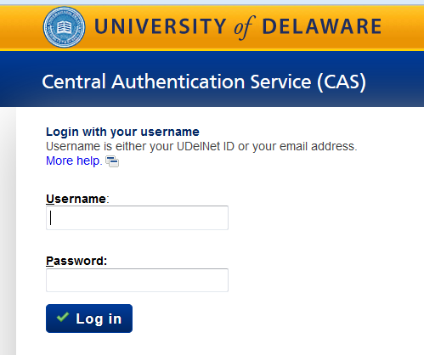
UDataGlance

Slide 8
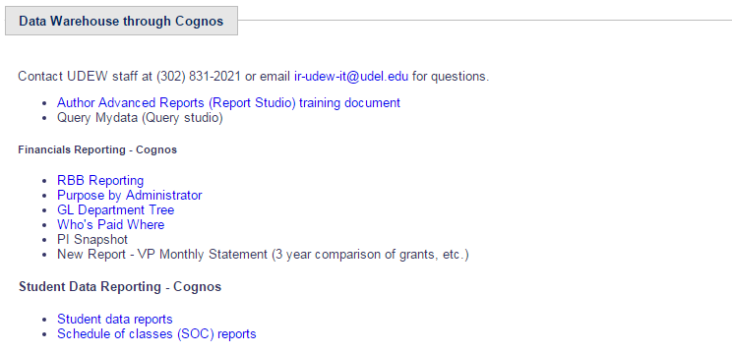
UDataGlance

Slide 9
Student Data Reports
Enrollment
Advisement
Graduation

Slide 10
Next Steps
Collaboration with Graduate Office
Understanding Policy and Procedures
Graduate Admission Data Mart
Time to Degree
Retention

