Slide 1
Woke from the Dead Linda S. Gottfredson, PhD School of Education University of Delaware
Heterodoxy in Psychology
The 2nd Biennial Conference
Orange, CA
January 10, 2020

Slide 2
Needed: Heterodoxy in academe
Being stamped out as moral necessity
Why & how?
What can we do?
Insights from
individual differences psychology

Slide 3
My Aim Today
Summarize how social justice “wokeness” has evolved since 1960s to reincarnate the corpse of racial intolerance, and worse
Explain how two distinctively human traits are driving it
Offer strategies for protecting heterodoxy in academe
Based on first-hand
observation and experience

Slide 4
Woke, stay woke, wokeness
1972 – black vernacular, from Civil Rights Era
Awakening to rights, hope, and pride
“I been sleeping all my life. And now that Mr. [Marcus] Garvey done woke me up, I’m gon stay woke. And I’m gon help him wake up other black folk.” (B. Beckman)
2020 – currently fashionable ideology that inequality proves (white) injustice
Injustice is endemic. Eradicate it by any means possible
“Aware of the truth behind things ‘the man’ doesn’t want you to know, i.e. classism, racism, and any other social injustices”
Be a warrior for “social justice”
Signals speaker’s virtue, “being with it”
“Being very pretentious about how much you care about a social issue”
“Trying to sound like a deep thinker when you’re really just following a trend”
Sources: www.dictionary.com, www.urbandictionary.com, Oxford English Dictionary.

Slide 5
Reflects sociological reasoning Explicit in the 1970s
Nothing to do with race, neo-Marxist fad
Equalitarianism
All humans born the same
Only their environments differ
Outcomes would be equal if environments (advantages) were too
Outcomes continue to differ a lot
Some people are unfairly hogging privileges they do not deserve
Call them to account and change the system
Is still the standard social science model
Family advantage Child IQ Education Occupation Income Health
And for woke reasoning

Slide 6
“Wokeness” rhetoric & strategy, 1960-2020
Racial Discrimination
Policies to combat it
Unequal outcomes (persist)
Coerce compliance to “social justice”
2020
1960
Oppression
White privilege
Microaggression
Unconscious racism
Racism
Discrimination
Prejudice
Inclusion
Diversity
Affirmative
Change standards (hiring, licensing, admissions)
Compensatory treatment
Equal treatment
Academic achievement
Years of education
Job level
Income
Health
Incarceration
Rewrite history
Add “social justice” to accreditation and promotion standards
Indoctrinate students
Demonize the “oppressor”
Punish dissent
Police speech
“Proof” of discrimination
Moral necessity!!
Least responsive to bureaucratic mandate
False
To be clear, there HAD BEEN bad, open, intentional discrimination

Slide 7
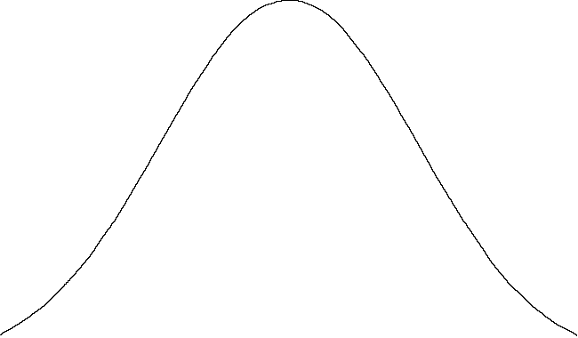
Woke ideology resolutely denies a key human trait—intelligence—to achieve its goal
But does talking about these facts constitute discrimination?
Isn’t it more noble to deny them?
Biological fact
Individual differences in phenotypic intelligence (g) are:
Real
Functionally important
Brain-based
Genetically influenced
More heritable with age
Worldwide
~Same across generations
Group differences are too*
X
X
More proficient learning, problem solving, abstract thinking, seeing connections, drawing inferences

Slide 8
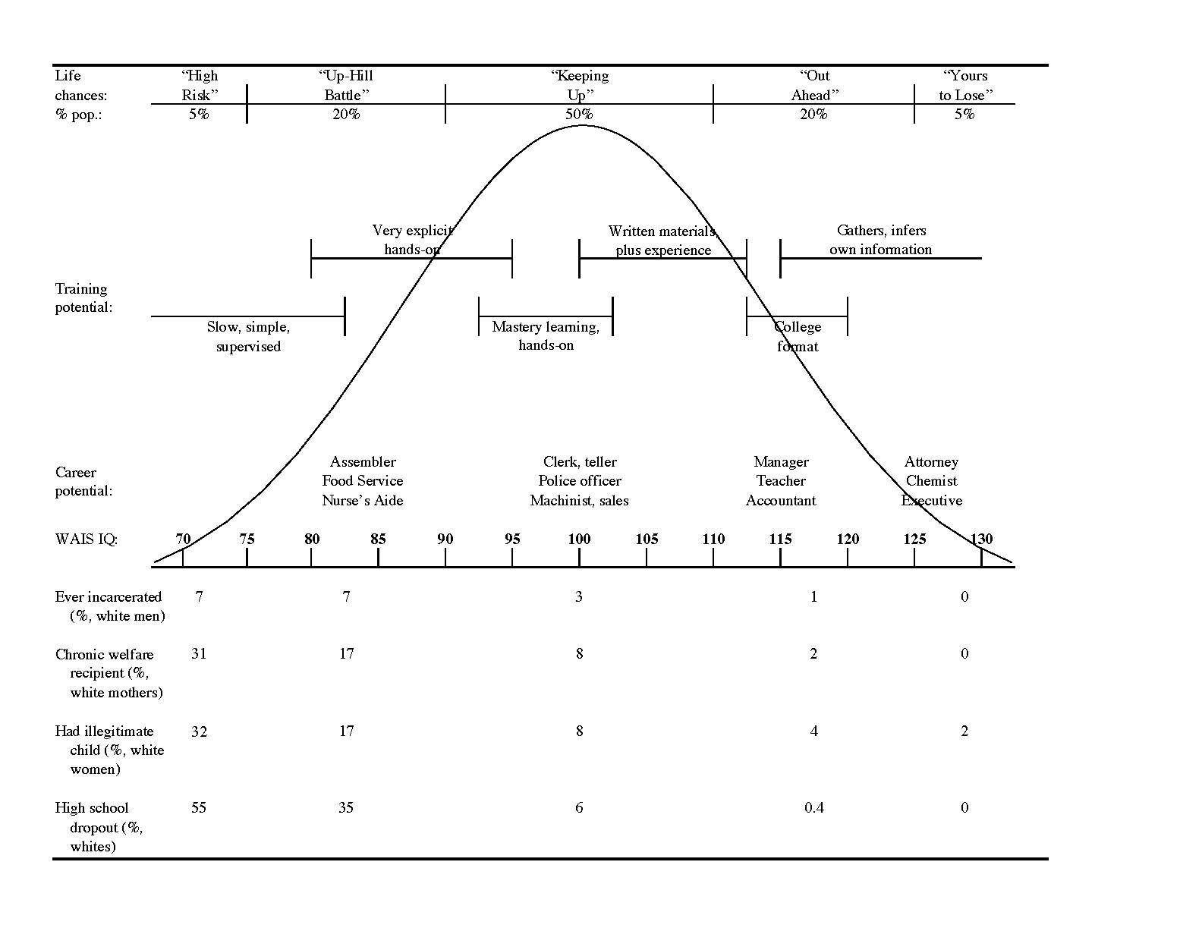
Higher g better performance in school, jobs, health inequality*
Military enlistment thresholds
10th
15th
30th
1 SD = 15 pts
X
Most military jobs require at least 30th percentile
Military policy forbids induction below 15th percentile
US law forbids induction below 10th percentile
** Gottfredson, L.S. (1997). Why g matters: The complexity of everyday life. Intelligence, 24(1), 79-132.
Notes:
8

Slide 9
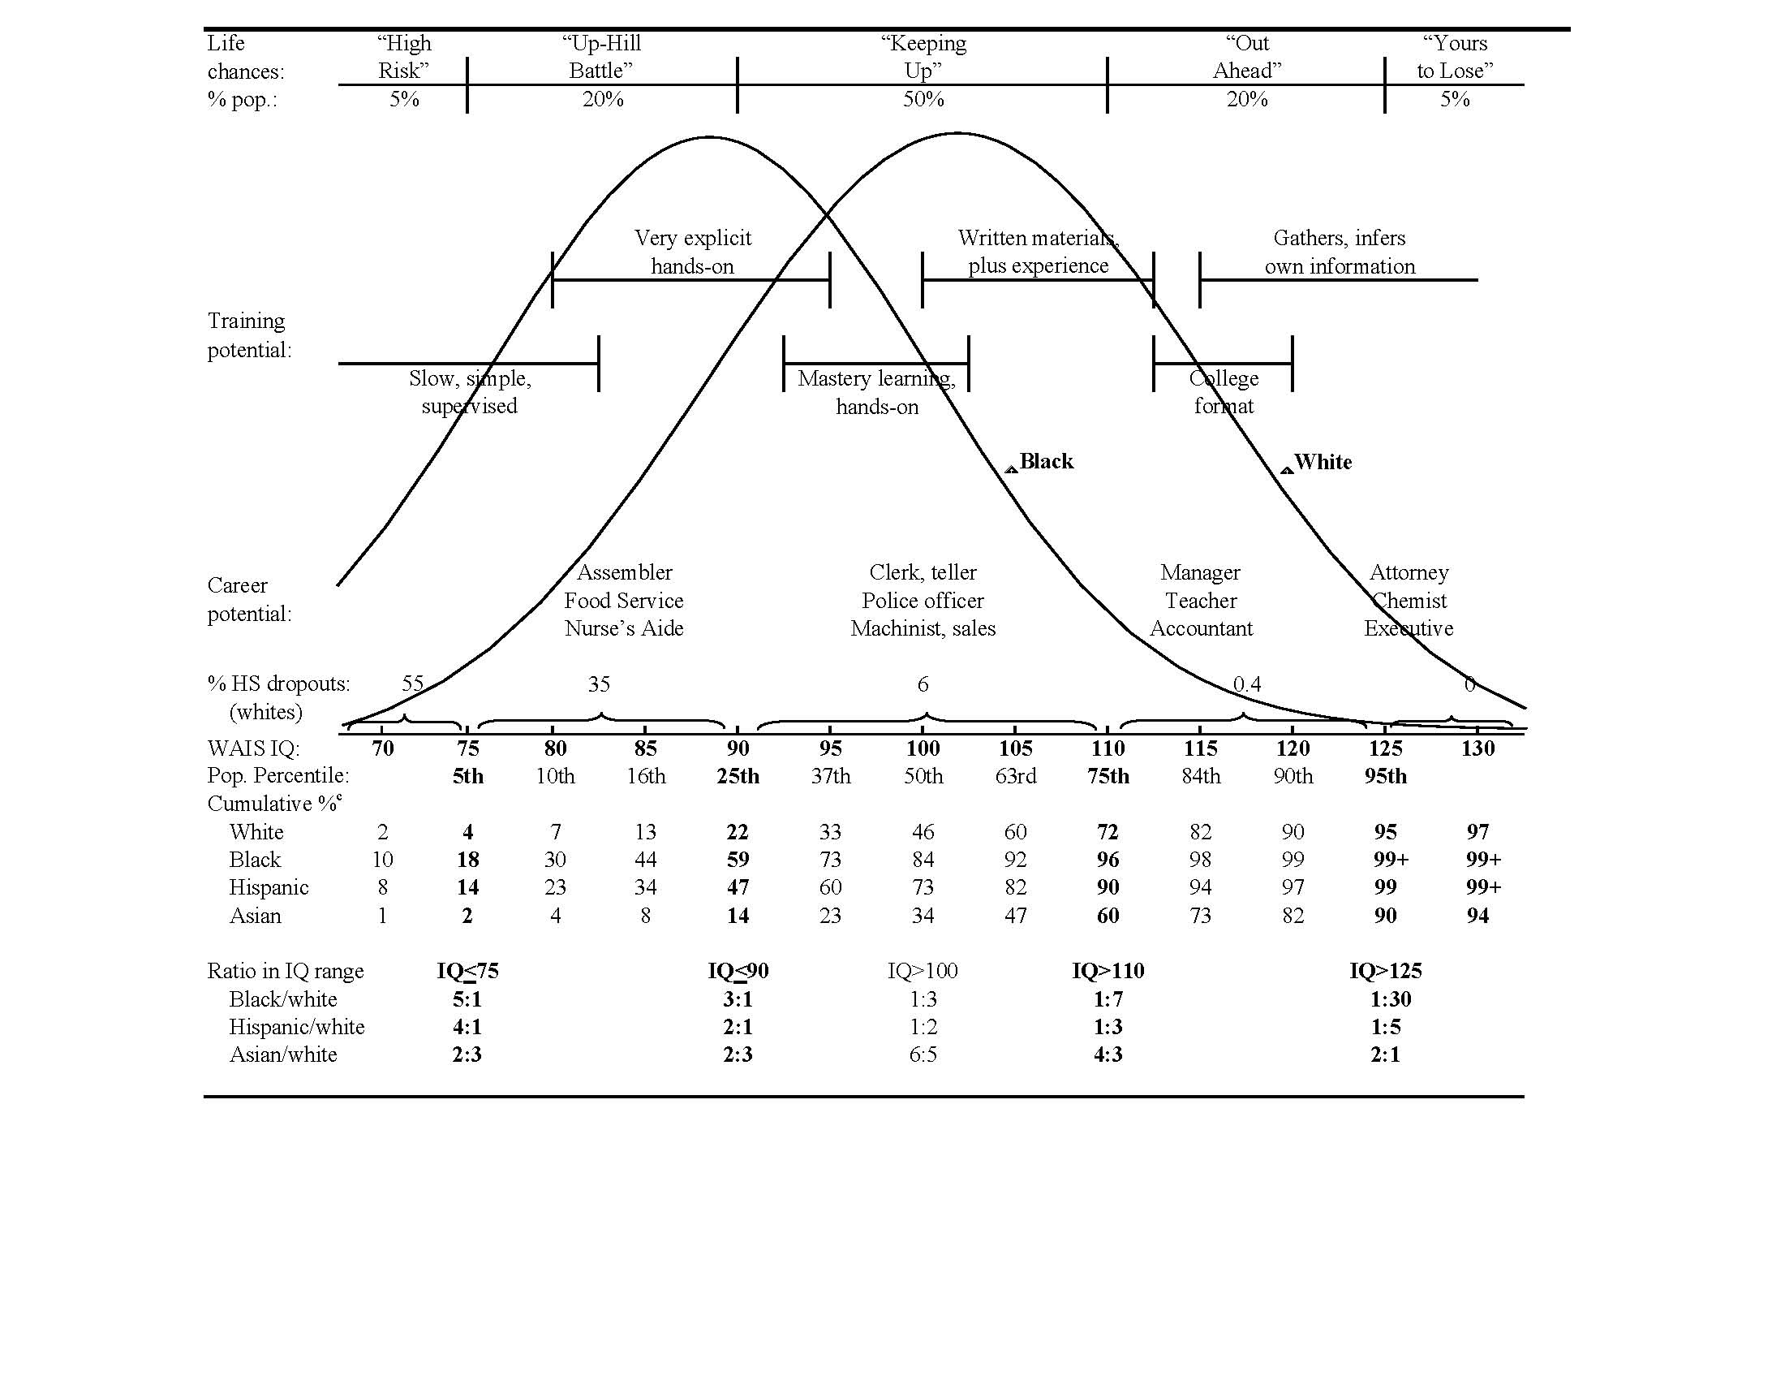
IQ bell curves differ by race unequal outcomes by race
1 SD = 15 pts

Slide 10
Denying g’s powerful real-world effects doesn’t neutralize them
Social advantage IQ Education Occupation Income Health
Biological advantage in g
Unequal outcomes persist
More disappointment, resentment, accusation
More coercive measures to get “social justice”
More anger in all groups
Ignores big risks facing lower-g individuals
“Noble lies” do great harm

Slide 11
Woke ideology exploits a second evolved trait— humans are exquisitely social beings
Want to belong & fear shunning
Deeper than politics
The ultimate motivated reasoning
Encourages group-think
Undermines intellectual integrity
Academe is reputational system
Gauntlet of evaluations
By colleagues, administrators, editors, etc.
Who decide promotion, publication, and much else
Using rules and norms
Often selectively applied to disfavor the heterodoxy
And suspended during moral panics

Slide 12
Moral panic Frenzied public effort to expose and destroy an “evil one”
Players
Grandstanding instigator “exposes the evil one”
Avenging angels rush in to vilify
Others pile on to show moral bona fides
Colleagues, administrators, media
Most shun the target, fearing guilt by association
Administrators twist protections (e.g, academic freedom) to justify expulsion
The target
Pressure to recant, betray others

Slide 13
Novel social emergency brings out individual differences in behavior
Opportunists
True believers
Groupies
Go along to get alongs
Fair weather friends
“Distancers” who know better
Supportive friends
Strangers to the rescue
Strangers expressing gratitude
Many are good people
Huge silent—silenced—audience

Slide 14
Some lessons in preventing, mitigating, & surviving anti-heterodoxy in academe
Everyone can make a difference, in some way
Think small—low-stakes transgressions are insidious but least threatening to correct.
Be prepared—know the institution’s written documents inside and out.
Watch for players to make stupid (self-incriminating) mistakes—woke arrogance and over-confidence make them careless.
Beware the stealth dictates of non-academic bureaucrats.
E.g., see NAS’s new report, Social Justice Education in America.
Enlist big guns where possible (e.g., FIRE).
Create synergy.
Like here! Thank you.

