Slide 1
Empirical Treasure, Lost and Found
Linda S. Gottfredson
University of Delaware, USA
International Society for Intelligence Research
Melbourne, Australia
December 12, 2013

Slide 2
Imagine

Slide 3
…that someone told you this.
“If all 13-year-olds took the same 15-minute test (WASI), I could give you each child’s odds for all these adult outcomes without knowing anything else about them.”
  Drops out of high school,
  Holds mostly unskilled jobs, skilled jobs vs. professional jobs
  Performs those jobs well
  Lives in poverty
  AND
  Can find a particular intersection on a map, or grams of carbohydrate per serving on a food label
  Adheres to a medical treatment regimen for diabetes or other chronic illness
  Dies prematurely
Miraculous?
Would you bet against this odds-maker?
Don’t!

Slide 4
Actual landscape of odds, by outcome and IQ*
Sample
Odds
(yes/no)
50:50
Outcomes
Ability level
* Source of data: Gottfredson, 1997, p.118 (young adults) and p.116 (all adults)

Slide 5
Now imagine

Slide 6
…that this person also claims that:
“With just one more piece of information, I can tell you how to improve the worst odds—without changing IQ and without leveling social resources.
  AND
It would save thousands if not millions of lives, and millions if not billions of health care dollars.”
Yes, and g is the key!
Miraculous? Credible??

Slide 7
Lost treasure of g—a personal account
Chronology
  Today—g 30 years after rediscovery
  Yesterday—Dark Ages before rediscovery
  Tomorrow—Vast opportunities ahead
Unexpected lessons
  Complexity of everyday life
  Power of “inconsequential” effects
A story to remember
Notes:
Note: The audience was already familiar with g. It stands for the general mental ability factor, which is the large first factor derived from factor analyzing any broad battery of mental tests. It is a more precise measure than is IQ of what laypeople commonly refer to as “intelligence.” See Slide 60 for a description of what it means in practical terms.

Slide 8
g: 30 Years of Discovery

Slide 9
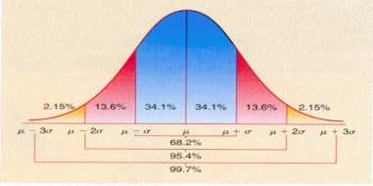
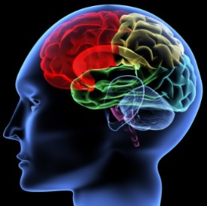


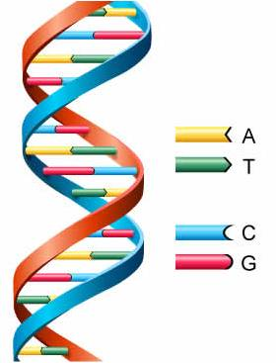




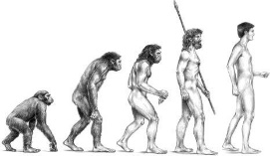
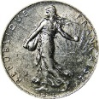
g rediscovered
(See notes for slide)
Traits
g
Brain
Performance
Genes
Life outcomes
Evolution
Social structure
Notes:
This is the circle of evidence on g—the wheel of human fortune--discovered over the last 30 years.
It’s been an exciting journey. I’ve sojourned in all these disciplines while trying to understand g’s biological origins, practical value, and real-life consequences for individuals and cultures. The more we’ve learned about this phenomenon—the enduring human variation in general cognitive ability, aka general intelligence—, the more remarkable it seems.
I never started out to study intelligence, nor did any of the pioneers I describe today. But all roads lead to g.
The now-extensive nomological network on g continues to expand and thicken.
Although already impressive, I think research on g is on the verge of liftoff (more on that later)

Slide 10
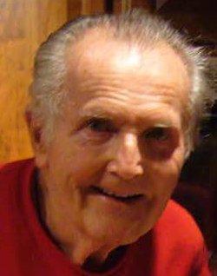

g rediscovered
(See notes for slide)
Traits
g
Brain
Performance
Genes
Life outcomes
Evolution
Social structure
Notes:
Key players whose work influenced me:
Frank Schmidt: Early in my career I researched the aptitude demands of jobs to improve career counseling. Schmidt, a personnel selection psychologist, was at that time co-developing meta-analysis & showing the generality of g in predicting job performance—a revolution in that field.
Arthur Jensen: This great psychometrician and experimentalist was then reintroducing Spearman’s g to psychology & documenting its evidentiary (nomological) network from genes to life outcomes. No one has done more than he to validate the construct of g, not just psychometrically, but also at the level of genes, physiology, academic and job performance, and socioeconomic outcomes. He was rated as one of the top 50 living psychologists of the 20th century. (He passed away in 2012.)
Like all the other pioneers I describe, their work was initially quite “controversial.”

Slide 11
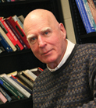
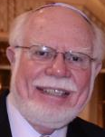
g rediscovered
(See notes for slide)
Traits
g
Brain
Performance
Genes
Life outcomes
Evolution
Social structure
Notes:
Then:
Robert Gordon, a sociologist, has a knack for seeing how traits play out in the minutiae of daily life, but also how variation in traits such as intelligence can gradually shape social relations and social structure. His work on the psychometrics of everyday life as an intelligence test particularly influenced my thinking.
Thomas Bouchard, Jr, who founded the famous study of identical twins reared apart, provided particularly compelling early evidence on the degree to which differences in intelligence and other traits are genetically heritable (and co-heritable) vs. not—and how, stunning all of us, the heritability of intelligence increases with age.

Slide 12

g rediscovered
(See notes for slide)
Traits
g
Brain
Performance
Genes
Life outcomes
Evolution
Social structure
Notes:
Rosalind Arden is a documentary file maker turned PhD evolutionary psychologist who taught me how to think more like an evolutionary biologist. I am her junior author on research on g as a general fitness factor (e.g., mutation load).

Slide 13
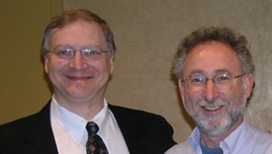
g rediscovered
(See notes for slide)
Traits
g
Brain
Performance
Genes
Life outcomes
Evolution
Social structure
Notes:
Ooops! How did those two get in there? Photo of current ISIR President (David Lubinski) and treasurer (Rich Haier) at the Albuquerque ISIR conference.

Slide 14
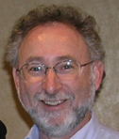
g rediscovered
(See notes for slide)
Traits
g
Brain
Performance
Genes
Life outcomes
Evolution
Social structure
Notes:
Richard Haier, a personality psychologist turned neuropsychologist, was the first researcher to study normal intelligence with brain imaging, to discover that IQ correlates (negatively) with glucose uptake in the brain, and to co-develop the leading (P-FIT) theory to explain the distributed nature of intelligence in the brain. As Jensen’s work suggested, intelligence differences can’t be traced to any particular module in the brain, but are reflected throughout it—perhaps reflecting a global property (efficiency?) of the brain.

Slide 15
g rediscovered
(See notes for slide)
Traits
g
Brain
Performance
Genes
Life outcomes
Evolution
Social structure
Notes:
I’ll now illustrate how each of these individuals helped build today’s thick, multi-level, multidisciplinary, interlocking network of evidence on the general mental ability factor, g, which in turn established its construct validity and systematic pattern of predictive validities across virtually all realms of modern life.
As I noted before, Jensen contributed virtually everywhere and usually before all others. He is unique, however, for his clever and thorough work investigating the psychometrics of g—do different test batteries, different factoring methods, different demographic groups, and different cultures yield the same g? (Yes.) What place does g have among our myriad cognitive abilities? (It is the most general, and is the core of all narrower ones.) Does psychometric g correlate with non-psychometric measures of mental performance? (Yes, for example, choice reaction time, evoked response potentials). And brain structure? (Yes, brain size, number of dendrites, etc.). Are all these things co-heritable with g? (Yes, moderately to highly so.) See Jensen’s 1998 book, The g Factor.
But what particularly interested me were his analyses of which sorts of tasks are most effective in bringing forth g. That is, what makes some tasks more “g loaded” than others? This is the question that captured me. How do g loadings rise and fall across different arenas of everyday life?

Slide 16
g rediscovered
(See notes for slide)
Traits
g
Brain
Performance
Genes
Life outcomes
Evolution
Social structure
Notes:
Frank Schmidt and his colleague John Hunter were bringing theoretical order to the empirical chaos of personnel selection psychology as I began my career. Knowing what best predicts on-the-job performance is crucial—economically, politically, and legally—for government, private, and military employers who hire, train, and promote large numbers of workers. They did so by showing that most of the chaos was owing to three statistical artifacts: sampling error, restriction in range, and measurement unreliability—all of which are rife in selection research. Once these artifacts are corrected for, predictive patterns pop out. Major findings were that general mental ability predicts performance to some degree in all jobs (called “validity generalization”), it is the best single predictor overall, and its predictive validity rises with job complexity.

Slide 17
g rediscovered
Traits
g
Brain
Performance
Genes
Life outcomes
Evolution
Social structure
Notes:
Robert Gordon is a rare sociologist—one who early recognized the profound importance of intelligence differences for social life. He is unique in tracing the cumulative effects of population variation in g from the individual to the cultural level. Jensen referred to this as the horizontal correlates of g.

Slide 18
g rediscovered
Traits
g
Brain
Performance
Genes
Life outcomes
Evolution
Social structure
Notes:
By contrast, Rosalind Arden has focused on the deepest “vertical” aspects of human to variation in g—the evolutionary roots of both genetic and phenotypic variation from a psychometrically informed understanding of intelligence.

Slide 19
g rediscovered
Traits
g
Brain
Performance
Genes
Life outcomes
Evolution
Social structure
Notes:
Tom Bouchard’s findings on the genetics of traits and outcomes, both psychological and physical, helped to constrain theorizing about the causes and consequences of intelligence differences. His findings rule out some popular causal explanations for differences in intelligence and life outcomes and why they correlate.

Slide 20
g rediscovered
Traits
g
Brain
Performance
Genes
Life outcomes
Evolution
Social structure
Notes:
Rich Haier’s work has instigated a flood of neuroimaging studies on intelligence, while encouraging more psychometric sophistication in their conduct and interpretation.

Slide 21
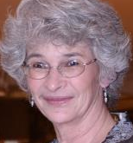
g rediscovered
Traits
g
Brain
Performance
Genes
Life outcomes
Evolution
Social structure
Notes:
My own work has focused on explicating how evolved variation in human intelligence shapes the lives of individuals, groups, and social structure itself, especially as modern life becomes more complex.

Slide 22
g rediscovered
Traits
g
Brain
Performance
Nomological network
Genes
Life outcomes
Evolution
Social structure
Notes:
In sum, these individuals illustrate how the broad and dense nomological network for g has developed. It is not just the piling up of studies, but diverse kinds of studies providing consilient results—that create a theoretically coherent pattern that also allows us to make novel predictions.

Slide 23
Human variation in g:
Extraordinary phenomenon
Recurring
Species-wide
General-use capacity
Shapes human institutions
Drives its own evolution
g

Slide 24
Dark Ages Before Rediscovery
Notes:
Many of you are too young to have experienced the Dark Ages of intelligence, so you may not realize how far the field has advanced since I was a graduate student. I will therefore give you a sense of the times, and what I mean when I say intelligence had been lost by the time I entered graduate school in 1973—and why it would stay lost for years to come.

Slide 25
g lost by 1970s
Traits
IQ
X
Brain
Performance
when I entered grad school
X
Genes
Life outcomes
X
Evolution
Social structure
Notes:
To quickly preview, the social sciences denied any role for biology (left side of figure); and they attributed all differences in traits, performance, and life outcomes to “social structure.”
Top sociologists were arguing that intelligence is socially constructed, (evil) human hands are responsible for all social inequality, everyone is able to perform almost any job, and so on.

Slide 26
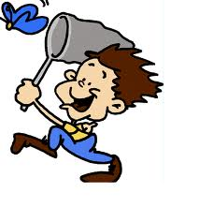
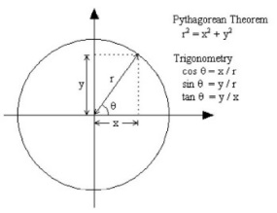


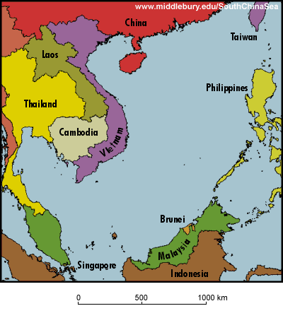
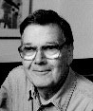
My 30 years, pre-PhD
  Themes
  Explore, collect & classify
  Chase puzzles
  Feet on the ground
  Man from Mars
Penang Malaysia
1947 1977
Notes:
I will take a short detour first to describe what drew me into the field despite having no particular interest in intelligence. People and careers differ, but it might be of interest to young scholars to share what worked for me.
Particularly useful was repeatedly being the Man from Mars, which I first experienced as a Peace Corps volunteer in Malaysia. It always challenges your assumptions, exposes what you take for granted, strips you of your jargon.

Slide 27
1970s
Sociology
Difference= inequality
Inequality is neither natural nor moral
Social inequality
Life outcomes
Social structure
Social class hierarchy
Notes:
Science in the early 1960s – Differences in intelligence said to exist and are important in school and work
But by early 1970s, social scientists insisted that differences in intelligence don’t exist, aren’t important, or are harmful to acknowledge.

Slide 28
1970s
Social privilege is…
Social inequality
…socially reproduced
Social class hierarchy
Notes:
Social privilege theory reigns. Inequality (re)produces inequality.

Slide 29
1970s
Social privilege is…
Performance
…socially inherited
Social inequality
…socially reproduced
Social class hierarchy
Notes:
Sociologists assumed that differences in achievements and abilities are created by differences in social privilege

Slide 30
1970s
Social privilege is…
Manufactured differences
aspirations
IQ
Performance
…disguised as “merit”
…socially inherited
“everyone can do any job”
“doctors should work up from orderly”
Social inequality
…socially reproduced
Social class hierarchy
Notes:
Sociologists argued that people are born with the same abilities, interests, and ambitions. Social privileges determine who gets ahead, but the privileged camouflage their advantages as “merit,” such as with IQ test scores. Yes, an occupation’s prestige correlates almost perfectly with its incumbents’ average IQ, but IQ is said to signal privilege, not competence.
The data seemed solid, but the explanation didn’t fit the real world. It fit the new neo-Marxist fervor in sociology, but not common sense. But what would be a better explanation?

Slide 31
Sound eerily familiar?
In USA:
Law—“No Child Left Behind”
Too-good-to-be-true science—“several weeks of N-back training raised intelligence”
Notes:
We still see the same arguments now as then, despite now having evidence to contrary

Slide 32
Needed: Shift in Focus
Knowing g by what brings it forth—
task complexity

Slide 33
My alternative explanation:*
Higher intelligence has functional value
Required me to study attributes
of jobs and tasks, not just people.
Specifically--
What in a job requires the exercise of g?
What makes some more “g loaded” than others?
*Alternative to social privilege theory

Slide 34
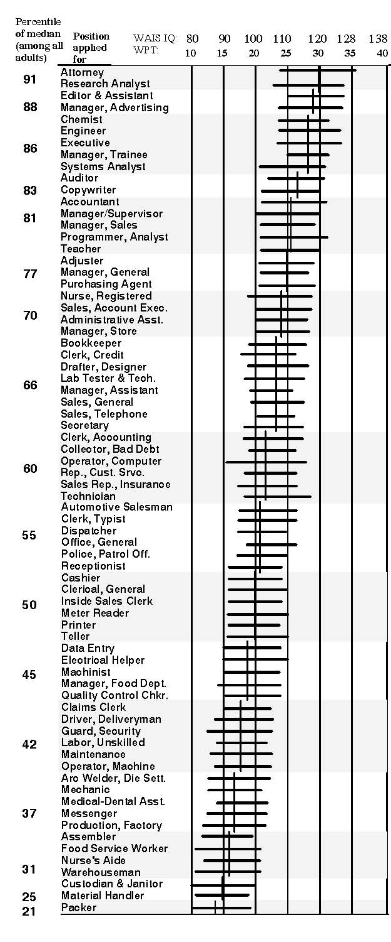
Key finding #1:
Occupational hierarchy is cognitive
Same worldwide
Mean worker IQs track jobs’ cognitive complexity
Job complexity hierarchy evolved as work tasks
clustered (into occupations) by g loading
to fit human variation in g

Slide 35
Key finding #2: “Judgment & Reasoning Factor” among jobs*
Complexity factor among jobs is mirror image of g factor among people
Workers must:
Correlation with factor
Learn and recall relevant information Reason and make judgments Deal with unexpected situations Identify problem situations quickly React swiftly when unexpected problems occur Apply common sense to solve problems Learn new procedures quickly Be alert & quick to understand things *Job analysis by Arvey (1986) | .75 .71 .69 .69 .67 .66 .66 .55

Slide 36
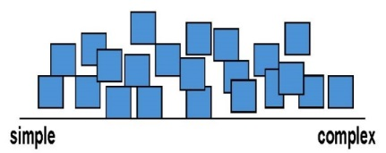
So, g loading is the flip side of g
Traits
g
+
Performance
g loadings
Tasks
Life outcomes
Social structure
Notes:
I had started looking into all available literatures on what abilities different occupational actually require, to help counselors provide more helpful guidance. Vocational psychology had abandoned abilities as too politically sensitive.
This search led me into employee selection literature.
I learned two things, which surprised me at first—
(1) g predicts performance in all jobs.
(2) and complexity is major distinction among jobs, which could explain the correlation between IQ and occupational status.
(3) So I looked at what in particular makes some jobs more complex than others. Means actually looking at the job content, the tasks; to fill in that black box of “occupation.” I discovered that complexity is neither content specific nor academic, but involves extent of reasoning, learning, abstract thinking, etc. Jensen had already given us a concept for that—g loaded.
(4) If true, then we should also find the following, a novel prediction. “IQ predicts performance better in more complex jobs.” It did, which is now well replicated.

Slide 37
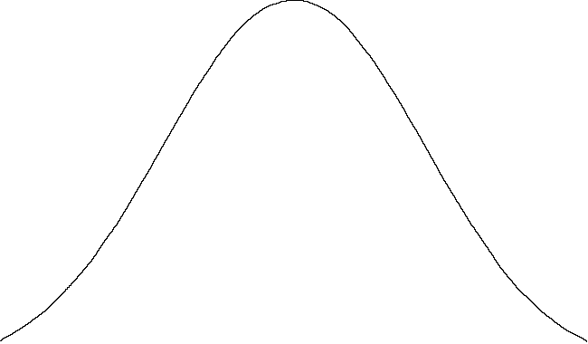
Key finding #3: The Complexity Dynamic
Tasks that are more complex
  put a bigger premium on learning-reasoning ability
  lead to bigger differences in task performance
Gaps
A
B
A
B
More complex
task
Gains
A
B
Performance level
Notes:
The complexity dynamic provides the general principle behind this prediction. It is also a basic fact in psychometrics.
Will come back to this repeatedly because it is absolutely crucial. It provides the basis for predictions of what will happen with new social policies in short and long term.
The important point here is that can expect—predict—differences in correlations with g depending on (1) the distribution of g in a group and (2) the complexity of tasks its members are to perform (assuming standard conditions).
The Complexity Dynamic helps explain why g is general in both nature and effects.

Slide 38
But how could a general intelligence ever evolve?
What adaptive challenges could possibly have been so general, so non-specific, to evolve such a content-free, domain-general ability??

Slide 39
Key finding #4: Power of cumulating “inconsequential” effects
Traits
g
Brain
Performance
Tasks
Genes
Life outcomes
innovation
New hazards
Evolution
Social structure
Notes:
I agreed a few years back to write a chapter for a book arguing the premise that intelligence is not modular, that is, not a set of adaptations to deal with specific challenges in the social or physical environments. “That’s an easy chapter to write,” I thought, “since there is lots of evidence for the generality of g.” But, if g is so general, so non-specific, how could it possibly have evolved. It clearly did, but how? Brains got bigger, and especially fast in the last half million years. Why? No schools, no medicine, no money, no government, not even spears. No technology, period, let alone complex technology. But intelligence kept going up. Our wheel of fortune is not complete without knowing why.
So, what in the task environment could possibly have lowered the odds of survival and reproduction among the less bright individuals of a group? I read and pondered for several years.
I finally realized the matter was much simpler than I imagined. In fact, that’s what the secret was—the ability to imagine something not concretely here and now; to have a mind’s eye. Imaginators accelerated our evolution by generating new complexities. Technology, for one. Much of it creates hazards of one sort or another, periodically generating what we refer to as “accidents.”
We often chalk them up to chance, and chance is a major component. But the task is not to explain why accidents happen, but why they weren’t prevented. Why hazards weren’t noticed, taken seriously, responded to appropriately, and lessons learned. Preventing them is a cognitive process.
I am going into some detail here because it sets the stage for the work a colleague and I are doing to improve adherence to treatment. The second piece of information our mythical oddsmaker would want is the complexity of tasks performed—that is, looking outside ourselves to the cognitive demands that require us to exercise our intelligence, that call forth g, just as does an intelligence test. Greater complexity puts us all at higher risk of error, but especially low g individuals.
The difference in odds need only be tiny, even minuscule, as long as they are consistent. Even far smaller than the house odds in roulette. Since they are not noticeable, we tend to dismiss low odds as inconsequential. They don’t explain any variance, we say. But if that wheel keeps rolling, generation after generation, those imperceptible results cumulate.

Slide 40
Key finding #5: Life’s complexity turns the wheel of g
Traits
g
Brain
Performance
Task complexity
Genes
Life outcomes
Evolution
Social structure

Slide 41
Complexity of everyday life, today

Slide 42
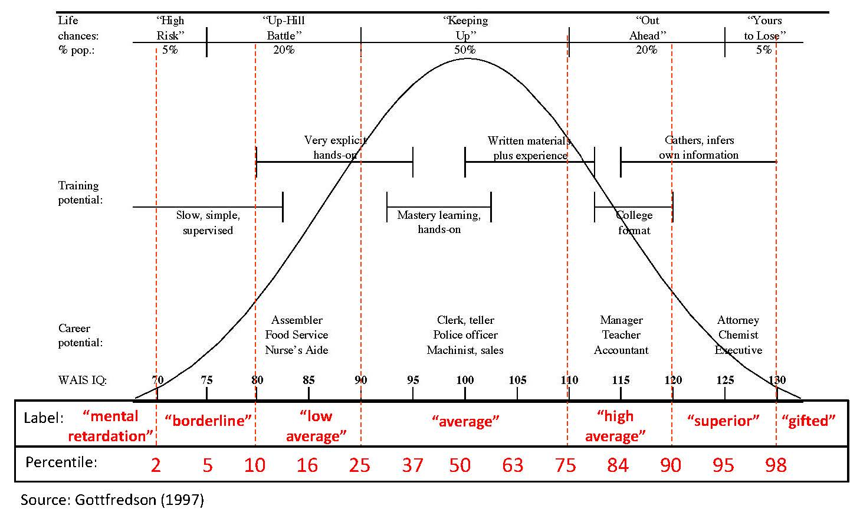
Typical life outcomes along IQ continuum

Slide 43
Landscape of cognitive error on everyday tasks*
Recall this
Sample
Odds
(yes/no)
50:50
Outcomes
Ability level
* Source of data: Gottfredson, 1997, p.118 (young adults) and p.116 (all adults)

Slide 44

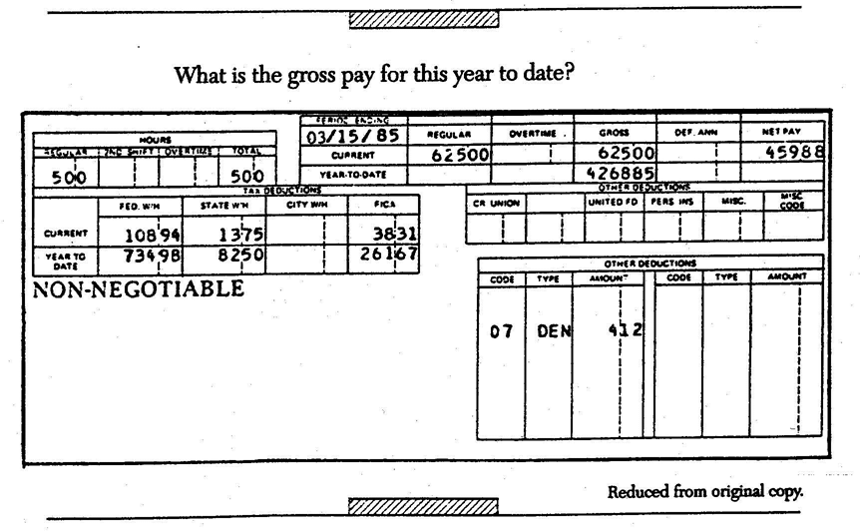
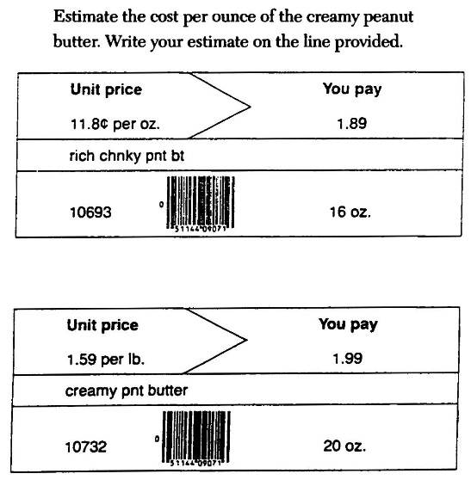
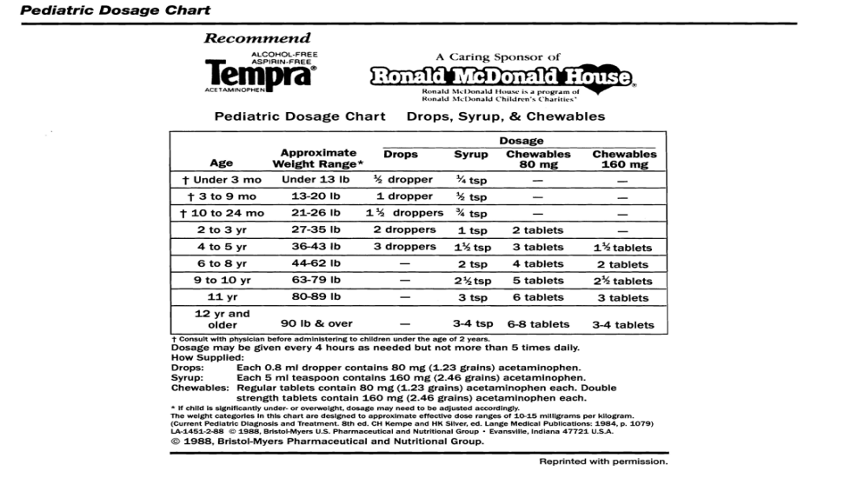
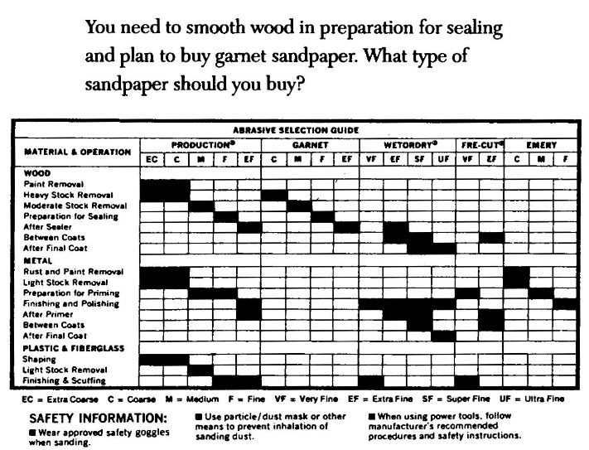
Examples of everyday tasks*
Level 1
Level 2
Level 5
Your child is 11 years old and weighs 85 pounds. How many 80 mg tablets can you give in 24-hr period?
Level 4
Level 3
*Items on 1993 National Adult Literacy Survey (NALS)

Slide 45
Landscape of cognitive error on everyday tasks*
Error rate (%)
Difficulty level
(sample literacy tasks)
Interpret brief phrase in long article
Calculate discount on bill paid early
Write letter explaining error in bill
Total the costs on order form
Find meeting time on form
2
3
4
5
*Source of data: National Adult Literacy Survey (NALS), ages 16-65., Kirsch et al. (1993)

Slide 46
Landscape of cognitive error on everyday tasks*
Error rate (%)
Cognitive risk
Cognitive burden
2
3
4
5
% of adults:
23%
28%
31%
15%
3%
% of adults ages 60+:
47%
33%
16%
4%
~0%
Cognitive resources
*Source of data: National Adult Literacy Survey (NALS), ages 16-65., Kirsch et al. (1993)

Slide 47
Opportunities—An Example

Slide 48
Current (g-blind) “solutions” to challenges in health care
Political: race-class disparities in health
  Equalize access to care [it actually increases disparities]
  Teach health providers to be more culturally sensitive
  Redistribute wealth to keep social disadvantage from “getting under the skin”
Practical: patient non-adherence to treatment
  Give patients more information
  “Déjà vu all over again”

Slide 49
Current project
Increase cognitive accessibility of DSM*
Analyze the “job” of diabetes
Focus on most critical tasks
Target instruction to ability level
Feedback & follow-up
*DSM = diabetes self-management

Slide 50
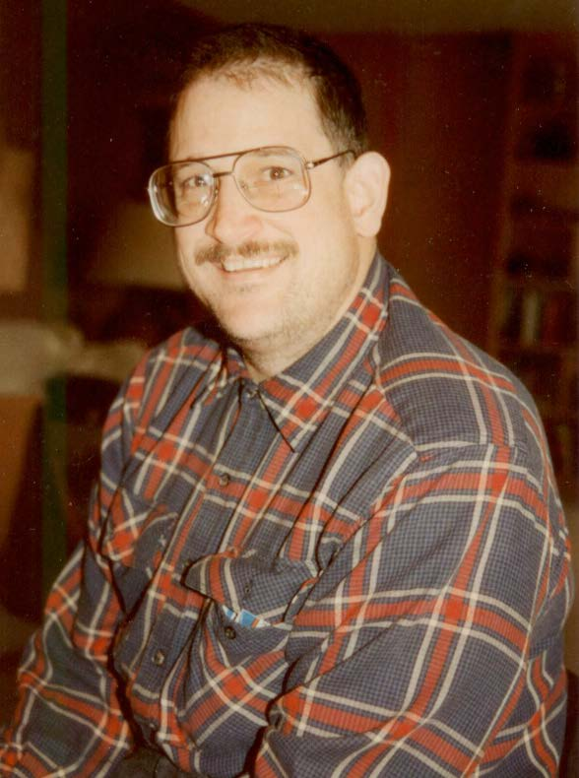
Human face of diabetes self-management
Notes:
Overcoming barriers and bad odds to get A+ results—it’s possible using g theory.

Slide 51
Job analyst’s view: The patient’s job description
Learn about diabetes in general (At “entry’)
  Physiological process
  Interdependence of diet, exercise, meds
  Symptoms & corrective action
  Consequences of poor control
Apply knowledge to own case (Daily, Hourly)
  Implement appropriate regimen
  Continuously monitor physical signs
  Diagnose problems in timely manner
  Adjust food, exercise, meds in timely and appropriate manner
Coordinate with relevant parties (Frequently)
  Negotiate changes in activities with family, friends, job
  Enlist/capitalize on social support
  Communicate status and needs to practitioners
Update knowledge & adjust regimen (Occasionally)
  When other chronic conditions or disabilities develop
  When new treatments are ordered
  When life circumstances change
Conditions of work—24/7, no days off, no retirement
Training
Self-
management

Slide 52
Good performance requires good judgment
IT IS NOT mechanically following a recipe
IT IS keeping a complex system under control in often unpredictable circumstances (like accident prevention process)
  Coordinate a regimen having multiple interacting elements
  Adjust parts as needed to maintain good control of system buffeted by many other factors
  Anticipate lag time between (in)action and system response
  Monitor advance “hidden” indicators (blood glucose) to prevent system veering badly out of control
  Decide appropriate type and timing of corrective action if system veering off-track
  Monitor/control other shocks to system (infection, emotional stress)
  Coordinate regimen with other daily activities
  Plan ahead (meals, meds, etc.)
    For the expected
    For the unexpected and unpredictable
  Prioritize conflicting demands on time and behavior

Slide 53
Occupational hierarchy
Cognitive complexity
Diabetes?

Slide 54
Sample guidance today
“Adjust insulin dose for number
of carbohydrates in meal”
Knowledge & mental calculations required??

Slide 55

Task #1—Underline sentence saying how often to give medicine
Sample health literacy item—how simple?
One piece of
info
Simple match
But lots of
irrelevant info
Caution!
Can train people
to do this task, but
not all possible
tasks like it

Slide 56
Task #1—Underline sentence saying how often to give medicine
Not so simple for many people…
One piece of
info
Simple match
But lots of
irrelevant info
Mean = 272
#1
239
NALS levels 1 2 3 4 5
LITERACY SCORES: 100 200 250 300 350 400 500

Slide 57
Need an epidemiology of patient error
Error rate (%)
Cognitive risk
Cognitive burden
2
3
4
5
% of adults:
23%
28%
31%
15%
3%
% of adults ages 60+:
47%
33%
16%
4%
~0%
Cognitive resources
*Source of data: National Adult Literacy Survey (NALS), ages 16-65., Kirsch et al. (1993)

Slide 58
Change the job (not person) strategies
Error rate (%)
Cognitive risk
Cognitive burden
2
3
4
5
Supplement when critical tasks complex
Reduce/limit
Cognitive resources
*Source of data: National Adult Literacy Survey (NALS), ages 16-65., Kirsch et al. (1993)
Notes:
Streamline the job
Assay complexity
Reduce where possible
Triage the rest to prevent the most critical errors
Focus the instruction
Target instruction to appropriate level
Provide cognitive assistance and feedback
Monitor

Slide 59
Stories of Synergy
in Research on g
Synergy –
Interaction of parts has bigger
effect than the sum of parts

Slide 60
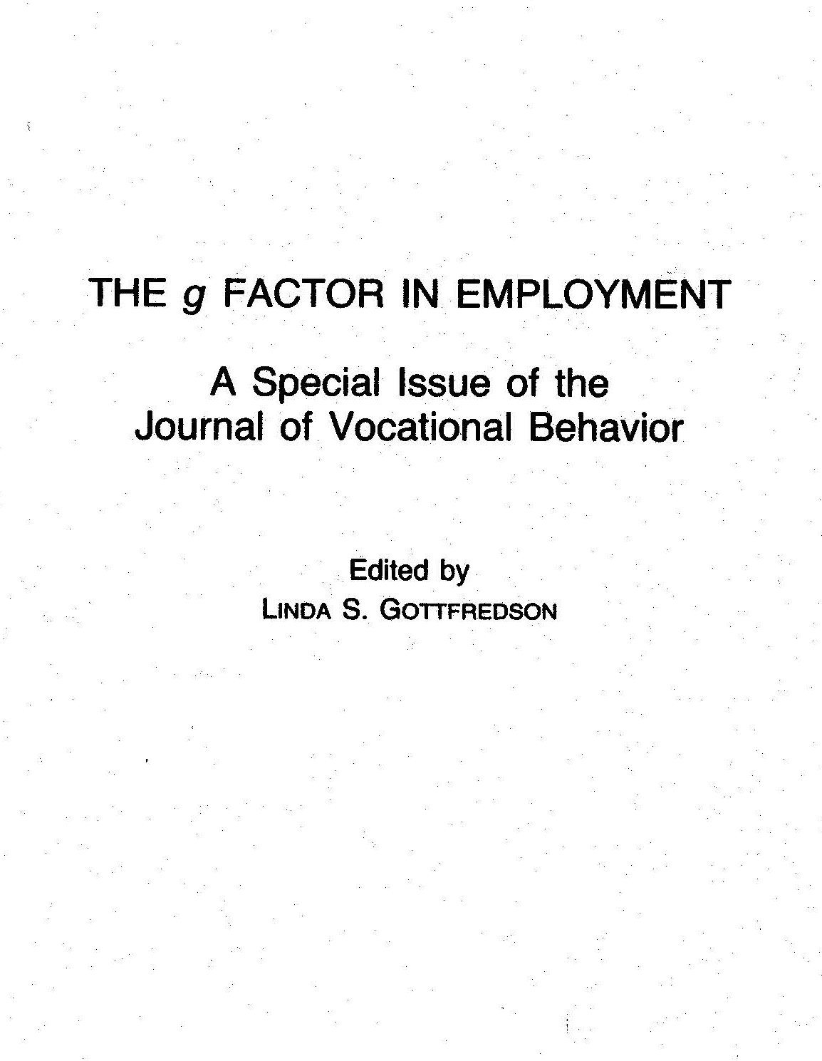
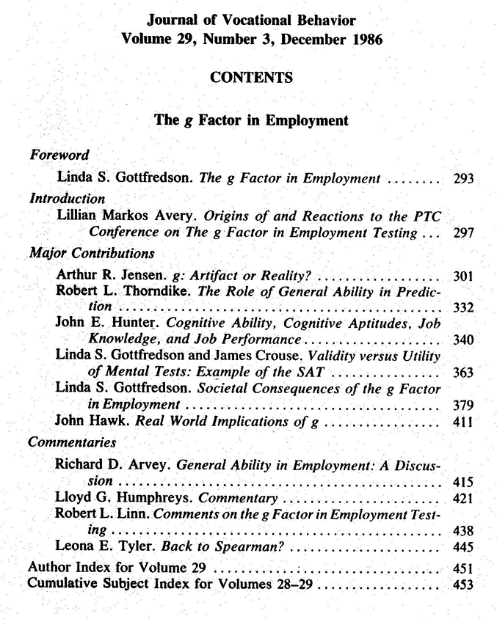
Example: 1986
Created synergy
Panel of illustrious authors
Peer-reviewed journal
Mailed 6000 copies to top researchers
Instant impact

Slide 61
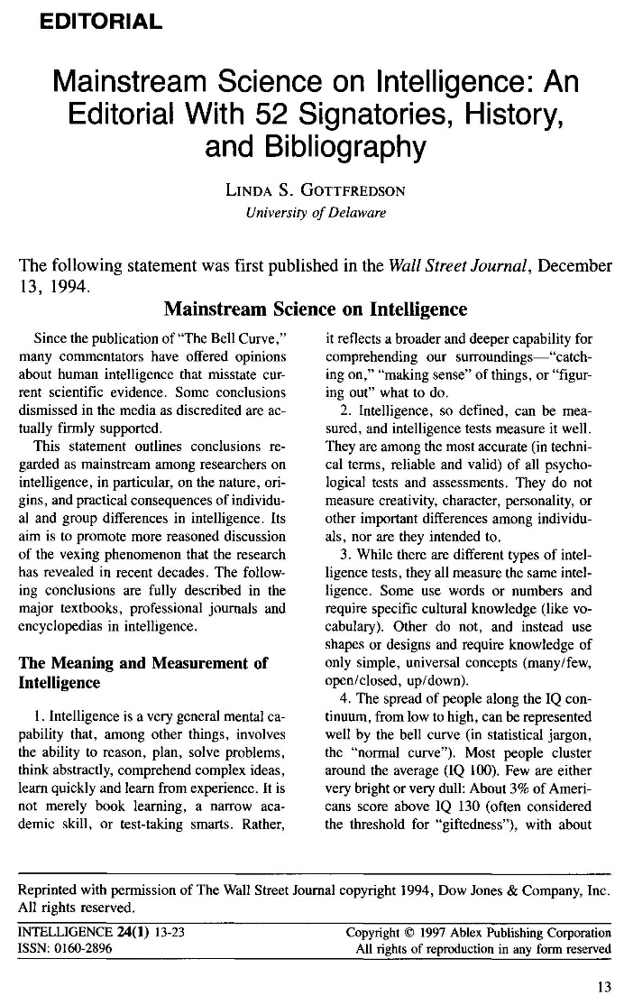
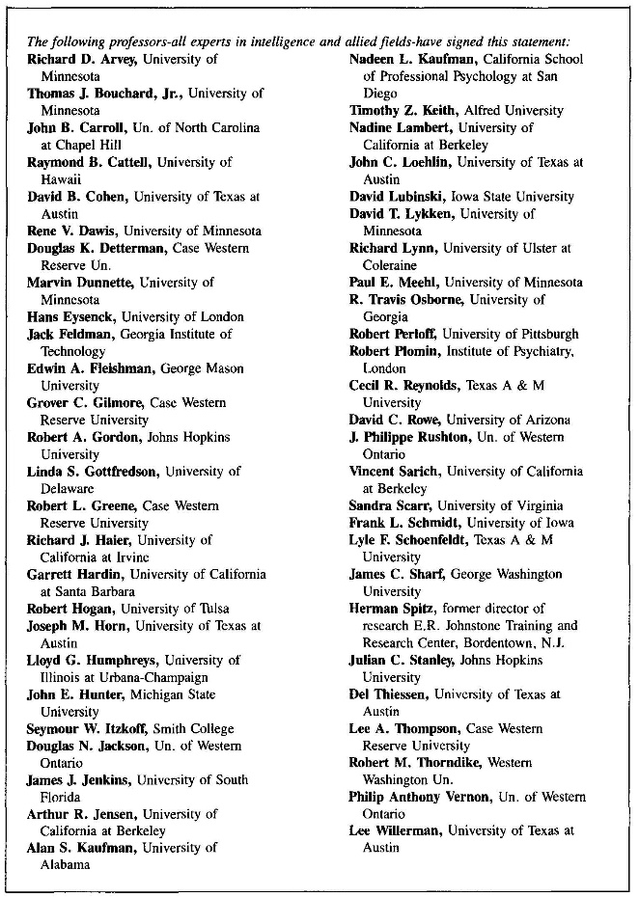
Example: 1997
“It is the position of AAIDD that intellectual functioning (as defined [by Mainstream Science on Intelligence, 1997]) is best conceptualized and captured by a general factor of intelligence, g” (p. 34).
AAIDD* Manual,
11th ed., 2010
*AAIDD = Amer. Assoc. of Intellectual & Developmental Disabilities

Slide 62
Traits
g
Brain
Performance
Nomological network grows
Genes
Life outcomes
Evolution
Social structure

Slide 63
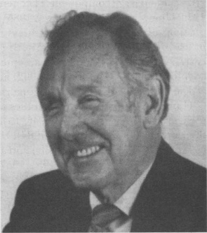
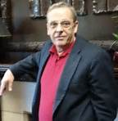
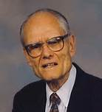
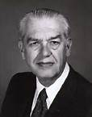

Traits
ISIR
Shoulders I’ve stood on
Arthur Jensen
g
Lloyd Humphreys
David Lubinski
Richard Haier
Frank Schmidt
Brain
Performance
Julian Stanley
John Carroll
Thomas Bouchard, Jr.
Genes
Life outcomes
Douglas Detterman
Many others
Robert Plomin
Rosalind Arden
Robert Gordon
Evolution
Social structure
Notes:
And how we got there, working together

Slide 64
To our young members
Go find some good shoulders to stand on!

Slide 65
Thank you.

