Slide 1
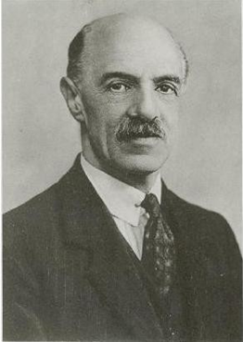
Spearman and the Cognitive Ergonomics of Health Disparities
Linda S. Gottfredson, School of Education, University of DE
Kathy Stroh, Diabetes Prevention & Control Program, DPH, DE
Eileen Sparling, Center for Disabilities Studies, University of DE
International Society for Intelligence Research, Limassol, Cyprus, December 8, 2011

Slide 2
Today
Spearman’s g (people)
Spearman’s g loading (tasks)
Diabetes epidemic ($$$$)
Wishful thinking (them)
Realistic strategy (us)
Pilot data
Rejected
Neglected
Non-adherence
Knowledge, not g
Diabetes a g-loaded job
Cognitive ergonomics

Slide 3
Exploding health care costs
Fast death, or death by parts (eyes, feet, heart…)
Patient error & non-adherence
Cognitive limitations of patients
High cognitive demands of diabetes self-care
₊
Diabetes up & up, younger & younger

Slide 4
Exploding health care costs
Fast death, or death by parts (eyes, feet, heart…)
Patient error & non-adherence
Cognitive limitations of patients
High cognitive demands of diabetes self-care
₊
Current health policy?
Access to care + Motivate + Educate
Diabetes up & up, younger & younger

Slide 5
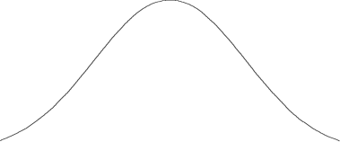
‘Enlightened’ Opinion
Individual differences = | “Inequalities” | Opinion
Inputs |  | Bad
Inputs |  | Unacceptable
Outcomes T1 |  | Bad
Outcomes T2 |  | Back-sliding
“Low literacy among highly educated too”
X
g
“See, it can’t be g!”

Slide 6
The reality
Adult patients
Wide variation
Gradual growth
~IQ 80
$$$
John B Carroll

Slide 7
Resolute ignorance about g
Health policy & practice?
No see
No hear
No say
No insult
So, patients die
Wide variation
Gradual growth

Slide 8
‘Enlightened’ Opinion
Individual differences | “Inequalities” | Opinion
Inputs |  | Bad
Inputs |  | Unacceptable
Outcomes T1 |  | Bad
Outcomes T2 |  | Back-sliding
“Low literacy among highly educated too”
g
“See, it can’t be g!”

Slide 9
Neglected—the patient’s job
Individual differences | “Inequalities” | Opinion
Inputs |  | Bad
Inputs |  | Unacceptable
Job to be done | Complexity (g loading) | Much is inherent
Outcomes T1 |  | Bad
Outcomes T2 |  | Back-sliding
g

Slide 10
Neglected—the patient’s job
Individual differences | “Inequalities” | Opinion
Inputs |  | Bad
Inputs |  | Unacceptable
Job to be done | Complexity (g loading) | Much is inherent
Outcomes T1 |  | Bad
Outcomes T2 |  | Back-sliding
g
g levels meet
g loadings
Simple task
Complex task

Slide 11
Current Strategy
Access to care + Motivate + Educate
Patient error & non-adherence
Patient error & non-adherence
Disparities generator
g loadings rise; g levels won’t
Neglected Reality

Slide 12
No hope? So, give up???
No!!
It’s the g loadings, stupid!!

Slide 13
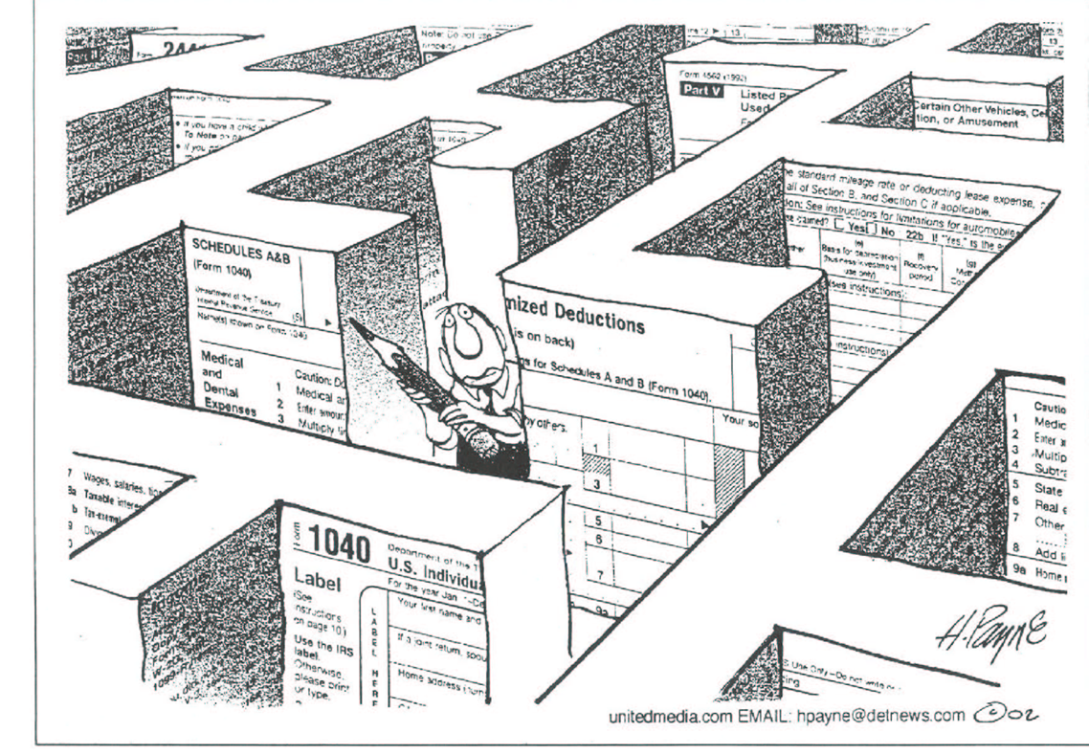
The patient’s reality
Eye exam
Meds
Exercise, except when…
Don’t stress
Sick day rules
Interpret readings
Monitor sugar
Do A if low,
Do B if high
Coordinate meds & eating
What’s a carb??
Adjust insulin
Collaborators
Conference venue
Check feet
Proper diet
Count carbs
Read labels
Call 911 for C, but doctor for D
System no longer on auto-pilot

Slide 14
Title
The health provider’s reality
My blood sugar is 154 over 90.
Eye exam
I don’t eat sugar any more. Just pasta.
Exercise, except when…
Meds
Don’t stress
It’s low fat, so it’s healthy.
Sick day rules
Interpret readings
Monitor sugar
I skipped lunch so I could have a big dinner.
Do A if low,
Do B if high
Coordinate meds & eating
What’s a carb??
Adjust insulin
Collaborators
Conference venue
You mean I have to measure stuff?!
Check feet
Proper diet
Never tested my sugar because I never figured out my meter.
Count carbs
Read labels
Can I still eat donuts?
Call 911 for C, but doctor for D
Patient fails to take control

Slide 15
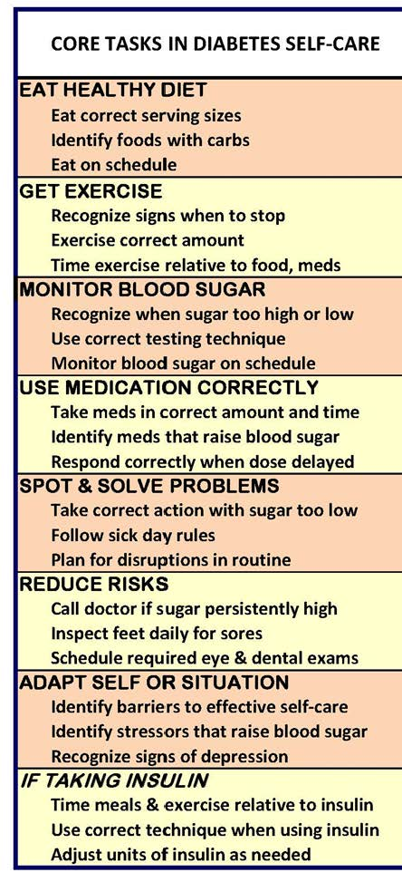
AADE7™ + 1
Teaching to take control

Slide 16
Self-management education today
Serial by topic
Abstract
Decontextualized
Fast
Concentrated
One-size-fits-all
No scaffolding
~No practice
~No assessment
Cognitive overload
g

Slide 17
Neglected job elements
Core tasks:
Interdependence
Criticality
Responsibility
Extinguish old habits
Work conditions:
Time pressure
Distractions
Predictability
Interferences in-situ
Rest breaks
Cognitive complexity
Cognitive interferences
g

Slide 18
Cognitive ergonomics project (9 FQHC clinics)
Job analysis of diabetes
Training modules for self-care
R & D
today
Clinic service delivery
Evaluation
I & E

Slide 19
Cognitive ergonomics project (9 FQHC clinics)
Job analysis of diabetes
Training modules for self-care
Keep system under control
Cognitive complexity
Critical incidents
Cognitive task analysis
R & D
Clinic service delivery
Evaluation
I & E

Slide 20
Cognitive ergonomics project (9 FQHC clinics)
Job analysis of diabetes
Training modules for self-care
Keep system under control
Cognitive complexity
Critical incidents
Cognitive task analysis
R & D
Accident prevention
Clinic service delivery
Evaluation
I & E

Slide 21
Cognitive ergonomics project (9 FQHC clinics)
Job analysis of diabetes
Training modules for self-care
Keep system under control
Cognitive complexity
Critical incidents
Cognitive task analysis
R & D
Priority
g loading
Criticality
Clinic service delivery
Evaluation
I & E

Slide 22
Cognitive ergonomics project (9 FQHC clinics)
Job analysis of diabetes
Training modules for self-care
Keep system under control
Cognitive complexity
Critical incidents
Cognitive task analysis
R & D
More cognitively accessible
Priority
g loading
Criticality
Clinic service delivery
Evaluation
I & E

Slide 23
Cognitive ergonomics project (9 FQHC clinics)
Job analysis of diabetes
Training modules for self-care
Keep system under control
Cognitive complexity
Critical incidents
Cognitive task analysis
R & D
Priority
g loading
Criticality
Clinics
lo-SES
medical “home” (facilitate)
Patients
high cost
low g (assess)
Evaluation
Clinic service delivery
I & E
Elderly too

Slide 24
Cognitive ergonomics project (9 FQHC clinics)
Job analysis of diabetes
Training modules for self-care
Keep system under control
Cognitive complexity
Critical incidents
Cognitive task analysis
R & D
Priority
g loading
Criticality
Clinics
lo-SES
medical “home” (facilitate)
Patients
high cost
low g (assess)
Evaluation
Clinic service delivery
I & E
Cognitive support

Slide 25
Cognitive ergonomics project (9 FQHC clinics)
Job analysis of diabetes
Training modules for self-care
Keep system under control
Cognitive complexity
Critical incidents
Cognitive task analysis
R & D
Priority
g loading
Criticality
Clinics
lo-SES
“medical home” (create)
Patients
high cost
low g (assess)
Evaluation
Clinic service delivery
Costs
ED visits
Hospitalizations
Patient outcomes
Glucose control
Complications
I & E

Slide 26
Criticality rankings (pilot data)
System unstable,
restore control
Recognize when sugar too high or low
Take correct action when sugar to low
Call doctor if sugar persistently high
Ranked by 30 diabetes health providers (MD, RN, RNP, RD, CDE, other)

Slide 27
Criticality rankings
Eat correct serving sizes
Recognize signs to stop exercise
Take meds in correct amount & time
Maintain system
control
Ranked by 30 diabetes health providers (MD, RN, RNP, RD, CDE, other)

Slide 28
Criticality rankings
Identify hazards
Identify barriers to self-care
Ranked by 30 diabetes health providers (MD, RN, RNP, RD, CDE, other)

Slide 29
Critical incidents
Took meds on time,
—but delayed meal BG crash
—but ate only a salad BG crash
Causal nexus
(food, meds, blood sugar)
From 30 diabetes health providers (MD, RN, RNP, RD, CDE, other)

Slide 30
Critical incidents
Sick & not eating,
—so took no insulin (T1) DKA
—but took same dose BG crash
Shift rule when conditions change
From 30 diabetes health providers (MD, RN, RNP, RD, CDE, other)

Slide 31
Critical incidents
Ate prophylactically to “prevent” low blood sugar, did not test blood sugar, got no exercise,
chronic high sugar
incubating, unseen damage
One cause
One effect
One tactic
From 30 diabetes health providers (MD, RN, RNP, RD, CDE, other)

Slide 32
Critical incidents
Did not control diet
chronic high sugar
poor wound healing
Feared treatment
hospitalized for necrotic foot
One goal
(avoid immediate pain)
One tactic
(avoid medical treatment)
From 30 diabetes health providers (MD, RN, RNP, RD, CDE, other)

Slide 33
1. When cognitive budget is small, spend it wisely.
High g loadings are expensive.
2. Focus on critical tasks
3. Teach g-efficiently
4. Supply g support

Slide 34
Advice and questions?

