Slide 1
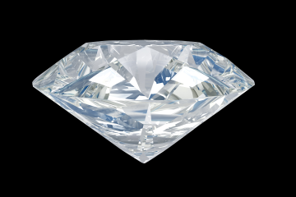
Diamond Analysis
Zachary Baine
Comm-486

Slide 2
Project Introduction
For the following project, I have created a brief, hypothetical statistical analysis presentation. The presentation is based off a sample set of 310 diamonds that I have analyzed using JMP statistical software. The data includes 5 variables for each diamond : the diamond’s cut, color, clarity, carat, and price. Each of these variables, excluding price, has its own rating system. The purpose of this presentation is to explain how each of these variables determines the price of a diamond. In a real world application this information could be used to inform a company, investor, etc. how diamonds should be priced in a competitive market.
As this is a short presentation I will not delve too far into the mathematics behind a diamond’s pricing, but rather explain what goes into a diamond’s price and short explanation why. That being said, let’s get started.

Slide 3



After conducting my analysis, I have found a few key factors that really seem to determine the price of each diamond. For starters, which of the four c’s (cut, color, clarity, and carat) do you think impacts a diamond’s price the most? (click on the diamond to select your choice)
CUT
COLOR
CLARITY
CARAT

Slide 4


Unfortunately not. A diamond’s cut is not the most impactful variable on a diamond’s price. Click on continue to find the most impactful or retry to guess again.
CONTINUE

Slide 5


Unfortunately not. A diamond’s color is not the most impactful variable on a diamond’s price. Click on continue to find the most impactful or retry to guess again.

Slide 6


Unfortunately not. A diamond’s clarity is not the most impactful variable on a diamond’s price. Click on continue to find the most impactful or retry to guess again.
RETRY

Slide 7

That’s right, a diamond’s carat increases the price of it more than any other variable by far. How do we know this? After formatting the data, I ran a correlation analysis which yields the following table:
Looking at the corresponding values between the column LnPrice and the variables LnCarat, Dum Cut, Dum Color, and Dum Clarity we can see (circled in red) that the greatest value is between LnCarat and LnPrice, indicating the most impactful.

Slide 8

How else is price determined?
Statistically speaking it is helpful to know that the price and carat of a diamond are strongly related; however, there is more to the price than just the carat. My next step was to run multiple regression models in JMP in order to find out how the other variables (color, cut, and clarity) impact the price. To do this I compared price with only color, cut, and clarity.

Slide 9



After running this model, which of the following do you think has the most impact on a diamond’s price?

Slide 10
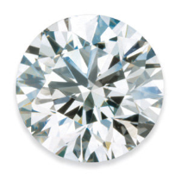

Unfortunately not. A diamond’s cut is not the most impactful remaining variable. Click on continue to find the most impactful remaining variable or retry to guess again.

Slide 11



Unfortunately not. A diamond’s cut is not the most impactful remaining variable. Click on continue to find the most impactful remaining variable or retry to guess again.

Slide 12
As it turns out, it is clarity that is the second most impactful variable. In order to avoid being too technical, let me just say that we can determine this since the coefficients yielded by the model were much greater for clarity than for cut or color.

Slide 13
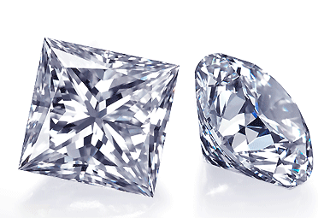
Conclusion
From all of this we can now determine that the price placed on a diamond is mainly based on its carat and then by its clarity. As a matter of fact, over 90% of the variability in a diamond’s price can be determined by these two characteristics alone; it turns out the cut and color of the diamond have little to no impact on its price.

