Slide 1
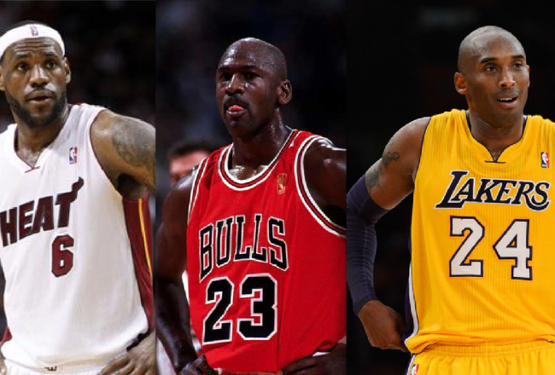
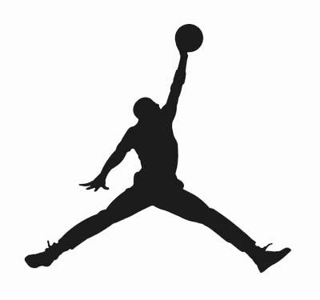
Greatest Player Of All Time?
3-Point Shooting
Defense
Scoring
Free-Throw
Shooting
See For Yourself
Winning
By: Will Townsville

Slide 2
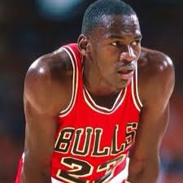
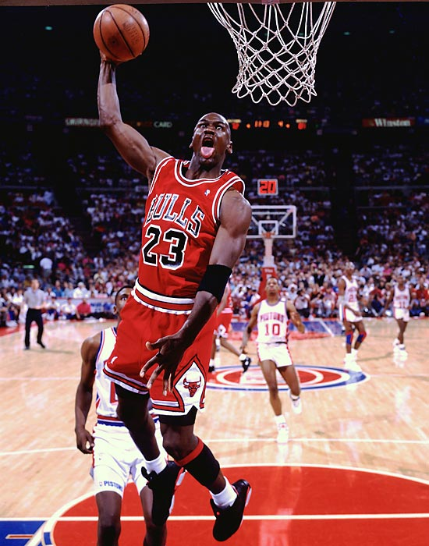
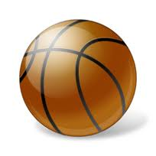
Michael “Air Jordan” Jordan!!!
Position: Guard-Forward ▪ Shoots: Right Height: 6-6 ▪ Weight: 195 lbs. Born: February 17, 1963 (Age 50)
Draft: Chicago Bulls, 3rd overall pick, 1984 Draft
Experience: 15 seasons

Slide 3
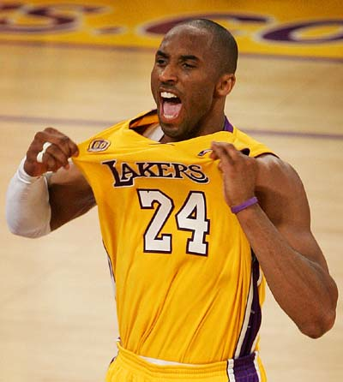
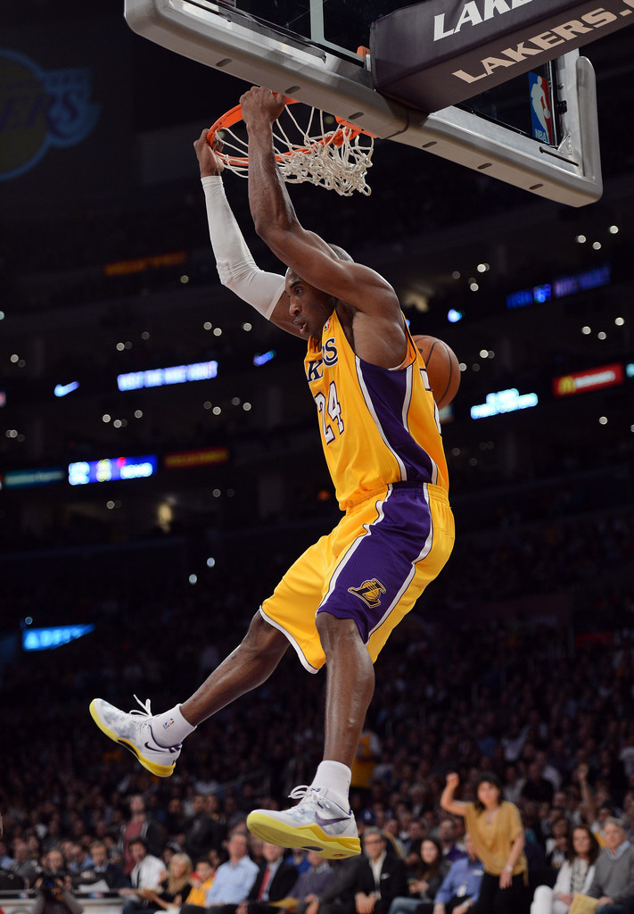
Kobe “Black Mamba”Bryant!!!!
Twitter: @kobebryant
Position: Guard ▪ Shoots: Right Height: 6-6 ▪ Weight: 200 lbs. Born: August 23, 1978 (Age 34) in Philadelphia, PA
Draft: Charlotte Hornets, 13th overall, 1996
Experience: 17 years

Slide 4
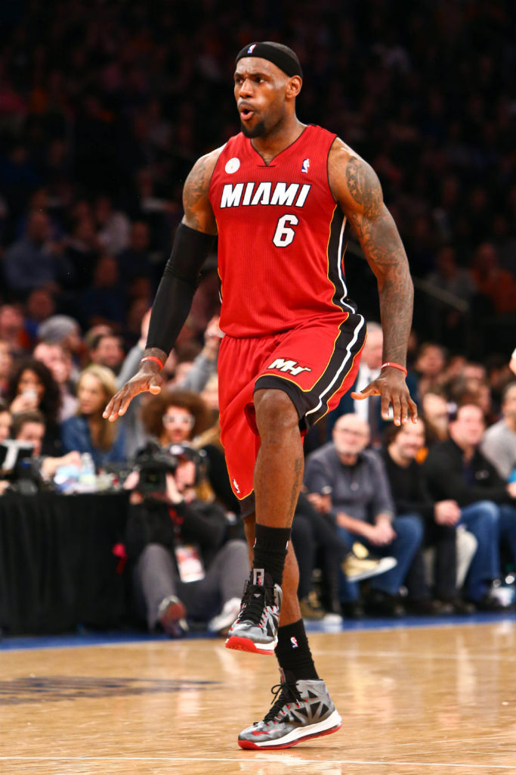
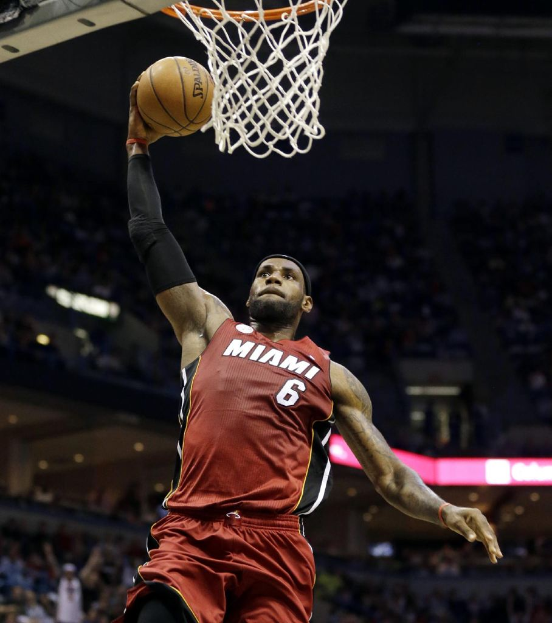
Lebron “King James” James
Twitter: @KingJames
Position: Forward-Guard ▪ Shoots: Right Height: 6-8 ▪ Weight: 240 lbs. Born: December 30, 1984 (Age 28)
Draft: Cleveland Cavaliers, 1st overall, 2003 draft
Experience: 10 seasons

Slide 5
3 Point Shooting
The ability to shoot the three point shot is key for any great guard/forward. It helps to draw defenders out of the paint, and it worth more points that traditional field goals.
Player | 3-Point FG Made | 3-Point FG %
Michael Jordan | 303 | 31%
Kobe Bryant | 799 | 34%
Lebron James | 1020 | 34%
*Stat totals after first 10 seasons

Slide 6
Defense
Defense is the act of stopping your opponent from scoring. Great defenders disrupt their opponents, help their teammates, and record steals, blocks, and charges.
Player | Steals | Blocks
Michael Jordan | 1845 | 697
Kobe Bryant | 1059 | 431
Lebron James | 1323 | 649
*Stat totals after first 10 seasons

Slide 7
Scoring
At the end of the day, scoring is the most highly touted skill for a great player. The only way to win, after all, is to score more points than your opponent. A really good scorer makes a lot of field goal and usually shoots a good percentage from the field.
Player | Field Goals Made | Shooting Percentage
Michael Jordan | 8245 | 51%
Kobe Bryant | 5868 | 45%
Lebron James | 7559 | 49%
*Stat totals after first 10 seasons

Slide 8
Winning
Perhaps the biggest measure of greatness, winning is the objective of any basketball team. Some players have a relentless drive to win games, and more importantly to win championships, and these players become invaluable to their teams.
Player | Championships Won
Michael Jordan | 6
Kobe Bryant | 5
Lebron James | 1
*Stat totals after first 10 seasons

Slide 9
Free-Throw Shooting
Free-throw shooting is a crucial asset in being a great scorer, and a great player. Free throws can be the difference between winning and losing, and require a great deal of confidence and concentration.
Player | Free-Throws Made | Free-Throw Percentage
Michael Jordan | 5205 | 85%
Kobe Bryant | 4331 | 83%
Lebron James | 4943 | 75%
*Stat totals after first 10 seasons

Slide 10
Career Highlights
Michael Jordan
Kobe Bryant
Lebron James

