Slide 1
Representation of Women in Advertising
By Laura Epstein

Slide 2
While advertising has progressed socially since the 1950s by frequently portraying women as equally capable to men, it has regressed in terms of its distortion of the female physique.

Slide 3
Social Depiction of Women in Advertising
1940s
Present day
1950s

Slide 4
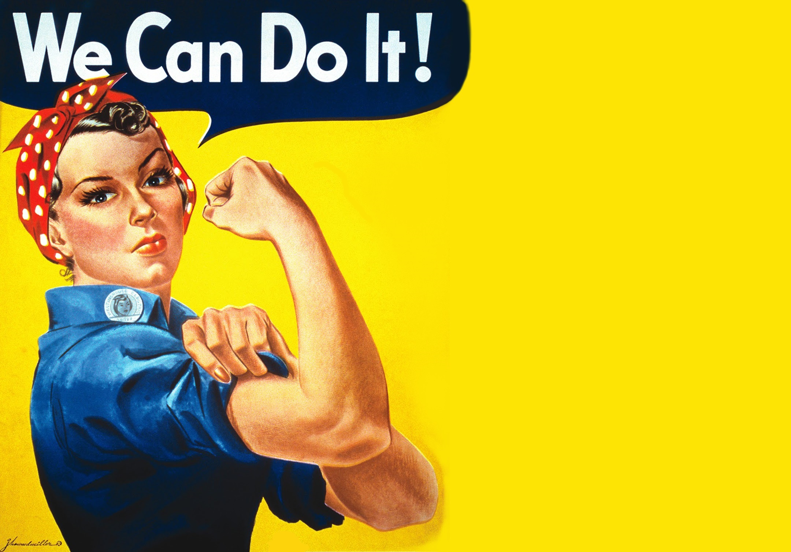
1940s
World War II
Men overseas at war;
lack of workers at home in US
Government used ads to persuade women to join the workforce
Rosie the Riveter

Slide 5
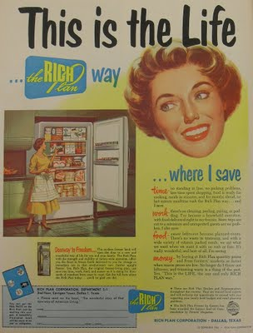
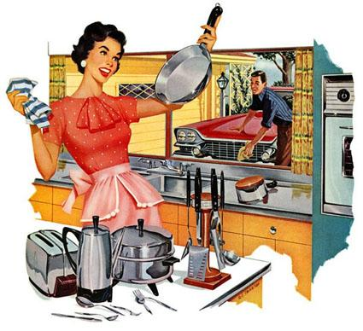
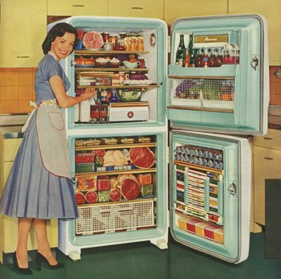
1950s
Complete reversal of social advance in 1950s
Men came back from war
Rise in traditional family values
Ads showed women happily returning to the house
Ads of women in kitchen or caring for the family

Slide 6
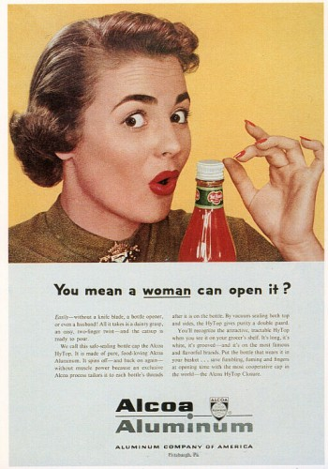
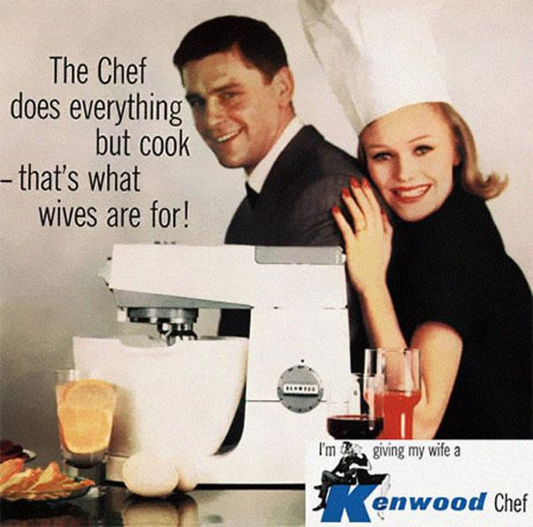

Slide 7
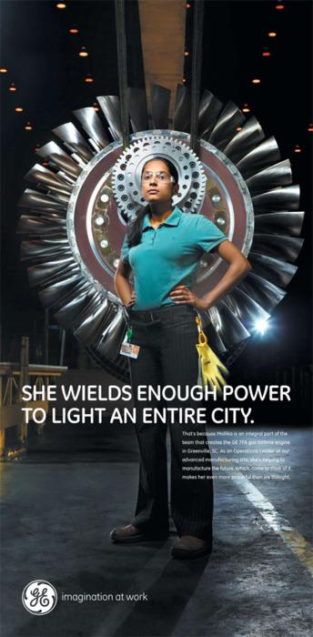
Present Day

Slide 8
Physical Depiction of Women in Advertising
1950s
Present Day
1960s

Slide 9
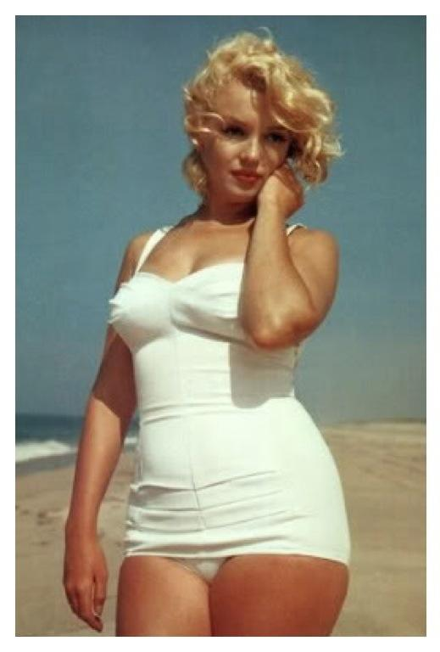
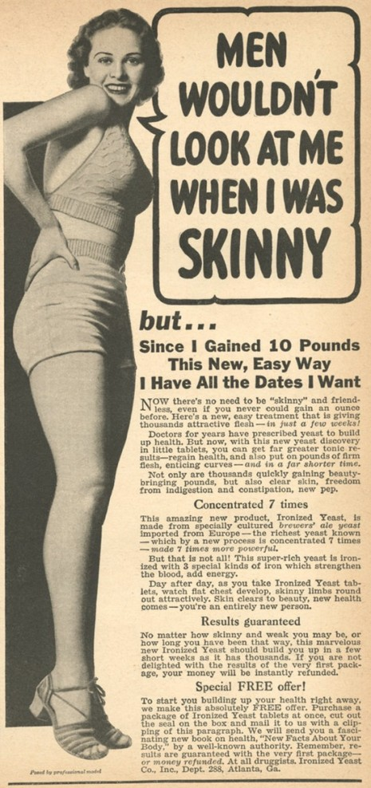
1950s
Post WWII
Men coming home brought back ideals of “feminine beauty that emphasize womanly bodies”
Wide hipped women who were robust/able to bear children are considered attractive
Marilyn Monroe
1950 ad

Slide 10
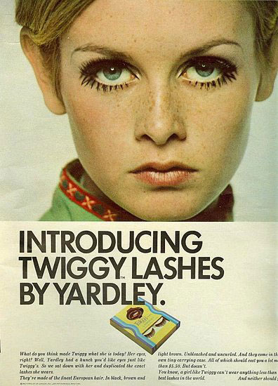
1960s
Cultural shift in body ideals
1960s fashion magazines became new hit.
Twiggy became the new icon for women
Having an iconic figure with such rare body proportions in the media, women began feeling self conscious that their bodies did not look like hers
Twiggy

Slide 11
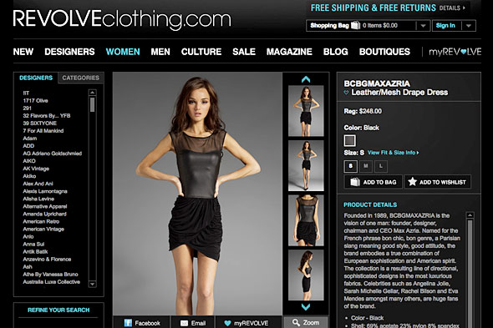
Present Day
Anorexia among adolescent girls has doubled every decade since the 1950s.
Up to 24 million people of all ages and genders suffer from an eating disorder (anorexia, bulimia and binge eating disorder) in the U.S

Slide 12
Eating disorders have the highest mortality rate of any mental illness.
The body type portrayed in advertising as the ideal is possessed naturally by only 5% of American females.
47% of girls in 5th-12th grade reported wanting to lose weight because of magazine pictures.

Slide 13
Who can contribute to solving these issues?

Slide 14
Until the 1950s, key employees of ad agencies
were white, protestant men (Women were secretaries/receptionists).
It wasn’t until the rebirth of feminism in 1970s that advertising began employing women in decision-making and creative roles in the industry.
Today more than 50% of the employees in US ad agencies are women.
We must recognize that women are now in the position to determine the direction the media/advertising industries portray women.

